Slide 1
Pivotal Cloud Platform Deep Dive
Part 3: Custom Buildpacks and Data Services
Pivotal CF Team

Slide 2
Buildpacks and Services
Buildpacks
Java Buildpack Deep Dive
User-Provided Services
Managed Services

Slide 3


REVIEW: Deploying Applications to Cloud Foundry Runtime
Blobstore
DB
SC
push app
+ app MD
Cloud Controller
Service Broker
Node(s)
Router
Upload bits/metadata
Create/bind services
Stage app
Deploy app
DEA
DEA
DEA
+
=
DEA
Runtime

Slide 4
REVIEW: Stage an App
Blobstore
DB
Cloud Controller
Router
DEA
System
Buildpacks
Detect
Compile
Upload
Yes
No
+
=
Runtime

Slide 5
Staging and Buildpacks
Buildpacks are responsible for preparing the machine image for an application.
}
Application
Buildpack
Container
Libraries
Droplet
DEA
Runtime
Operating System

Slide 6
Types of Buildpacks
System
deployed with Cloud Foundry
Admin
uploaded to Cloud Foundry
BYO
specified at app push

Slide 7
Managing Admin Buildpacks
$ cf buildpacks $ cf create-buildpack <name> <path to bits> <position>
$ cf update-buildpack <name> [-p <path>] [-i <position>]
$ cf delete-buildpack <name>

Slide 8

Buildpack selection
$ cf push
The application is tested against admin then system buildpacks.
$ cf push -b <url>
The buildpack is referenced by a Git URL
$ cf push -b <name>
The admin buildpack is referenced by name
Notes:
Git != GitHub - use any public Git provider or local Git repositories
Git repository must be visible on the network that CF is running on - public CF requires public Git repo, private CF can use private or public Git repo

Slide 9










Tested Buildpacks
https://github.com/cloudfoundry-community/cf-docs-contrib/wiki/Buildpacks
Containers
Languages
Haskell
Notes:
Not tested or endorsed by Pivotal, all community-contributed and maintained.
Existing buildpacks are a great place to start when creating a new buildpack from scratch.

Slide 10

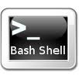
Buildpack API
/bin/detect app_directory
Inspect app bits to determine buildpack applicability
/bin/compile app_directory cache_directory
Download and install runtime, container, packages, libraries; install app bits as necessary
/bin/release app_directory
Build app start command
Notes:
Written in bash shell scripts or Ruby

Slide 11

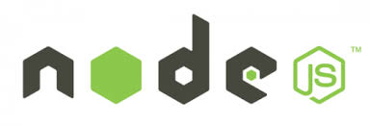

/bin/detect
Inspect the app bits to determine if the buildpack knows how to handle the application
 | Gemfile exists
 | package.json exists
 | setup.py exists
On match, return exit code 0 and
write to STDOUT a string identifying the buildpack
(often just the name of the language supported)
Notes:
Java intentionally left off this list because the CF Java buildpack has more complex detection criteria

Slide 12
/bin/detect
$ cf push
DEA iterates over admin and system buildpacks calling
/bin/detect scripts
until one of them returns exit code 0
$ cf push -b <url|name>
/bin/detect is
not called

Slide 13
/bin/compile
Download and install any necessary
runtime (Java VM, Ruby interpreter, JavaScript interpreter)
container (web server)
support libraries, packages, modules (Ruby gems, NPM packages)
… and then installing the app bits into the runtime or container
Notes:
This is where most of the buildpack work is done.
More package manager examples - Python PIP, Perl CPAN
Installing the app may mean copying or moving the app files from the location DEA put them in, or symlinking them to a different location

Slide 14
/bin/compile Caching
Runtime, container, and support packages are downloaded from sources external to Cloud Foundry
DEA provides a location for storing downloaded artifacts to speed subsequent staging operations
Notes:
External source can include custom packages in S3 buckets or public mirrors for public CF, or internal download locations for private CF.

Slide 15
/bin/release
Build a YAML-formatted hash with three possible keys
addons: []
config_vars: {}
default_process_types:
web: <start command>
On Cloud Foundry, currently only the web: value is used to get the start command for the app
Notes:
If creating a buildpack for compatibility, consult documentation for other platforms to see how addons and config_vars might be used.

Slide 16
Buildpacks and Services
Buildpacks
Java Buildpack Deep Dive
User-Provided Services
Managed Services

Slide 17







Java Buildpack
Supports a variety of JVM languages, containers, and frameworks with a modular, configurable, and extensible design

Slide 18
Java Buildpack Concepts
Frameworks
Additional application
transformations
Containers
How an application is run
JREs
Java Runtimes
Notes:
Frameworks - loose definition, basically anything that is orthogonal to the container

Slide 19
Java Buildpack Concepts
Containers
Frameworks
Java main()
Tomcat
Groovy
Spring Boot CLI
Play
Spring config
Play config
Play JPA config
New Relic agent
AppDynamics agent
JREs
OpenJDK
Notes:
Zero Effort Spring - Tue 12:45-2:15 - Dave Syer and Phil Webb

Slide 20
Container Detection Criteria
Java main() | META-INF/MANIFEST.MF exists with Main-class attribute set
Tomcat | WEB-INF directory exists
Groovy | .groovy file with a main() method, or .groovy file with no classes, or .groovy file with a shebang (#!) declaration
Spring Boot CLI | one or more POGO .groovy files with no main() method, and no WEB-INF directory
Spring Boot Embedded | start script and lib/spring-boot-*.jar exist
Play | start script and lib/play.play_*.jar exist
Ratpack | start script and ratpack-core-*.jar exist
Choose zero or one
Notes:
Detection is typically based on file existence and content of files.
Zero Effort Spring - Tue 12:45-2:15 - Dave Syer and Phil Webb
This list is likely to grow to support other containers like Spring XD.

Slide 21
Framework Detection Criteria
Spring | spring-core*.jar exists
Play config | Play application detected
Play JPA config | play-java-jpa plugin exists in app
Spring Insight | Insight service bound to app
New Relic agent | New Relic service bound to app
AppDynamics agent | AppDynamics service bound to app
Choose all that apply
Notes:
Detection is typically based on file existence and content of files.
Can also be done based on services bound to an app.

Slide 22

/bin/compile Output Example
DEA
Buildpack
DEA
-----> Downloaded app package (18M)
-----> Downloading OpenJDK 1.7.0_21 JRE (17.5s)
Expanding JRE to .java (1.4s)
-----> Downloading Auto Reconfiguration 0.7.1 (1.4s)
Modifying /WEB-INF/web.xml for Auto Reconfig
-----> Downloading Tomcat 7.0.42 (3.5s)
Expanding Tomcat to .tomcat (0.2s)
Downloading Buildpack Tomcat Support 1.1.1 (0.0s)
-----> Uploading droplet (55M)

Slide 23
See What’s Going On
$ cf files <app-name> app
.buildpack-diagnostics/
.java/
.lib/
.tomcat/
META-INF/
WEB-INF/
assets/
Buildpack-installed runtime
Buildpack-installed support libraries
Buildpack-installed container
DEA-downloaded application files
Notes:
The buildpack-installed locations are decisions made by the Java buildpack - other buildpacks will put things in other places.

Slide 24
See What’s Going On
$ cf files <app-name> staging_info.yml
detected_buildpack: openjdk=1.7.0_45 tomcat=7.0.47 spring-auto-reconfiguration=0.7.2 tomcat-buildpack-support=1.1.1
start_command: JAVA_HOME=.java
JAVA_OPTS="-Dhttp.port=$PORT
-Djava.io.tmpdir=$TMPDIR -XX:MaxPermSize=52428K
-XX:OnOutOfMemoryError=./.buildpack-diagnostics/killjava
-Xmx384M -Xss1M" .tomcat/bin/catalina.sh run

Slide 25

Customization
Two ways to customize the Java buildpack
Configure artifacts used by standard JREs, Containers, and Frameworks
Extend the buildpack with your own JREs, Containers, and Frameworks
Customization is done by forking the buildpack
Notes:
Awesome documentation is in the github repo

Slide 26
Customization by Configuration
Configuration files in java-buildpack/config determine the behavior of a JRE, Container, or Framework
# http://download.pivotal.io.s3.amazonaws.com/openjdk/lucid/x86_64/index.yml
---
1.6.0_27: http://download.pivotal.io.s3.amazonaws.com/openjdk/lucid/x86_64/openjdk-1.6.0_27.tar.gz
1.7.0_21: http://download.pivotal.io.s3.amazonaws.com/openjdk/lucid/x86_64/openjdk-1.7.0_21.tar.gz
1.7.0_25: http://download.pivotal.io.s3.amazonaws.com/openjdk/lucid/x86_64/openjdk-1.7.0_25.tar.gz
1.8.0_M6: http://download.pivotal.io.s3.amazonaws.com/openjdk/lucid/x86_64/openjdk-1.8.0_M6.tar.gz
1.8.0_M7: http://download.pivotal.io.s3.amazonaws.com/openjdk/lucid/x86_64/openjdk-1.8.0_M7.tar.gz
# cloudfoundry/java-buildpack/config/openjdk.yml
---
version: 1.7.0_+
repository_root: "http://download.pivotal.io.s3.amazonaws.com/openjdk/{platform}/{architecture}"
memory_sizes:
memory_heuristics:
heap: 0.75
permgen: 0.1
stack: 0.05
native: 0.1
Notes:
version and repository_root are common to all components that download artifacts
other options are specific to the component
1. consult <component-name>.yml
2. read repository_root/index.yml
3. look up the specified version in the index
4. download the matching artifact

Slide 27

Customization by Extension
Implement a JRE, Container, or Framework support class as one Ruby file in the appropriate directory
(with additional support classes as necessary)
cloudfoundry/java-buildpack/lib/java_buildpack
jre
container
framework
Notes:
One class is sufficient for most extensions
Existing support classes serve as good examples

Slide 28
Customization by Extension
Support class types have similar interfaces, following the buildpack scripts naming conventions
# initialize the support class with platform information provided in context
# context includes app_dir, lib_dir, environment, java_home, java_opts,
# vcap_application, vcap_services
def initialize(context)
# return a String or an Array<String> that uniquely identifies the container/framework/jre,
# or nil
def detect
# download and unpack the container/framework/jre, and transform the application as necessary
def compile
# create and return the command to run the application with (containers) or add
# options to context[:java_opts] (frameworks)
def release
Notes:
if detect returns nil, compile and release will not be called
only one container support class can return non-nil from detect

Slide 29
Customization by Extension
Add new support class to config/components.yml
---
containers:
- "JavaBuildpack::Container::Groovy"
- "JavaBuildpack::Container::JavaMain"
- "JavaBuildpack::Container::SpringBootCLI"
- "JavaBuildpack::Container::Tomcat"
- "JavaBuildpack::Container::PlayFramework"
jres:
- "JavaBuildpack::Jre::OpenJdk"
frameworks:
- "JavaBuildpack::Framework::AppDynamicsAgent"
- "JavaBuildpack::Framework::JavaOpts"
- "JavaBuildpack::Framework::NewRelicAgent"
- "JavaBuildpack::Framework::PlayAutoReconfiguration"
- "JavaBuildpack::Framework::PlayJpaPlugin"
- "JavaBuildpack::Framework::SpringAutoReconfiguration"
Notes:
The buildpack will iterate over all components, applying them as necessary

Slide 30
Customization
Much more information and documentation included in the GitHub repository
https://github.com/cloudfoundry/java-buildpack
Notes:
The buildpack will iterate over all components, applying them as necessary

Slide 31
Buildpacks and Services
Buildpacks
Java Buildpack Deep Dive
User-Provided Services
Managed Services

Slide 32
Use Cases: User Provided Service Instances
Typically legacy or existing instances of a service (databases, queues, mail, etc) where applications connect to the same instance
Credential passing when you need to inject the same credential set into an application
Notes:
Be sure to explain that even legacy and existing services can also be exposed via a Managed Service
Example: multiple applications connect to the same legacy oracle database and therefore just need connection info and credentials

Slide 33
$ cf cups
FAILED
Incorrect Usage.
NAME:
create-user-provided-service - Make a user-provided service instance available to cf apps
ALIAS:
cups
USAGE:
cf create-user-provided-service SERVICE_INSTANCE [-p PARAMETERS] [-l SYSLOG-DRAIN-URL]
Pass comma separated parameter names to enable interactive mode:
cf create-user-provided-service SERVICE_INSTANCE -p "comma, separated, parameter, names"
Pass parameters as JSON to create a service non-interactively:
cf create-user-provided-service SERVICE_INSTANCE -p '{"name":"value","name":"value"}'
EXAMPLE:
cf create-user-provided-service oracle-db-mine -p "host, port, dbname, username, password"
cf create-user-provided-service oracle-db-mine -p '{"username":"admin","password":"pa55woRD"}'
cf create-user-provided-service my-drain-service -l syslog://example.com
OPTIONS:
-p Parameters
-l Syslog Drain Url

Slide 34
Buildpacks and Services
Buildpacks
Java Buildpack Deep Dive
User-Provided Services
Managed Services
Choose Your Own Lab:
Customize Java Buildpack
Deploy and Test HaaSh (HashMap as a Service)

Slide 35
Managed Services
Managed Services are integrated with Cloud Foundry by implementing a documented API for which the cloud controller is the client
Service Broker is a component which implements the required API.
Service brokers advertise a catalog of service offerings and service plans to Cloud Foundry, and receive calls from the Cloud Controller for five functions: fetch catalog, create, bind, unbind, and delete.

Slide 36
REVIEW: Create and Bind Services
DB
Service
credentials
CLI
create service (HTTP)
Cloud Controller
create service (HTTP)
Service
Broker
reserve resources
Data
Service
Router
bind service (HTTP)
bind service (HTTP)
obtain connection data
Runtime

Slide 37
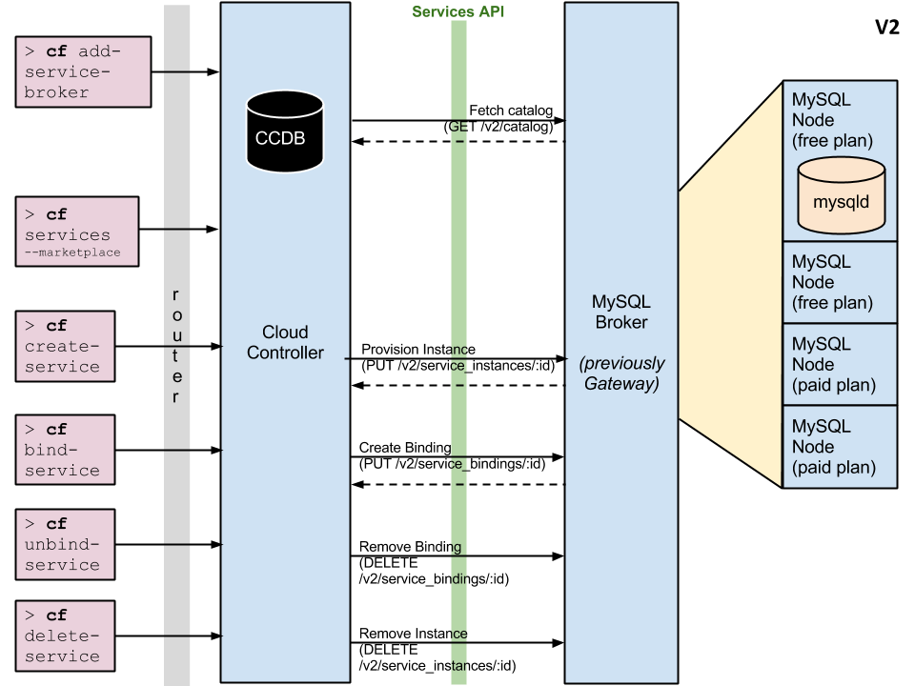

Slide 38
Server Broker API
GET /v2/catalog – List services and plans available from this broker.
PUT /v2/service_instances/:id – Create a new service instance.
PUT /v2/service_instances/:instance_id/service_bindings/:id – Create a new binding to a service instance.
DELETE /v2/service_instances/:instance_id/service_bindings/:id – Unbind from a service instance.
DELETE /v2/service_instances/:id – Delete a service instance.
Notes:
In both ‘service instance creation’ and ‘service binding creation’, org/space/plan identifiers are provided to the ‘service broker’
This allows the broker flexibility what to do
Explain ORG
Explain SPACE
Explain PLAN

Slide 39
Server Broker Registration
Make the service broker known to the Cloud Controller
cf create service-broker <broker name> <username> <password> <broker base URI>
Broker should ONLY allow access to those requestors it shared its credential with (Basic Auth)
See: http://docs.gopivotal.com/pivotalcf/services/managing-service-brokers.html#register-broker
Make ‘plans’ accessible to users in a specific org/space
Somewhat cumbersome: need to “hand parse” JSON to find service plan UUID as registered with the CC
See: http://docs.gopivotal.com/pivotalcf/services/access-control.html#make-plans-public
Need admin creds/role in order to introduce a service broker to the Cloud Controller!
Notes:
In both ‘service instance creation’ and ‘service binding creation’, org/space/plan identifiers are provided to the ‘service broker’
This allows the broker flexibility what to do

Slide 40
Service Broker Implementation
Service implementation is up to the service provider/developer.
Cloud Foundry only requires that the service provider implement the service broker API.
A broker can be implemented as a separate application, or by adding the required http endpoints to an existing service.

Slide 41
Service Broker Implementation
Best Practice: Each binding is represented by its own credentials =>
T=1: create service instance
Neither App-1 or App-2 has access to the service instance
T=2: bind App-1 to service instance
Only App-1 can access the service instance
T=3: bind App-2 to service instance
Both App-1 and App-2 have access to the service instance
T=4 unbind App-1 from service instance
Only App-2 can access the service instance

Slide 42
Service Instance Provisioning Examples
The result of provisioning varies by service type, although there are a few common actions that work for many services. For a MySQL service, provisioning could result in:
An empty dedicated mysqld process running on its own VM.
An empty dedicated mysqld process running in a lightweight container on a shared VM.
An empty dedicated mysqld process running on a shared VM.
An empty dedicated database, on an existing shared running mysqld.
A database with business schema already there.
A copy of a full database, for example a QA database that is a copy of the production database.
For non-data services, provisioning could just mean getting an account on an existing system.
Notes:
No strong semantics dictated regarding a ‘service instance’

Slide 43
Service Broker Deployment Models
Because Cloud Foundry only requires that a service implements the broker API in order to be available to Cloud Foundry end users, many deployment models are possible. The following are examples of valid deployment models:
Entire service (service backend + broker) packaged and deployed by BOSH alongside Cloud Broker packaged and deployed by BOSH alongside Cloud Foundry, rest of the service deployed and maintained by other means
Broker (and optionally service) pushed as an application to Cloud Foundry user space Foundry (this is the approach we’ll take in the lab…)
Entire service, including broker, deployed and maintained outside of Cloud Foundry by other means

Slide 44
Resources
Service Broker API: http://docs.gopivotal.com/pivotalcf/services/api.html
Managing Service Brokers: http://docs.gopivotal.com/pivotalcf/services/managing-service-brokers.html
Binding Credentials: http://docs.gopivotal.com/pivotalcf/services/binding-credentials.html
Tiny sample application: https://github.com/cloudfoundry-samples/spring-hello-env

Slide 45
Buildpacks and Services
Buildpacks
Java Buildpack Deep Dive
User-Provided Services
Managed Services
DEMO: Deploy and Test HaaSh (HashMap as a Service)

Slide 46
Coming Up
Break (4:00 - 4:15)
Part Four (4:15 - 5:30)
Learn How CF Enables Continuous Delivery
DEMO: Setup a CD Pipeline with Jenkins, Artifactory, CF Client, and PCF

Slide 47
Break into Teams!
#
1
2
3
4
5
6
7
8
9
10
API: api.s#.pcf.pivotal.io
WEB CONSOLE: console.s#.pcf.pivotal.io
USER: s#-admin
PASSWORD: pivotal
ORG: lab
SPACE: lab

Slide 48
Labs
BUILDPACKS
Follow instructions at https://github.com/cf-platform-eng/cf-workshop-bp-module using your assigned team Pivotal CF environment.
SERVICE BROKERS
Follow instruction at https://github.com/cf-platform-eng/cf-workshop-sb-module using your assigned team Pivotal CF environment.

Slide 49
Buildpacks and Services
Buildpacks
Java Buildpack Deep Dive
User-Provided Services
Managed Services
Choose Your Own Lab:
Customize Java Buildpack
Deploy and Test HaaSh (HashMap as a Service)

Slide 50
THANK YOU!
See you after the break!

