Slide 1
Pivotal CF
Building Cloud ready apps

Slide 2
The limitations of traditional apps
Scalability
Inter-Dependency
Platform Specificity
Location Specificity
Resiliency
Traceability / Logging

Slide 3
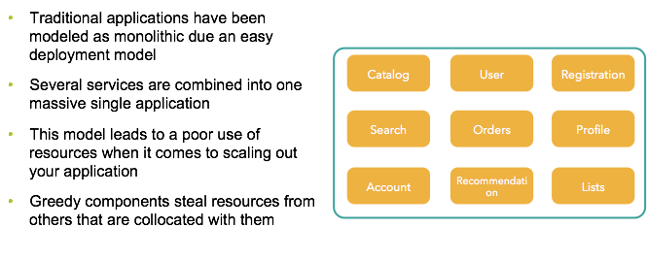
Scalability

Slide 4
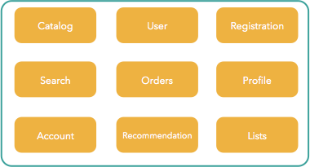
Scaling monolithic apps

Slide 5
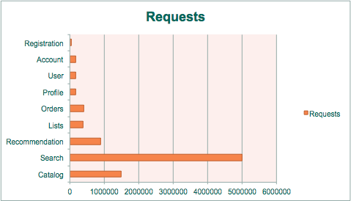
How you should scale

Slide 6
The limitations of traditional apps
Scalability
Inter-Dependency
Platform Specificity
Location Specificity
Resiliency
Traceability / Logging

Slide 7
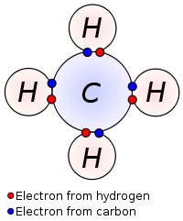
Inter dependency
Monolithic applications represent component dependency as strong bindings at the code level
It makes harder to get a independent scalable model promoted by service oriented architectures

Slide 8
The limitations of traditional apps
Scalability
Inter-Dependency
Platform Specificity
Location Specificity
Resiliency
Traceability / Logging

Slide 9


Platform specificity
Hard dependencies on the runtime environment make applications not portable
At code level with runtime dependencies
At OS level (relying on cron as a scheduler)
import javax.servlet.http.HttpServlet;
import com.ibm.servlet.engine.webapp.*;

Slide 10
The limitations of traditional apps
Scalability
Inter-Dependency
Platform Specificity
Location Specificity
Resiliency
Traceability / Logging

Slide 11
Location Specificity : Writing to disk
Applications often need to write to disk, this includes form uploads with binary data, or content in most CMS systems
Containers are short lived and not guaranteed to be executed on the same hardware every time they are needed to restart. Depending on a local file system is a big lock dependency some applications impose on the runtime
This is one of the first issues to question or address when starting a conversation around new applications or selecting candidates to execute in PCF
Some CMS vendors support usage of a service such as S3 to be the persistent mechanism of choice

Slide 12
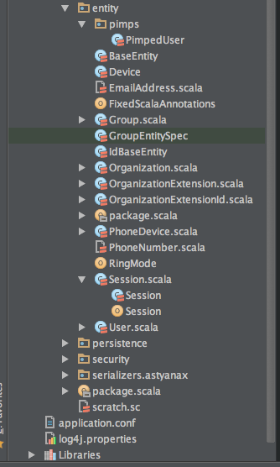
Location Specificity : service locations
Cache.hosts=10.68.27.41,10.68.27.42
#naming does not help either
Cache.hosts=cacheserver1, cacheserver2
Properties file deployed
With application

Slide 13
Location Specificity : Sticky sessions
Applications that rely on session stickiness are subject to lead to unexpected behavior in case of failure of the node that contains that data
Most web applications that use sessions do not have a replication strategy in place
Your application availability is subject to a single node (even if you LB the load over other nodes)
Some app servers use P2P session replication which can be very costly on large deployments
Dynamic Router
jsessionId
DEA
DEA

Slide 14
The limitations of traditional apps
Scalability
Inter-Dependency
Platform Specificity
Location Specificity
Resiliency
Traceability / Logging

Slide 15
Resilience
No graceful shutdown in case of catastrophic events
No recovery when the process executing the application dies
No horizontal and automatic scale under heavy load
No fallback mechanisms when dependent services are broken

Slide 16
The limitations of traditional apps
Scalability
Inter-Dependency
Platform Specificity
Location Specificity
Resiliency
Traceability / Logging

Slide 17
Traceability / Logging
Traditional apps usually write logs to files on disk
When you have a cluster composed of several instances, it becomes really hard to trace log files spread across different locations

Slide 18
What about J2EE?

Slide 19
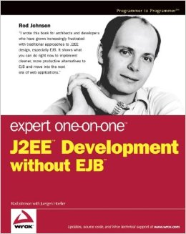
The J2EE story
Java enterprise beans has always been seen as a mammoth.
It inspired Rod Johnson to create Spring Framework, and the rest is history
The cumbersome model, coupled to fat application servers, and excessive plumbing code, led the market to embrace spring as the top application framework in the world
EJB 3 tried to fight back by adopting a lot of spring framework’s core concepts. Unfortunately by the time it was released, AWS was already a reality.

Slide 20
Can I run my JEE app on PCF?
JEE is a vast spec, people usually take for granted that JEE = EJB. EJBs are not a good match for running inside cloud foundry we will cover that later
For the majority of the spec, we actually support it inside tomcat. The main concerns are mostly around the application architecture and not the specs it uses
There are just a few specs are really not supported, be careful when bumping on those

Slide 21
JEE 7 and CloudFoundry (Most common JSRs)
JSR | Description | Supported | Notes
JSR 338 | Java Persistence API 2.1 | yes | Spring data JPA has better support than this JSR
JSR 340 | Java Servlets 3.1 | yes | Tomcat 8 support servlets 3.1
JSR 339 | JAX-RS 2.0 Restfull web services | yes | Jersey and resteasy can be used instead of SpringMVC
JSR 344 | JSF 2.2 Java server faces | yes | Supported on tomcat containers
JSR 349 | Bean Validation 1.1 | yes | Spring has support for bean validation
JSR 245 | Java server pages 2.3 | yes | Supported on tomcat containers
JSR 919 | Java mail 1.5 | yes | Spring has extensive support for java mail senders
JSR 343 | JMS 2.0 | partial | No support for MDBs, but JMS client is fully supported
JSR 345 | Enterprise Java Beans 2.0 | No
JSR 322 | Java Connector Architecture 1.7 | No
JNDI | Java Naming Directory Interface | No | Actually part of JSE, but its used by most containers

Slide 22
JNDI
JNDI is not JEE it’s actually part of JSE, but it’s quite often used by containers to store objects such as datasources or remote clients to EJBs
JNDI was never truly portable, across different vendors naming is different for same type of objects, stress that with your customer
Tomcat offers a read-only JNDI, so although possible to run applications that rely on datasource JNDI objects, its really not recommended, sometimes its not that simple to port them.

Slide 23
EJB: Stateless Session Beans
SLSB could potentially be executed on a supported container on PCF, but if the application only use them as a service bridge between the local web application (WAR) and business code, spring is a much lighter weight approach for that.
The problem on running SLSBs on PCF its really the fact that EJBs are located using JNDI on a remote port (1099 for example) and RPC are made towards another port (4445 for example). Warden only exposes one port for your application
So although an application using a web front end and a SLSB packaged on a single WAR could potentially be executed on PCF, there could never be an external route to the EJBs

Slide 24
EJB: Stateful Session Beans
SFSBs on the other hand are not really supported. The main issue is how replication works, and this is usually locked by vendor, and it requires multiple ports opened, which Warden would not allow. It could also be implemented using multicast (Jboss) and most cloud providers ban multicasting from their networks
SFSB makes code testing really hard. They allow state on the class level, and wrap calls on proxies to prevent racing conditions. This also makes the code practically impossible to be ported

Slide 25
EJB: Message Driven Beans
MDBs could be supported if running a JEE container inside PCF. MDBs are just message listeners to JMS that runs inside a transactional container.
Spring Messaging offers a very similar model (including transaction support) without the coupling of the container.
If message driven architecture is a requirement for the application, show how simple it is to implement a message driven pojo with spring as opposed to a message driven bean

Slide 26
JTA and distributed transactions
If an application relies on distributed transactions across several EJB containers, that is a good indication that is really not a good fit for cloud applications.
Distributed transactions should be avoided, they bring a lot of complexity to the architecture, with very rarely any benefit
Spring supports 2PC using an external transaction provider (atomikos) but when talking about microservices, transactions should be a good boundary to start a conversation around the responsibility of the service

Slide 27
3rd Platform Strategies

Slide 28
Better 3rd Platform Strategies
Local Disk Storage
Embedded Services
Session Replication
Logging

Slide 29
Local disk storage
Use an storage gateway service instead of relying on plain old file system access
This abstracts the need of a local file system while giving your application a flexible mechanism to rely depending on it’s runtime (local on your dev, S3 or swift on prod)
Storage
Gateway
Service
S3
Swift

Slide 30
Embedded services
Let the runtime inject any service reference through environment variables
Reduces location specificity of the application
Allows disposability of containers
Runtime should inject any variable into the container
Service Broker Node(s)
Service Broker Node(s)
${VCAP_SERVICES}
DEA
Env

Slide 31
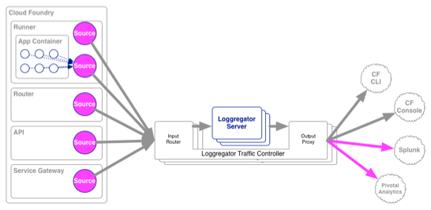
Logging
Do not write to log files
Output logs to console and use a syslog drain to collect all logs

Slide 32
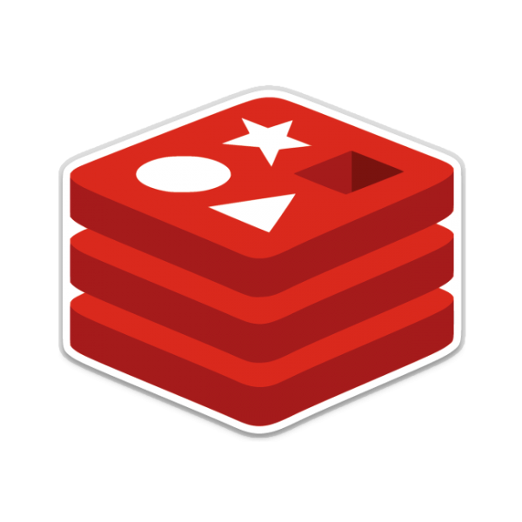
Session replication
The java buildpack supports redis session replication
Sessions are now stored on redis, and in case of a node failure, the client state can still be found on a second node
Dynamic Router
DEA
DEA
jsessionId

Slide 33

Microservices Overview
Notes:
So let’s do a brief overview of the microservices architectural style…but first <TRANSITION>

Slide 34
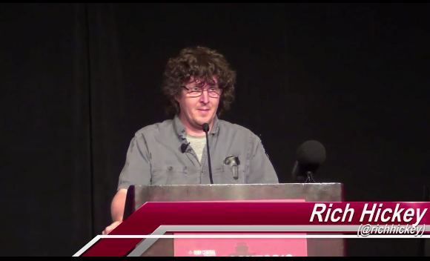
Simple vs. Easy
Simple
sim- plex
one fold/braid
vs complex
Easy
ease < aise < adjacens
lie near
vs hard
Notes:
…I want to define some terms.
Rich Hickey — Strange Loop “Simple Made Easy” — 2011

Slide 35



Monolithic Architecture
HTML
JavaScript
MVC
Service
Service
Data Access
Browser
Monolithic Application
Relational Database
Notes:
a large, monolithic enterprise relational DB — often preexisting
a layered, monolithic architecture:
Data access objects (JPA, Hibernate)
Service Beans (Spring Service Beans, EJB Session Beans)
Server-side MVC and templating (Spring MVC, Struts, JSF); Perhaps a smattering of JavaScript/AJAX
Delivered to the browser

Slide 36
Monolithic Architectures
Complex / Easy
Modularity Dependent Upon Language / Frameworks
Change Cycles Tightly Coupled / Obstacle to Frequent Deploys
Inefficient Scaling
Can be Intimidating to New Developers
Obstacle to Scaling Development
Requires Long-Term Commitment to Technical Stack

Slide 37




Microservice Architecture
Relational
DB
HTTP
HTTP
HTTP
Key/Value
Store
HTTP
HTTP
HTTP
HTTP
…
AMQP
AMQP
HTTP
Graph
DB
Notes:
REST and message-driven services
Polyglot persistence, services encapsulate data store semantics
Diversity of clients acknowledged
API Gateway for service aggregation, reduce chattiness, protocol translation, reduce latency/round-trips, deal with mobile device fragmentation, build use case/device specific API’s

Slide 38
Microservice Architectures
Simple / Hard
Modularity Based on Component Services
Change Cycles Decoupled / Enable Frequent Deploys
Efficient Scaling
Individual Components Less Intimidating to New Developers
Enables Scaling of Development
Eliminates Long-Term Commitment to Technical Stack

Slide 39
Organize Around Business Capabilities
Siloed
Functional
Teams
UI Specialists
Middleware Specialists
DBAs
Business Capability
Business Capability
Business Capability
Cross-
functional
Teams
HTML
JavaScript
MVC
Siloed
Application
Architectures
Microservice
Architectures
Service
Service
Data Access
http://martinfowler.com/articles/microservices.html#OrganizedAroundBusinessCapabilities
Notes:
Business Capability Organization:
- broad-stack implementation of software for that area
- includes UI, persistence, external collaborations
- cross-functional teams: UX, DB, PM, QA, etc.
- Cross functional teams are responsible for building and operating each product and each product is split out into a number of individual services communicating via a message bus. <TRANSITION>

Slide 40
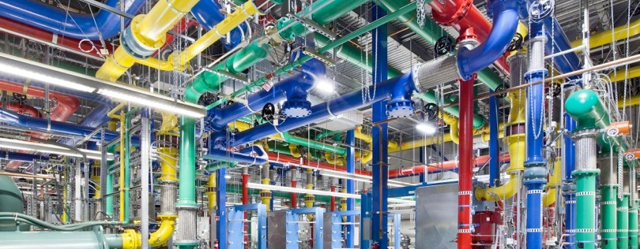
UNIX Pipes and Filters
cut -d" " -f1 < access.log | sort | uniq -c | sort -rn | less
Notes:
Applications built from microservices aim to be as decoupled and as cohesive as possible - they own their own domain logic and act more as filters in the classical Unix sense - receiving a request, applying logic as appropriate and producing a response.
Communication style = smart endpoints (filters) and dumb pipes as opposed to ESB
- Don’t put the smarts in the communication mechanism, put the smarts in the endpoints.
- Neal Ford = choreography not orchestration

Slide 41
Choreography over Orchestration
https://www.flickr.com/photos/chrisbrenschmidt/2223763842
https://www.flickr.com/photos/gabrielsaldana/5896491978
http://martinfowler.com/articles/microservices.html#SmartEndpointsAndDumbPipes
Notes:
These are choreographed using simple RESTish protocols rather than complex protocols such as WS-Choreography or BPEL or orchestration by a central tool. The two protocols used most commonly are HTTP request-response with resource API's and lightweight messaging. <TRANSITION>

Slide 42

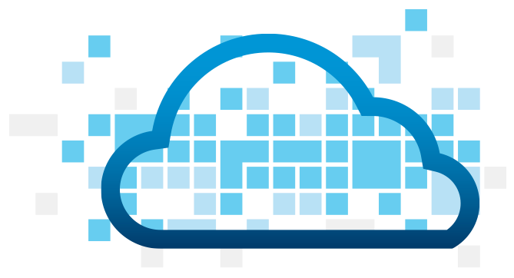
A Mutualistic Symbiotic Relationship…
Cloud Foundry
Microservices
http://en.wikipedia.org/wiki/Symbiosis#Mutualism
Notes:
So it's recently been said that "microservices are not a free lunch" — and that’s true, there is a significant cost associated with migrating to the microservices style, much as there is a significant cost associated with migrating to the twelve-factor style. Interestingly enough, if you look at the concerns expressed about microservices, many of them are *exactly* the challenges that a CF is intended to address. So while microservices do not necessarily imply Cloud Foundry (and vice versa), there is in fact a symbiotic relationship between the two, with each approach somehow compensating for the limitations of the other, much like the practices of eXtreme Programming do the same [3].

Slide 43
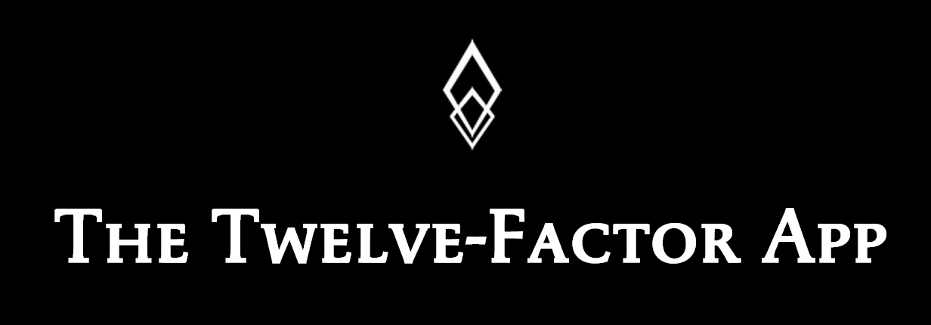
Overview
http://12factor.net
Notes:
So now I’ll switch gears and give a brief overview of the twelve-factor application and how Cloud Foundry is tuned to support applications developed in that style.

Slide 44
Twelve Factor + Cloud Foundry
One codebase tracked in revision control, many deploys
Multiple = Distributed System
Consistent with CF application unit
Explicitly declare and isolate dependencies
CF emphasis on deployable units (e.g. Java WAR)
CF Buildpacks provide runtime dependencies
Notes:
- App Unit —> Codebase…multiple codebases result in distributed system. CF matches this.
- Explicitly declare/isolate dependencies: A twelve-factor app never relies on implicit existence of system-wide packages. On CF, they won’t be there (unless you create a custom buildpack that provides them).

Slide 45
Twelve Factor + Cloud Foundry
Store config in the environment
Nicely facilitated via CF
Notes:
Store Configuration in the Environment — strict separation of config from code, language/OS-agnostic standard. CF facilitates this well via “cf set-env” and application manifests.

Slide 46
Twelve Factor + Cloud Foundry
Store config in the environment
Nicely facilitated via CF
Treat backing services as attached resources
cf create-service / cf bind-service
Notes:
Backing Services == attached (CF -> bound) resources…no distinction between local and 3rd-party. All the same, all via VCAP_SERVICES whether brokered or user-provided.

Slide 47
Twelve Factor + Cloud Foundry
Store config in the environment
Nicely facilitated via CF
Treat backing services as attached resources
cf create-service / cf bind-service
Strictly separate build and run stages
CF Buildpacks + immutable Warden containers
Notes:
- Build/release/run - build a deployable package, combine with config/environment/bound services (STAGING on CF), runtime (deploy to DEA as droplet in Warden)…strict separation b/w stages, runtime deployments are immutable!

Slide 48
Twelve Factor + Cloud Foundry
Execute the app as one or more stateless processes
CF Warden containers - no app server clustering, no shared FS.
Challenge for the monolith!
Notes:
- Stateless, shared-nothing processes - any persistent data in stateful backing-service (DB, object store). CF optimizes for this as well by providing no clustered memory or shared filesystems (today). Sticky sessions supported, but not to be relied upon exclusively.

Slide 49
Twelve Factor + Cloud Foundry
Execute the app as one or more stateless processes
CF Warden containers - no clustered memory, no shared FS.
Challenge for the monolith!
Export services via port binding
CF provides HTTP/HTTPS today, more future (TCP?)
Notes:
- Export services via port binding. VCAP_APP_PORT for HTTP/HTTPS. More in the future (TCP?). If container required (i.e. Tomcat), it is injected via BP.

Slide 50
Twelve Factor + Cloud Foundry
Execute the app as one or more stateless processes
CF Warden containers - no clustered memory, no shared FS.
Challenge for the monolith!
Export services via port binding
CF provides HTTP/HTTPS today, more future (TCP?)
Scale out via the process model
cf scale app -i 1000
Notes:
- Concurrency - scale out via process model. “cf scale app -i 1000”

Slide 51
Twelve Factor + Cloud Foundry
Maximize robustness with fast startup and graceful shutdown
CF scales quickly, but can only move as fast as your app can bootstrap (challenge for the monolith!
Notes:
- Disposability - maximize effectiveness via fast startup, graceful shutdown —> cf scales up super quickly, but can only start apps as fast as your app can start. On scale in, CF shuts you down gracefully, but on you to clean up properly.

Slide 52
Twelve Factor + Cloud Foundry
Maximize robustness with fast startup and graceful shutdown
CF scales quickly, but can only move as fast as your app can bootstrap (challenge for the monolith!)
Keep development, staging, and production as similar as possible
CF is CF! Spaces provide separation of concerns without technical differences.
Notes:
- Dev/prod parity - CF is CF! Spaces provide separation of concerns without technical differences.

Slide 53
Twelve Factor + Cloud Foundry
Treat logs as event streams
CF Loggregator!
Run admin/management tasks as one-off processes
Still a challenge to be addressed…
Notes:
Logs - treat as event streams, log to stdout. CF loggregator handles routing and storage concerns (drain API).
- Admin processes - Run admin/management tasks as one-off processes — we’re not there yet (experiments like tmate-buildpack and websocketd)

Slide 54
Twelve Factor + Microservices
Fully compatible architectural style
Frameworks tend to optimize around same ideas
Examples:
Spring Boot + Cloud
http://projects.spring.io/spring-boot
http://projects.spring.io/spring-cloud
Dropwizard (https://dropwizard.github.io/dropwizard)
Notes:
Spring Boot represents the next generation of how to build server-side applications well, making the bootstrapping cost of new Spring projects approach zero. It’s auto-configuration mechanisms support sensible, production-grade defaults for most common Spring configuration choices, and provides an extensive set of additional production-ready features such as metrics, health checks and externalized configuration applied in the twelve-factor style. <TRANSITION>

Slide 55
Twelve Factor + Microservices
Fully compatible architectural style
Frameworks tend to optimize around same ideas
Examples:
Spring Boot + Cloud
http://projects.spring.io/spring-boot
http://projects.spring.io/spring-cloud
Dropwizard (https://dropwizard.github.io/dropwizard)
Notes:
Spring Cloud takes Boot to the next level by providing trivial-to-use mechanisms for connecting to services and gaining operating environment awareness in 12-factor tuned PaaS platforms like Cloud Foundry and Heroku.
Much of this was inspired by the Dropwizard framework, which was one of the first JVM frameworks targeted at building 12-factor style, microservices applications.

Slide 56
3rd Platform Realities

Slide 57
Paying for your lunch…
Significant Operations Overhead
Substantial DevOps Skills Required
Implicit Interfaces
Duplication of Effort
Distributed System Complexity
Asynchronicity is Difficult!
Testability Challenges
Notes:
He enumerated the costs of microservices at these seven bullet points…

Slide 58
Paying for your lunch…
Significant Operations Overhead
Substantial DevOps Skills Required
Implicit Interfaces
Duplication of Effort
Distributed System Complexity
Asynchronicity is Difficult!
Testability Challenges
Notes:
I want to focus on these four, as Cloud Foundry has a lot to say about addressing each of them.

Slide 59
Significant Operations Overhead
Mitigate polyglot language/environment provisioning complexity via CF Buildpacks
Mitigate failover and resilience concerns via CF Scale, CF Health Monitor, and future CF App AZ’s (http://blog.gopivotal.com/cloud-foundry-pivotal/products/the-four-levels-of-ha-in-pivotal-cf)
Notes:
So first, he enumerates the significant operations overhead associated with microservices. Let’s walk through each of the concerns bullet by bullet and show how Cloud Foundry mitigates ALL OF THEM.
- tens of separate services to build, test, deploy and run, potentially in polyglot languages and environments (CF Buildpacks).
- All of these services potentially need clustering for failover and resilience, turning your single monolithic system into, say, 20 services consisting of 40-60 processes after we've added resilience (CF Scale, CF Health Monitor, CF App HA — future). <TRANSITION>

Slide 60
Significant Operations Overhead
Mitigate polyglot language/environment provisioning complexity via CF Buildpacks
Mitigate failover and resilience concerns via CF Scale, CF Health Monitor, and future CF App AZ’s (http://blog.gopivotal.com/cloud-foundry-pivotal/products/the-four-levels-of-ha-in-pivotal-cf)
Mitigate routing/load balancing and plumbing concerns via CF Router and CF Services
High quality monitoring = CF BP agent-based tooling, future CF metric streams
High quality operations infrastructure = CF BOSH!
Notes:
- Throw in load balancers (CF Router) and messaging layers for plumbing between the services (CF Services — e.g. RabbitMQ, IronMQ, Redis) and the estate starts to become pretty large when compared to that single monolithic application that delivered the equivalent business functionality!
Productionising all of this needs high quality monitoring (CF agent-based monitoring w/ New Relic, AppDynamics, Spring Insight…integrated APM in PCF coming)
and operations infrastructure (BOSH, CF).

Slide 61
Significant Operations Overhead
Mitigate polyglot language/environment provisioning complexity via CF Buildpacks
Mitigate failover and resilience concerns via CF Scale, CF Health Monitor, and future CF App AZ’s (http://blog.gopivotal.com/cloud-foundry-pivotal/products/the-four-levels-of-ha-in-pivotal-cf)
Mitigate routing/load balancing and plumbing concerns via CF Router and CF Services
High quality monitoring = CF BP agent-based tooling, future CF metric streams
High quality operations infrastructure = CF BOSH!
Robust release/deployment automation = CF API, scriptable CF CLI, Maven/Gradle Plugins, Strong Cloudbees/Jenkins partnerships
Notes:
- Physically shipping this plethora of Microservices through your pipeline and into production also needs a very high degree of robust and release and deployment automation. (CF enables automation via API’s, scriptable CLI, Maven/Gradle plugins. Strong partnerships with Cloudbees around Jenkins).

Slide 62
Substantial DevOps Skills Required
This is a Good Thing™ in any architecture!
CF keeps your microservices up and available (and your monoliths too!)
CF = development and production parity!
Polyglot persistence without all the fuss: CF BOSH and Service Brokers
Notes:
you definitely need high quality DevOps and release automation skills embedded within your development team. (I won’t argue with this so much, as I think it’s a good idea in general, but what he goes on to say just ain’t true)
Dev teams running Tomcat clusters and keeping them available? With CF you don’t! Buildpacks, Health Monitor…
You can’t throw apps built in this style over the wall to an ops team (with CF you don’t, and you shouldn’t be anyway)…dev team needs to be operationally focused and production aware (CF gives dev and prod parity, so you know where/how your code is going to run) <TRANSITION>

Slide 63
Distributed System Complexity
Agreed: Microservices imply distributed systems.
All of the CF platform features we’ve discussed help to mitigate these concerns:
latent/unreliable networks
fault tolerance
load variability
Notes:
- Microservices imply a distributed system. ==> sure
- Once we have distributed a system, we have to consider a whole host of concerns that we didn't before:
* Network latency - microservices in CF will tend to live on the same network, so this is minimized
* fault tolerance - CF HA and Health Monitoring reduce absolute need for this
* unreliable networks - see above
* varying loads within our application tiers - CF APM, (Auto)scaling helps a lot here

Slide 64
Testability Challenges
With CF, it is NOT difficult to recreate environments in a consistent way for either manual or automated testing!
Idiomatic Microservices involves placing less emphasis on testing and more on monitoring
Not sure where this idea comes from…
CF is an enabler of both!
Notes:
- Idiomatic Microservices involves placing less emphasis on testing and more on monitoring (CF is enabling this approach as well) so we can spot anomalies in production and quickly roll back or take appropriate action. I am a big believer in this approach - lowing the barriers to release and leaning continuous delivery in order to speed up lean delivery (don’t know where this comes from…CF is itself a microservice architecture, and it relies heavily on automated testing via TDD).

