Slide 2
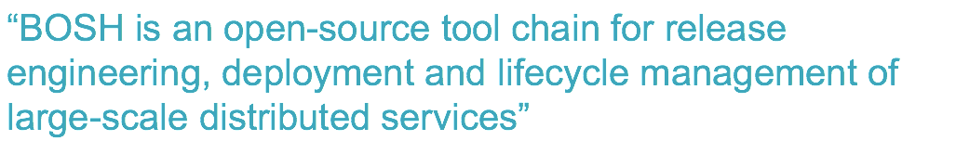
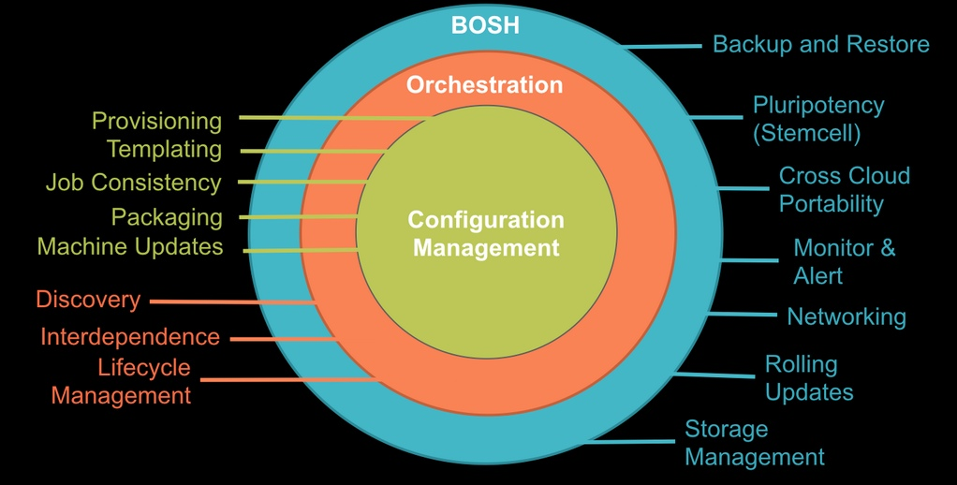

Slide 3
Why BOSH
Provision services, not machines
Enables continuous delivery
Cloud-agnostic view of Platform Ops
Holistic Toolchain for “rule them all"
Eliminate bespoke automation on top of config management

Slide 4
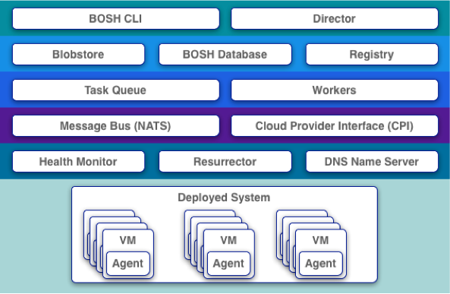
The BOSH Architecture
Very similar to CF architecture itself
Director as analogy to Cloud Controller
Different CPIs exist per IaaS implementation
Workers responsible for executing tasks as dictated by Director

Slide 5
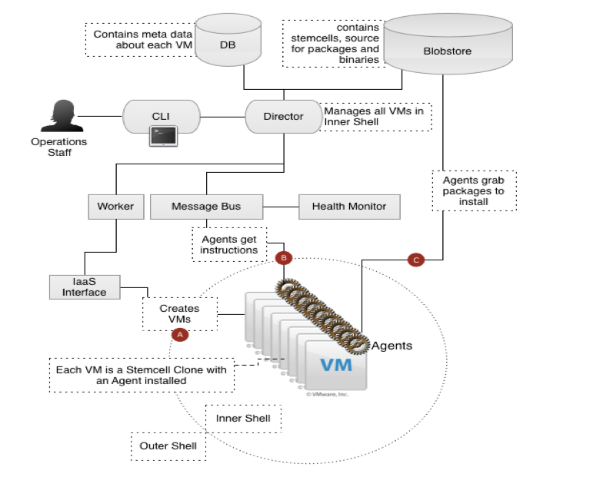
The BOSH Architecture
Very similar to CF architecture itself
Director as analogy to Cloud Controller
Different CPIs exist per IaaS implementation
Workers responsible for executing tasks as dictated by Director

Slide 6

Three main components of a bosh deployment
Manifest
Stemcell
Release
Agent

Slide 7



BOSH deployment
DB
BOSH
Upload Stemcell
BOSH CLI
BOSH Director
Blobstore
NATS
Health
Monitor

Slide 8
BOSH deployment
DB
BOSH
Upload Release
BOSH CLI
BOSH Director
Blobstore
NATS
Health
Monitor

Slide 9
BOSH deployment
DB
BOSH
Set Manifest
BOSH CLI
BOSH Director
Blobstore
NATS
Health
Monitor

Slide 10

BOSH deployment
IaaS
DB
BOSH
Deploy
BOSH CLI
BOSH Director
Worker VMs
Blobstore
NATS
Target VM
Target VM
Health
Monitor
Target VM
BOSH agent

Slide 11
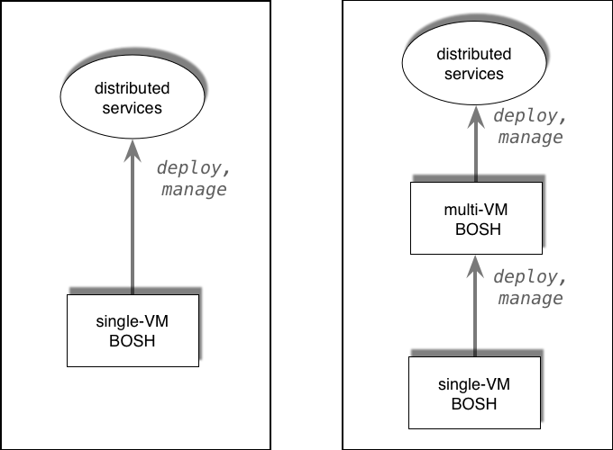
BOSH possible flows
http://docs.cloudfoundry.org/bosh/workflow.html

Slide 12


How about and CF?

Slide 13


















CloudBees Jenkins
Enterprise
Cassandra
for Pivotal CF
ElasticSearch
for Pivotal CF
Mobile Services
for Pivotal CF
BOSH Director
BOSH Agent
IaaS

Slide 14
Click to install
No downtime updates
Explore install logs
Click to scale the platform
CloudBees Jenkins
Enterprise
Built-in High Availability
Cassandra
for Pivotal CF
Built-in Platform Monitoring
ElasticSearch
for Pivotal CF
Mobile Services
for Pivotal CF
BOSH Director
BOSH Agent
Integrated services
IaaS

Slide 15


CF
BOSH releases
CloudBees Jenkins
Enterprise
Cassandra
for Pivotal CF
ElasticSearch
for Pivotal CF
Mobile Services
for Pivotal CF
BOSH Director
BOSH Agent
IaaS

Slide 16

BOSH possible flows
Pivotal CF flow
Bootstrap
+
Manage Releases
Manage Config
Bosh Client
http://docs.cloudfoundry.org/bosh/workflow.html

Slide 17
How does a Pivotal CF install work?

Slide 18
Pivotal CF flow
Deploy Ops Manager VM

Slide 19


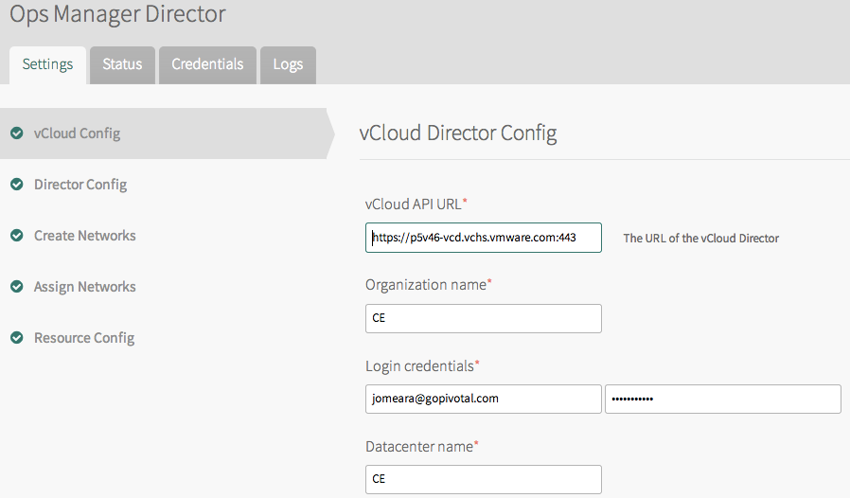


Deploy Ops Manager VM
Conf. IaaS tile / apply changes
Manifest
BOSH Bootstrap

Slide 20
Deploy Ops Manager VM
Ops Manager Director
MicroBOSH
Conf. IaaS tile / apply changes
Manifest
BOSH Bootstrap

Slide 21

Deploy Ops Manager VM
Ops Manager Director
MicroBOSH
Conf. IaaS tile / apply changes
CF Release
Add ER tile (BOSH release)

Slide 22


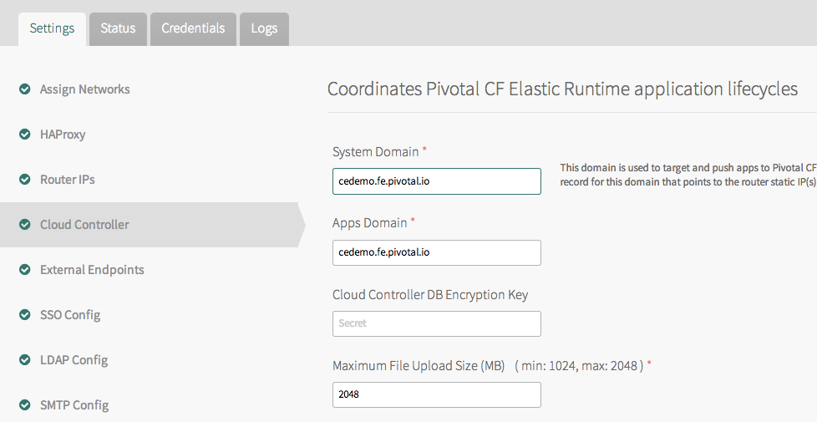
Deploy Ops Manager VM
Ops Manager Director
MicroBOSH
Conf. IaaS tile / apply changes
CF Release
CF Release
Manifest
Add ER tile (BOSH release)
Config parameters

Slide 23

Deploy Ops Manager VM
Ops Manager Director
MicroBOSH
Conf. IaaS tile / apply changes
CF Release
Manifest
Add ER tile (BOSH release)
Apply Changes
Upload Release + Stemcell

Slide 24
Deploy Ops Manager VM
Ops Manager Director
MicroBOSH
Conf. IaaS tile / apply changes
CF Release
Manifest
Add ER tile (BOSH release)
Apply Changes
Set Manifest

Slide 25
Deploy Ops Manager VM
Ops Manager Director
MicroBOSH
Conf. IaaS tile / apply changes
CF Release
Add ER tile (BOSH release)
Apply Changes
Deploy

Slide 26
Ops Manager Director
Deploy Ops Manager VM
Ops Manager Director
MicroBOSH
Conf. IaaS tile / apply changes
CF Release
Add ER tile (BOSH release)
Blobstore
DB
Apply Changes
Cloud Controller
BOSH Director
NATS
Health Manager
BOSH Agent
DEA
BOSH Agent
BOSH Agent
BOSH Agent
NATS
Worker VMs
Health Monitor
MicroBOSH
vSphere

Slide 27
Deploy Ops Manager VM
Ops Manager Director
MicroBOSH
Conf. IaaS tile / apply changes
CF Release
Add ER tile (BOSH release)
Blobstore
DB
Apply Changes
Cloud Controller
BOSH Director
NATS
Health Manager
BOSH Agent
DEA
Ping
BOSH Agent
BOSH Agent
BOSH Agent
NATS
Worker VMs
Elastic Runtime
Health Monitor
MicroBOSH

Slide 28

Deploy Ops Manager VM
Ops Manager Director
MicroBOSH
Conf. IaaS tile / apply changes
CF Release
Add ER tile (BOSH release)
Apply Changes
(… same for other services)

Slide 29


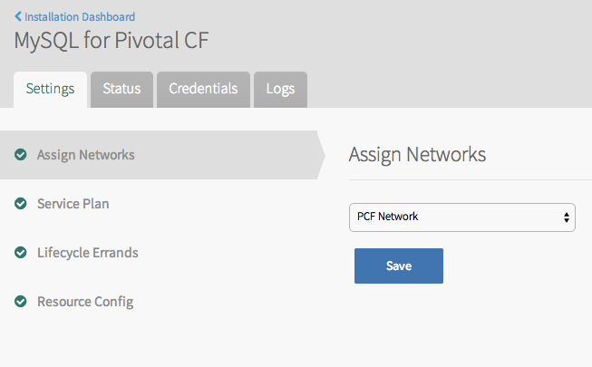
Deploy Ops Manager VM
Ops Manager Director
MicroBOSH
Conf. IaaS tile / apply changes
CF Release
Manifest
Add ER tile (BOSH release)
Apply Changes
(… same for other services)

Slide 30
Deploy Ops Manager VM
Ops Manager Director
MicroBOSH
Conf. IaaS tile / apply changes
CF Release
Manifest
Add ER tile (BOSH release)
Apply Changes
Upload Release + Stemcell
(… same for other services)

Slide 31
Deploy Ops Manager VM
Ops Manager Director
MicroBOSH
Conf. IaaS tile / apply changes
CF Release
MySQL Release
Manifest
Add ER tile (BOSH release)
Apply Changes
Set Manifest
(… same for other services)

Slide 32
Deploy Ops Manager VM
Ops Manager Director
MicroBOSH
Conf. IaaS tile / apply changes
CF Release
MySQL Release
Add ER tile (BOSH release)
Apply Changes
Deploy
(… same for other services)

Slide 33
Ops Manager Director
Deploy Ops Manager VM
Ops Manager Director
MicroBOSH
Conf. IaaS tile / apply changes
CF Release
MySQL Release
Add ER tile (BOSH release)
Blobstore
DB
Apply Changes
MySQL Server
BOSH Director
Service Broker
BOSH Agent
(… same for other services)
MySQL Server
BOSH Agent
BOSH Agent
NATS
Worker VMs
Health Monitor
MicroBOSH
vSphere

Slide 34
Deploy Ops Manager VM
Ops Manager Director
MicroBOSH
Conf. IaaS tile / apply changes
CF Release
MySQL Release
Add ER tile (BOSH release)
Blobstore
DB
Apply Changes
MySQL Server
BOSH Director
Service Broker
BOSH Agent
(… same for other services)
MySQL Server
Ping
BOSH Agent
BOSH Agent
NATS
Worker VMs
Pivotal MySQL
Health Monitor
MicroBOSH

Slide 35
Deploy Ops Manager VM
Ops Manager Director
MicroBOSH
Conf. IaaS tile / apply changes
CF Release
MySQL Release
Add ER tile (BOSH release)
BOSH Director
Apply Changes
NATS
Health Monitor
(… same for other services)
Ping
Ping
MySQL Server
Cloud Controller
Service Broker
NATS
Health Manager
BOSH Agent
BOSH Agent
MySQL Server
DEA
BOSH Agent
BOSH Agent
BOSH Agent
BOSH Agent
BOSH Agent
Pivotal MySQL
Elastic Runtime

Slide 36
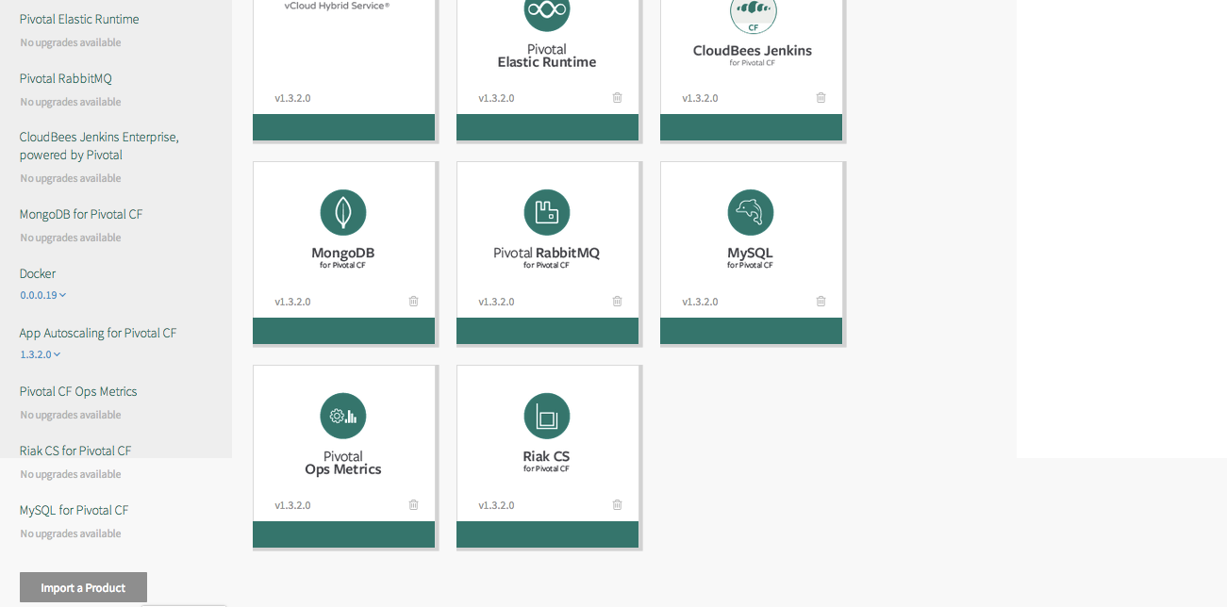


… adding a new tile
Upload a .pivotal file
p-rabbitmq-1.3.pivotal

Slide 37
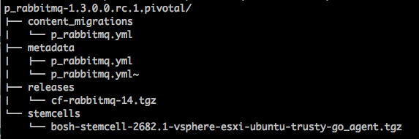
What’s inside a .pivotal file?
Ops Manager tile file
p-rabbitmq-1.3.pivotal
Migration from previous versions
Manifest template (includes tile image)
BOSH release
Stemcell

Slide 38
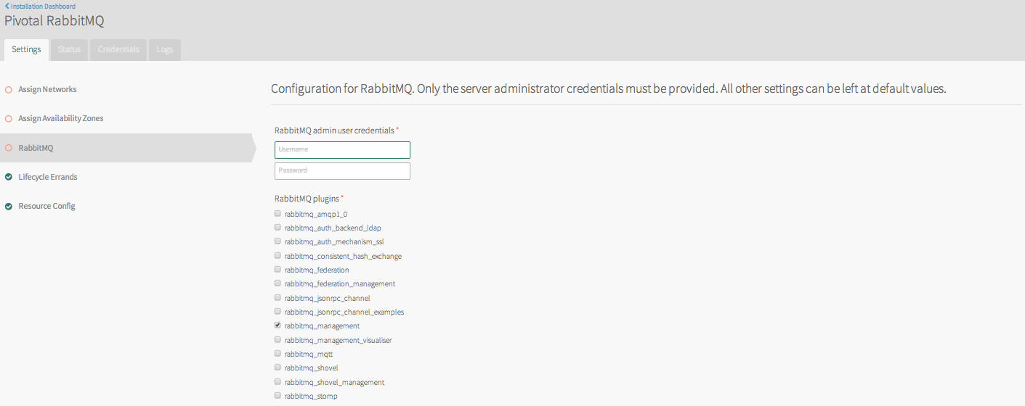
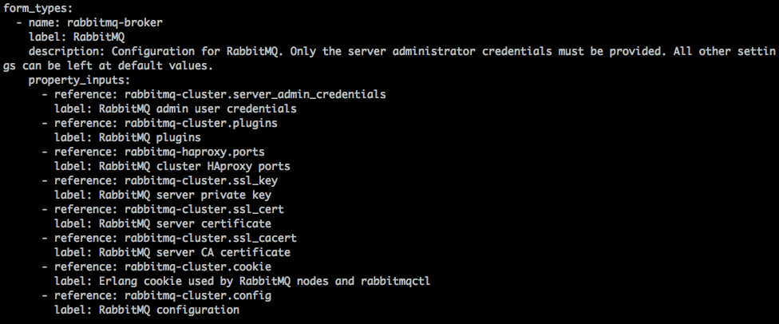
What’s inside a .pivotal file?
Ops Manager tile file
Manifest

Slide 39
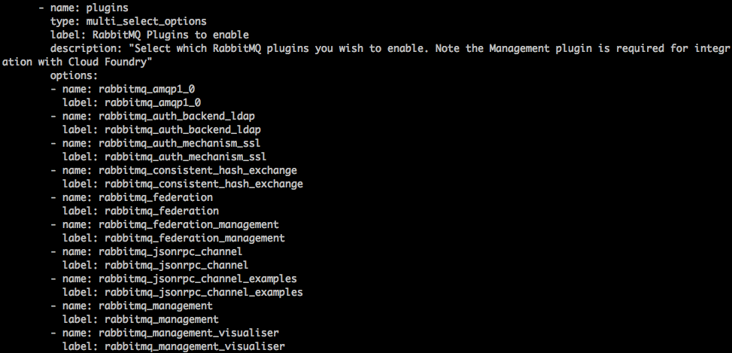
What’s inside a .pivotal file?
Ops Manager tile file
Manifest

Slide 40
Three main components of a bosh deployment
Manifest
Deployment Descriptor
Stemcell
Release
Agent
VM / Container template + Agent

Slide 41

… so what exactly is a BOSH release?
Release

Slide 42

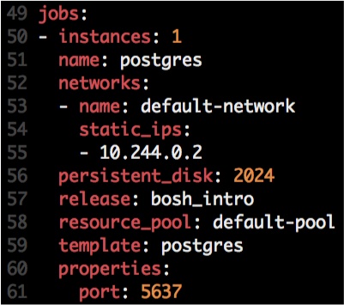



Anatomy of BOSH releases
http://docs.cloudfoundry.org/bosh/create-release.html
Release
Job
Job
Stemcell
OS Process
Monit script
OS Process
OS Process
Instantiated in runtime based on
Agent
Monit
Monit
Manifest
Monit
Example of Jobs:
DEA (CF)
CloudController (CF)
Service Broker (MySQL & Rabbit)
Locator (possible GemFire release)
Depends
src
Scripts:
Depends
Packaging
Packages
Pre-Packaging
Depends
Blobs
Depends

Slide 43

Job Creation
Deployment
Job
Stemcell
VM / Container
VM / Container
OS Process
BOSH Director
Ping
Agent
Monit
Agent
Agent
NATS
Job
Job
Ping
Health Monitor
OS Process
Monit
Compiled Packages

Slide 44

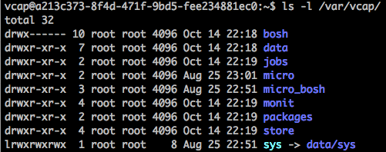
Logs
Deployment
Job
VM / Container
Stemcell
OS Process
BOSH Director
Agent
Ping
Monit
Log: /var/vcap/monit/monit.log
NATS
Job
Agent
Logs: /var/vcap/sys/logs/<job>
Health Monitor
Logs: /var/vcap/sys/logs/hm9000*.log
Compiled Packages

