Slide 1
Pivotal CF Resources
Getting Involved

Slide 2
Using Cloud Foundry
Pivotal CF Resources
 | Pivotal Web Services | Free trial account | No Ops Mgr Cannot add service brokers 3rd Party Services (no PHD, Mobile, etc) | http://run.pivotal.io
 | vSphere / vCloud Air (formerly vCHS) | Download Pivotal CF distributions and add on services for a 60 day free trial | Complete PCF environment and set of services | http://network.pivotal.io
 | Local (OSS) | Local install into a VM using vagrant and bosh | No Ops Mgr Substantial learning curve If you learn bosh, you can deploy the full suite of PCF services | https://github.com/cloudfoundry/bosh-lite

Slide 3

Additional Learning
Pivotal CF Resources
http://academy.pivotal.io/

Slide 4


Documentation and Help
Pivotal CF Resources
 | All of the documentation for every Pivotal product | http://docs.pivotal.io
 |  Pivotal Support for all licensed products | http://support.pivotal.io
 | Home of the CF Foundation & the OSS project | http://cloudfoundry.org
 |  Mailing list for OSS CF developers | https://groups.google.com/a/cloudfoundry.org/forum/#!forum/vcap-dev
 |  Mailing list for Bosh developers | https://groups.google.com/a/cloudfoundry.org/forum/#!forum/bosh-dev
 |  Mailing list for Bosh users | https://groups.google.com/a/cloudfoundry.org/forum/#!forum/bosh-users

Slide 5

Code Resources & Demos
Pivotal CF Resources
https://github.com/cloudfoundry
The OSS repository containing all of the core CF code along
with associated projects.
https://github.com/cloudfoundry-samples
Sample applications leveraging a wide range of technologies
contributed by the community
https://github.com/cloudfoundry-community
Resources for extending CF & building applications
contributed by the community

Slide 6

















Demos & Industry Videos
Pivotal CF Resources
https://www.youtube.com/user/CloudFoundry
Product demos, sample applications, competitive
comparison and more

Slide 7
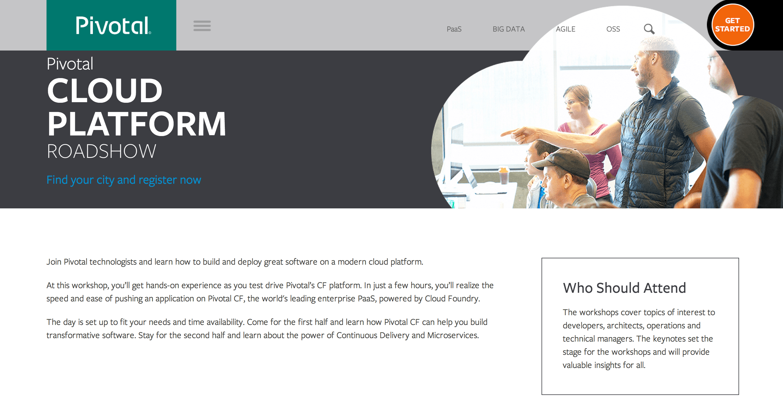
http://pivotal.io/platform-as-a-service/cloud-platform-roadshow

Slide 8
Contact your local Pivotal Team!

Slide 9


