Slide 1
Cloud Foundry Technical Overview
HA Proxy
ELASTIC RUNTIME
Dynamic Router
ROUTING
OAuth 2.0 (UAA)
Login Server
AUTHENTICATION &
AUTHORIZATION
Cloud Controller
Health Manager
APP LIFECYCLE
Message Bus (NATS)
MESSAGING
Service Brokers
App Execution (DEA)
Blob Store
Warden
APP EXECUTION &
STORAGE
Build packs
Syslog
Collector
App Log
METRICS &
LOGGING
Ops Manager & BOSH

Slide 2
Goal:
Cloud Foundry Technical Overview
To understand the major components of Cloud Foundry and how they contribute to:
HA Proxy
ELASTIC RUNTIME
Dynamic Router
ROUTING
OAuth 2.0 (UAA)
Login Server
AUTHENTICATION &
AUTHORIZATION
Cloud Controller
Health Manager
APP LIFECYCLE
Message Bus (NATS)
MESSAGING
The Core Tenets of Pivotal Cloud Foundry:
Service Brokers
App Execution (DEA)
Blob Store
Warden
APP EXECUTION &
STORAGE
Build packs
Syslog
Collector
App Log
The 4 levels of High Availability
METRICS &
LOGGING
Ops Manager & BOSH
What about Diego, Lattice & CF?

Slide 3


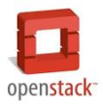


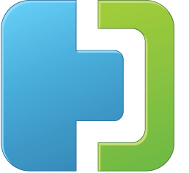
Core Tenets of Pivotal Cloud Foundry
The Enterprise Platform as a Service
Radically Simple, Developer Friendly
Broad Ecosystem Services
Operational Benefits for Every Application
Push an app and “it just works”
Build applications that consume increasing amounts of data, supporting wide ranging use cases
Support new application patterns like Microservices
Highly scalable, self healing
Logging and audit trail requirements
Existing enterprise policies on user access & authorization
Application Monitoring and Operational metrics
Application Uptime SLAs
Data Services
App Services
Mobile Services
Easy to add and customize
Deploy, Operate, Update & Scale with minimal downtime on Any IaaS
….and more
Notes:
And finally, Pivotal CF aligns all 3 of these pillars (Dev, Services and Ops) with a common model for deployment, operations, and scale on any IaaS without changes in the application. This offers the customer a converged platform to build --- as IDC calls it -- 3rd platform applications combining cloud, mobile, big data and social. This enables the new frontier to compete via software.
CFOs and CIOs love Pivotal CF because with Enterprise, private PaaS you can unlock the investment in your own data center infrastructure as well as leverage public clouds. You can turn your own private data center into this next generation platform to speed innovation.
Pivotal CF is multi-cloud which means you don’t have to decide at development time which cloud your app will run on. And you can move apps dynamically to the best cloud for the app, based on price, security, SLAs. Today, development on current IaaS means you build vendor-specific infrastructure calls into each app. Conversely, with Pivotal CF, the multi-cloud portability gives you freedom to move clouds and ensures you don’t get locked in as you build, or to go with lower cost or other best fit criteria. Pivotal CF does this by abstracting the IaaS layer from each provider with 14 API calls.
Here’s a good cost/opportunity example: Do you recall why Amazon dropped their prices by 45% last year? Because the day before, Google had announced their price drop of 50%. So as a CFO, you want to take advantage of any price war and not have to choose ahead of time. You want to have the flexibility, to not only take advantage of your dc but take advantage of lowest cost public cloud as you like.
Put this 4 pillars together and you have a great value story for both application developers and cloud operators; as well as the IT Executive Buyers. Lets recap:
First for developers. The Developer experience is where PaaS historically has focused, keeping developers happy with a revolutionary faster and simpler experience of how they deploy
Second, this idea of an infinitely extensible ecosystem of Services comes to the enterprise. This Extensibility is going to keep CTOs happy because she is going to want to have rapid access to the newest technologies.
Third, Pivotal CF gives Cloud Operators a more efficient way of managing apps that abstracts them from individual VM maintenance. Built in to every app is auto scaling, auto healing, 4 levels of high availability. This makes IT Teams magnitudes more efficient and ensures that all technologies meet enterprise standards, while giving developers the flexibility they need to innovate.
And finally, CFOs and CIOs love Pivotal CF because with Enterprise, private PaaS you can unlock the investment in your own data center infrastructure as well as leverage public clouds. You can turn your own private data center into this next generation platform to speed innovation.

Slide 4
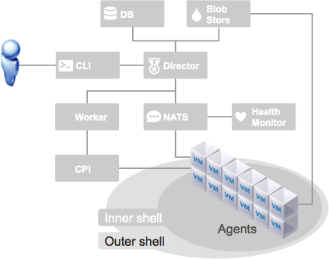
BOSH deploys and manages large scale distributed systems. It provides the means to go from deployment (i.e., Chef/Puppet) to VM creation and lifecycle management. Core to bosh is the ability to execute Canary-style deployments with zero downtime.
Ops Manager & BOSH

Slide 5

Canary Style Updates
BOSH
v1.0
v1.1
# of Canaries: 2
Ops Manager & BOSH
Max in Flight: 2

Slide 6
Canary Style Updates
BOSH
v1.0
v1.1
# of Canaries: 2
Ops Manager & BOSH
Max in Flight: 2

Slide 7

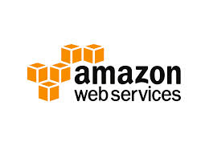


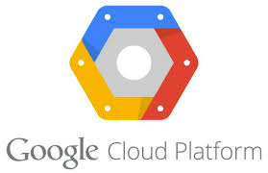
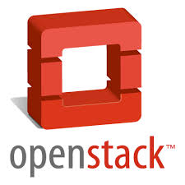
BOSH deploys and manages large scale distributed systems. It provides the means to go from deployment (i.e., Chef/Puppet) to VM creation and lifecycle management. Core to bosh is the ability to execute Canary-style deployments with zero downtime.
The Health Monitor provides lifecycle availability for all deployed VM’s and VM processes.
The Cloud Provider Interface (CPI) abstracts the underlying IaaS provider, allowing bosh deployed clusters to operate on any IaaS which has a CPI.
Ops Manager & BOSH

Slide 8
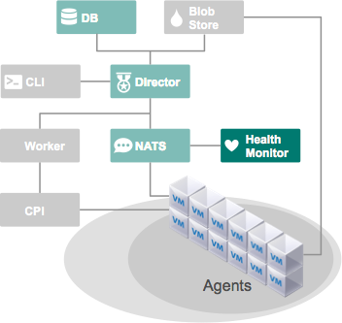
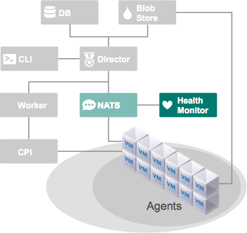

desired state
actual state
4 Levels of High Availability
cf push my-app -i 6
ELASTIC RUNTIME
Cloud Controller
Health Manager
ELASTIC RUNTIME
Message Bus (NATS)
desired state
App Execution (DEA)
App Execution (DEA)
DEA
DEA
DEA
my-app
my-app
actual state
my-app
my-app
my-app
my-app
Blob Store
AZ-1
AZ-2

Slide 9
Failed VMs are Recovered
4 Levels of High Availability
desired state
actual state

Slide 10
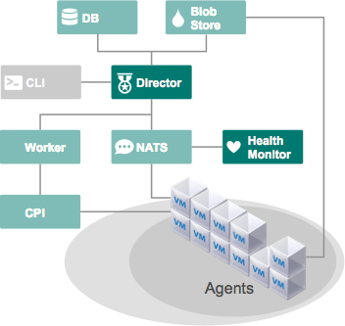
Failed VMs are Recovered
4 Levels of High Availability
→
desired state
actual state

Slide 11
Failed VMs are Recovered
4 Levels of High Availability
desired state
actual state

Slide 12
4 Levels of High Availability
desired state
actual state
Failed VMs are Recovered
cf push my-app -i 6
ELASTIC RUNTIME
Cloud Controller
Health Manager
ELASTIC RUNTIME
Message Bus (NATS)
desired state
App Execution (DEA)
App Execution (DEA)
DEA
DEA
DEA
my-app
my-app
actual state
my-app
my-app
my-app
my-app
Blob Store
AZ-1
AZ-2

Slide 13
Failed Processes are Recovered
4 Levels of High Availability
→

Slide 14
4 Levels of High Availability
desired state
actual state
Failed VMs are Recovered
Failed Processes are Recovered
cf push my-app -i 6
ELASTIC RUNTIME
Cloud Controller
Health Manager
ELASTIC RUNTIME
Message Bus (NATS)
desired state
App Execution (DEA)
App Execution (DEA)
DEA
DEA
DEA
my-app
my-app
actual state
my-app
my-app
my-app
my-app
Blob Store
AZ-1
AZ-2

Slide 15

BOSH deploys and manages large scale distributed systems. It provides the means to go from deployment (i.e., Chef/Puppet) to VM creation and lifecycle management. Core to bosh is the ability to execute Canary-style deployments with zero downtime.
The Health Monitor provides lifecycle availability for all deployed VM’s and VM processes.
The Cloud Provider Interface (CPI) abstracts the underlying IaaS provider, allowing bosh deployed clusters to operate on any IaaS which has a CPI.
Open Source
Ops Manager & BOSH

Slide 16
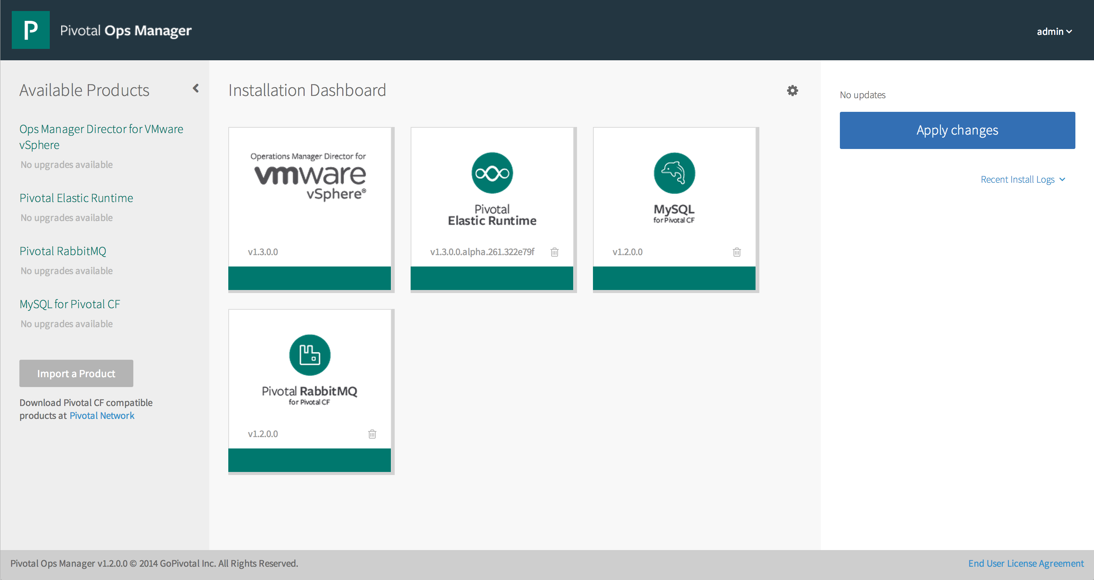


Ops Manager is a web based front end to manage Pivotal Cloud Foundry installations and associated services. Ops Manager leverages BOSH to deploy and manage clusters.
Ops Manager & BOSH

Slide 17

All Cloud Foundry traffic flows through a proxy server. CF can be fronted by the packaged HAProxy or a customer provided proxy. The proxy server is responsible for SSL termination.
HA Proxy
NATS is a fast internal messaging bus that provides system wide communication via a publish-and-subscribe mechanism.
Message Bus (NATS)
MESSAGING
Ops Manager & BOSH

Slide 18
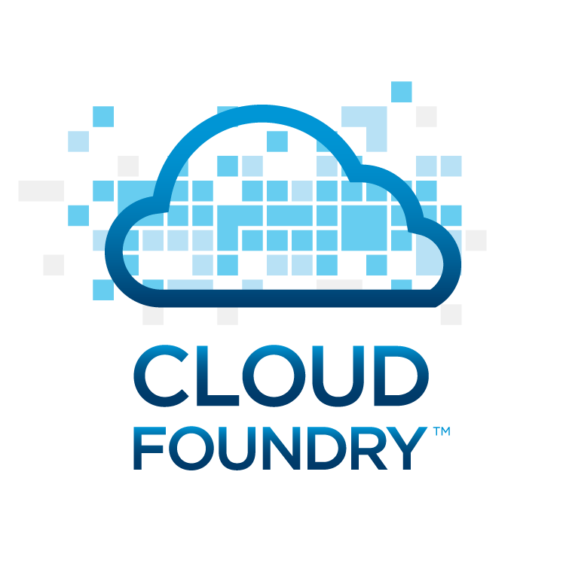
HA Proxy
ELASTIC RUNTIME
The Elastic Runtime is Cloud Foundry. It is made up a of a set of micro services that provide a comprehensive PaaS platform.
Open Source
Cloud Foundry follows the Open Core model of open source software. All elastic runtimes are the same regardless of distribution.
Ops Manager & BOSH

Slide 19
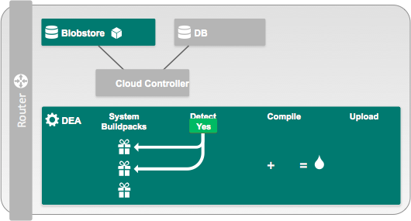
Application instances run inside of Warden containers, using a Build Pack to construct the runtime, on Droplet Execution Agent (DEA) virtual machines. Application code + Runtime = a Droplet, which is cached in the Blob Store.
HA Proxy
ELASTIC RUNTIME
Message Bus (NATS)
MESSAGING
App Execution (DEA)
Blob Store
Warden
APP EXECUTION &
STORAGE
Build packs
Ops Manager & BOSH

Slide 20
App Execution (DEA)
Blob Store
Application Density
Warden
APP EXECUTION &
STORAGE
Build packs
More Application Instances
… Less Resources!
App Instance
App Instance
App Instance
App Instance
App Instance
VM
VM
VM
VM
VM
App Instance
App Instance
App Instance
App Instance
App Instance
DEA
DEA
VM
VM
VM
VM
VM

Slide 21
App Execution (DEA)
Blob Store
Scale/Recovery Speed
Warden
APP EXECUTION &
STORAGE
Build packs
Faster scaling…
faster recovery!
App Instance
App Instance
App Instance
App Instance
App Instance
App Instance
App Instance
App Instance
App Instance
VM
VM
VM
VM
VM
App Instance
App Instance
App Instance
App Instance
Droplet
App Instance
App Instance
App Instance
App Instance
App Instance
App Instance
App Instance
BLOB STORE
DEA
DEA
VM
VM
VM
VM
VM
2-5 minutes
< 10 seconds

Slide 22


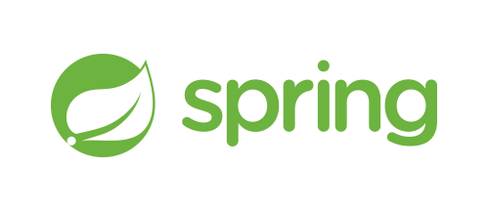








App Execution (DEA)
Blob Store
Build Packs
Warden
APP EXECUTION &
STORAGE
Build packs

Slide 23









App Execution (DEA)
Blob Store
Build Packs
Warden
APP EXECUTION &
STORAGE
Build packs
Only Pivotal Cloud Foundry build packs are
certified to operate offline

Slide 24
Application Instances Balanced across Availability Zones
4 Levels of High Availability
cf push my-app -i 6
ELASTIC RUNTIME
App Execution (DEA)
App Execution (DEA)
my-app
my-app
my-app
my-app
my-app
my-app
AZ-1
AZ-2

Slide 25
4 Levels of High Availability
desired state
actual state
Failed VMs are Recovered
Failed Processes are Recovered
Application Instances Balanced across Availability Zones
cf push my-app -i 6
ELASTIC RUNTIME
Cloud Controller
Health Manager
ELASTIC RUNTIME
Message Bus (NATS)
desired state
App Execution (DEA)
App Execution (DEA)
DEA
DEA
DEA
my-app
my-app
actual state
my-app
my-app
my-app
my-app
Blob Store
AZ-1
AZ-2

Slide 26
HA Proxy
ELASTIC RUNTIME
Cloud Controller
APP LIFECYCLE
The Cloud Controller handles all client requests including pushing applications. It is responsible for expected app state, state transitions, and desired convergence.
Message Bus (NATS)
MESSAGING
App Execution (DEA)
Blob Store
Warden
APP EXECUTION &
STORAGE
Build packs
Ops Manager & BOSH

Slide 27
HA Proxy
ELASTIC RUNTIME
The Health Manager monitors application uptime by listening to the NATS message bus for mismatched application states (expected vs. actual). The Cloud Controller publishes expected state and the DEAs publish actual state. State mismatches are reported to the Cloud Controller.
Cloud Controller
Health Manager
APP LIFECYCLE
Message Bus (NATS)
MESSAGING
App Execution (DEA)
Blob Store
Warden
APP EXECUTION &
STORAGE
Build packs
Ops Manager & BOSH

Slide 28
Failed Application Instances are Recovered
4 Levels of High Availability
ELASTIC RUNTIME
Health Manager
Cloud Controller
Message Bus (NATS)
desired state
actual state
DEA
DEA
DEA
Blob Store

Slide 29
Failed Application Instances are Recovered
4 Levels of High Availability
ELASTIC RUNTIME
Health Manager
Cloud Controller
Message Bus (NATS)
desired state
actual state
DEA
DEA
DEA
X
Blob Store

Slide 30
Failed Application Instances are Recovered
4 Levels of High Availability
ELASTIC RUNTIME
Health Manager
Cloud Controller
Message Bus (NATS)
desired state
actual state
DEA
DEA
DEA
Blob Store

Slide 31
4 Levels of High Availability
desired state
actual state
Failed VMs are Recovered
Failed Processes are Recovered
Application Instances Balanced across Availability Zones
Failed Application Instances are Recovered
cf push my-app -i 6
ELASTIC RUNTIME
Cloud Controller
Health Manager
ELASTIC RUNTIME
Message Bus (NATS)
desired state
App Execution (DEA)
App Execution (DEA)
DEA
DEA
DEA
my-app
my-app
actual state
my-app
my-app
my-app
my-app
Blob Store
AZ-1
AZ-2

Slide 32
HA Proxy
ELASTIC RUNTIME
User Authorization and Authentication provides identity, security and authorization services. It manages third party Oauth 2.0 access credentials and can provide application access and identity-as-a-service for apps running on Cloud Foundry.
The Login Server can leverage external LDAP sources, including Active Directory, for authentication.
OAuth 2.0 (UAA)
Login Server
AUTHENTICATION &
AUTHORIZATION
Cloud Controller
Health Manager
APP LIFECYCLE
Message Bus (NATS)
MESSAGING
App Execution (DEA)
Blob Store
Warden
APP EXECUTION &
STORAGE
Build packs
Ops Manager & BOSH

Slide 33
HA Proxy
ELASTIC RUNTIME
Dynamic Router
ROUTING
OAuth 2.0 (UAA)
Login Server
AUTHENTICATION &
AUTHORIZATION
The router shapes and routes all external system traffic (HTTP/API) and application traffic from the internet/intranet. It maintains a dynamic routing table for each load-balanced app instance with IP addresses and ports.
Cloud Controller
Health Manager
APP LIFECYCLE
Message Bus (NATS)
MESSAGING
App Execution (DEA)
Blob Store
Warden
APP EXECUTION &
STORAGE
Build packs
Ops Manager & BOSH

Slide 34
Blue/Green deployments
HA Proxy
ELASTIC RUNTIME
cf push Blue -n demo-time
Dynamic Router
ROUTING
OAuth 2.0 (UAA)
Login Server
AUTHENTICATION &
AUTHORIZATION
Dynamic Router
Blue
Cloud Controller
Health Manager
APP LIFECYCLE
demo-time.example.com
Message Bus (NATS)
MESSAGING
App Execution (DEA)
Blob Store
Warden
APP EXECUTION &
STORAGE
Build packs
Ops Manager & BOSH

Slide 35
Blue/Green deployments
HA Proxy
ELASTIC RUNTIME
cf push Green -n demo-time-temp
ROUTING
OAuth 2.0 (UAA)
Login Server
AUTHENTICATION &
AUTHORIZATION
Dynamic Router
Blue
Cloud Controller
Health Manager
APP LIFECYCLE
demo-time.example.com
Message Bus (NATS)
MESSAGING
App Execution (DEA)
Blob Store
Warden
APP EXECUTION &
STORAGE
demo-time-temp.example.com
Build packs
Green
Ops Manager & BOSH

Slide 36
Blue/Green deployments
HA Proxy
ELASTIC RUNTIME
cf map-route Green example.com -n demo-time
ROUTING
OAuth 2.0 (UAA)
Login Server
AUTHENTICATION &
AUTHORIZATION
Dynamic Router
Blue
Cloud Controller
Health Manager
APP LIFECYCLE
demo-time.example.com
Message Bus (NATS)
MESSAGING
App Execution (DEA)
Blob Store
Warden
APP EXECUTION &
STORAGE
demo-time-temp.example.com
Build packs
demo-time.example.com
Green
Ops Manager & BOSH

Slide 37
Blue/Green deployments
HA Proxy
ELASTIC RUNTIME
cf unmap-route Blue example.com -n demo-time
ROUTING
OAuth 2.0 (UAA)
Login Server
AUTHENTICATION &
AUTHORIZATION
Dynamic Router
Blue
Cloud Controller
Health Manager
APP LIFECYCLE
demo-time.example.com
Message Bus (NATS)
MESSAGING
App Execution (DEA)
Blob Store
Warden
APP EXECUTION &
STORAGE
demo-time-temp.example.com
Build packs
demo-time.example.com
Green
Ops Manager & BOSH

Slide 38
Blue/Green deployments
HA Proxy
ELASTIC RUNTIME
cf unmap-route Green example.com -n demo-time-temp
ROUTING
OAuth 2.0 (UAA)
Login Server
AUTHENTICATION &
AUTHORIZATION
Dynamic Router
Blue
Cloud Controller
Health Manager
APP LIFECYCLE
Message Bus (NATS)
MESSAGING
App Execution (DEA)
Blob Store
Warden
APP EXECUTION &
STORAGE
demo-time-temp.example.com
Build packs
demo-time.example.com
Green
Ops Manager & BOSH

Slide 39
HA Proxy
ELASTIC RUNTIME
Dynamic Router
ROUTING
OAuth 2.0 (UAA)
Login Server
AUTHENTICATION &
AUTHORIZATION
The router shapes and routes all external system traffic (HTTP/API) and application traffic from the internet/intranet. It maintains a dynamic routing table for each load-balanced app instance with IP addresses and ports.
Cloud Controller
Health Manager
APP LIFECYCLE
Message Bus (NATS)
MESSAGING
App Execution (DEA)
Blob Store
Warden
APP EXECUTION &
STORAGE
Build packs
Ops Manager & BOSH

Slide 40
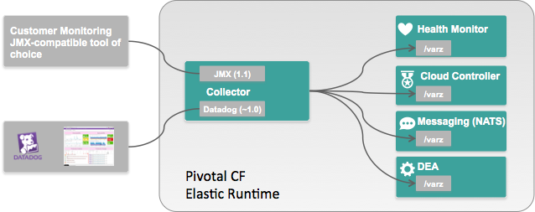
HA Proxy
ELASTIC RUNTIME
Dynamic Router
ROUTING
OAuth 2.0 (UAA)
Login Server
AUTHENTICATION &
AUTHORIZATION
Cloud Controller
Health Manager
APP LIFECYCLE
Message Bus (NATS)
MESSAGING
App Execution (DEA)
Blob Store
Warden
APP EXECUTION &
STORAGE
Build packs
Collector
METRICS &
LOGGING
Ops Manager & BOSH

Slide 41
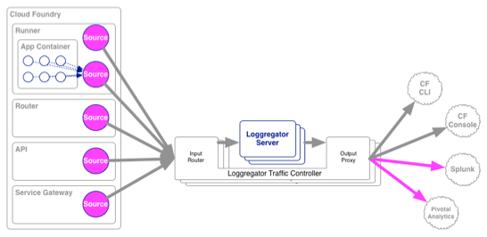
HA Proxy
ELASTIC RUNTIME
Dynamic Router
ROUTING
OAuth 2.0 (UAA)
Login Server
AUTHENTICATION &
AUTHORIZATION
Cloud Controller
Health Manager
APP LIFECYCLE
Message Bus (NATS)
MESSAGING
App Execution (DEA)
Blob Store
Warden
APP EXECUTION &
STORAGE
Build packs
Syslog
Collector
App Log
METRICS &
LOGGING
Ops Manager & BOSH
https://www.youtube.com/watch?v=rk_K_AAHEEI

Slide 42
HA Proxy
ELASTIC RUNTIME
Dynamic Router
ROUTING
OAuth 2.0 (UAA)
Login Server
AUTHENTICATION &
AUTHORIZATION
Cloud Controller
Health Manager
APP LIFECYCLE
Message Bus (NATS)
MESSAGING
Service Brokers
App Execution (DEA)
Blob Store
Warden
APP EXECUTION &
STORAGE
Build packs
Syslog
Collector
App Log
METRICS &
LOGGING
Ops Manager & BOSH

Slide 43
Service: An external application dependency made available in the platform (database, message queue, rest endpoint, etc)
HA Proxy
ELASTIC RUNTIME
Service Plan (catalog): The profile of available offerings for a service, often tiered in nature (i.e. 250MB Redis Service allowing 10 concurrent connections)
Dynamic Router
ROUTING
OAuth 2.0 (UAA)
Login Server
AUTHENTICATION &
AUTHORIZATION
Cloud Controller
Health Manager
APP LIFECYCLE
Message Bus (NATS)
What is a Service?
MESSAGING
Service Brokers
App Execution (DEA)
Blob Store
Warden
Service Instance: An instantiation of a Service and Service Plan made available to applications
APP EXECUTION &
STORAGE
Build packs
Syslog
Collector
App Log
METRICS &
LOGGING
Service Binding: A binding between an application and a service instance allowing the application to leverage the instance.
Ops Manager & BOSH

Slide 44

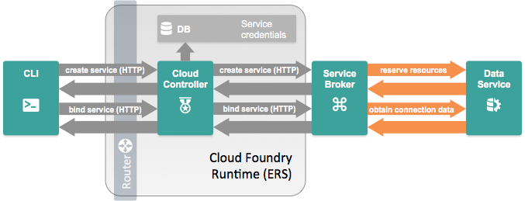
A Service Broker implements a published RESTful API and is registered with the Cloud Controller
HA Proxy
/v2/catalog [GET] – List services and plans available from this broker.
/v2/service_instances/:id [PUT] – Create/update a new service instance.
/v2/service_instances/:id [DELETE] – Delete a service instance.
/v2/service_instances/:instance_id/service_bindings/:id [PUT] – Create a new binding to a service instance.
/v2/service_instances/:instance_id/service_bindings/:id [DELETE] – Delete a service instance binding (unbind).
ELASTIC RUNTIME
Dynamic Router
ROUTING
OAuth 2.0 (UAA)
Login Server
AUTHENTICATION &
AUTHORIZATION
Cloud Controller
Health Manager
APP LIFECYCLE
Message Bus (NATS)
MESSAGING
Service Brokers
App Execution (DEA)
Blob Store
Warden
APP EXECUTION &
STORAGE
Build packs
Syslog
Collector
App Log
METRICS &
LOGGING
Ops Manager & BOSH

Slide 45
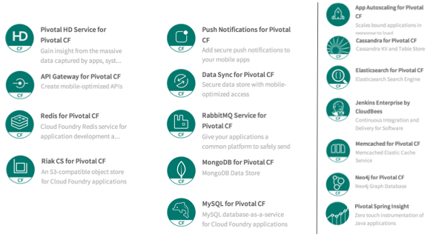
Managed Services
HA Proxy
ELASTIC RUNTIME
Dynamic Router
ROUTING
OAuth 2.0 (UAA)
Login Server
AUTHENTICATION &
AUTHORIZATION
Cloud Controller
Health Manager
APP LIFECYCLE
Message Bus (NATS)
MESSAGING
Service Brokers
App Execution (DEA)
Blob Store
Warden
APP EXECUTION &
STORAGE
Build packs
Syslog
Collector
App Log
METRICS &
LOGGING
Ops Manager & BOSH

Slide 46
HA Proxy
ELASTIC RUNTIME
Dynamic Router
ROUTING
User-provided service instances are service instances which have been provisioned outside of Cloud Foundry
Behave like other service instances once created
Familiar commands (‘create-service’) provide service instance configuration (including credentials) to applications, eliminating the need to hard code service instance endpoints
OAuth 2.0 (UAA)
Login Server
AUTHENTICATION &
AUTHORIZATION
Cloud Controller
Health Manager
APP LIFECYCLE
Message Bus (NATS)
MESSAGING
Service Brokers
App Execution (DEA)
Blob Store
Warden
APP EXECUTION &
STORAGE
Build packs
Syslog
Collector
App Log
METRICS &
LOGGING
Ops Manager & BOSH

Slide 47
Diego, Lattice & CF
re-architecting the Elastic Runtime

Slide 48
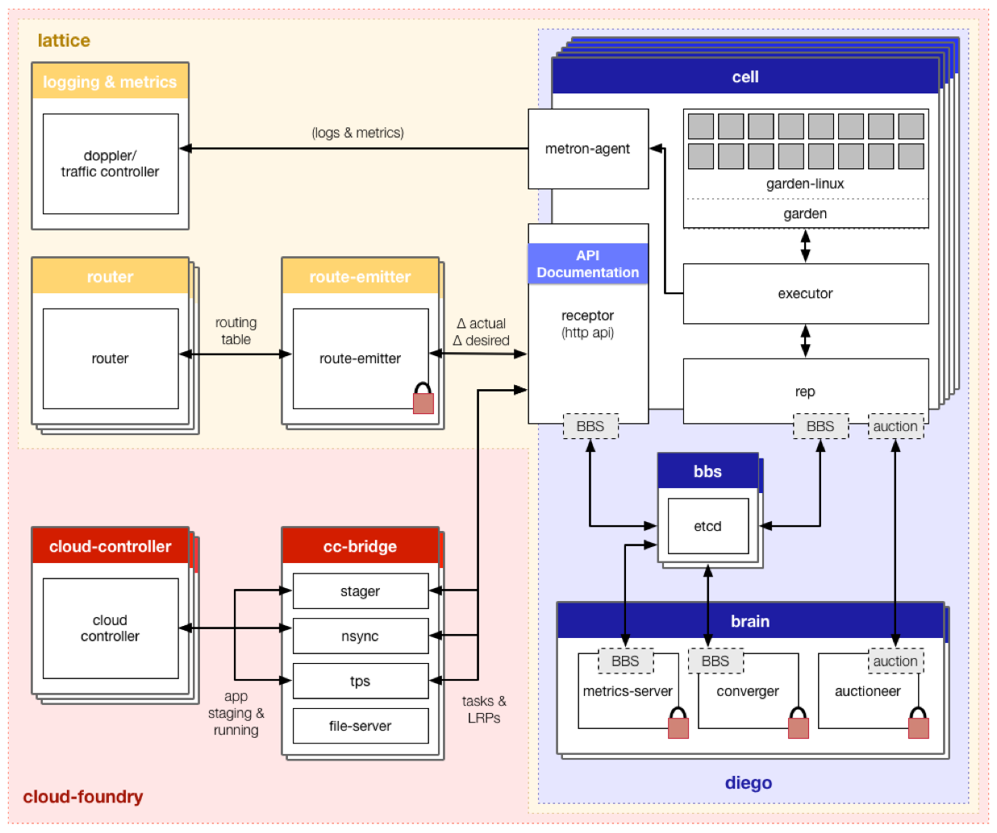

Slide 49
recap: Who can describe the Core Tenets of Pivotal Cloud Foundry?

Slide 50
Core Tenets of Pivotal Cloud Foundry
The Enterprise Platform as a Service
Radically Simple, Developer Friendly
Broad Ecosystem Services
Operational Benefits for Every Application
Push an app and “it just works”
Build applications that consume increasing amounts of data, supporting wide ranging use cases
Support new application patterns like Microservices
Highly scalable, self healing
Logging and audit trail requirements
Existing enterprise policies on user access & authorization
Application Monitoring and Operational metrics
Application Uptime SLAs
Data Services
App Services
Mobile Services
Easy to add and customize
Deploy, Operate, Update & Scale with minimal downtime on Any IaaS
….and more
Notes:
And finally, Pivotal CF aligns all 3 of these pillars (Dev, Services and Ops) with a common model for deployment, operations, and scale on any IaaS without changes in the application. This offers the customer a converged platform to build --- as IDC calls it -- 3rd platform applications combining cloud, mobile, big data and social. This enables the new frontier to compete via software.
CFOs and CIOs love Pivotal CF because with Enterprise, private PaaS you can unlock the investment in your own data center infrastructure as well as leverage public clouds. You can turn your own private data center into this next generation platform to speed innovation.
Pivotal CF is multi-cloud which means you don’t have to decide at development time which cloud your app will run on. And you can move apps dynamically to the best cloud for the app, based on price, security, SLAs. Today, development on current IaaS means you build vendor-specific infrastructure calls into each app. Conversely, with Pivotal CF, the multi-cloud portability gives you freedom to move clouds and ensures you don’t get locked in as you build, or to go with lower cost or other best fit criteria. Pivotal CF does this by abstracting the IaaS layer from each provider with 14 API calls.
Here’s a good cost/opportunity example: Do you recall why Amazon dropped their prices by 45% last year? Because the day before, Google had announced their price drop of 50%. So as a CFO, you want to take advantage of any price war and not have to choose ahead of time. You want to have the flexibility, to not only take advantage of your dc but take advantage of lowest cost public cloud as you like.
Put this 4 pillars together and you have a great value story for both application developers and cloud operators; as well as the IT Executive Buyers. Lets recap:
First for developers. The Developer experience is where PaaS historically has focused, keeping developers happy with a revolutionary faster and simpler experience of how they deploy
Second, this idea of an infinitely extensible ecosystem of Services comes to the enterprise. This Extensibility is going to keep CTOs happy because she is going to want to have rapid access to the newest technologies.
Third, Pivotal CF gives Cloud Operators a more efficient way of managing apps that abstracts them from individual VM maintenance. Built in to every app is auto scaling, auto healing, 4 levels of high availability. This makes IT Teams magnitudes more efficient and ensures that all technologies meet enterprise standards, while giving developers the flexibility they need to innovate.
And finally, CFOs and CIOs love Pivotal CF because with Enterprise, private PaaS you can unlock the investment in your own data center infrastructure as well as leverage public clouds. You can turn your own private data center into this next generation platform to speed innovation.

Slide 51
recap: Who can describe the 4 Levels of Availability in Cloud Foundry?

Slide 52
4 Levels of High Availability
desired state
actual state
Failed VMs are Recovered
Failed Processes are Recovered
Application Instances Balanced across Availability Zones
Failed Application Instances are Recovered
cf push my-app -i 6
ELASTIC RUNTIME
Cloud Controller
Health Manager
ELASTIC RUNTIME
Message Bus (NATS)
desired state
App Execution (DEA)
App Execution (DEA)
DEA
DEA
DEA
my-app
my-app
actual state
my-app
my-app
my-app
my-app
Blob Store
AZ-1
AZ-2

Slide 53
