Slide 2
Pivotal CF: Adding External Services
June 2014

Slide 3
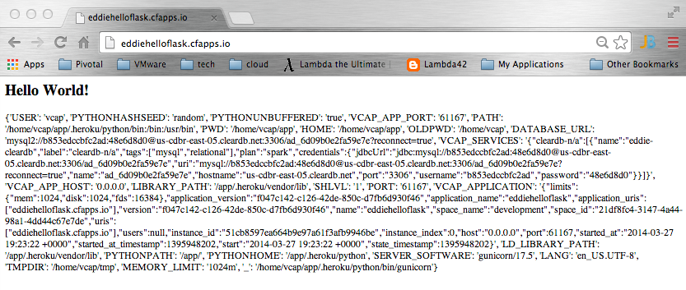
Service Connectivity Information
What does “application is bound to a service instance” mean?: VCAP_SERVICES

Slide 4
Pivotal CF
User Provided Service Instances

Slide 5
Use Cases: User Provided Service Instances
Typically legacy or existing instances of a service (databases, queues, mail, etc) where applications connect to the same instance
Credential passing when you need to inject the same credential set into an application
Notes:
Be sure to explain that even legacy and existing services can also be exposed via a Managed Service
Example: multiple applications connect to the same legacy oracle database and therefore just need connection info and credentials

Slide 6
Pivotal CF
Managed Services

Slide 7
Managed Services
Managed Services are integrated with Cloud Foundry by implementing a documented API for which the cloud controller is the client
Service Broker is a component which implements the required API.*
Service brokers advertise a catalog of service offerings and service plans to Cloud Foundry, and receive calls from the Cloud Controller for five functions: fetch catalog, create, bind, unbind, and delete.
* In CF v1, Service Brokers were called Service Gateways.

Slide 8












Cloud Foundry Architecture
Internet
Dynamic Router
The Cloud Foundry platform is abstracted as a set of large-scale distributed services. It uses Cloud Foundry Bosh to operate the underlying infrastructure from IaaS providers (e.g., VMware, Amazon AWS, OpenStack).
Cloud Controller
UAA/Login Servers
Health Manager
Service Broker Node(s)
DEA Pool
Apps
User Provided
Service Instances
Build Packs
PaaS
Logging
Components are dynamically discoverable and loosely coupled, exposing health through HTTP endpoints so agents can collect state information (app state & system state) and act on it.
Messaging (NATS)
Cloud Foundry BOSH
Underlying
Infrastructure
Notes:
Service brokers are ‘known’ to (registered with) the CC

Slide 9
Creating and Binding a Service
Developer
Service
credentials
DB
CLI
create service (HTTP)
Cloud Controller
create service (HTTP)
Service
Broker
reserve resources
Data
Service
Router
bind service (HTTP)
bind service (HTTP)
obtain connection data
Cloud Foundry
Runtime (PaaS)

Slide 10
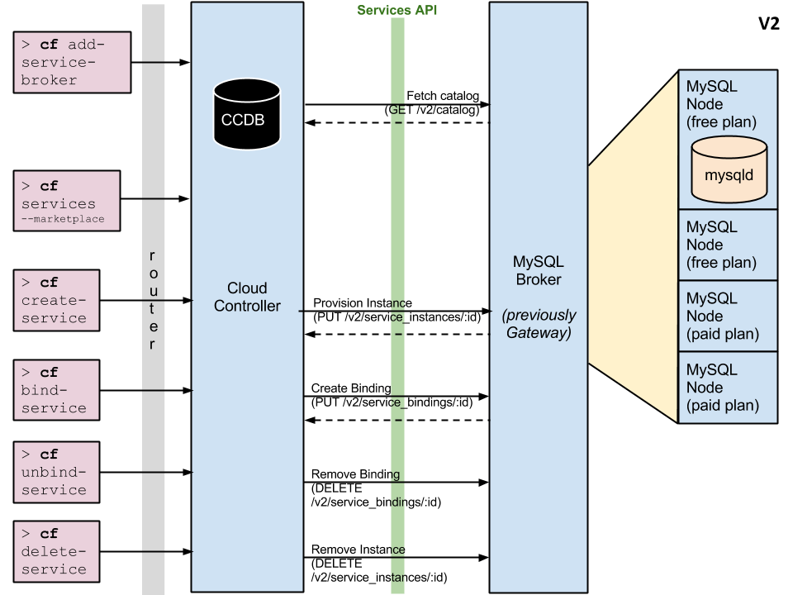
Notes:
Example: MySQL
Notice ‘PLAN’ differences

Slide 11
Server Broker API
GET /v2/catalog – List services and plans available from this broker.
PUT /v2/service_instances/:id – Create a new service instance.
PUT /v2/service_instances/:instance_id/service_bindings/:id – Create a new binding to a service instance.
DELETE /v2/service_instances/:instance_id/service_bindings/:id – Unbind from a service instance.
DELETE /v2/service_instances/:id – Delete a service instance.
Notes:
In both ‘service instance creation’ and ‘service binding creation’, org/space/plan identifiers are provided to the ‘service broker’
This allows the broker flexibility what to do
Explain ORG
Explain SPACE
Explain PLAN

Slide 12
Server Broker Registration
Make the service broker known to the Cloud Controller
cf create service-broker <broker name> <username> <password> <broker base URI>
Broker should ONLY allow access to those requestors it shared its credential with (Basic Auth)
See: http://docs.gopivotal.com/pivotalcf/services/managing-service-brokers.html#register-broker
Make ‘plans’ accessible to users in a specific org/space
Somewhat cumbersome: need to “hand parse” JSON to find service plan UUID as registered with the CC
See: http://docs.gopivotal.com/pivotalcf/services/access-control.html#make-plans-public
Need admin creds/role in order to introduce a service broker to the Cloud Controller!
Notes:
In both ‘service instance creation’ and ‘service binding creation’, org/space/plan identifiers are provided to the ‘service broker’
This allows the broker flexibility what to do

Slide 13
Service Broker Implementation
Service implementation is up to the service provider/developer.
Cloud Foundry only requires that the service provider implement the service broker API.
A broker can be implemented as a separate application, or by adding the required http endpoints to an existing service.

Slide 14
Service Broker Implementation
Best Practice: Each binding is represented by its own credentials =>
T=1: create service instance
Neither App-1 or App-2 has access to the service instance
T=2: bind App-1 to service instance
Only App-1 can access the service instance
T=3: bind App-2 to service instance
Both App-1 and App-2 have access to the service instance
T=4 unbind App-1 from service instance
Only App-2 can access the service instance

Slide 15
Service Instance Provisioning Examples
The result of provisioning varies by service type, although there are a few common actions that work for many services. For a MySQL service, provisioning could result in:
An empty dedicated mysqld process running on its own VM.
An empty dedicated mysqld process running in a lightweight container on a shared VM.
An empty dedicated mysqld process running on a shared VM.
An empty dedicated database, on an existing shared running mysqld.
A database with business schema already there.
A copy of a full database, for example a QA database that is a copy of the production database.
For non-data services, provisioning could just mean getting an account on an existing system.
Notes:
No strong semantics dictated regarding a ‘service instance’

Slide 16
Service Broker Deployment Models
Because Cloud Foundry only requires that a service implements the broker API in order to be available to Cloud Foundry end users, many deployment models are possible. The following are examples of valid deployment models:
Entire service (service backend + broker) packaged and deployed by BOSH alongside Cloud Broker packaged and deployed by BOSH alongside Cloud Foundry, rest of the service deployed and maintained by other means
Broker (and optionally service) pushed as an application to Cloud Foundry user space Foundry (this is the approach we’ll take in the lab…)
Entire service, including broker, deployed and maintained outside of Cloud Foundry by other means

Slide 17
Resources
Service Broker API: http://docs.gopivotal.com/pivotalcf/services/api.html
Managing Service Brokers: http://docs.gopivotal.com/pivotalcf/services/managing-service-brokers.html
Binding Credentials: http://docs.gopivotal.com/pivotalcf/services/binding-credentials.html
Tiny sample application: https://github.com/cloudfoundry-samples/spring-hello-env

