Slide 1
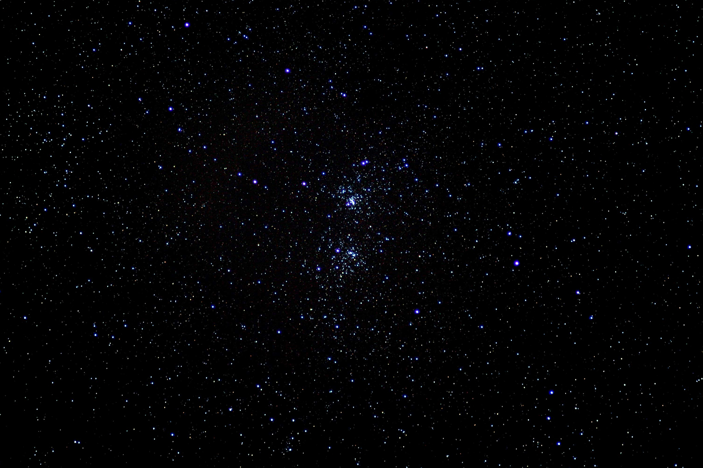

INTRODUCTION

Slide 2
What is the goal?
IDEA
REQUIRED
REQUIRED
REVENUE
IS IT ACCEPTED BY USERS ?
IMPLEMENTATION
All we are doing is looking at the timeline from the moment a cus‐
tomer gives us an order to the point when we collect the cash. And we
are reducing that timeline by removing the nonvalue-added wastes.
—Taichi Ohno
<number>

Slide 3
Planning - best of the best
100% Brilliant ideas
⅓ negative effect
⅓ no difference
10-40% positive effect
60% - 90% of ideas
<number>

Slide 4
Simplified IT project
<number>

Slide 5
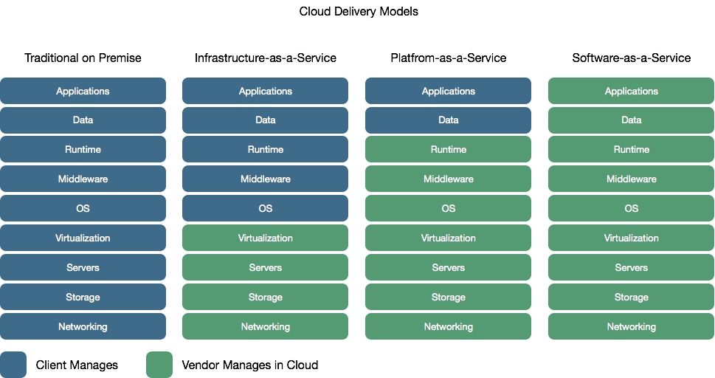
Delivery - IT operations
<number>

Slide 6
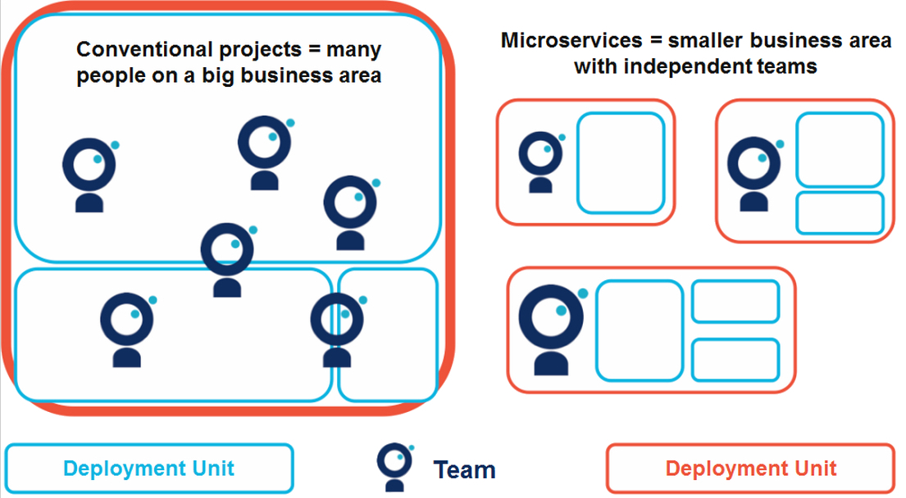
Planning - Processes and Team structure
<number>

Slide 7
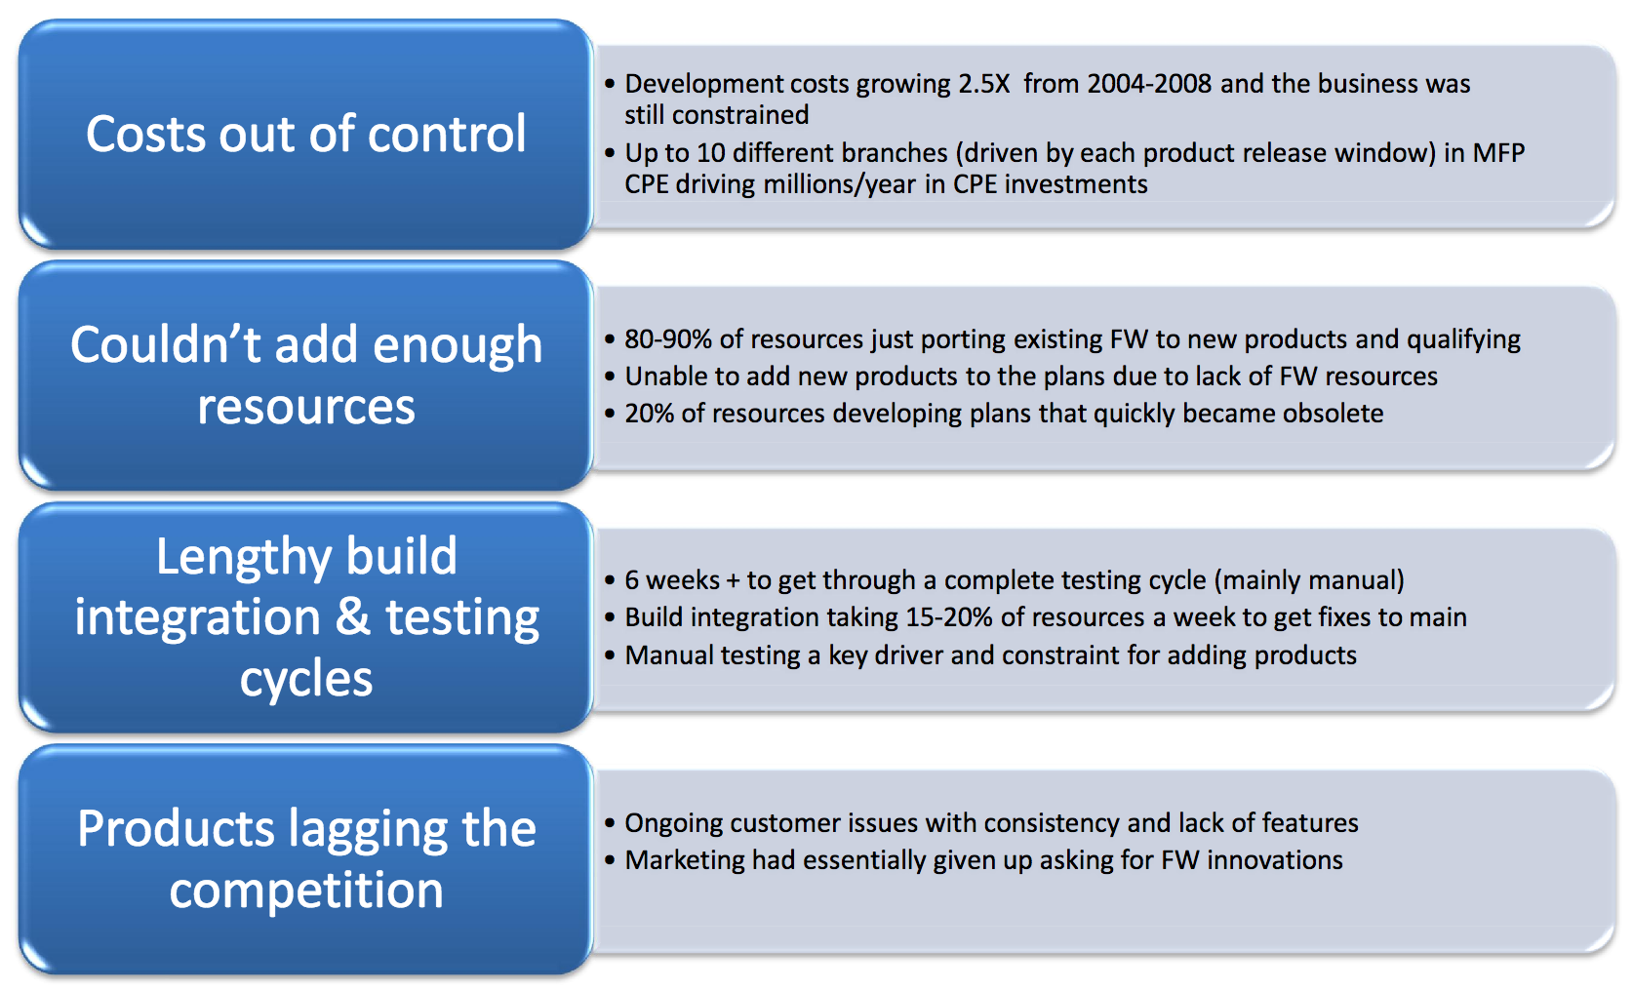
HP State of the development process - 2008
<number>

Slide 8
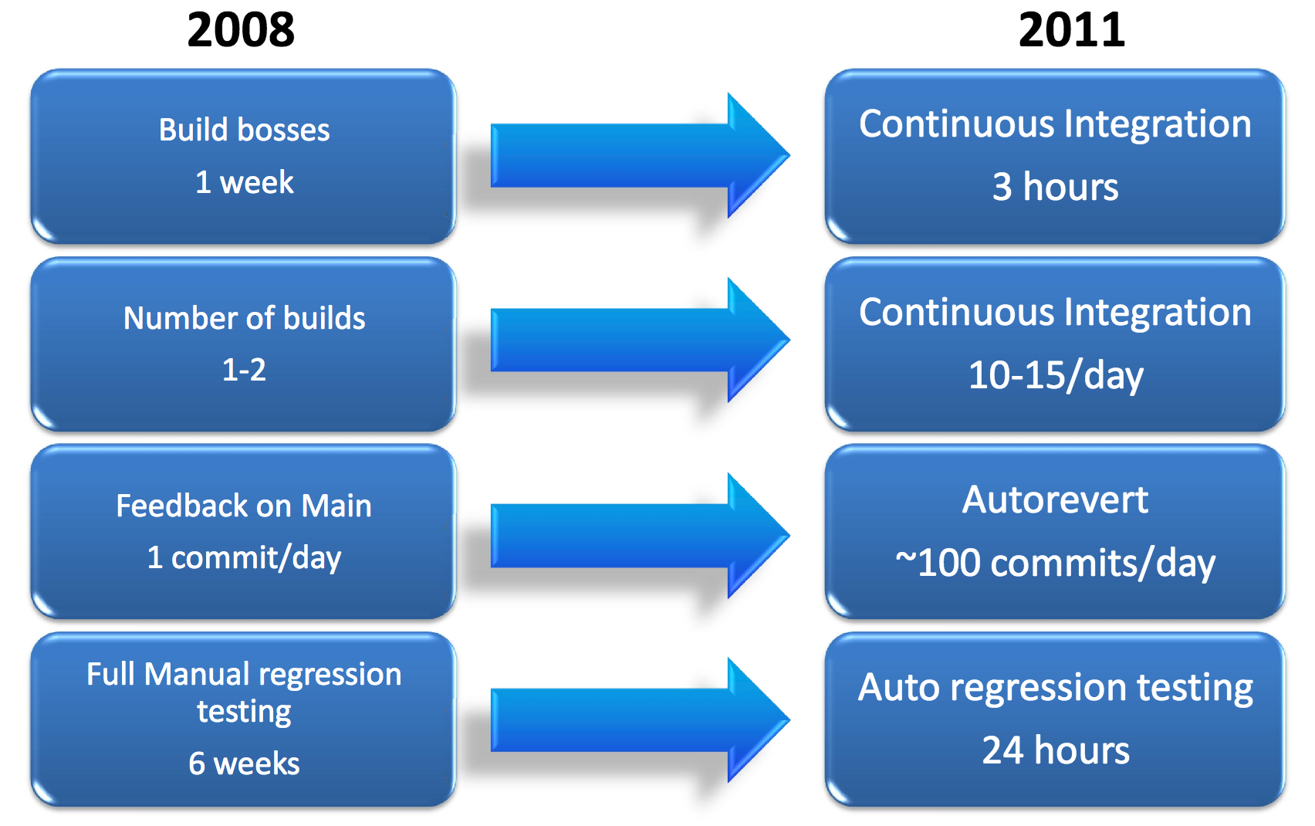
Cycle time driver improvements
<number>

Slide 9
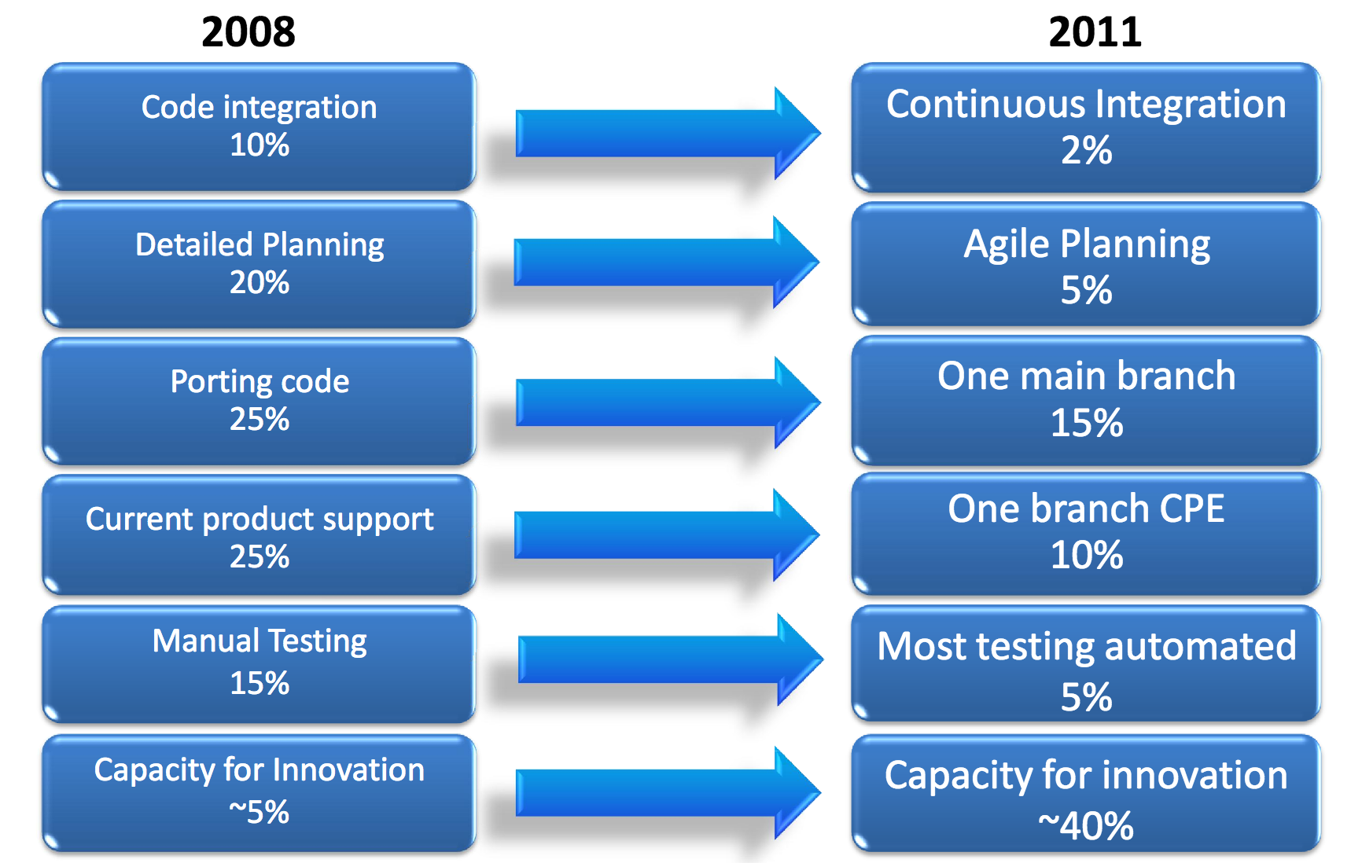
HP LaserJet Firmware Case Study
<number>

