Slide 1
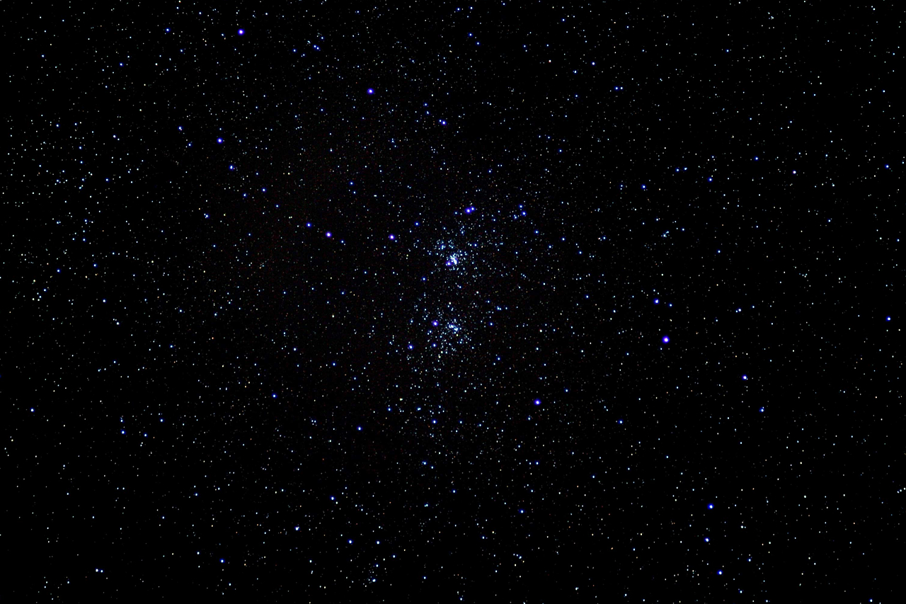

INTRODUCTION

Slide 2
https://goo.gl/LR0Zfp
REQUIRED
REQUIRED

Slide 3
What is the goal?
IDEA
REQUIRED
REQUIRED
REVENUE
IS IT ACCEPTED BY USERS ?
IMPLEMENTATION
All we are doing is looking at the timeline from the moment a cus‐
tomer gives us an order to the point when we collect the cash. And we
are reducing that timeline by removing the nonvalue-added wastes.
—Taichi Ohno

Slide 4
Planning - best of the best
100% Brilliant ideas
⅓ negative effect
⅓ no difference
10-40% positive effect
60% - 90% of ideas

Slide 5
Simplified IT project

Slide 6
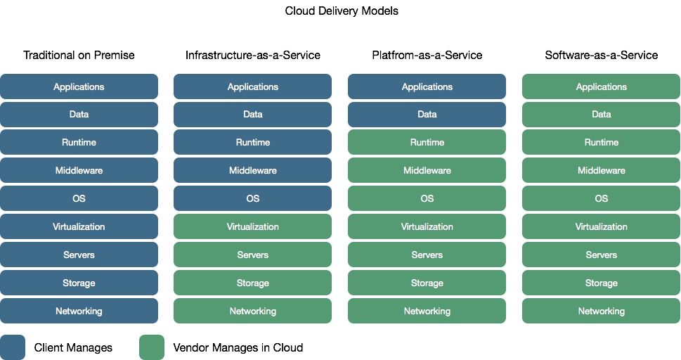
Delivery - IT operations

Slide 7
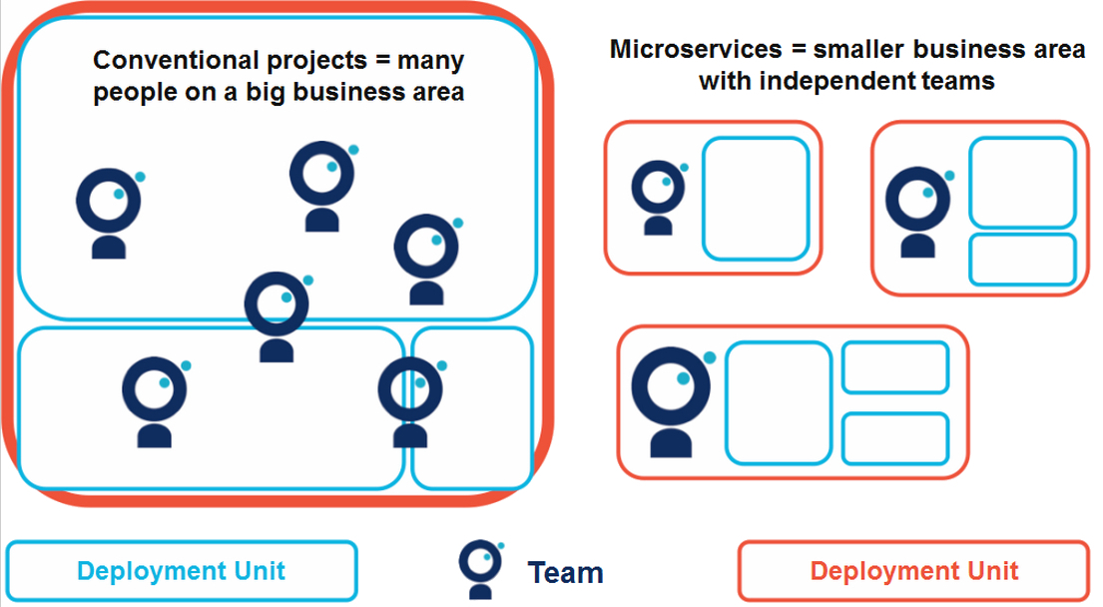
Planning - Processes and Team structure

Slide 8
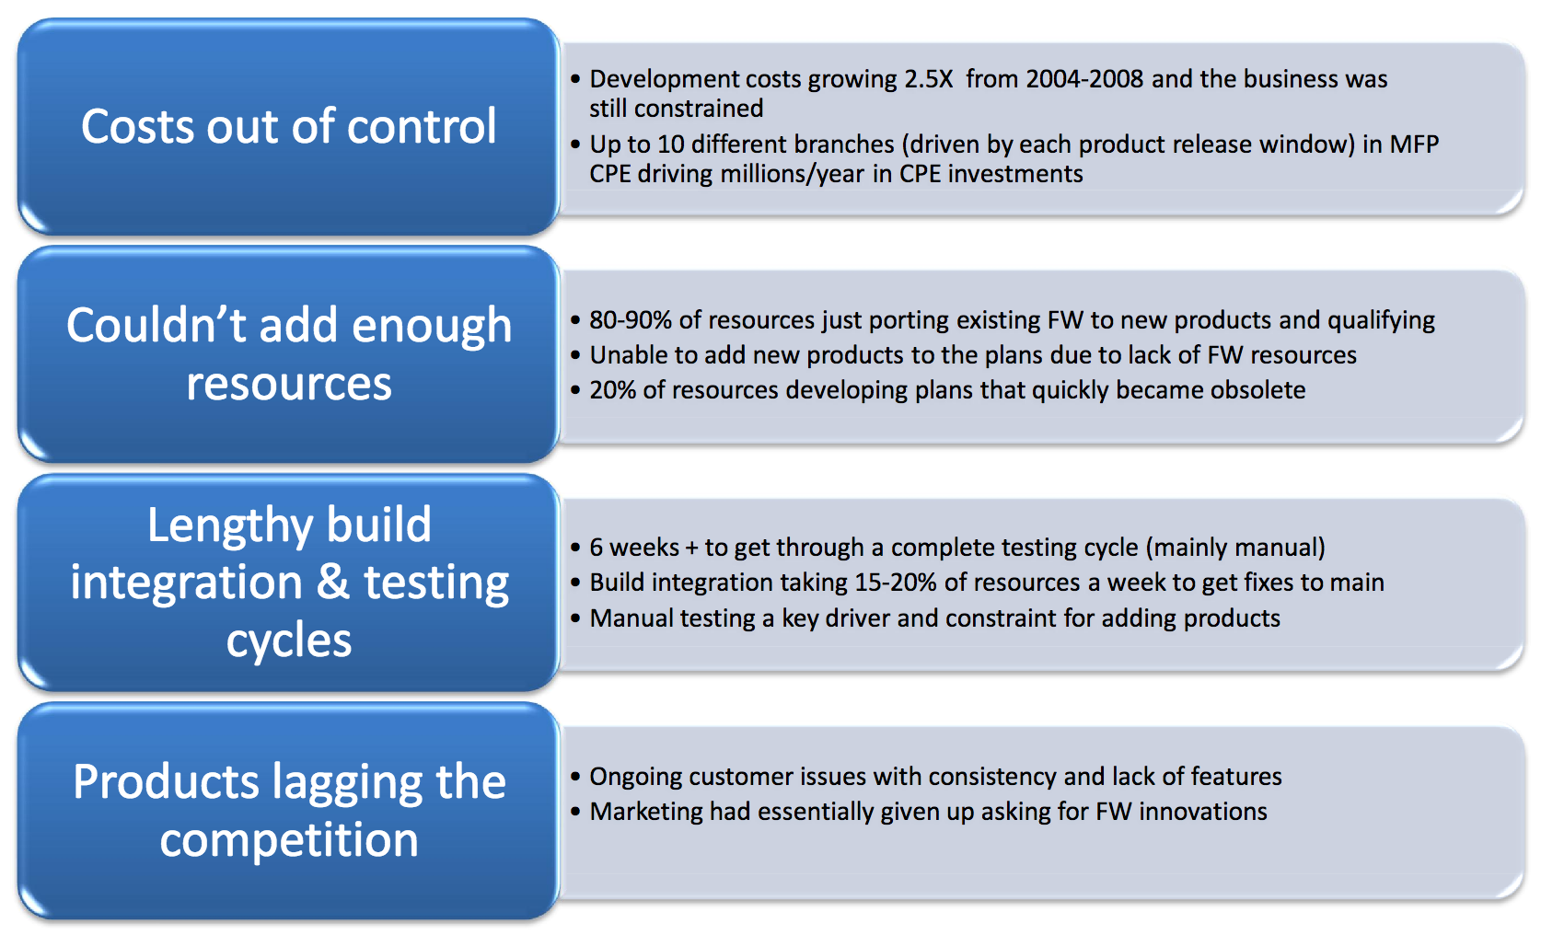
HP State of the development process - 2008

Slide 9
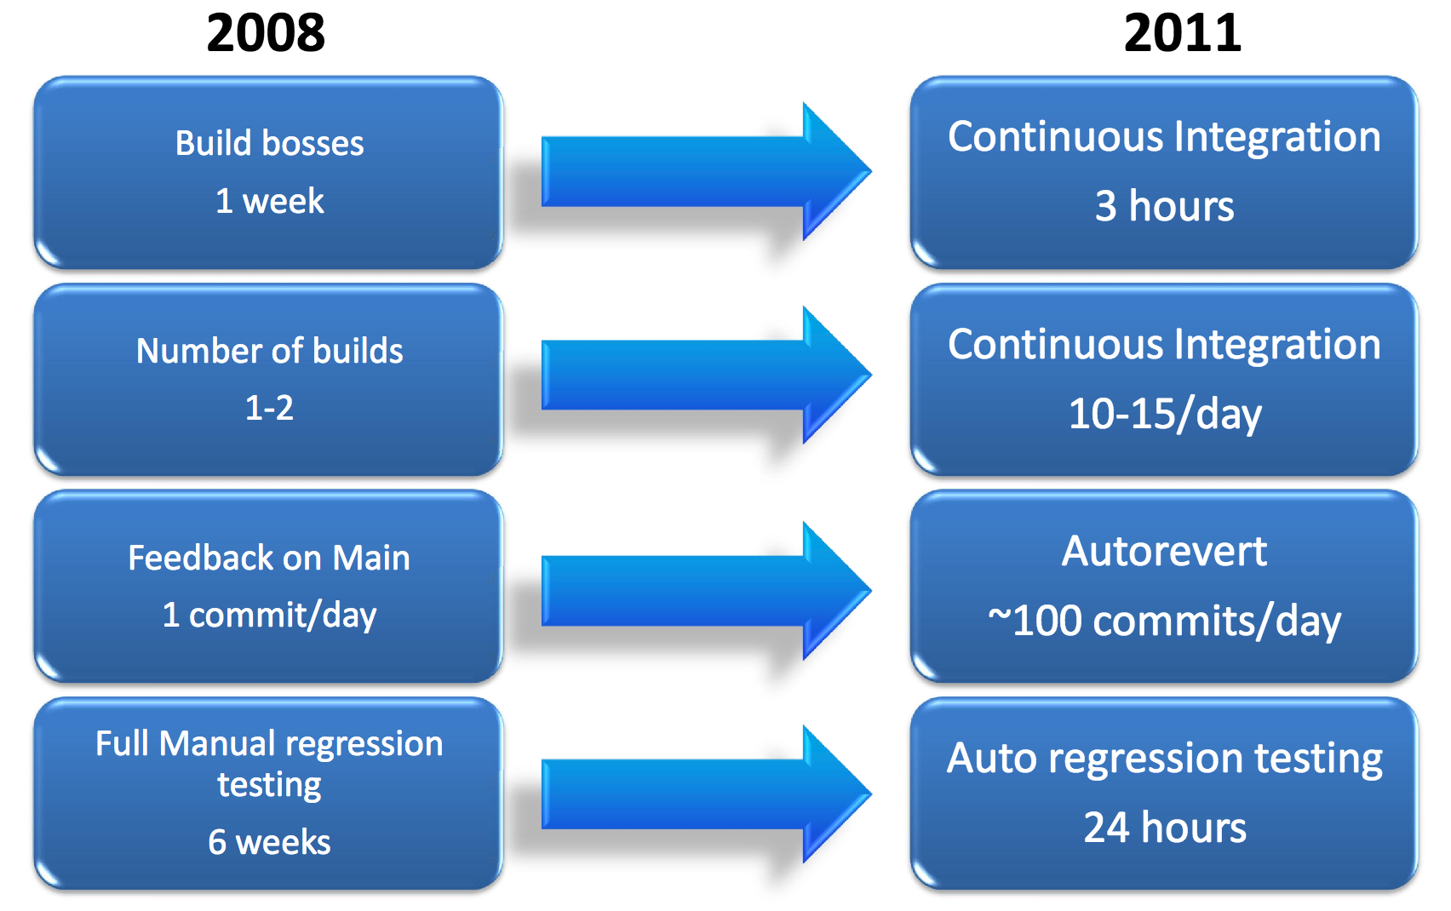
Cycle time driver improvements

Slide 10
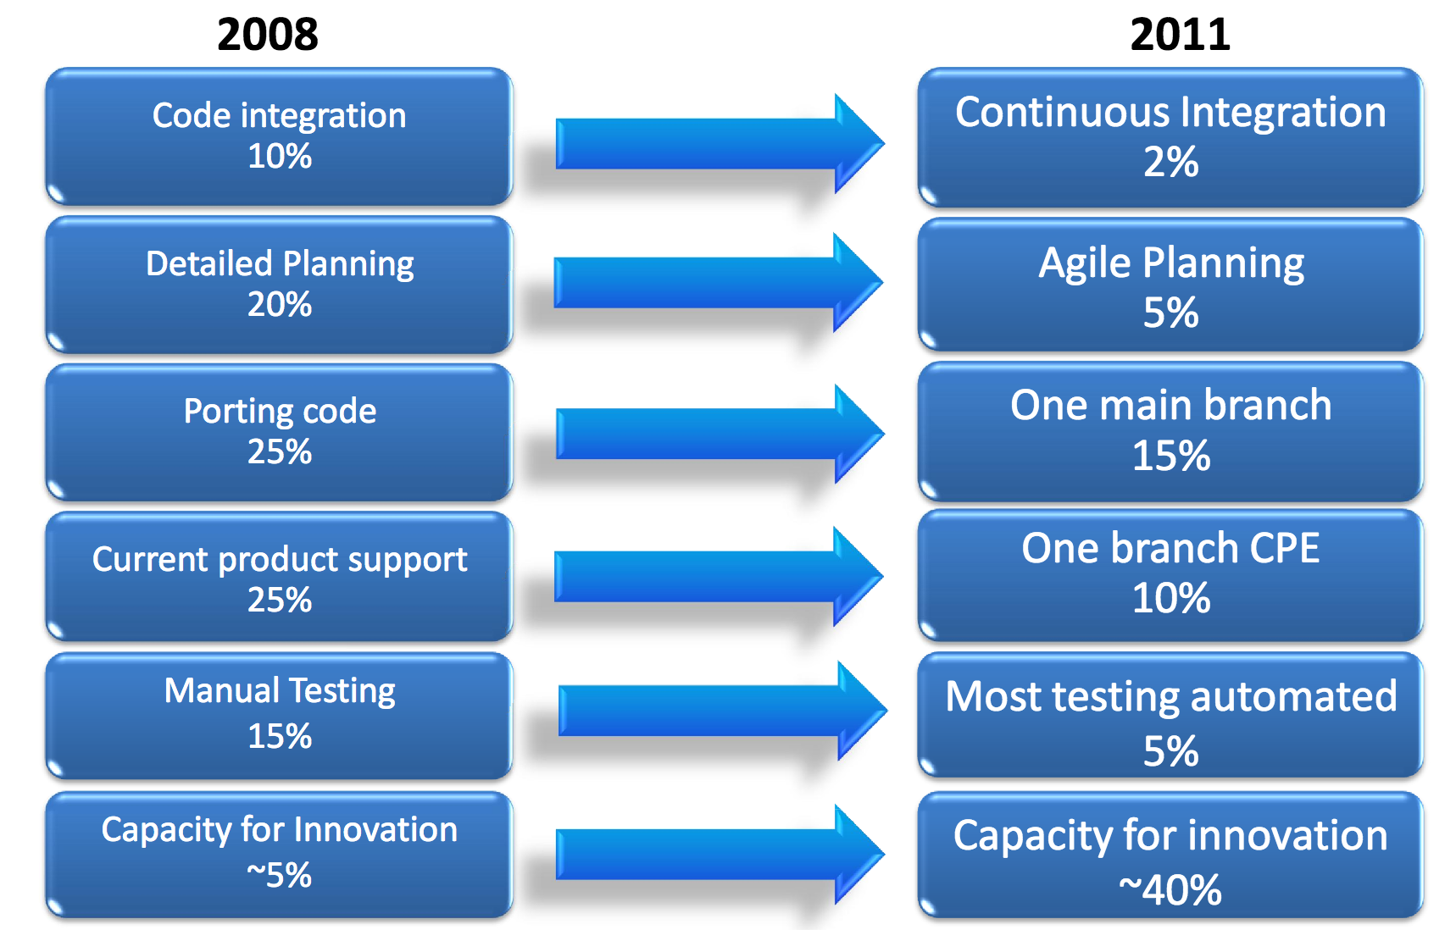
HP LaserJet Firmware Case Study

