Slide 1

Services

Slide 2
Services
Any software accessible by an application deployed in Cloud Foundry
Can be deployed inside or outside Cloud Foundry
Can be accessed through a common interface (API)
Route is added to the route table
Notes:
goal:
single platform for all devices
Increase quality and reduce the amount of stabilization
reduce planning.
PaaS is good fit for Project automatization
tests should be small.

Slide 3
Marketplace
A list of services and plans available to Cloud Foundry users
Notes:
goal:
single platform for all devices
Increase quality and reduce the amount of stabilization
reduce planning.
PaaS is good fit for Project automatization
tests should be small.

Slide 4
Service instance
An instance of a particular service, ready to be used by an application
Notes:
goal:
single platform for all devices
Increase quality and reduce the amount of stabilization
reduce planning.
PaaS is good fit for Project automatization
tests should be small.

Slide 5
Service binding
Is the process in which all the relevant data to use the service is injected through environment variables into the application’s container configuration.
Notes:
goal:
single platform for all devices
Increase quality and reduce the amount of stabilization
reduce planning.
PaaS is good fit for Project automatization
tests should be small.

Slide 6
Service Broker
A software accessible through an HTTP API that complies with Cloud Foundry’s Service Broker API specification:
https://docs.cloudfoundry.org/services/api.html
It can be developed in any programming language that can be exposed via HTTP
Contains all the logic to provision the necessary information (URL, credentials, etc) and the required resoures for the service instance required by the user.
Notes:
goal:
single platform for all devices
Increase quality and reduce the amount of stabilization
reduce planning.
PaaS is good fit for Project automatization
tests should be small.

Slide 7
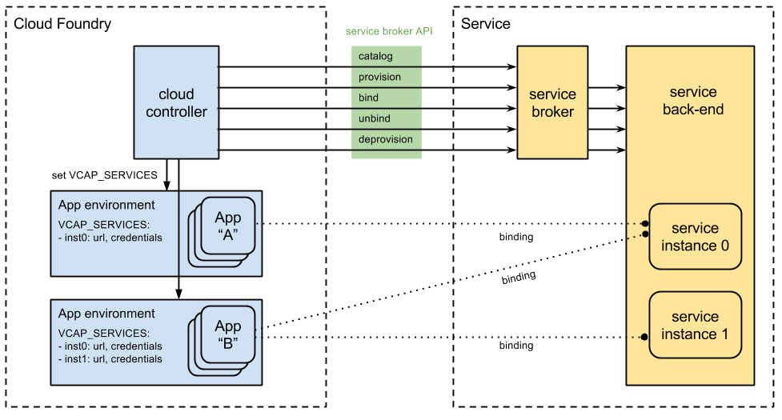
General architecture
Notes:
goal:
single platform for all devices
Increase quality and reduce the amount of stabilization
reduce planning.
PaaS is good fit for Project automatization
tests should be small.

Slide 8
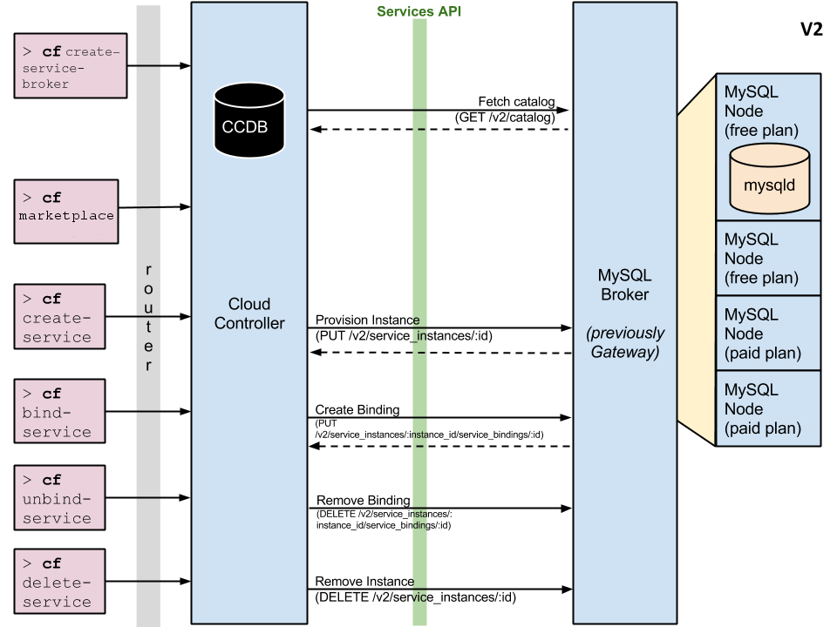
Usage workflow
Notes:
goal:
single platform for all devices
Increase quality and reduce the amount of stabilization
reduce planning.
PaaS is good fit for Project automatization
tests should be small.

