Slide 1
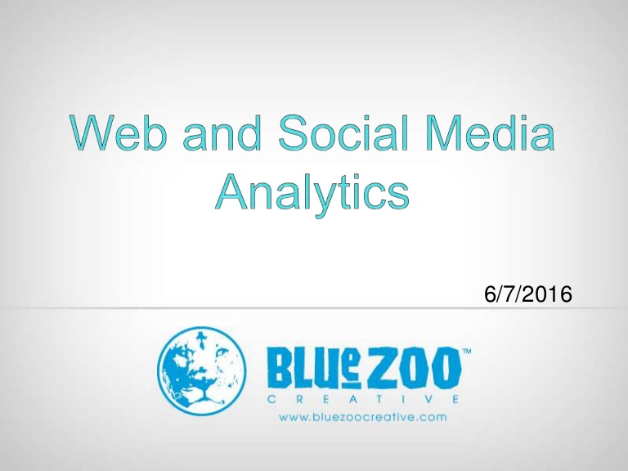
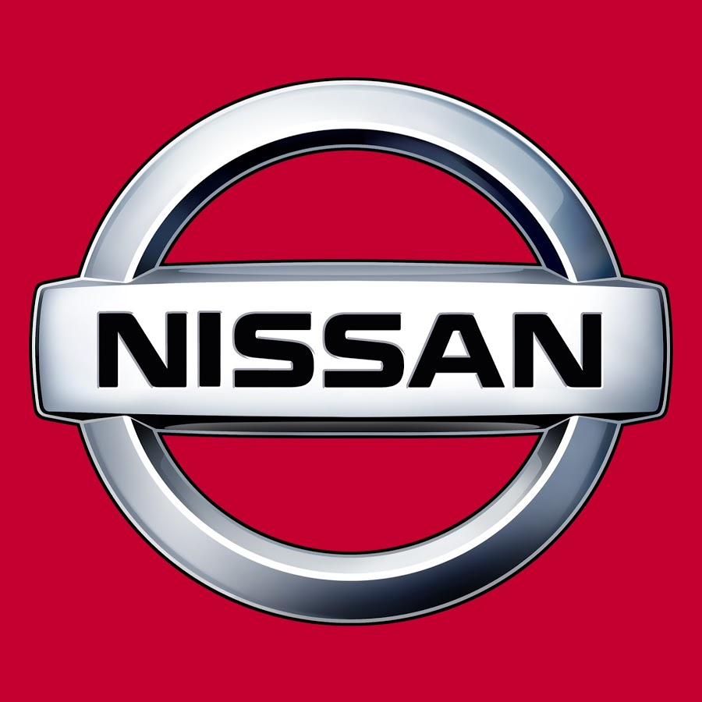
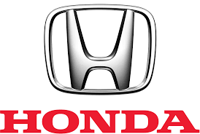

Who’s most trusted Brand? What’s social media saying? How’s Social sites defining them?
Let’s start a journey of Analytics in Auto Industry…..!
- Sandhya Kumari

Slide 2
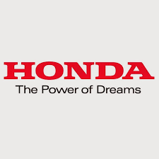
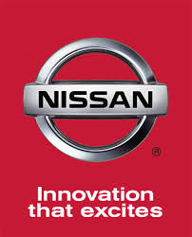
Let’s check out brief history of two auto brands!
@Honda
Founded in 1948 in Hamamatsu, Japan
Joined Twitter on May 2009.
7 continents running Honda equipment or vehicles. Yes, even Antarctica!
Slogan of Honda
@NissanMotor
Established in 1933 in Yokohama City, Japan.
Joined Twitter on November 2011
Nissan offers products and services in more than 160 countries.
Slogan of Nissan

Slide 3
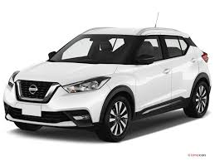
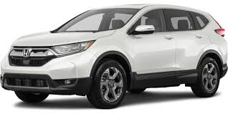
Who has most followers on Twitter?
@Honda
Tweets 202K |
Following 1,582 |
Followers 975K |
Likes 7,775
@Nissan
Tweets 7,235 |
Following 456 |
Followers 742K |
Likes 4203
Clearly, Honda is ahead with 233K followers.

Slide 4
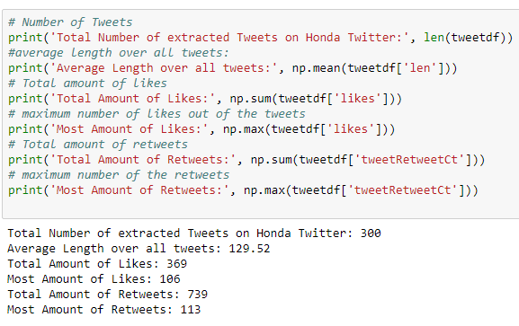
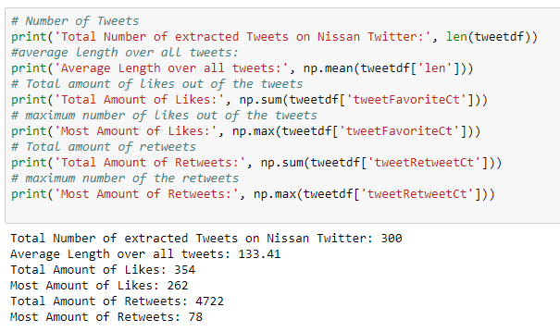
Number of Tweets, Most amount of likes & Total mount of tweets :
The Statistics confirms that Nissan is way ahead in total retweets whereas Honda is ahead
In total likes with little margin

Slide 5

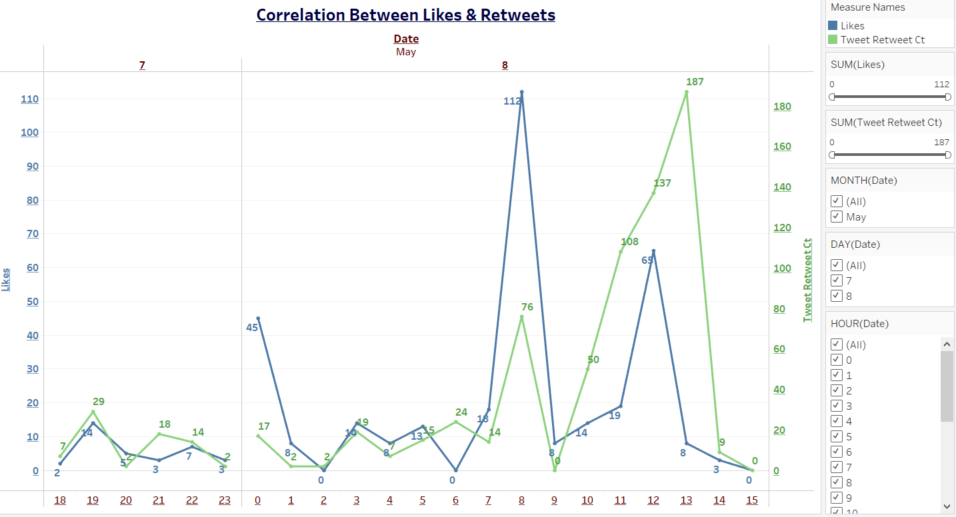
How’s the relationship of likes & retweets on Honda Twitter? There’s positive correlation between likes and retweets most of the time with some exception where likes are way ahead of retweets and vice-versa.

Slide 6
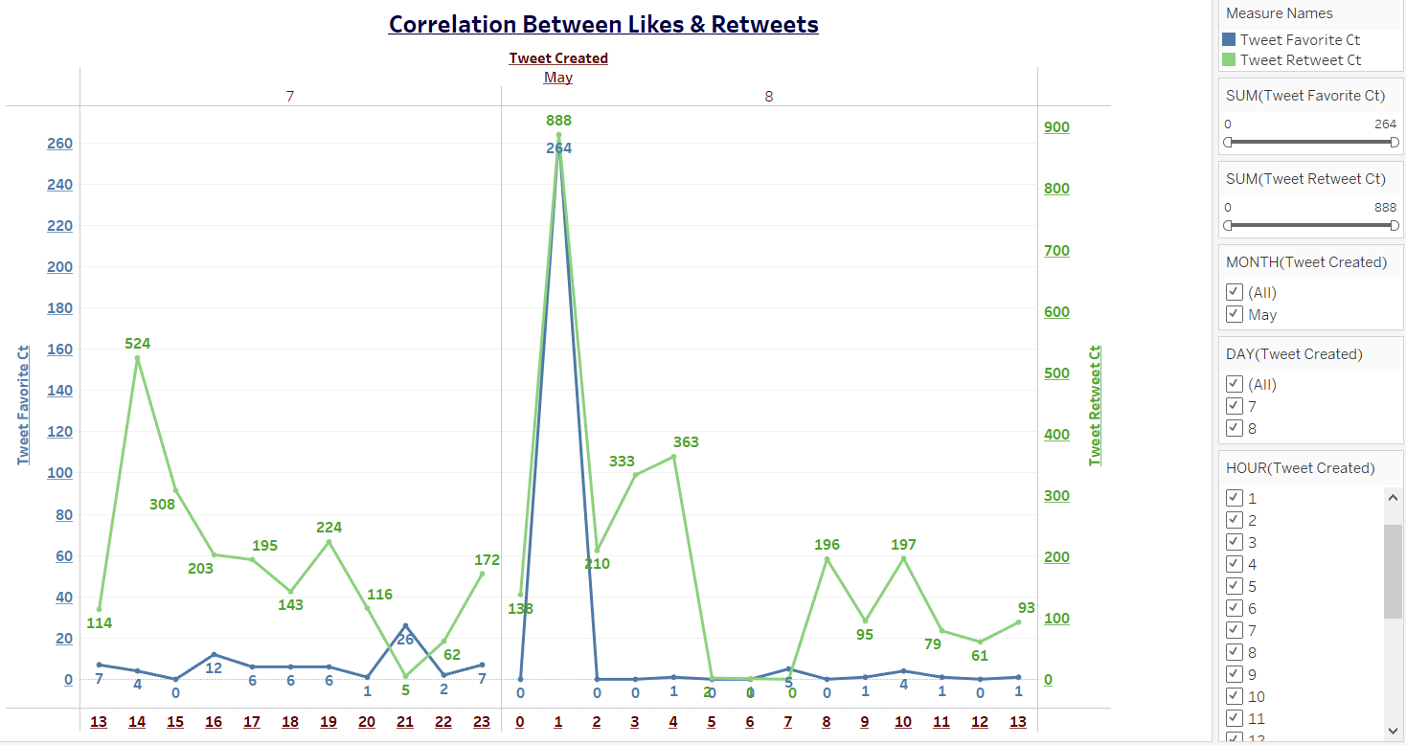
Now, let’s check on Nissan Twitter: Here, Likes are underperforming than retweets with few exception of late hours of may 7th and early hours of May 8th.

Slide 7
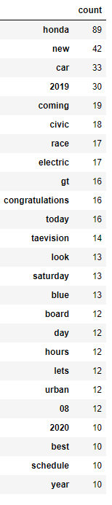
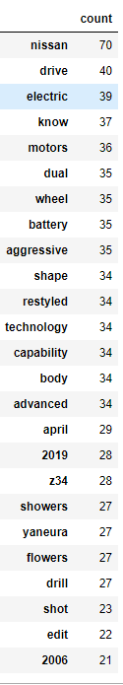
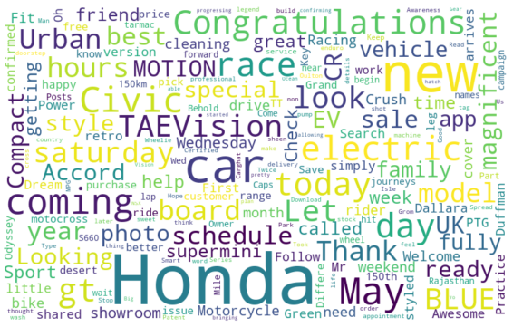
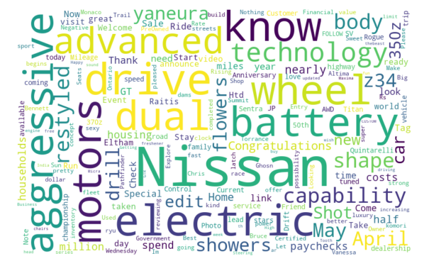
Let’s see Top 25 Words on Twitter…
Obviously, words that appear darker & bigger indicate higher average Engagement

Slide 8
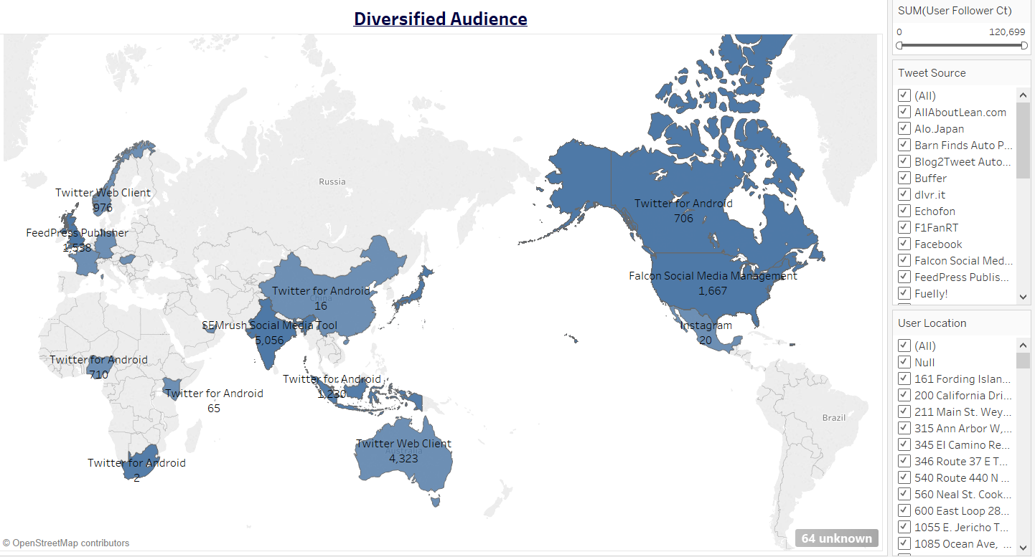
The overall audience of the Honda is spread all around the world. Here, we can see Tweet Source, user location and user follower count. India is ahead in having followers of users which can be used by Honda.

Slide 9
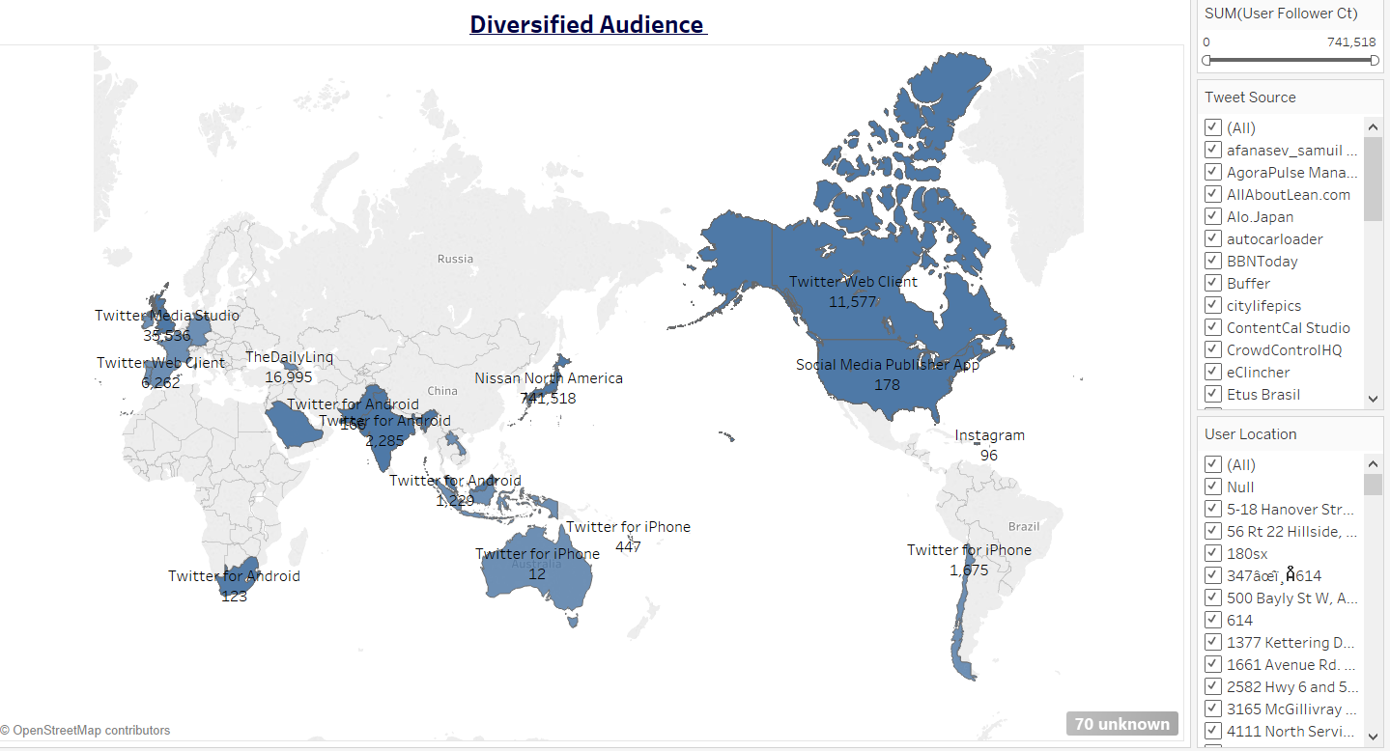
Target Audience for Nissan can also be seen all over the world. United Kingdom is leading with 35,536 followers of user. Nissan can use this it in its favor.
Certainly, both Auto Brands have fair share of audience around the globe

Slide 10
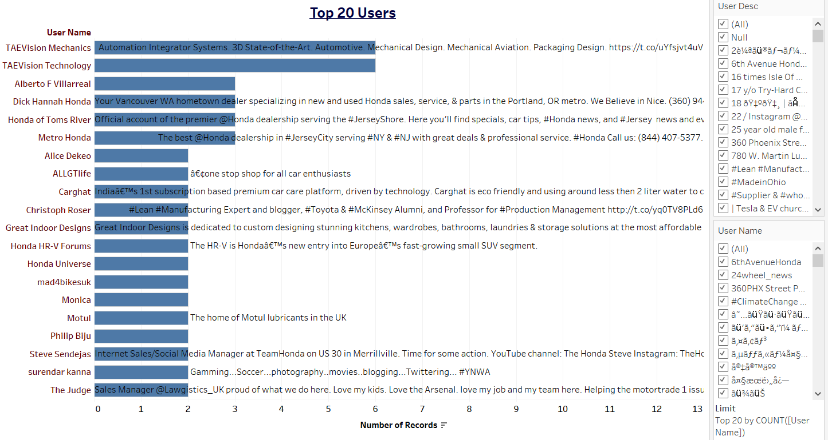
Honda automobile has great levels of engagement on Twitter. Looking at messy user description, it can be said that Honda audience consists of both auto dealers and individuals.

Slide 11
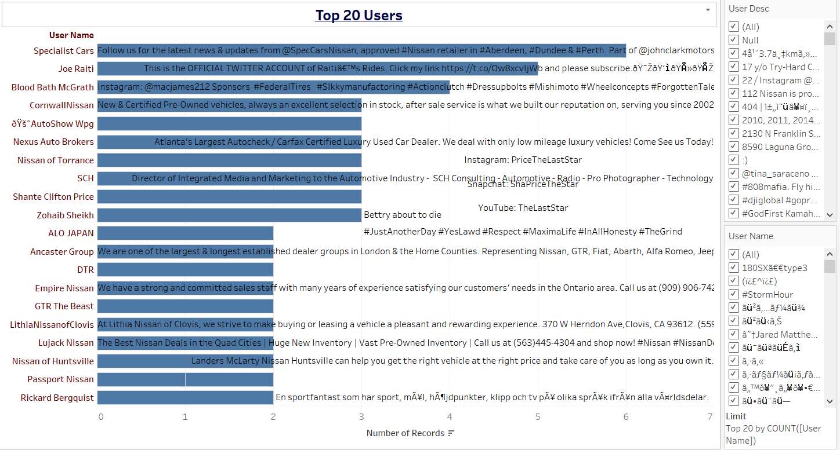
Nissan seem to have very high levels of involvement on social sites. Engaged audience are mainly auto dealers and some car enthusiast.

Slide 12
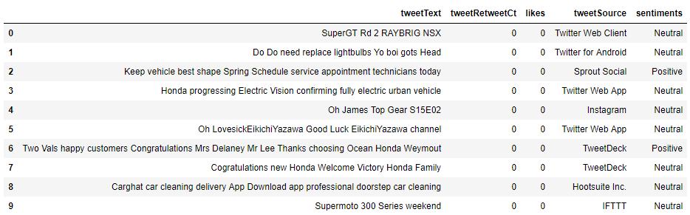
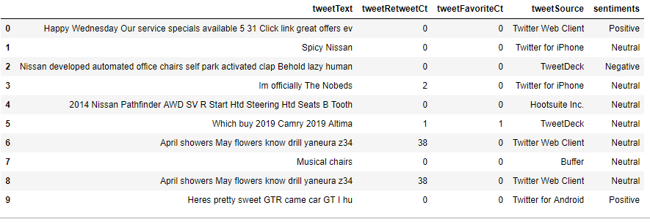
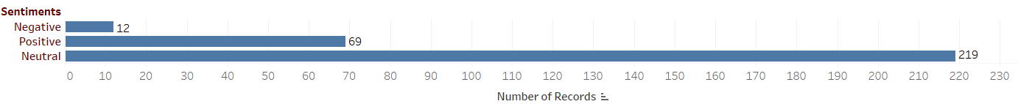
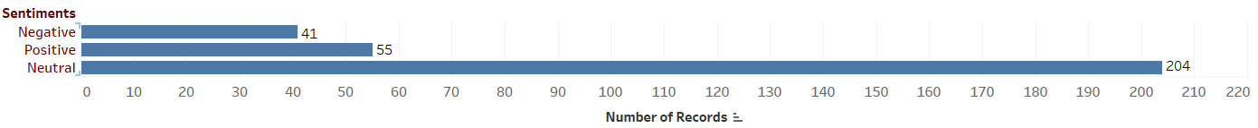
What does the sentiment Analysis say?
73% Neutral, 23% positive & 4% negative sentiments for Honda Automobile
68% Neutral ,18% Positive & 14% Negative sentiments for Nissan Auto Company

Slide 13
Purpose of the two firms on social media…
Honda has engaging content and effective social media strategies besides announcing product’s posts and videos
Honda is talking power of dreams and adventurous journey with their new models.
Honda is utilizing Twitter to connect with millions of followers and listening and trying to respond each customer.
Surely, Honda is enhancing the firm’s reputation using social media platform by targeting general audience.
Nissan is more on the path of sharing Nissan products’ announcement and posting pictures of Nissan cars’ racing events and videos.
Nissan is sharing innovative process involving Nissan Motors’ new models
Nissan is not much into customer service as they’re not connecting with audience on an individual’s basis, in my perspective.
Nissan is providing contents for car lovers to look at and informing them about auto events such as NY Auto Show, Auto Shanghai 2019 etc.

Slide 14
So, which firm has the most effective use of Twitter and why?
As of my analysis, Honda Motors are considerably leveraging the social media strategy better than Nissan Motors.
Honda has maintained an extensive social media presence, connecting with its fans and followers and engaging directly with them whereas I don’t witness the same from the Nissan Twitter feed.

Slide 15
Evaluation & Comparison of the sentiment of the Two Auto Firms’ tweets, metrics, success:
Well, based on my sentiment analysis, 4% negative out of 300 tweets for Honda Motors is convincing that people are conversing good stuff than bad.
Honda joined Twitter in 2009, made 202K tweets with 7,775 likes and following 1,582 people and firms altogether around the globe.
Nissan has 14% negative sentiments out of 300 tweets is not bad either besides the fact that Nissan is less engaging in direct conversation with audience .
Nissan joined Twitter in February 2011, engaged in 7,235 tweets with 4203 likes and following only 456 people/firms from all over the world.
As the number says, it’s quite evident that Honda has more success in achieving social media presence in comparison to Nissan.

Slide 16
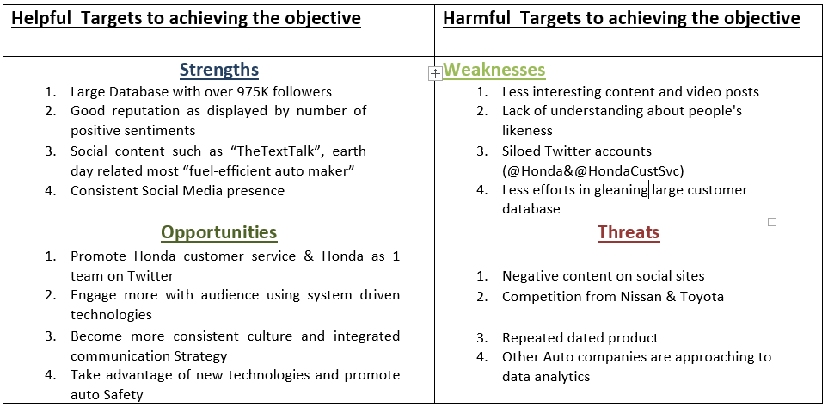
Swot Analysis For Honda Automobiles:

Slide 17
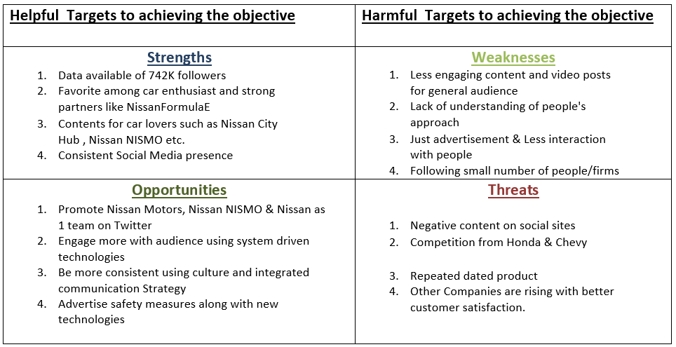
Swot Analysis For Nissan:

Slide 18
Insights/My Views From This Analysis:
Honda is more successful in balancing the act of marketing their product and connecting with people at the same time.
1. Marketing:
HondaPassport-the all-new SUV fully equipped
HondaCivic-being a leader in U.S. passenger car sales,
The INDY 500- a month away (MayMotorSports).
2. Social engagement:
No Texting while driving and taking pledge on one of their webpages.
Carbon-free society through zero emission vehicles.
Engaging with Audience using vote system such as podcasts/Music, Civic Si/Civic Hatch, Drive-through car-wash/ Hand-wash, Manual/Automatic Clutch.

