Slide 1
Causal Inference for Retail Promotions
A Complete Technical Tutorial
4 Indian Cities | 100 SKUs | 3 Years of Weekly Data
DoWhy + EconML | DAGs + Double Machine Learning
From Correlation to Causation to Strategy
Target Audience: Data Scientists & ML Engineers

Slide 2
Agenda
1
Why Causal Inference?
The correlation trap and why standard ML fails
Project At a Glance
2
The Causal Framework
62,400
Observations
DAGs, Backdoor Criterion, d-separation
3
Data & Experimental Design
7
Treatment Levers
Synthetic data with known causal structure
4
Estimation Methodology
4
Indian Cities
DoWhy, DML, CausalForest
156
Weeks (3 Years)
5
Results & Findings
City-level uplift, CATE, winning combos
100
SKUs Analyzed
6
Robustness & Sensitivity
Refutation, confounder omission, stability
6
Robustness Tests
7
Strategic Recommendations
Actionable playbook by city
2

Slide 3
Part 1
Why Causal Inference?
3

Slide 4
The Correlation Trap
!
?
X
Confounding Bias
Simpson's Paradox
Selection Bias
High-equity brands get more promos AND sell more. Naive models attribute the brand effect to the promotion.
A discount looks effective overall but harmful in every city -- because discounts cluster in high-sales cities.
Stores with displays are already top performers. The 'display effect' is partly pre-existing advantage.
Causal inference solves this by formally identifying and adjusting for confounding paths.
4

Slide 5
The Bias We're Correcting
Treatment Lever
Naive Effect
Causal ATE
Bias
discount_depth
520
468
-10.0%
is_instore_display
195
164
-15.9%
local_channel_promo
98
79
-19.4%
sms_blast_active
110
83
-24.5%
loyalty_topup_discount
180
151
-16.1%
special_coupon_usage
260
215
-17.3%
is_2x_points_active
22
15
-31.8%
Every naive estimate is inflated by confounding. Smaller true effects have larger proportional bias (2x Points: 32% overstated).
5

Slide 6
Part 2
The Causal Framework
6

Slide 7
Potential Outcomes Framework (Neyman-Rubin)
For each store-week observation i :
Y_i(1) = Sales if treated (e.g., SMS sent)
Y_i(0) = Sales if NOT treated
Individual Treatment Effect:
ITE_i = Y_i(1) - Y_i(0)
Average Treatment Effect:
ATE = E[Y(1)] - E[Y(0)]
The Fundamental Problem
We NEVER observe both Y(1) and Y(0)
for the same unit at the same time.
One potential outcome is always
counterfactual -- we must estimate it.
Solution: Conditional Independence (Ignorability)
If we condition on the right set of confounders W, the treatment assignment becomes 'as-if random':
Y(0), Y(1) independent of T | W
This allows us to estimate ATE = E[Y | T=1, W] - E[Y | T=0, W], averaged over W.
The DAG tells us exactly which variables belong in W.
7

Slide 8
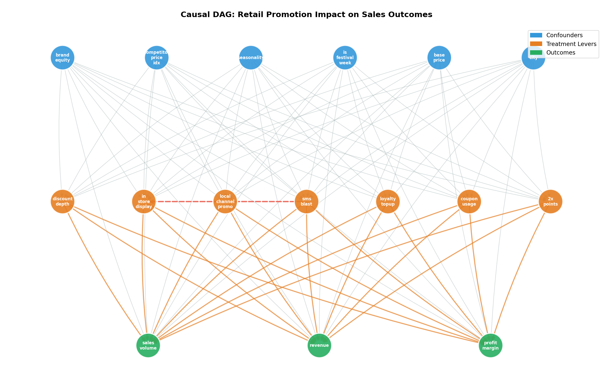
The Causal DAG
8

Slide 9
Backdoor Criterion & d-Separation
Chain
Fork
Collider
A -> B -> C
A <- B -> C
A -> B <- C
Conditioning on B BLOCKS the path
Conditioning on B BLOCKS the path
Conditioning on B OPENS the path!
Pearl's Backdoor Criterion
A set Z satisfies the backdoor criterion if:
1. No node in Z is a descendant of T
2. Z blocks every backdoor path between T and Y
Conditioning on Z gives unbiased causal estimates.
Our adjustment set:
Z = { brand_equity,
competitor_price_index,
seasonality_multiplier,
is_festival_week,
base_price, city_id }
9

Slide 10
Part 3
Data & Experimental Design
10

Slide 11
Synthetic Data with Known Causal Structure
Why Synthetic Data?
Dataset Specifications
We know the TRUE causal effects by construction.
This lets us validate that our causal methods
actually recover the correct treatment effects.
62,400 rows = 100 SKUs x 156 weeks x 4 cities
24 columns: 7 treatments, 6 confounders, 3 outcomes
Seed: np.random.seed(42) for full reproducibility
Embedded Non-Linear Interactions (Key Design Choices)
SMS + Display Synergy
synergy = 90 * sms_blast * display
+90 units when both active (36% above additive)
Discount Saturation
effect = 20*d - 0.3*d^2
Quadratic: diminishing returns beyond 20%
Loyalty Interaction
boost = 30 * is_2x * coupon
2x Points amplifies coupon redemption effect
Confounded Assignment
discount ~ brand_equity + festival
High-equity brands get deeper discounts
11

Slide 12
Indian Festival Seasonality
Festival
Timing
Primary Cities
Weight
Diwali
Oct-Nov (wk 44-45)
Mumbai, Delhi
1.0
Holi
March (wk 11-12)
Delhi, Mumbai
0.9
Eid
Varies by year
Hyderabad
1.0
Pongal
January (wk 2-3)
Bengaluru
1.0
Christmas
December (wk 52)
All cities
0.7
Ganesh Chaturthi
Aug-Sep
Mumbai
1.0
Navratri
October
All cities
0.8
Festival weeks amplify BOTH treatment propensity AND base sales, creating seasonal confounding that must be controlled for.
12

Slide 13
Part 4
Estimation Methodology
13

Slide 14
DoWhy: The 4-Step Causal Pipeline
1
2
3
4
>
>
>
MODEL
IDENTIFY
ESTIMATE
REFUTE
Define the causal DAG (nodes + directed edges)
Find estimand via Backdoor Criterion
Compute ATE/CATE using regression/DML
Validate with placebo, random CC, subset tests
model = dowhy.CausalModel(data=df, treatment="discount_depth", outcome="sales_volume", graph=gml)
estimand = model.identify_effect() # Step 2: Backdoor identification
estimate = model.estimate_effect(estimand, # Step 3: Linear regression estimate
method_name="backdoor.linear_regression")
refutation = model.refute_estimate(estimand, estimate, # Step 4: Placebo test
method_name="placebo_treatment_refuter")
14

Slide 15
Double Machine Learning (Chernozhukov et al., 2018)
Step 1
Step 2
Step 3
Residualize Y
Residualize T
Causal Regression
Y_res = Y - E[Y|W]
Remove confounder
effects from outcome
using ML (GBM)
>
T_res = T - E[T|W]
Remove confounder
effects from treatment
using ML (GBM)
>
Y_res = theta * T_res
theta is the CAUSAL
effect, immune to
regularization bias
Why DML over Plain Regression?
• Handles non-linear confounding (ML first stage handles complexity)
• Valid confidence intervals via Neyman-orthogonal construction
• Cross-fitting prevents overfitting bias in high dimensions
• Automatic heterogeneous effects (CATE) via effect modifiers X
15

Slide 16
CausalForest vs LinearDML
LinearDML
CausalForestDML
• Effect is LINEAR in X
• theta(x) = beta_0 + beta_1 * x
• Fast, interpretable
• Best for: known effect modifiers
• Our use: multi-treatment CATE
• Effect is NON-LINEAR in X
• theta(x) = learned tree ensemble
• Flexible, less interpretable
• Best for: discovering heterogeneity
• Our use: binary treatment CATE
Gotchas:
model_t MUST be a regressor (not classifier) -- even for binary T. | n_estimators must be divisible by subforest_size (4). | Multi-treatment: wrap model_t in MultiOutputRegressor().
16

Slide 17
Part 5
Results & Findings
17

Slide 18
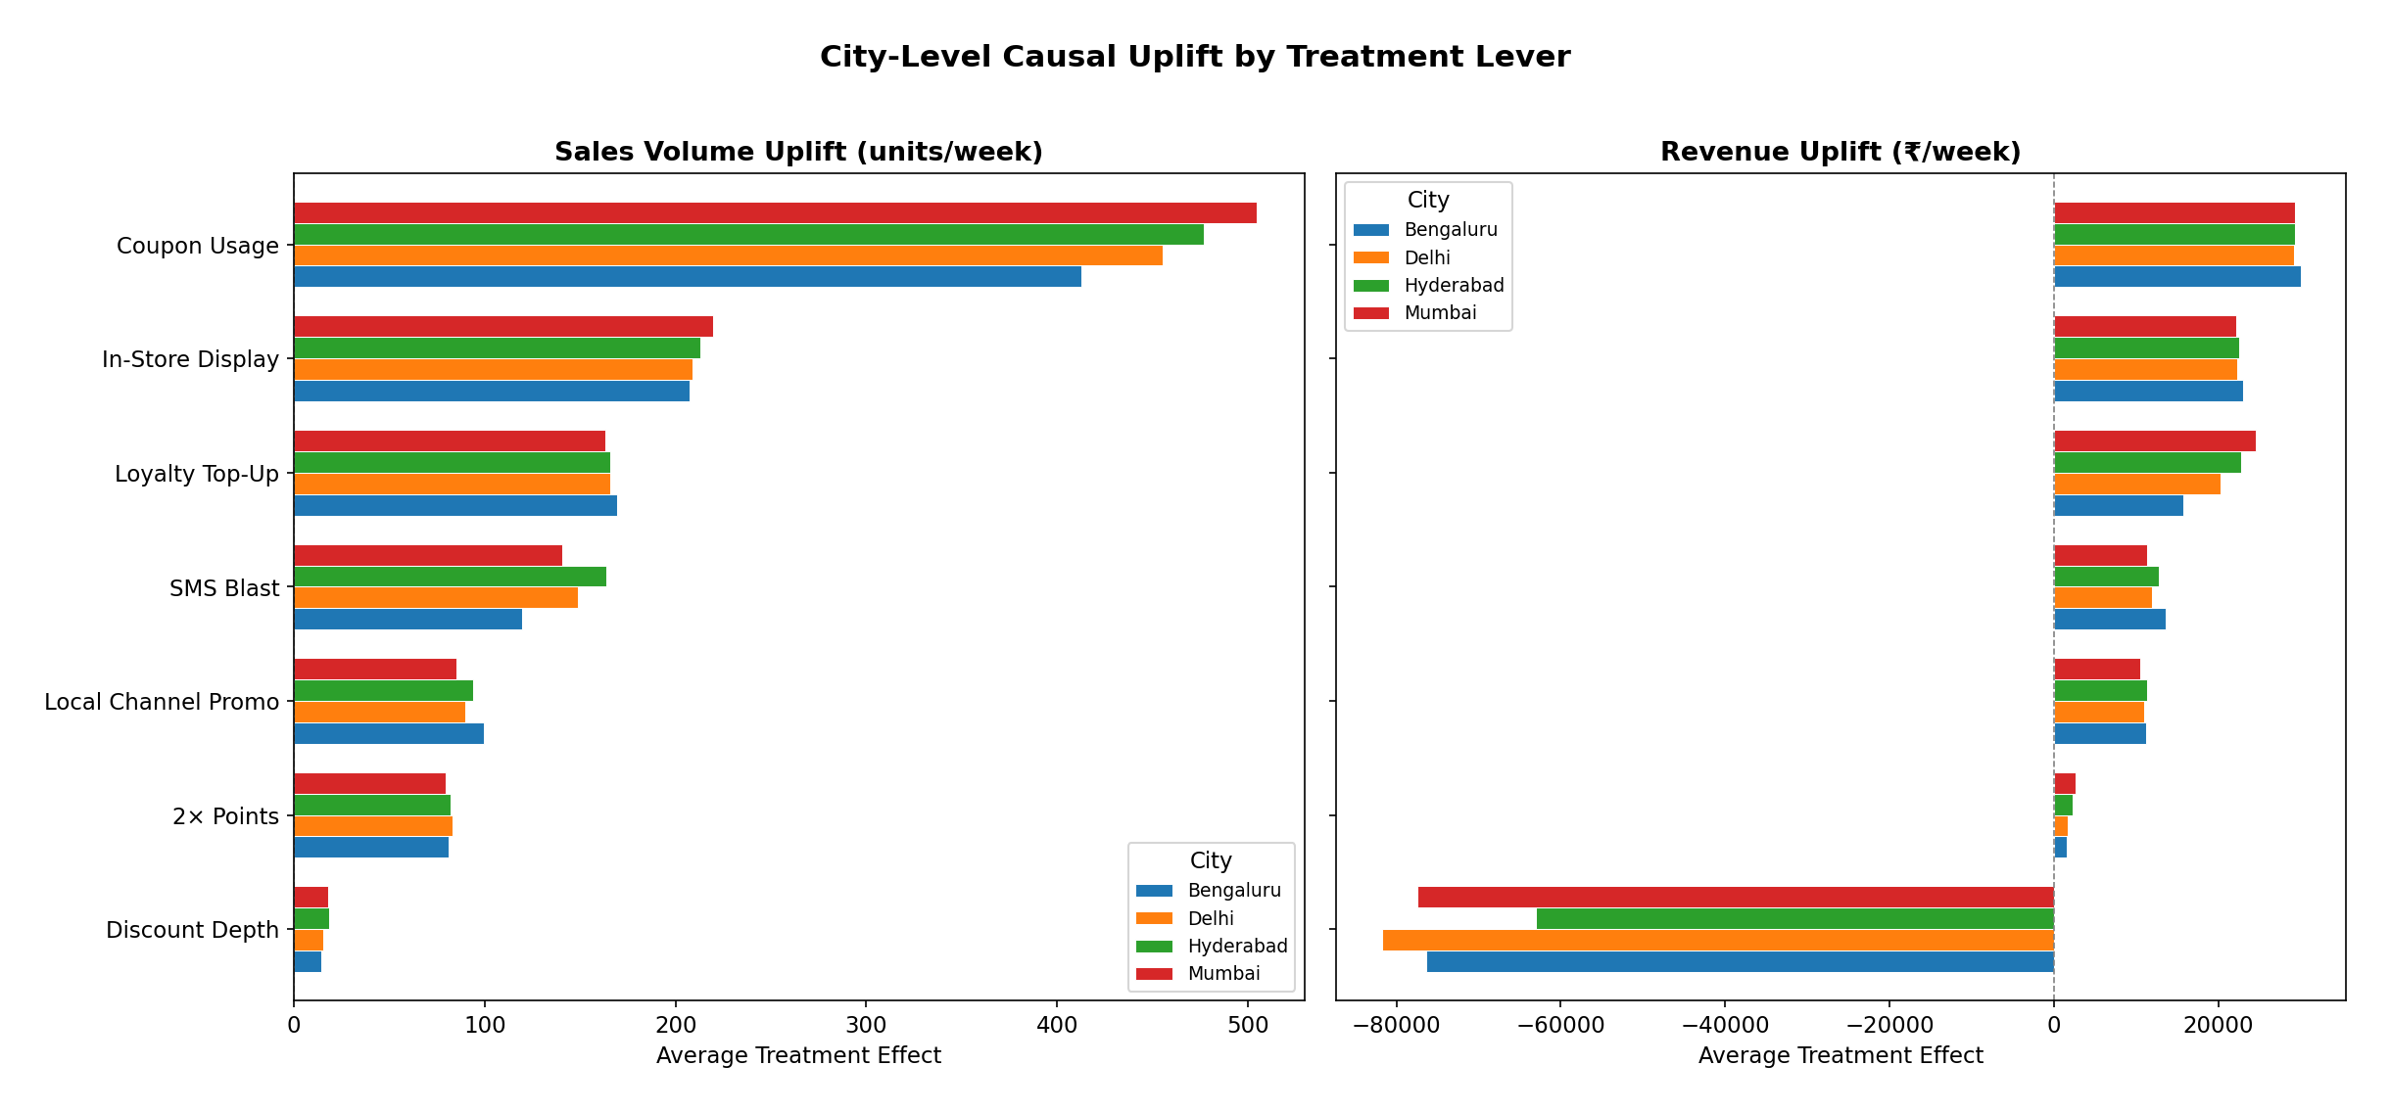
City-Level Causal Uplift (ATE)
18

Slide 19
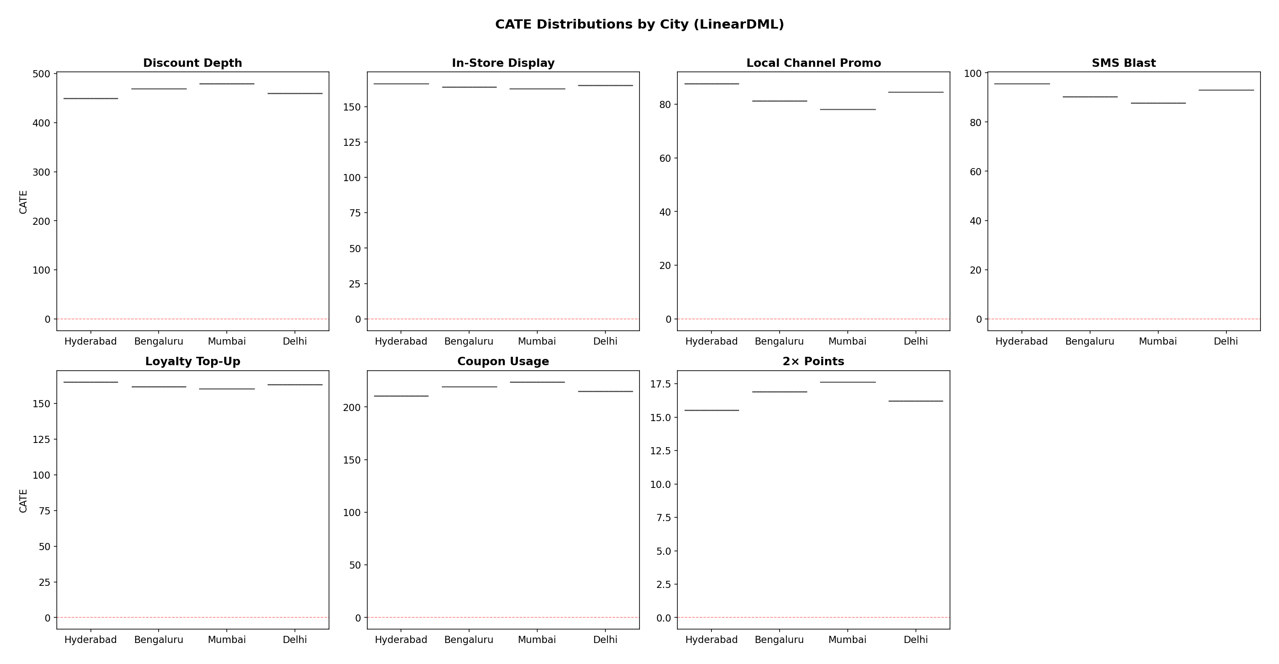
Treatment Effect Heterogeneity (CATE by City)
19

Slide 20
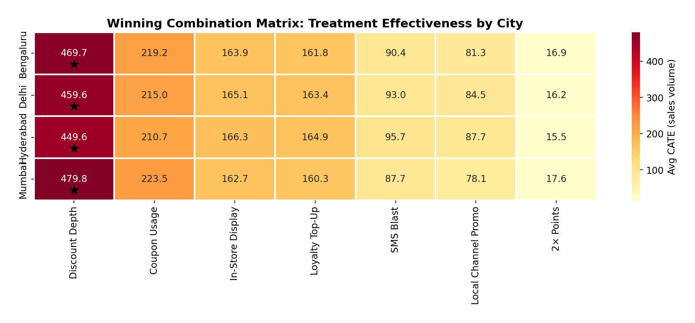
Winning Combination Matrix
Stars mark the top-performing lever per city. Discount Depth dominates volume, but erodes revenue. SMS + Display synergy yields +90 bonus units (36% above additive) -- always pair them together.
20

Slide 21
The Volume vs. Revenue Trade-Off
Volume Drivers
Revenue Impact Warning
1. Coupon Usage
+470 units/week
Discount Depth:
Volume ATE: +468 units
Revenue ATE: -70,000 INR
The margin erosion FAR outweighs
the volume gain at scale.
In contrast, In-Store Display:
Volume ATE: +164 units
Revenue ATE: +20,000 INR
Display is the most BALANCED lever:
drives both volume AND revenue.
Highest & most consistent
2. Discount Depth
+468 units/pct point
BUT destroys revenue!
3. In-Store Display
+164 units/week
Also boosts revenue
4. Loyalty Top-Up
+151 units/week
Moderate, consistent
5. SMS Blast
+83 units/week
Best paired with Display
21

Slide 22
Part 6
Robustness & Sensitivity Analysis
22

Slide 23
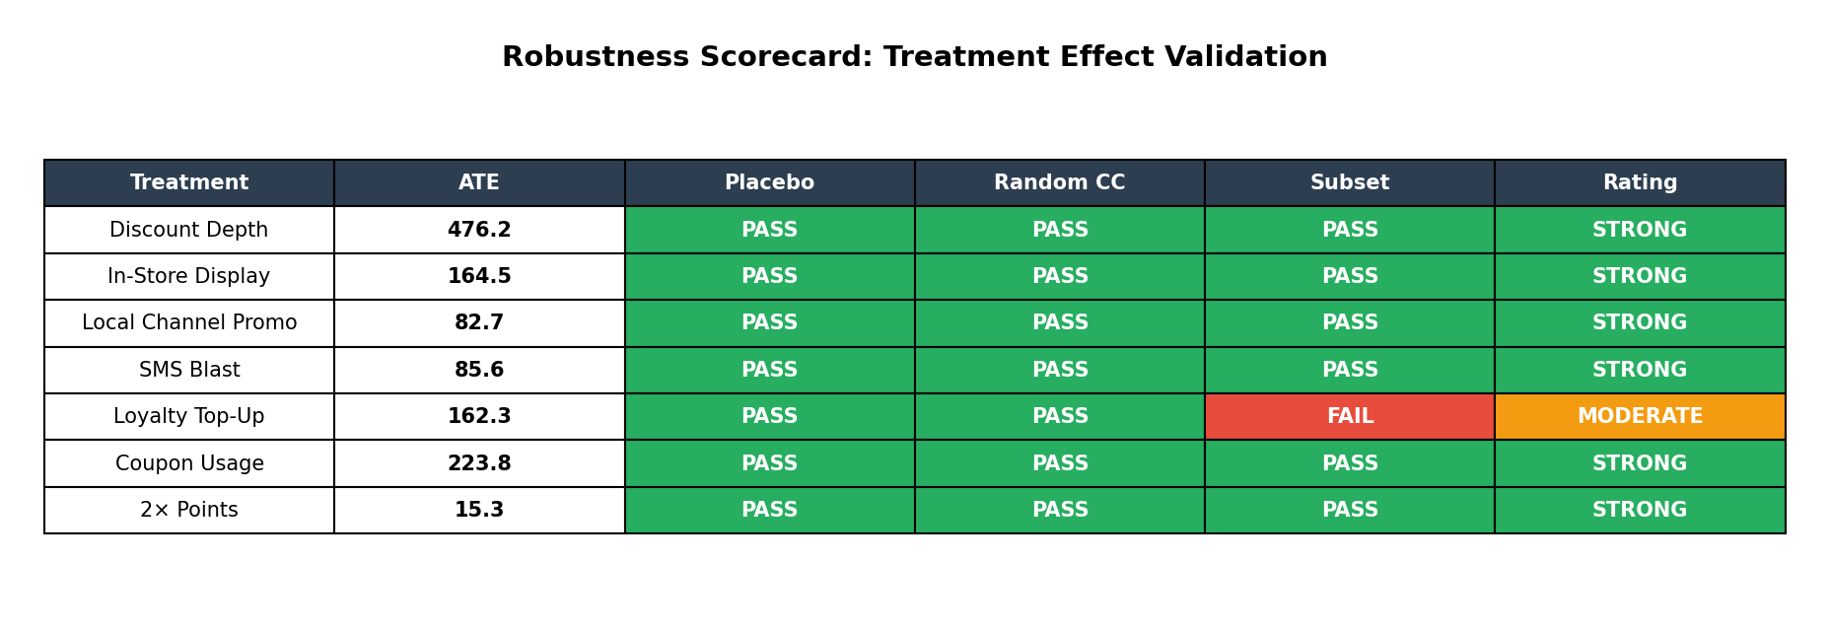
Robustness Scorecard
Placebo Test
Random Common Cause
Data Subset Test
Randomly permute treatment. If effect drops to ~0, the original was real.
Add random noise confounder. If ATE barely changes (<5%), estimate is robust.
Re-estimate on 70% subsample. If ATE is stable (<5% change), not driven by outliers.
23

Slide 24
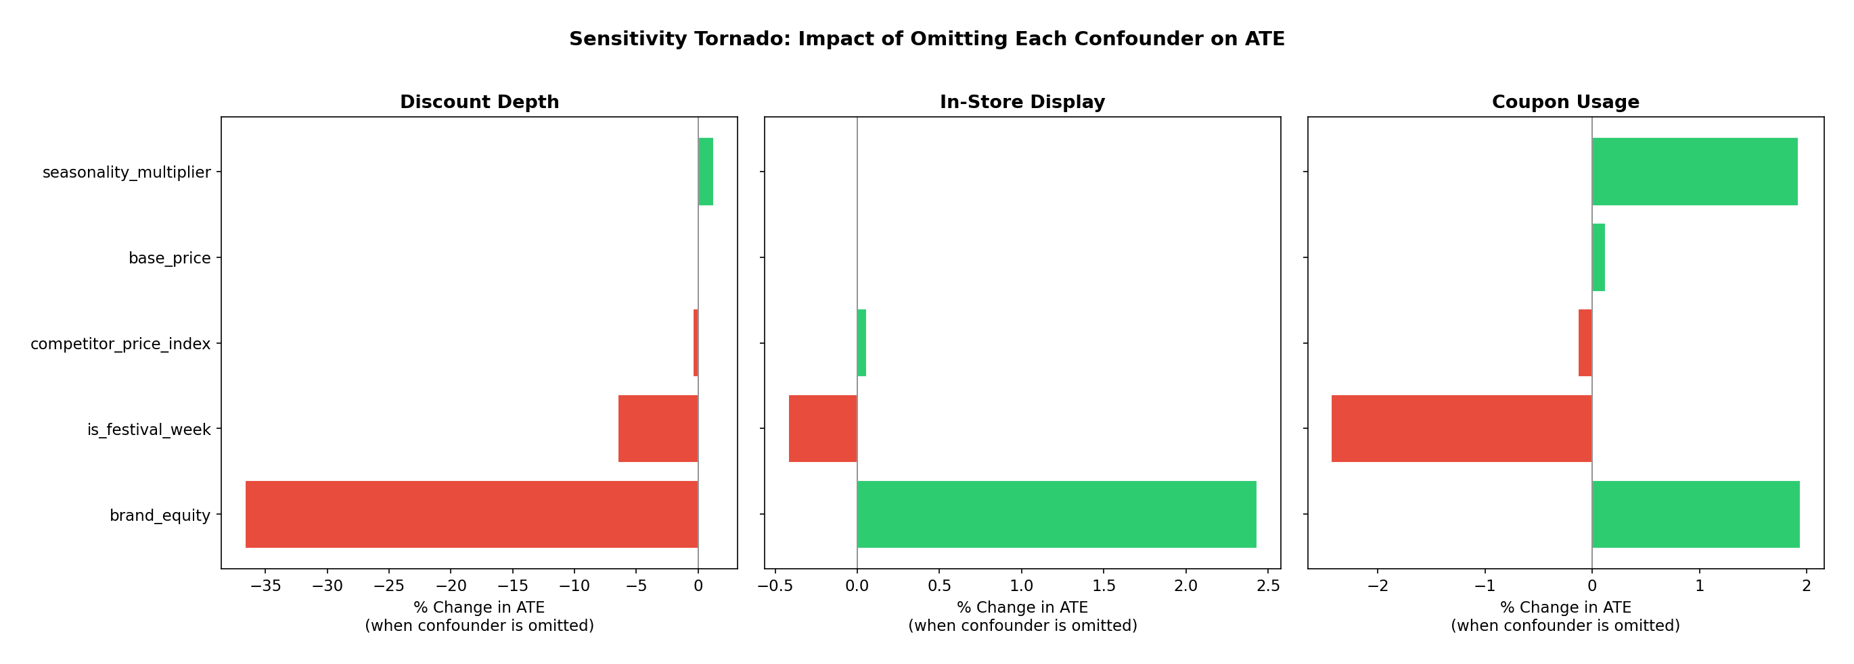
Confounder Sensitivity Analysis
Brand equity is the most critical confounder -- omitting it shifts Discount Depth ATE by 35%.
In-Store Display and Coupon Usage are robust to confounder omission (<3% shift).
Any production model MUST include brand equity as a control variable.
24

Slide 25
CATE Cross-Split Stability
City
Split 1
Split 2
Split 3
CV%
Mumbai
163.0
165.5
160.5
1.6%
Bengaluru
166.4
163.0
169.8
2.0%
Delhi
165.5
166.8
164.3
0.8%
Hyderabad
163.3
162.5
164.2
0.5%
All CV% values are well below 20%
CATE estimates from CausalForestDML are highly stable across independent data splits.
25

Slide 26
Part 7
Strategic Recommendations
26

Slide 27
City-Specific Promotional Playbook
Mumbai
Bengaluru
Delhi
Hyderabad
Highest Response
Tech-Savvy
Northern Hub
Emerging Market
> Primary: Coupons (224) + Display (163)
> Synergy: SMS + Display during Ganesh Chaturthi & Diwali
> Avoid: Deep discounts >20% (revenue destructive)
> Primary: Coupons (219) + Display (164)
> Digital: Consider app-based targeting over SMS
> Festival: Pongal week for max seasonal amplification
> Primary: Coupons (215) + Display (165)
> Synergy: SMS + Display during Diwali & Holi
> Cost play: Local Channel Promo highest CATE here (85)
> Primary: Coupons (211) + SMS Blast (96)
> Festival: Eid & Bonalu for maximum impact
> Growth: Loyalty programs show above-avg response
27

Slide 28
Action Items: Do's and Don'ts
DO
DON'T
+ Pair SMS + In-Store Display in all cities (+90 unit synergy)
+ Cap discount depth at 15% (saturation beyond this point)
+ Increase coupon distribution in Mumbai & Delhi (highest CATE)
+ Activate 2x Points during festival weeks (cost-effective amplifier)
+ Shift budget from discounts to In-Store Display (volume + revenue)
+ Build city-specific promotional calendars
X Run deep discounts (>20%) for revenue targets -- they destroy value
X Run standalone SMS without Display pairing -- 3x less effective
X Apply uniform promotions across cities -- CATE varies 10-15%
X Omit brand equity from targeting models -- causes 35% bias
28

Slide 29
Thank You
Questions & Discussion
Tech Stack: DoWhy | EconML | scikit-learn | pandas | matplotlib
Methods: DAGs | Backdoor Criterion | Double Machine Learning | CausalForest
Repo: scripts/ + notebooks/ + reports/ | Fully reproducible (seed=42)

