Slide 1


Synopsis Presentation on Implementation of Smart Financial Advisor Using Unsupervised Leraning
Guided By: Presented By:
Dr. Prashant Lakkadwala Aarohi Balde (0827IO211001)
Aaryan Gupta (0827IO211002)
Abdeali Kota Wala (0827IO211003)
Kshitiz Rai (0827IO211035)

Slide 2
Contents
Introduction
1.1 Overview
1.2 Purpose
Literature Review
Problem Statement
Proposed Solution
Objectives
Theoretical Analysis
6.1 Block Diagram
6.2 Hardware Requirements
6.3 Software Requirements
Applications
REFERENCES

Slide 3
1. Introduction
1.1 Overview
Provides personalized investment advice using AI and ML.
Suggests optimal strategies in Mutual Funds, ETFs and Fixed Deposit.
Analyzes salary, expenses, savings, and investments to create tailored recommendations.
Focuses on minimizing tax liabilities while maximizing returns.
1.2 Purpose
Simplify investment decisions for users of all experience levels.
Deliver cost-effective and efficient financial guidance.
Provide real-time insights, market trends, and alerts.
Promote long-term financial planning and risk management.

Slide 4
2. Literature Review
Following highlights the gaps in current solutions, emphasizing the need for an intelligent, cost-effective, and user-friendly platform like the Smart Financial Advisor.
Sr. No. | Name of Solution/System | Features | Limitations/ Drawbacks
1 | Traditional Advisors | Personalized guidance and tailored advice. | High cost, requires physical interaction.
2 | Robo-Advisors | Automated portfolio management using algorithms. | Limited customization and flexibility.
3 | Self-Investing Platforms | Direct market access for independent investors. | Requires significant user expertise.
4 | Budget Management Apps | Tracks expenses and budgets. | Lacks advanced investment advice.

Slide 5
3. Problem Statement
Many individuals face challenges in managing finances due to limited financial literacy, high advisory costs, and emotional biases in decision-making. Existing solutions, such as traditional advisors or robo-advisors, often lack accessibility or personalization. This results in poor risk management, inadequate diversification, and missed financial opportunities, highlighting the need for a cost-effective, intelligent financial advisory platform.

Slide 6
4. Proposed Solution
AI-driven personalized financial advisory system.
Objective, data-driven recommendations eliminate emotional biases.
Goal-oriented strategies with integrated risk management tools.

Slide 7
5. Objectives
Develop a user-friendly platform for financial literacy and investment.
Leverage AI to automate investment recommendations and risk profiling.
Optimizes financial growth by using reliable data.
Enhance user experience through iterative improvements.

Slide 8
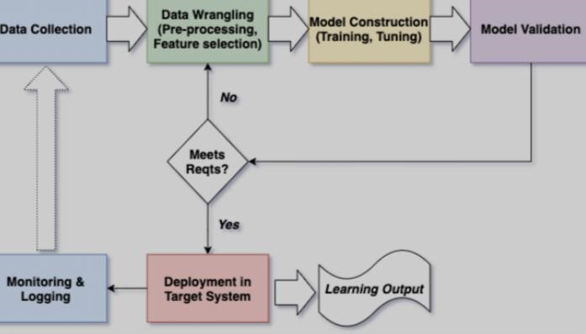
6. Theoretical Analysis
6.1 Block Diagram

Slide 9
6. Theoretical Analysis
6.2 Hardware Requirements
Cloud servers for backend processing.
User devices (smartphones, computers).
6.3 Software Requirements
Frontend: React.js, HTML5, CSS3.
Backend: Python (Flask/Django), AWS, Docker.
Database: AWS RDS with MySQL.
Data Source: NSE Official Website for market data, ETMoney.com and Screener.com.

Slide 10
Applications
Personal financial management for individuals.
Portfolio management for advisors.
Risk assessment and diversification for investors.

Slide 11
GitHub Link
https://www.github.com/aarohibalde11
https://www.github.com/AaryanGupta2002
https://www.github.com/53Abdeali
https://www.github.com/Kumarkshitiz

Slide 12
REFERENCES
NSE Official Website for market data, ETMoney.com and Screener.com.
Machine Learning resources for AI model development.
Official documentation of React.js, Flask, and AWS.

Slide 13
Thank You
Queries ?

