Slide 1
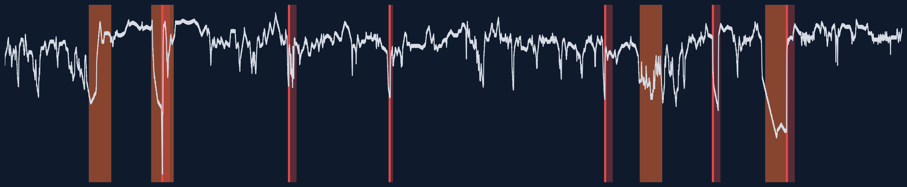
UTKRISHTA 2026 · CHALLENGE 2 · ANOMALY DETECTION
Sentinel
Watches a live stream of numbers, raises one alert per real problem, and explains why.
Team: YouPlusMeThreeMama · Kommana Srinivasa Rao · Panuganti Bhanu · Vishnu Datta · Kumarran Mahesh
Notes:
Sentinel reads a stream of numbers one point at a time, like a server's CPU or a machine's temperature. It learns what normal looks like, raises one alert when something goes wrong, and gives a short reason. In the picture: orange bands are the real problems, red lines are our alerts.

Slide 2
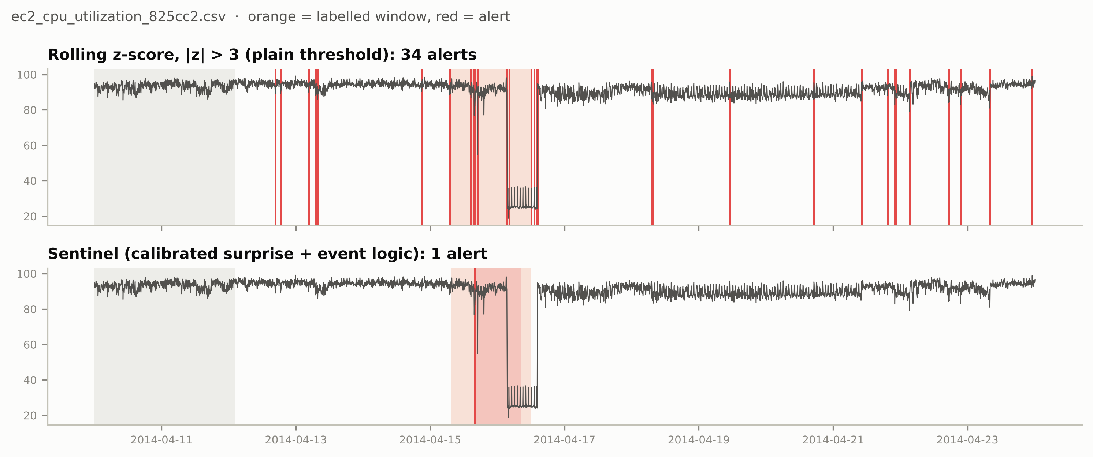



Why this problem matters
Data arrives every few minutes
Servers, machines and traffic sensors never stop. Someone has to spot trouble as it happens.
Too many alarms get ignored
A simple rule can fire dozens of times for one problem. People stop trusting it.
34 alerts
simple rule, same problem
1 alert
Sentinel, inside the problem
Decide now, using only the past
We cannot wait for tomorrow's data to judge today's point.
Notes:
Real use: cloud servers, factory machines, traffic. The real cost is not missing a number; it is drowning people in alarms. On this server a textbook rule fired 34 times for one incident. Sentinel fired once, inside the incident.

Slide 3
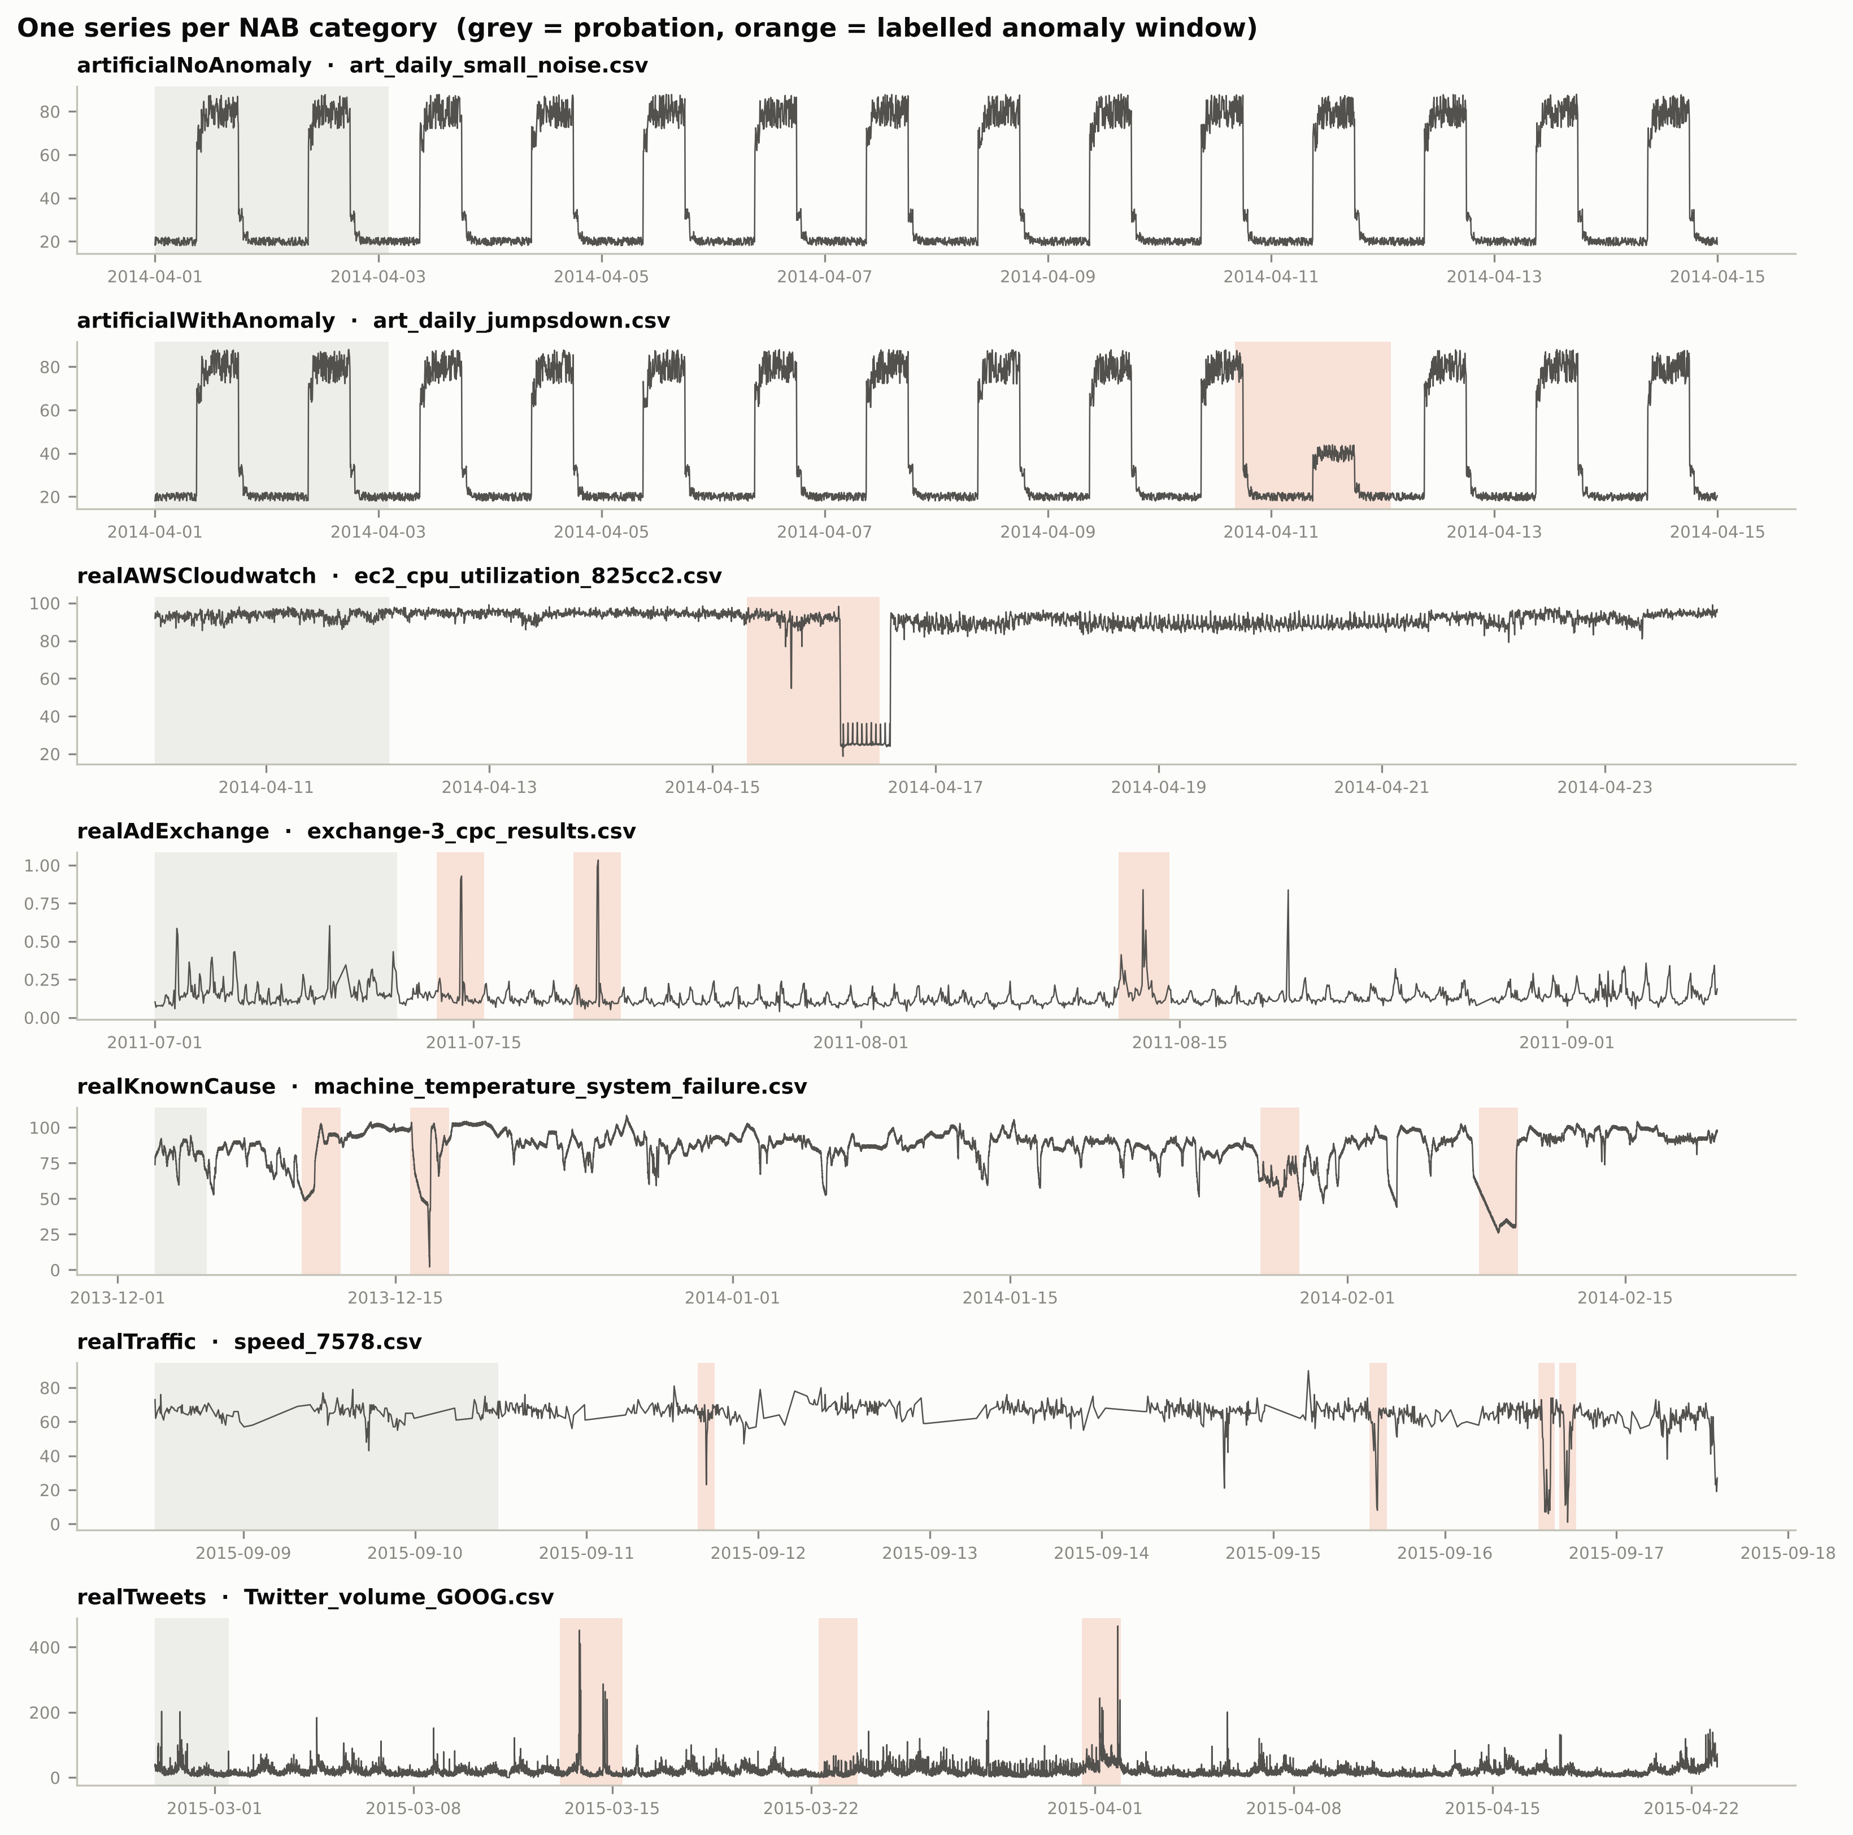
The data: Numenta Anomaly Benchmark (NAB)
58
7
real and synthetic series
kinds: servers, ads, tweets, traffic, machines...
116
365,558
marked problem periods
data points in total
How we prepare it
First 15% of each series: learn only, no alerts
Detect daily or weekly patterns automatically
No scaling with future data: every step looks only backwards
Notes:
NAB is the standard public benchmark for this problem. Each file is one metric over time; experts marked the periods where something went wrong. The detector never sees these marks; we only use them to score ourselves.

Slide 4

How Sentinel works, step by step
New value
one point arrives
4 watchers
each looks for one kind of trouble
Common scale
"how unusual is this?" in the same units
Combine
take the strongest signal
Alert logic
one alert per incident, then quiet
Output
score, NORMAL / ANOMALOUS, reason
The 4 watchers
Spike watcher
Shift watcher
Shape watcher
Odd-window watcher
a value far from what the daily pattern predicts
the level or spread changes and stays changed
a stretch of values with a shape never seen while learning
the recent window looks unlike any normal window
While an alert is open, Sentinel stops learning, so a problem never becomes the new "normal".
Notes:
Each value goes through the same pipeline. Four small watchers each look for one kind of trouble. Their scores are turned into one common scale, like 'this happens once in 100,000 normal points'. The alert logic then makes sure one incident gives one alert, not fifty.

Slide 5
Existing approaches and why we chose ours
Approach | Good at | Problem
Simple threshold (rolling z-score) | fast, easy to explain | thousands of false alarms
Isolation Forest, LOF, One-Class SVM | general outlier finders | ignore time; one alert per point
Deep learning (autoencoders, forecasters) | complex patterns | needs training; we tested one: no gain
Published NAB detectors | high scores | see each file's full range in advance (not fair live)
Sentinel (ours) | 4 watchers + common scale + alert logic | fast, explainable, one alert per incident
Why: on this kind of data, simple statistics plus smart alert logic beat heavy models, and every alert can be explained to a person.
Proof: give LOF our common scale and alert logic and its score jumps from 0.12 to 0.47.
Notes:
All permitted approaches were tried as baselines. The biggest lesson: the detector matters less than what you do after it. Calibration and alert logic turn a mediocre detector into a good one. Deep learning added cost without adding accuracy on NAB.

Slide 6


How we got here: three rounds
First working system
v3 ideas we tested
v1
Found our own scoring had a loophole: flagging everything scored 0.95. We fixed the metric first.
Shape watcher (SSA)
Odd-window watcher (LOF)
Careful tuning
Both together
v2
231 settings tried, every run logged. Fewer false alarms: 80 to 49.
Distribution-change test
Multi-feature test (Hotelling)
New ideas under strict rules
Forecast model (AR)
v3
10 ideas tested. Kept only what wins on unseen data: 2 new watchers.
Neural network forecaster
Count-data transform
Rule written before testing: an idea must win on unseen categories AND on the later part of every file.
Notes:
We worked in three rounds. In v3 we tested ten ideas, including a neural network. To avoid fooling ourselves we wrote the rule down before running anything: an idea is kept only if it wins on data it was not tuned on.

Slide 7
How we measure success
orange = real problem period
Two fair tests
Unseen kind of data
Tune on 6 of the 7 kinds, test on the 7th.
caught
false alarm
missed
Precision: of our alerts, how many were real
Recall: of the real problems, how many we caught
F1: one score that balances both (0 to 1)
Delay: how late the alert came
Unseen future
Tune on the first half of each file, test on the second half.
No official scorer was given, so we defined one and checked it cannot be gamed.
Notes:
An alert counts where it starts. If it starts inside a real problem period, it is a catch; outside, a false alarm. The judges test on hidden data, so we score ourselves on data we did not tune on: a held-out kind of series, and the later half of every file.

Slide 8
Results
56 of 116
problems caught
35
false alarms (v2: 49)
0.57
F1 on unseen future data (v2: 0.53)
21 µs
per data point
Baselines shown out of the box. A plain rolling z-score raises 5,215 false alarms; Sentinel raises 35.
Notes:
Sentinel scores 0.54, the standard methods score between 0.04 and 0.12 out of the box. Compared with our own previous version, v3 catches 4 more problems and cuts false alarms from 49 to 35. On the fair test with unseen future data it scores 0.57 against 0.53. One point takes about 21 microseconds, so about 50,000 points per second on one core.

Slide 9
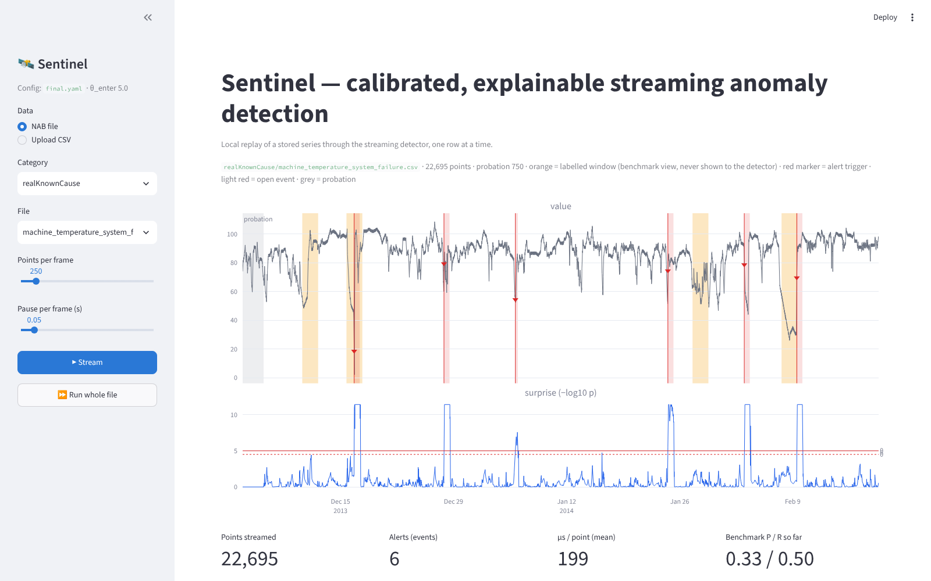
Demo: every alert comes with a reason
Caught: machine temperature
"Value 69.6 is 11.6× the normal spread above the expected 32.1."
Caught: shape break
"Only 74% of the last 32 values' shape matches the usual patterns."
False alarm, explained
"Sustained upward shift for 3 points." Fired outside every marked problem period.
Live app: streamlit run app/streamlit_app.py · any CSV: python scripts/run_stream.py
Notes:
The app replays a series point by point. Orange is the real problem, red marks our alert. Under the chart, each alert has a sentence a person can check: what value, what was expected, which watcher fired.

Slide 10
Limits, next steps and conclusion
Where it struggles
What we would do better
Future scope
Problems that look like normal daily patterns
Very spiky data such as tweet counts
Some expert labels mark periods with no visible change
Faster odd-window watcher (it is most of the run time)
Test dropping the shift watcher (looked better in one check)
Learn more seasonal patterns, not only day and week
Many metrics together (a whole server, not one number)
Learn from operator feedback ("this alert was useful")
Retrain the neural option on a GPU with more data
Conclusion
Four small, explainable watchers with smart alert logic catch about half of all real problems with few false alarms, at about 21 µs per point. Every change was kept only if it won on data it had not seen.
Notes:
Be honest about limits: some problems look normal, and some labels are debatable. The main message: simple, explainable methods with careful alert logic, tested fairly, work well and run fast.

