Slide 1

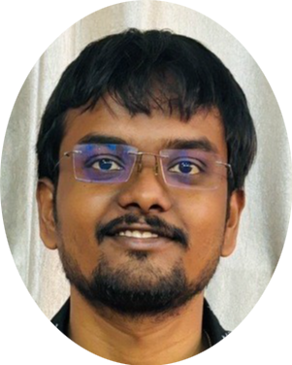

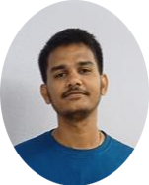
Navento
Hi Buddy, I’m Vento
Team Details:
Gowtham
Vinitha
Kumar sai

Slide 2


Slide 3
