Slide 1
JAVASCRIPT
- Manideep

Slide 2
Display Possibilities:
Innerhtml
document.write( )
window.alert( )
console.log( )

Slide 3
Operators:
Arithmetic Operators
Assignment Operators
Comparison Operators
Logical Operators

Slide 4
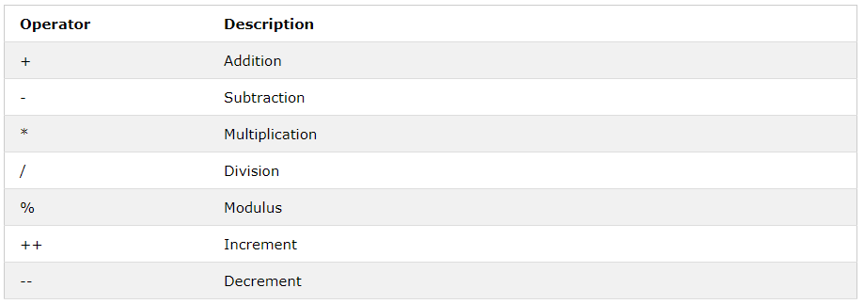
Arithmetic Operators:

Slide 5
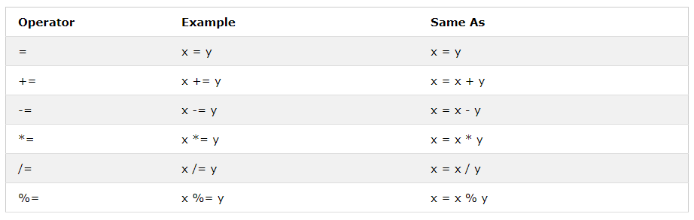
Assignment Operators:

Slide 6
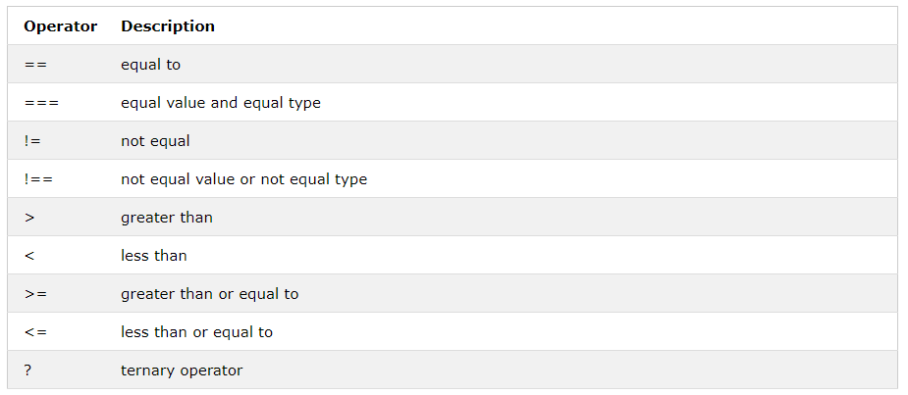
Comparison Operators:

Slide 7
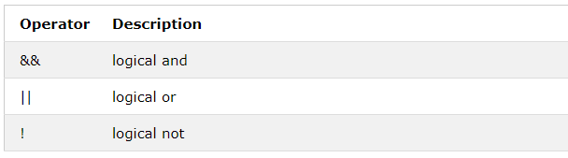
Logical Operators:

Slide 8
Objects:
An object is a standard alone entity.
An object is collection of properties.
Property is an association between a name (key) and a value.
A property’s value can be a function, in which case the property is known as method.

Slide 10
Creation of Object types
Using Object Literal
Using new keyword
Using Create Method
Using function constructor

Slide 11
Using Object Literal
Syntax:
Var object_name = {
Property: value,
Property: value,
.....
};

Slide 12
Example:
Var myCar = {
Make: ‘Ford’,
Model: ‘Figo’,
Description: function(){ return make + “ ” + model; }
};

Slide 13
Syntax to access object properties:
Object_name.property;
Examples:
myCar.model
myCar[‘model’]

Slide 14
2) Using new Keyword:
Syntax:
Var object_name = new Object();
Example:
Var myDetails = new Object();
myDetails.name = ‘Naveen’;

Slide 15
3) Using constructor function
Function Car(make, model, year) {
This.make = make;
This.model = model;
This.year = year;
}
Var myCar = new Car(‘benz’, ‘520’, ‘2017’);

Slide 16
4) Using Create method:
→ Create an object using object literal.
Var technology = {
name: ‘mean stack’,
displayName: function(){
console.log(this.name);
}
}

Slide 17
Var front_end = Object.create(technology);
To assign a property to object:
Front_end.name = “Angular”;
To display the value:
front_end.displayName();

Slide 18
Scope:
$ Scope determines the accessibility (visibility) of a variable.
Types:
Global Scope
Local Scope
$ Global Scope: Variable declared outside the function.
$ Local Scope: Variable declared inside the function.

Slide 19
Global Scope:
$ Variable declared outside the function which has global access.
Example:
Var carName = “BMW X5” // Global Scope
Function displayCarName(){
console.log(this.carName);
}

Slide 20
Local Scope:
$ A Variable declared inside the function.
Example:
Function displayPhone(){
Var phoneName = “Iphone X”; //local scope
console.log(this.phoneName);
}

Slide 21
IIFE (Immediately Invocable Functions):
Syntax:
(function (parameter, parameter){
//stmts
//stmts
})();

Slide 22
Events:
$ An HTML event can be something the browser does, or something a user does.
Example:
An HTML web page has finished loading.
An HTML input field was changed.
An HTML button was clicked.

Slide 23
Arrays:
Arrays are used to store multiple values into a single variable.
Syntax:
Var variable_name = [value1, value2, value3, … ];
Example:
Var students = [“Hari”, “Prasad”, “Nihanth”, “Hema Sai”];

Slide 24
Methods:
a.toString();
push( );
pop( );
splice(index_pos, delete_num, “new_value”, “new_value”); // To add and del.
concat( second_arr);
Sort( )
Reverse( )

Slide 25
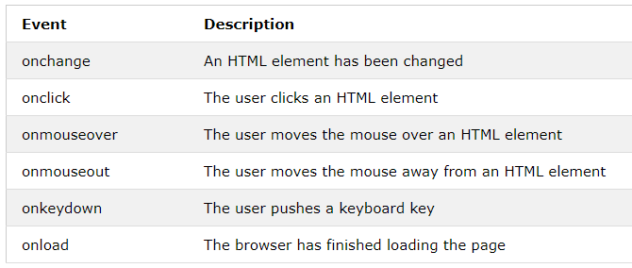
Common Events:

Slide 26
Strings:
Strings are used for storing and manipulating text.
Javascript strings simply stores a series of characters.
Examples:
Var carName = “Volvo XC60.”
Var answer = “It’s all right.”;
Var answer = “It’s all ‘right.’ ”;
Var answer = ‘It’s all right.’

Slide 27
String Methods:
Length
indexOf(string)
lastIndexOf(string)
slice(start, end)
substr(start, len)
toUpperCase()
toLowerCase()
concat(“ ”, str) //"Hello".concat(" ", "World!");
charAt(index);

Slide 28
Date Object:
Represents a single moment in time.
Syntax:
New Date( )
New Date(millisec)
New Date(dateString) // October 13, 2014 11:13:00
New Date(year, month, date, hrs, mins, secs, millisecs)

Slide 29
Methods
Get Methods Set Methods
getDate() setDate()
getDay() setFullYear()
getFullYear() setHours()
getHours() setMonth()
getMinutes() setMinutes()

Slide 30
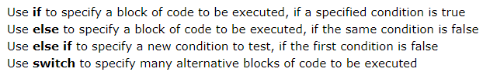
Conditional Statements
Conditional Statements are used to perform different actions based on different conditions.
Types of Conditional Statements:

Slide 31
If else If Statement:
Syntax:
if(condition1){
// block of code to be executed
}else if (condition2){
// block of code to be executed.
}else{
// block of code to be executed. }

Slide 32
Switch Statement
Syntax:
Switch(expression){
Case n: //block break;
Case n: //block break;
Case n: //block break;
default : //block;
}

Slide 33
Looping Statements:
Loops can execute a block of code a number of lines.
Types:
1) While / do-while
2) For
3) for-in

Slide 34
DOM Manipulation:
Finding HTML Elements:
document.getElementById(‘ value ’);
document.getElementsByTagName(‘ value ’);
document.getElementsByClassName( name )

Slide 35
Object Prototypes
Every Javascript Object has a prototype. The prototype is also an object.
All Javascript objects inherit properties and methods from their prototype.
Objects created using object literal or with new Object ( ), inherit from a prototype called Object.prototype.
The Object.prototype is on the top of the prototype chain.

