Slide 1
Learning for the Decision
1
2
3
Replicating and extending end-to-end Markowitz learning on China A-shares
Based on Wang, Gao, Harvey, Liu & Tao (2026), Machine Learning Meets Markowitz
Kumar Utkarsh · IIT Guwahati · October 2026
Predict
Optimize
Decide
Train the forecaster on the portfolio it produces
Notes:
The paper asks whether a return forecaster should be trained for statistical accuracy or for the portfolio it feeds. We replicate it on free China A-share data, audit it, and extend it.

Slide 2
Why predict-then-optimize falls short
Two-stage (the benchmark)
The paper's example, reproduced exactly
Characteristics
Model g(x; θ)
Forecast r̂
Optimizer
Portfolio w
Realized utility (%) of mean-variance portfolios built from three pricing models
Loss: MSE, every stock equal
Investor | OLS (best fit) | pro-large-cap | pro-small-cap
risk-averse, η = 10 | 31.97 | 32.01 | 31.90
risk-tolerant, η = 1 | 62.84 | 62.53 | 62.90
End-to-end (the paper)
Characteristics
Model g(x; θ)
Forecast r̂
Optimizer
Portfolio w
The model with the lowest MSE is best for neither investor.
Accuracy matters most where the portfolio puts its weight, and that depends on the investor.
Loss: realized portfolio return
gradients flow back through the optimizer
Our check: OLS fit [0.652, 0.927] and all six utilities match the paper (OLS without intercept).
Notes:
Two-stage learning fits returns for all stocks equally. E2E puts the optimizer in the loop. The paper's four-asset example, which we reproduced exactly, shows the best statistical fit is best for neither investor.

Slide 3
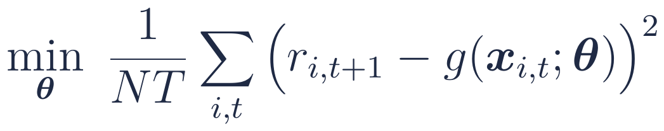
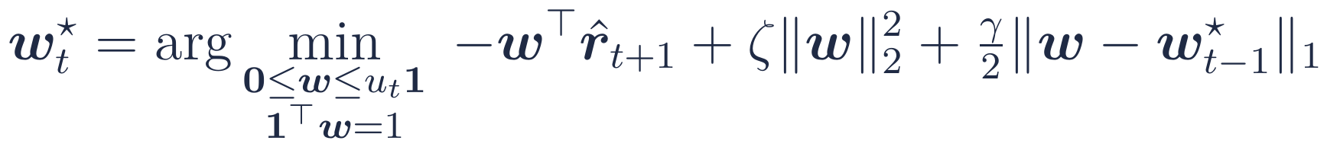
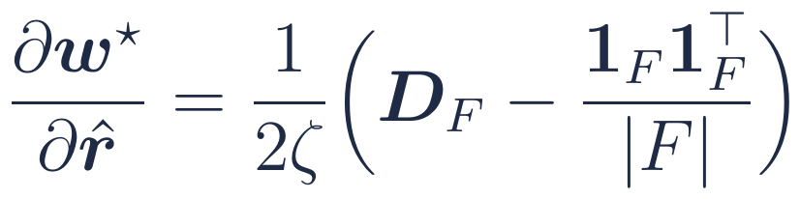
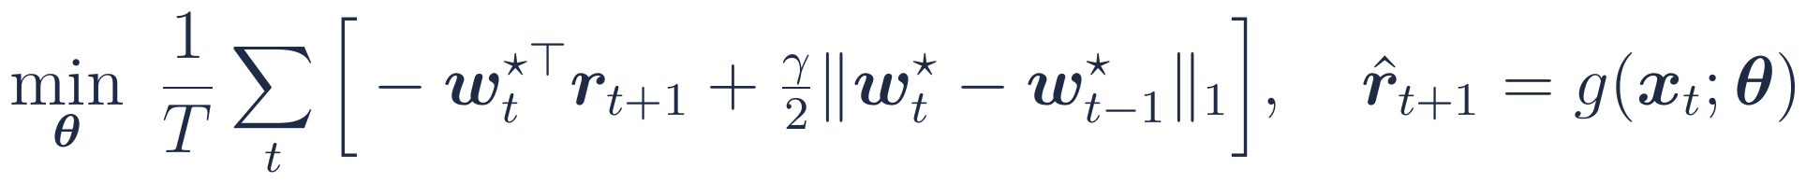
Methodology: learning through the optimizer
Benchmark: fit, then optimize
Our exact layer (replaces KKT solvers)
The problem is separable up to the budget, so one threshold τ solves it:
Linear or NN1–NN5, Adam, early stopping; deciles of r̂ each day
S is a soft threshold around yesterday's weight p. On the free stocks F:
Lower level: the portfolio layer
Cap u = 1/(10% of N): with ζ and γ at zero this is the equal-weight top decile
O(N) backward pass on the GPU
Solution never worse than a generic solver (gap < 1e-17)
Gradient matches finite differences (error ~1e-11)
Upper level: learn θ for the decision
ζ smooths the linear program; γ is the transaction cost rate
Notes:
The bilevel problem: the inner problem chooses weights from forecasts, the outer problem chooses network parameters for realized performance. Our layer solves the inner problem exactly and gives its Jacobian in closed form.

Slide 4
Machine learning at each stage, and why
1
Prediction layer
2
Training objective
3
Optimization layer
Linear and NN1–NN5 (32-16-8-4-2); LayerNorm, ReLU, BatchNorm, 5% dropout
MSE for the two-stage model; realized portfolio return for E2E
Smoothed top-decile program with a transaction-cost penalty
Why: Benchmark architectures of Gu, Kelly & Xiu; small nets resist daily noise
Why: Puts accuracy where the long-only portfolio puts its weight
Why: Gradients through argmin; ζ makes the solution Lipschitz
4
Training protocol
5
Validation design
6
Our models
Adam, early stopping (patience 10); E2E warm-started from MSE; 8-day batches
39m / 9m / 3m rolling windows, 2-day embargo, all choices on validation
Ridge, PCR, PLS, LDA, GMM experts, SVR, decision-aware PCA
Why: Stable and fast; days kept in order when costs link them
Why: No look-ahead: the test quarter is never used to choose anything
Why: Regularize 251 collinear features; test reduction chosen by the decision
Notes:
Each stage uses a specific learning choice. Cards 1 to 5 follow the paper; card 6 lists our additions.

Slide 5
Auditing the paper: what doesn't add up
11.2M
53.35
p = 0.08
−0.04%
stock-days implied by Table A.1; the text reports 5.96M
NN3-E2E long-short return implied by its own H and L; 54.9 is reported
two-sided, for t = 1.74, which the paper marks significant at 5%
2017Q1 top-decile daily return once untradeable stocks are excluded (+0.76% with them)
Conventions recovered from the tables
Our fixes
H–L is (H − L)/2 in every cell but one
Cost = γ × one-sided turnover ½‖Δw‖₁ (matches Table 3 to 0.2 pp)
Annualized with about 243 trading days
Drawdowns on cumulative sums; length in calendar days
Smoothing ζ‖w‖² squared and tuned (paper: unsquared, ζ unreported)
Daily rebalancing, despite "quarterly" captions
Two-day embargo at every train / validation / test boundary
Tradability: drop new listings and stocks locked at the upper limit
Tuned MSE-Opt benchmark; one- and two-sided tests
Notes:
We recomputed the paper's tables. Three numbers do not reconcile, several conventions are implied but unstated, and we adopt explicit fixes for each.

Slide 6

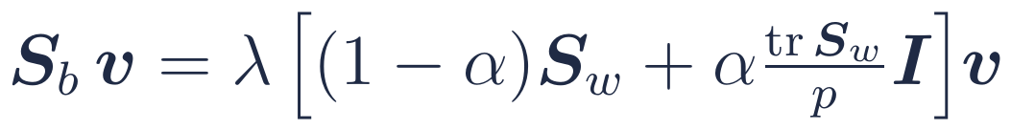
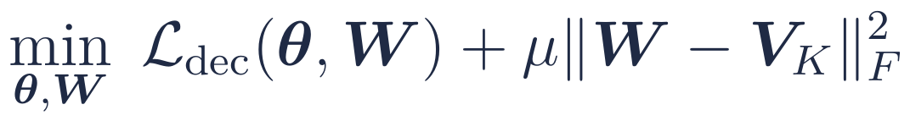
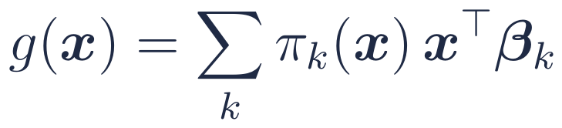
Our extensions: dimension reduction for the decision
251 features
Reduction
Model
Portfolio layer
PCA (unsupervised)
LDA (supervised by deciles)
Key point
For a linear model, a learned linear bottleneck adds nothing: (Wγ)ᵀx is still one linear score.
So reduction must act as a constraint. Decision-aware PCA keeps W near the PCA loadings and lets the portfolio objective move them.
Also: PLS, persistence-aware (low-turnover) components, linear and kernel SVR.
Top-K principal components of the numeric features
Directions that separate each day's return deciles
Decision-aware PCA (new)
GMM mixture of experts
Start at PCA loadings; let the portfolio loss move them
Separate linear rules for large and small firms
Notes:
Dimension reduction sits between the features and the model. We compare reduction chosen by variance (PCA), by class separation (LDA) and by the portfolio objective (decision-aware PCA).

Slide 7
Results so far (2014–2023, 40 test quarters)
Higher IC ≠ better portfolio
Ridge-rank has the best rank IC (0.077), but Linear has the best long-only Sharpe (1.36): the paper's argument, in our data.
Unlike the paper, the networks do not beat Linear (NN3: 1.23).
Excluding microcaps
Our Linear: 22.8% a year (SR 1.03); the paper reports 28.0% (1.44)
To be added when training finishes: E2E versions (paper models and ours), transaction costs 0–40 bps, risk aversion, decision-aware PCA, GMM experts.
Notes:
Long-only, equal-weight top decile, before costs, market-adjusted against the CSI 500. Final E2E and network results are added after training.

