Slide 1

Human Resources division
Human Resources Division
People Strategy 2016 – 2021
Emma Stone, Director of Human Resources
Emma Stone, Director of Human Resources

Slide 2

The division
Director of HR
Assistant Director (Strategy)
Personal and Professional Development
Equality and Diversity
Pensions
Assistant Director (Operations)
Childcare Services
Office of Postdoctoral Affairs
Employment Relations
HR School Teams
HR Systems and Analytics
Recruitment Services
Policy
Reward
Strategy
Engagement

Slide 3
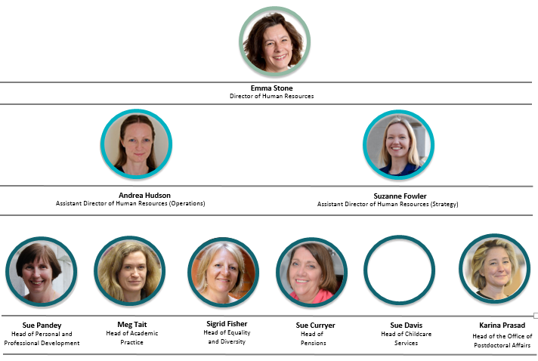
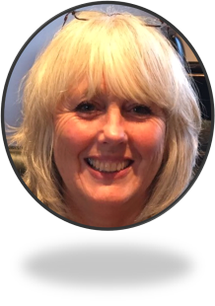
HR division – Senior Management Team

Slide 4
What do we do?
HIRE RETIRE
Recruitment, selection and grading
Reward and recognise staff
Develop policies, procedures and tools to support managers and staff
Induction and probation
Facilitate career progression, and succession planning
Consult and engage with staff and trade unions
Train and develop
Provide employee benefits, nurseries and childcare
Support organisational change
Provide personnel administration
Administer pensions
Provide HR data to inform decision-making
Diversity, inclusivity and wellbeing
Coach managers on resolving employee relations issues

Slide 5
How many staff do we support?
Total
11,589
Academic
1,751
Lecturers to Professors
Academic-Related
2,064
Lawyers, accountants, system developers, fundraisers, environmentalists, librarians
Research
4,039
Research Assistants to
Directors of Research
Assistant
3,735
Cleaners, technicians, secretaries, gardeners, cooks, security guards

Slide 6

People Strategy

Slide 7
Our People Strategy
The next 5 years are likely to bring profound changes to the HE sector.
Developed in consultation with institutions, the People Strategy and Action Plan set out the projects and initiatives that will aim to:
provide a stimulating and rewarding environment for staff at all levels
support institutions in preparing for the people challenges they will face
provide a competitive advantage to the University
The People Strategy has 8 goals under 4 key themes (see next slide). Many of the projects are already underway.

Slide 8

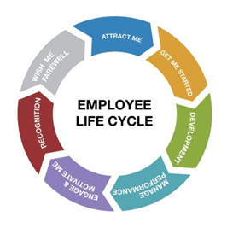


People Strategy - Key themes
Recruitment & retention
Talent management
Reward
Thriving and inclusive community
PEOPLE STRATEGY

Slide 9

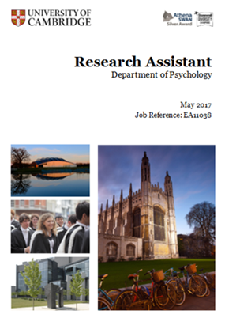
1. Recruitment
To attract and retain the best talent from across the world and give them the best possible start (Goals 1-3)
Review current procedures to ensure recruitment is fair, rigorous, agile and professional
Proposal to replace academic Standing Appointments Committees with locally agreed selection committees
Develop training for all those involved in recruitment. Initially academic recruitment training to be delivered Michaelmas term 2017/18
Introduce new improved further particulars to support all recruitment campaigns
Develop new Recruitment Policy and revised recruitment guidelines

Slide 10

2. Talent Management
To offer personal and professional development to all staff and progression routes to enable them to fully contribute to the University and reach their full potential (Goals 4 & 5)
Develop career pathways for academic staff, including review of promotions process, consideration of teaching and research career strands and probation arrangements
Develop career paths for professional services staff
Introduce a range of apprenticeships, funded by the Apprenticeship Levy
Increase access to mentoring opportunities
Continue to develop the new Cambridge Centre for Teaching and Learning
Launch new range of On Demand web-enabled learning resources
Develop suite of HR policies and case management tools for effective people management

Slide 11


3. Reward
To reward fairly and competitively and to recognise and retain outstanding staff at all levels (Goal 6)
Develop and deliver sustainable reward strategy
Review HERA framework and improve grading process
Develop and deliver a robust benefits strategy
Improve reward data and benchmarking to inform institution decision making
Develop staff housing and accommodation initiatives eg rental deposit loan scheme
Improve communication of total reward package to staff eg annual reward statements and financial education

Slide 12

4. a) Thriving and inclusive environment - Diversity
Embed supportive, inclusive culture with effective leadership (Goal 7)
Equality and Diversity Strategy Action Plan 2016-2021
Increase diversity at senior levels
Progress gender equality and tackle gender pay gap
Address student attainment differentials
Embed inclusion and family friendly practice
Maintain compliance, engagement and best practice
Projects underway: University Athena SWAN, Race Equality Charter & InterConnect, Unconscious Bias, Sexual Harassment work stream, SPACE (Supporting Parents & Carers at Cambridge), WiSETI, disability support, diversity networks

Slide 13
4. b) Thriving and inclusive community - Wellbeing
To actively promote health and wellbeing so our people are engaged and feel valued (Goal 8)
Overall, to develop initiatives for a more comprehensive health and wellbeing provision
Annual Festival of Wellbeing
During 2017/18:
Mental health awareness, including local, trained Wellbeing Advocates
Managing work demands, including Academic Leadership Essentials
Lunchtime sessions on topics related to the above themes
Website development for information and making bookings
Building on existing good practice and allowing local flexibility to accommodate proposals within existing wellbeing provision.

Slide 14
Further information
For more information please contact your HR School team or visit the HR Division website where you will find the following:
People Strategy 2016-2021
People Strategy Action plan
Human Resources 12 month work plan 2017/18 – coming soon
Regular progress updates

Slide 15
Human Resources division
Thank you
Emma Stone, Director of Human Resources

