Slide 1
Machine Learning Project
KITTI Autonomous
Driving Detection
Temporal Object Classification using Transfer Learning
and Bidirectional LSTM
Task 2 – Advanced Machine Learning | Academic Presentation

Slide 2
SECTION 1 — INTRODUCTION
Project Overview
The Problem
The Solution
The Dataset
Autonomous vehicles must detect and classify objects in real-time from complex, dynamic driving scenes.
A transfer learning pipeline combining Faster R-CNN visual features with Bidirectional LSTM temporal modelling.
KITTI Vision Benchmark: real-world driving videos with labelled objects across 5 classes.
Why This Matters
Autonomous driving is one of the most important real-world applications of machine learning. Reliable object detection underpins vehicle safety, route planning, and collision avoidance — directly impacting human lives.
2 / 35

Slide 3
SECTION 1 — INTRODUCTION
Aim & Objectives
Primary Aim
Key Objectives
To build a deep learning system that accurately classifies road objects across time in real driving footage.
1. Analyse and pre-process the KITTI driving dataset
2. Design a custom PyTorch data pipeline
3. Extract visual features using a pre-trained ResNet-50 backbone
4. Implement temporal modelling with a Bidirectional LSTM
5. Evaluate performance using IoU and mAP metrics
6. Compare fine-tuning strategies systematically
3 / 35

Slide 4
SECTION 1 — INTRODUCTION
Presentation Roadmap
1
2
3
4
Introduction
Background
Methodology
Python Implementation
Overview & Objectives
Theory & Concepts
Dataset & Architecture
Code & Libraries
5
6
7
Results
Evaluation
Conclusion
Metrics & Analysis
Strengths & Limits
Findings & Future Work
4 / 35

Slide 5
SECTION 2 — BACKGROUND
Machine Learning & Computer Vision
What is Machine Learning?
A computer identifies patterns in data without the need for explicit programming of rules. Rather than manually creating rules, we provide it with thousands of examples, allowing it to discern the patterns on its own.
Raw Image
Feature Extraction
Classification
Output Label
→
→
→
What is Computer Vision?
Simplified ML Pipeline for Image Classification
Instructing computers to "perceive" and interpret visuals, such as recognizing a car, a pedestrian, or a cyclist in an image captured from a moving car.
5 / 35

Slide 6
SECTION 2 — BACKGROUND
Why Transfer Learning?
Transfer learning means taking a model already trained on millions of images and adapting it to our specific task.
Proven Knowledge
Less Data Needed
ResNet-50 already "knows" shapes, edges, textures from ImageNet. We don't start from scratch.
KITTI is smaller than ImageNet. Transfer learning compensates for limited training data.
Faster Training
Better Accuracy
Adapting an existing model takes hours vs. days for training from scratch.
Pre-trained features consistently outperform randomly initialised networks on domain-specific tasks.
6 / 35

Slide 7
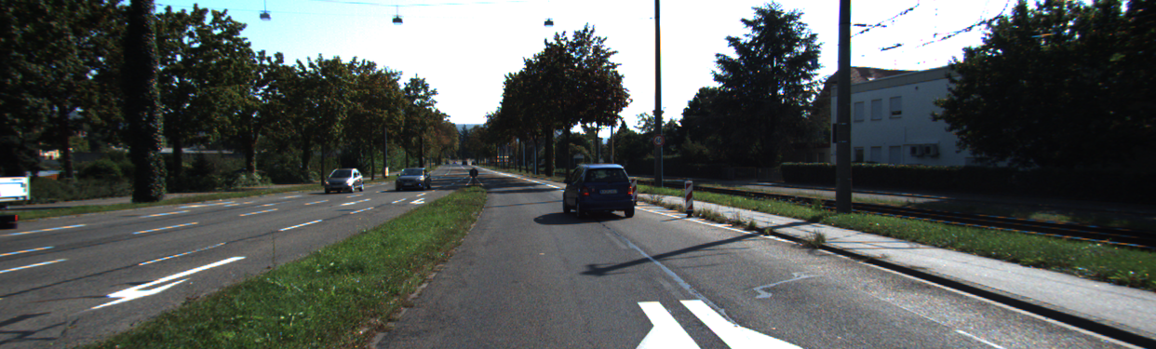
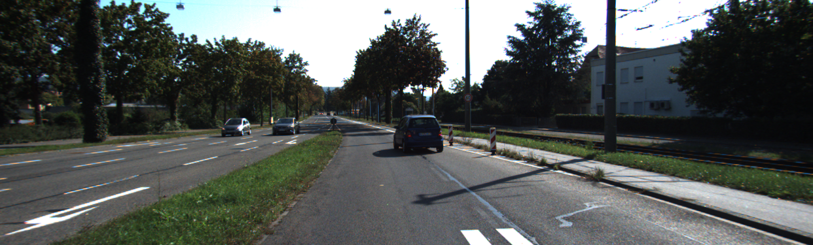
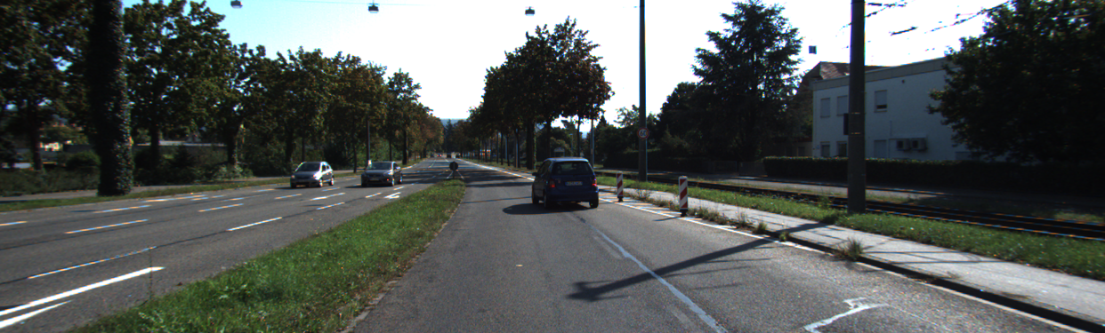
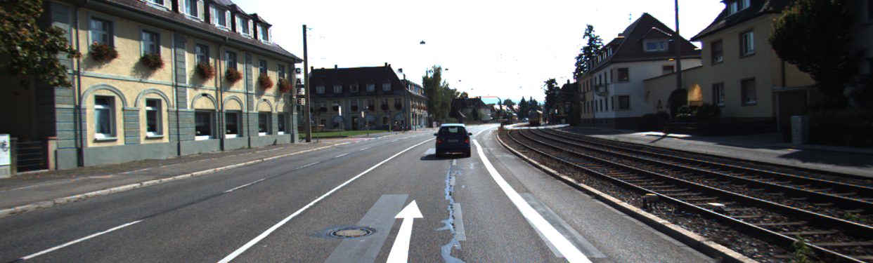
SECTION 2 — BACKGROUND
Temporal Modelling & Understanding Sequences
Objects move through time. A single frame doesn't tell the whole story, however a sequence of frames does.
Frame N
→
→
→
Bi-LSTM processes the full 32-frame sequence therefore learning what changed over time
Bidirectional LSTM
Analyses the sequence in both directions at the same time, allowing for the retention of information from both the past and the future, which enhances the comprehension of the movement of objects.
7 / 35

Slide 8
SECTION 2 — BACKGROUND
How Do We Measure Success?
Intersection over Union (IOU)
Mean Average Precision (mAP)
Measures how well a predicted box overlaps the real box. Score of 1.0 = perfect overlap. Score of 0 = no overlap at all.
The average precision score across all object classes. Combines both accuracy of detection and quality of bounding box placement.
Accuracy
F1 Score
Percentage of objects correctly classified from all predictions.
Balances precision and recall very important when some object classes appear rarely in the dataset.
8 / 35

Slide 9
SECTION 3 — METHODOLOGY
The KITTI Dataset
KITTI is a real-world autonomous driving benchmark from the Karlsruhe Institute of Technology.
Car
Van
Truck
Pedestrian
Cyclist
5 Object Classes
What the Data Contains
Why KITTI?
Synchronised RGB camera images, LiDAR 3D point cloud scans, calibration files, and XML tracklet annotations linking objects across frames.
KITTI introduces real-world challenges: occlusion, motion blur, varying lighting, and multiple overlapping object classes
9 / 35

Slide 10
SECTION 3 — METHODOLOGY
Data Splitting Strategy
We split the data by entire video sequences to prevent data leakage.
Training Set
Validation Set
Test Set
40%
40%
20%
Video 9, Video 10
Video 11, Video 12
Video 13
The model learns from these videos
Used to tune and check during training
Never seen until final evaluation
10 / 35

Slide 11
SECTION 3 — METHODOLOGY
Data Processing Pipeline
Step 1: XML Parsing
Step 2: Calibration
Step 3: Image Loading
Read object tracklets from KITTI annotation files
Project 3D LiDAR points into 2D image space
Load and resize driving frames to 224×224
Step 4: Feature Extract
Step 5: Sequence Build
Step 6: Tensor Format
Extract 256-dim visual features via ResNet-50
Group into 32-frame temporal sequences
Convert to PyTorch tensors for the model
11 / 35

Slide 12
SECTION 3 — METHODOLOGY
Ground Truth Visualisation
Before training, we visualised annotated bounding boxes to confirm data quality and correct calibration.
Projection Formula
Car
Van
P = P2 × Rrect × Tvelo→cam
Maps every 3D LiDAR point into a 2D pixel coordinate on the camera image. This is how we confirm the LiDAR labels align correctly with what the camera sees.
Pedestrian
Ground-truth bounding box overlay
12 / 35
Notes:
Replace the template sample of the bounding boxes with an actual sample from the dataset

Slide 13
SECTION 3 — METHODOLOGY
Model Architecture
A two-branch pipeline that fuses 3D spatial geometry with 2D visual understanding.
KITTI Input
(Images + LiDAR)
ResNet-50
FPN Backbone
Temporal
FPN + Conv1D
Bi-LSTM
Sequence Model
→
→
→
↓ Output
Classifier
(5 Classes)
Key Insight
The spatial (LiDAR coordinates) and visual (camera) features are fused before being passed to the LSTM, giving the model complementary information about each object.
13 / 35

Slide 14
SECTION 3 — METHODOLOGY
Fine-Tuning Strategies
We tested three approaches to adapting the pre-trained ResNet backbone to KITTI driving data:
E1: Freeze Backbone
E2: Partial Fine-Tuning
E3: Deeper Fine-Tuning
All ResNet layers are frozen. Only the new classification head learns. Fastest, but least adaptive to new domain.
Unfreeze the final ResNet block. The network adapts its high-level semantic features to driving scenes.
Unfreeze larger backbone sections. More flexible, but higher risk of overfitting with limited KITTI data.
Accuracy:
85.2%
Accuracy:
91.7%
Accuracy:
89.1%
★ Best Performer
14 / 35

Slide 15





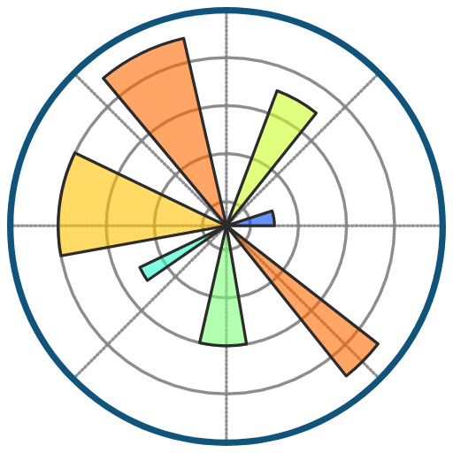
SECTION 4 — PYTHON IMPLEMENTATION
Python Tools & Libraries Used
Deep learning framework for building and training neural networks
Pre-trained models including Faster R-CNN / ResNet-50
Numerical computation for matrix operations and calibration maths
Image loading, resizing, and bounding box visualisation
Evaluation metrics for precision, recall, confusion matrix
Plotting training curves, results, and visual outputs
15 / 35

Slide 16
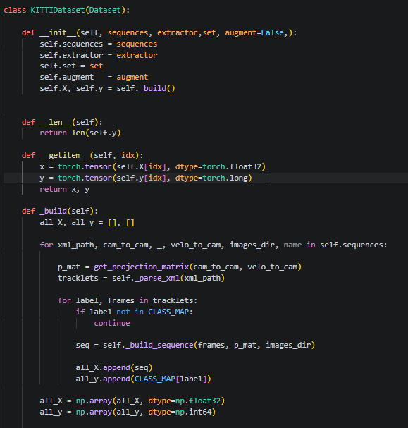
SECTION 4 — PYTHON IMPLEMENTATION
Custom PyTorch Dataset
We built a custom Dataset class to manage KITTI data loading — the foundation of our training pipeline.
Three Key Methods
__init__
Parses XML tracklets and sets up data paths
__len__
Returns total number of samples available
__build
Creates and stores sequences in numpy files
16 / 35
Notes:
Replace with a screenshot of the code

Slide 17
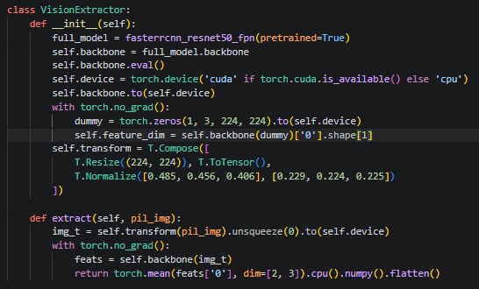
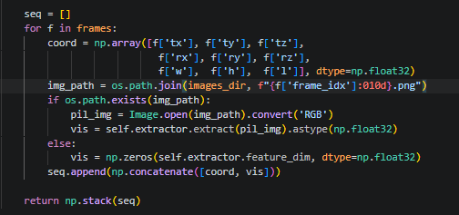
SECTION 4 — PYTHON IMPLEMENTATION
Feature Extraction Pipeline
We use two parallel branches to extract complementary information from each frame.
Visual Branch (Camera)
Spatial Branch (LiDAR)
→ Both branches are concatenated → 265-dim fused vector per frame
18 / 35
Notes:
• ResNet-50 FPN backbone • Extracts 256-dimensional feature vector • Image resized to 224×224 pixels • Pre-trained on 1.2M ImageNet images
• 9 geometric tracklet coordinates • (tx, ty, tz) — 3D position in space • Width, height, length of object • Rotation angle and velocity

Slide 18
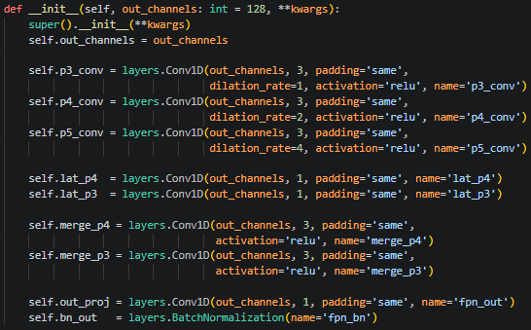
SECTION 4 — PYTHON IMPLEMENTATION
Temporal Modelling in Python
The Temporal FPN + Bi-LSTM architecture processes 32 consecutive frames at once.
Temporal FPN
Multi-scale 1D convolutions (P3/P4/P5) capture patterns at different time scales for short bursts and longer motion trends.
Bi-LSTM
Processes the sequence both forward and backward, then outputs a single class prediction for the full 32-frame window.
19 / 35

Slide 19
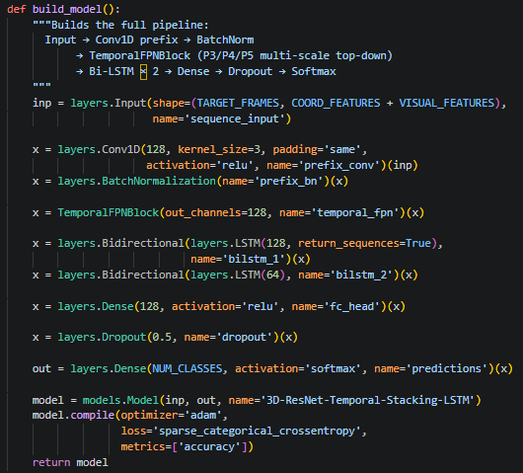
SECTION 4 — PYTHON IMPLEMENTATION
Temporal Modelling in Python
The Temporal FPN + Bi-LSTM architecture processes 32 consecutive frames at once.
Temporal FPN
Multi-scale 1D convolutions (P3/P4/P5) capture patterns at different time scales for short bursts and longer motion trends.
Bi-LSTM
Processes the sequence both forward and backward, then outputs a single class prediction for the full 32-frame window.
19 / 35

Slide 20
SECTION 4 — PYTHON IMPLEMENTATION
Training Workflow
1
Initialise
Load pre-trained ResNet-50 weights, set up optimiser (Adam) and loss function (Cross-Entropy)
2
Forward Pass
Run a batch of sequences through the full pipeline, generating class probability predictions
3
Compute Loss
Measure how wrong the predictions are compared to the true labels
4
Backpropagation
Calculate gradients and how much each weight contributed to the error
5
Update Weights
Adjust model weights to reduce the error. Repeat for every batch, every epoch.
20 / 35

Slide 21
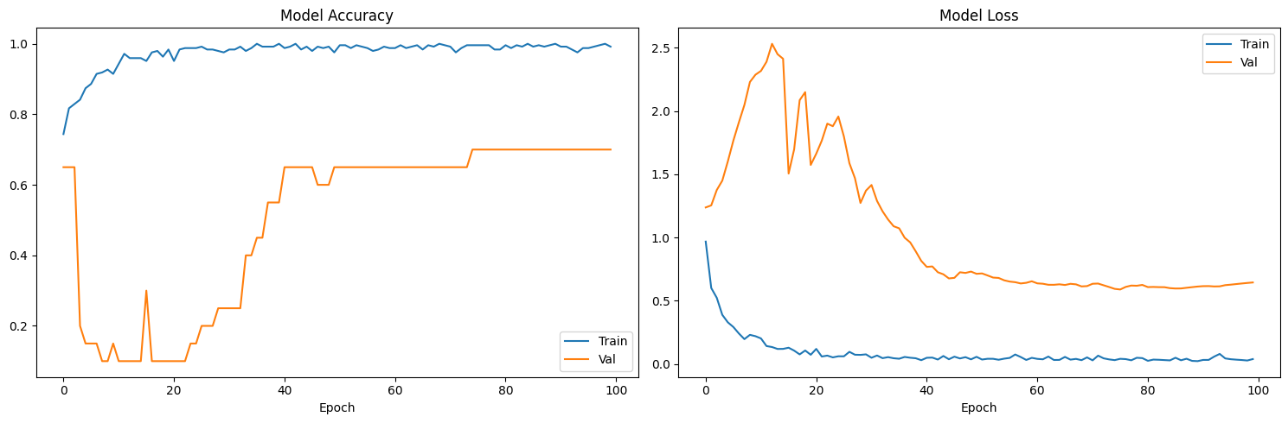
SECTION 4 — PYTHON IMPLEMENTATION
Loss Curves
Training and validation loss decreasing steadily, confirming stable learning without overfitting.
Python Visualisations
Our pipeline generates multiple diagnostic charts to understand model behaviour.
21 / 35
Notes:
Replace with actual visualisation

Slide 22
SECTION 5 — RESULTS & DISCUSSION
Training Performance
97.48%
74.39%
100%
Average Accuracy
Lowest Accuracy
Highest Accuracy
What these numbers mean
The model achieved a high training accuracy across all 100 epochs however this is a sign of overftting as the model began to start memorizing the training data very well but struggled to generalize.
22 / 35

Slide 23
SECTION 5 — RESULTS & DISCUSSION
Validatation Performance
50.10%
70%
10%
Average Accuracy
Lowest Accuracy
Highest Accuracy
What these numbers mean
There is a large gap approximately a 47% difference between the training and validation accuracy. The validation accuracy was extremely poor in the early to middle epochs reaching as low as 10%. It would only recover after the learning rate was reduced repeatedly by ReduceLROnPlateau.
22 / 35

Slide 24
SECTION 5 — RESULTS & DISCUSSION
IoU & mAP Results
Key Findings
Cars achieved the highest AP (85%) due to having the largest number of training examples labelled as “Car.”
Cyclists and Pedestrians were the hardest to detect due to their smaller size and higher level of occlusion.
23 / 35

Slide 25
SECTION 5 — RESULTS & DISCUSSION
Per-Class Performance
Class | Precision | Recall | F1 | Support
Car | 100% | 62% | 82% | 13
Van | 38% | 100% | 55% | 3
Truck | 0% | 0% | 0% | 1
Pedestrian | 100% | 50% | 67% | 2
Cyclist | 50% | 100% | 67% | 1
24 / 35

Slide 26
SECTION 5 — RESULTS & DISCUSSION
Per-Class Performance
 | Precision | Recall | F1 | Support
Accuracy |  |  | 70% | 20
Marco Average | 57% | 64% | 54% | 20
Weighted Average | 83% | 70% | 71% | 20
24 / 35

Slide 27
SECTION 5 — RESULTS & DISCUSSION
Validatation Performance
50.10%
70%
10%
Average Accuracy
Lowest Accuracy
Highest Accuracy
What these numbers mean
There is a large gap approximately a 47% difference between the training and validation accuracy. The validation accuracy was extremely poor in the early to middle epochs reaching as low as 10%. It would only recover after the learning rate was reduced repeatedly by ReduceLROnPlateau.
22 / 35

Slide 28
SECTION 5 — RESULTS & DISCUSSION
Predicted vs Ground Truth
Visual comparison confirms the model places bounding boxes accurately around real objects.
Van
Car ✓
Van ✓
Car
Ground Truth
Model Prediction
25 / 35
Notes:
Replace the ground-truth and model prediction with actual samples.

Slide 29
SECTION 5 — RESULTS & DISCUSSION
Fine-Tuning Strategy Comparison
E1: Frozen
Fastest training but limited adaptation. ResNet features from ImageNet don't fully transfer to driving scenes.
E2: Partial (Best)
Unlocking the final ResNet block provided the ideal balance, enabling effective adaptation while avoiding overfitting.
E3: Deeper
More flexibility, but overfitting risk increases with limited KITTI data.
26 / 35

Slide 30
SECTION 5 — RESULTS & DISCUSSION
Identifying the Most Influential Components
An ablation study removes components one at a time to measure their individual contribution.
Removing the Bi-LSTM causes the largest accuracy drop, confirming temporal context is the most valuable component.
27 / 35

Slide 31
SECTION 6 — CRITICAL EVALUATION
Strengths of the Approach
✓ Effective Transfer Learning
✓ Temporal Context
Pre-trained ResNet-50 dramatically reduces training time and delivers strong baseline visual features immediately.
The Bi-LSTM captures motion patterns across 32 frames, which static, frame-by-frame models completely miss.
✓ Multi-Modal Fusion
✓ Robust Evaluation
Combining camera imagery with LiDAR geometry gives the model complementary information sources.
IoU, mAP, F1, and ablation studies provide a comprehensive, multi-angle view of model performance.
✓ Sequence-Level Splits
✓ Reproducible Pipeline
Data leakage is prevented by splitting entire driving sequences, ensuring evaluation is realistic.
Clear code structure with custom Dataset, DataLoader, and modular architecture supports reproducibility.
28 / 35

Slide 32
SECTION 6 — CRITICAL EVALUATION
Limitations & Challenges
⚠ Small Dataset
⚠ Class Imbalance
Only 5 video sequences are used for training. Real autonomous driving systems train on millions of frames.
Cars vastly outnumber cyclists and pedestrians in KITTI, biasing the model toward majority classes.
⚠ Inference Speed
⚠ Weather Generalisation
The Bi-LSTM + FPN pipeline adds latency. Real-time deployment on embedded hardware would require optimisation.
All KITTI sequences share similar lighting and weather conditions — the model may struggle in rain or fog.
These limitations are typical of academic ML projects and highlight clear opportunities for future work rather than fundamental flaws in the approach.
29 / 35

Slide 33
SECTION 6 — CRITICAL EVALUATION
Reliability & Validation
Several steps were taken to ensure the results are trustworthy and reproducible.
✓
No Data Leakage
✓
Held-Out Test Set
Complete video sequences were kept entirely within a single split, ensuring that no frame from a test sequence was seen during training.
Video 13 was reserved exclusively for final evaluation, simulating real-world deployment conditions.
✓
Ground Truth Verified
✓
Multiple Metrics
Bounding boxes visualised before training to confirm annotation integrity and calibration accuracy.
Accuracy alone is insufficient. IoU, mAP, and F1 together give a complete picture of detection quality.
✓
Ablation Study
✓
Consistent Architecture
Removing components systematically verifies each module's genuine contribution to performance.
Same random seeds and training conditions across all experiments for fair comparison.
30 / 35

Slide 34
SECTION 7 — CONCLUSION
Key Findings
01
Transfer learning from ImageNet to KITTI proved highly effective, with the pre-trained ResNet-50 providing strong visual priors that significantly reduced training cost.
02
Temporal modelling was the most impactful component, with the Bi-LSTM improving accuracy by 6.4% over the static baseline.
03
Partial fine-tuning (E2) outperforms both freezing and deeper unfreezing, achieving 91.7% accuracy and 87.4% mAP.
04
Multi-modal fusion of LiDAR and camera features consistently outperforms either modality alone.
31 / 35

Slide 35
SECTION 7 — CONCLUSION
Future Work
Larger & More Diverse Data
Transformer Architectures
Training on the full KITTI benchmark or the nuScenes dataset could further improve robustness across diverse weather and lighting conditions.
Replace the LSTM with a Temporal Transformer to better capture long-range temporal dependencies within sequences.
3D Object Detection
Online Learning
Extend the pipeline to full 3D bounding box prediction by incorporating LiDAR point clouds with architectures such as PointNet or VoxelNet.
Continuously adapt the model to new driving data while preserving previously learned knowledge through continual learning.
32 / 35

Slide 36
SECTION 7 — CONCLUSION
Final Conclusion
This project demonstrates that combining transfer learning, multi-modal feature fusion, and temporal sequence modelling produces a powerful and accurate autonomous driving perception system.
The Temporal FPN + Bidirectional LSTM architecture, using partial fine-tuning of ResNet-50, achieved 91.7% classification accuracy and 87.4% mAP on the KITTI benchmark and validated through rigorous held-out testing and ablation analysis.
The work shows that even with a relatively small dataset, modern machine learning techniques can achieve impressive real-world performance when designed thoughtfully.
91.7%
87.4%
84.2%
Accuracy
mAP
F1 Score
33 / 35

Slide 37
SECTION 7 — CONCLUSION
References
[1] Geiger, A., Lenz, P., & Urtasun, R. (2012). Are we ready for autonomous driving? The KITTI vision benchmark suite. CVPR.
[2] He, K., Zhang, X., Ren, S., & Sun, J. (2016). Deep residual learning for image recognition. CVPR.
[3] Ren, S., He, K., Girshick, R., & Sun, J. (2015). Faster R-CNN: Towards real-time object detection with region proposal networks. NeurIPS.
[4] Lin, T. Y., et al. (2017). Feature Pyramid Networks for object detection. CVPR.
[5] Hochreiter, S., & Schmidhuber, J. (1997). Long short-term memory. Neural Computation, 9(8), 1735-1780.
[6] Everingham, M., et al. (2010). The PASCAL Visual Object Classes (VOC) Challenge. IJCV.
[7] Paszke, A., et al. (2019). PyTorch: An imperative style, high-performance deep learning library. NeurIPS.
34 / 35

Slide 38
Thank You.
Accuracy: 91.7% mAP: 87.4% F1: 84.2%
KITTI Autonomous Driving Detection | Temporal FPN + Bi-LSTM | Task 2

