Slide 1
DOCKER INSTALLATION
Done by
K.Shivani(CSE(aiml)
M.Lavanya(ECE-3b)
M.Vivek Reddy(ECE-3b)
M.Manideep(CSE-3b)
S.Chenna Rao(ECE-3c)

Slide 2

Docker Installation
Step 1: For installation of Docker, go to your favorite browser(chrome will be used here, but it can be done by using any browser). In the search bar, type Docker download. And click on the first link that appears.

Slide 3
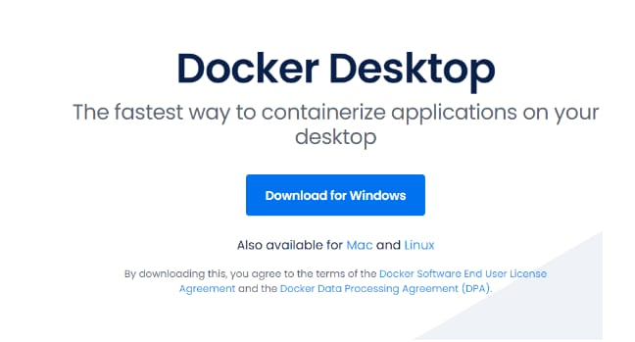
Step 2: After clicking the link, choose your OS, be it Windows, MAC, or Linux for installation.

Slide 4
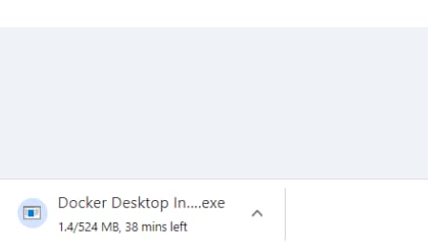
Step 3: The download will start, and based on your internet speed, it will take some time to do so. To know more about docker desktop installation visit Docker Desktop

Slide 5
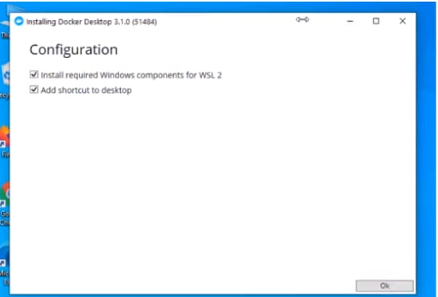
Start Docker Desktop Tool
Step 1: After installation, it will look something like this in Windows:
1.Open the Docker Desktop.
2.Accept the Docker Subscription Service Agreement window. and click On continue. Docker Desktop will start after we accept the terms and conditions.

Slide 6
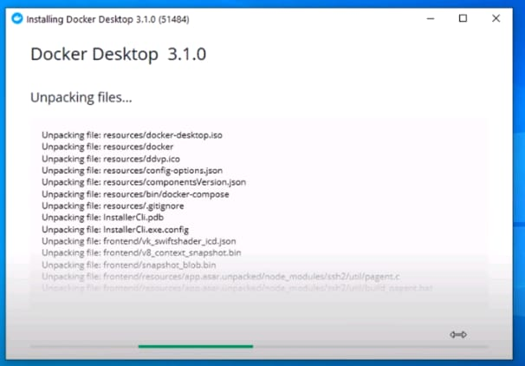
Step 2:After clicking ok the installation will start.

Slide 7
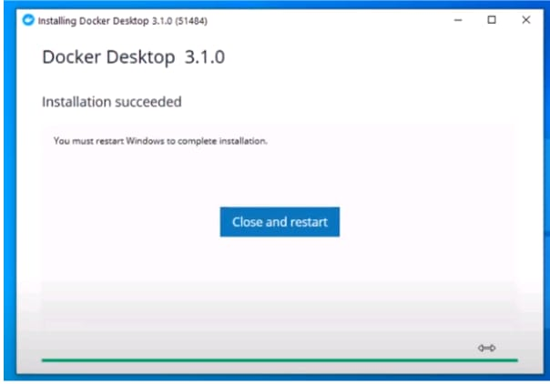
Step-3:After installation ,it will show something like the below:

Slide 8
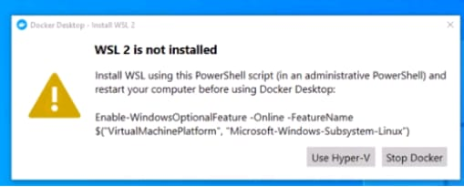
Step 3: After installation, we need to restart our PC and install WSL 2, which stands for Windows Setup for LINUX. It is a compatibility layer for running Linux binary executables natively on Windows 10. Please follow the next few instructions carefully. After restarting, the following dialog box will appear, then click on the Stop Docker button there.

Slide 9
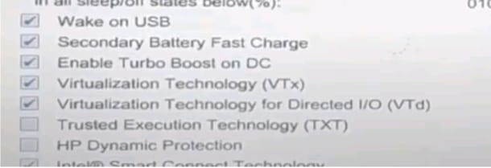
Step 4: After clicking, we need to enable the Hyper-V, for that we will restart the PC and go to BIOS setup, Settings>Update and Security>Recovery>Advanced Setup>Device Configuration. After that, if the option Enable Turbo Boost on DC. is unmarked, mark it, after it, save, and exit.

Slide 10
Step 5: Afterward, in the last step, go to Control Panel> Turn Windows Features on and off. Then for activating Hyper-V, mark the Hyper-V and Windows Hypervisor Platform.At this point, you have successfully installed and configured Docker on your Windows machine.

Slide 11
THANK YOU

