Slide 1
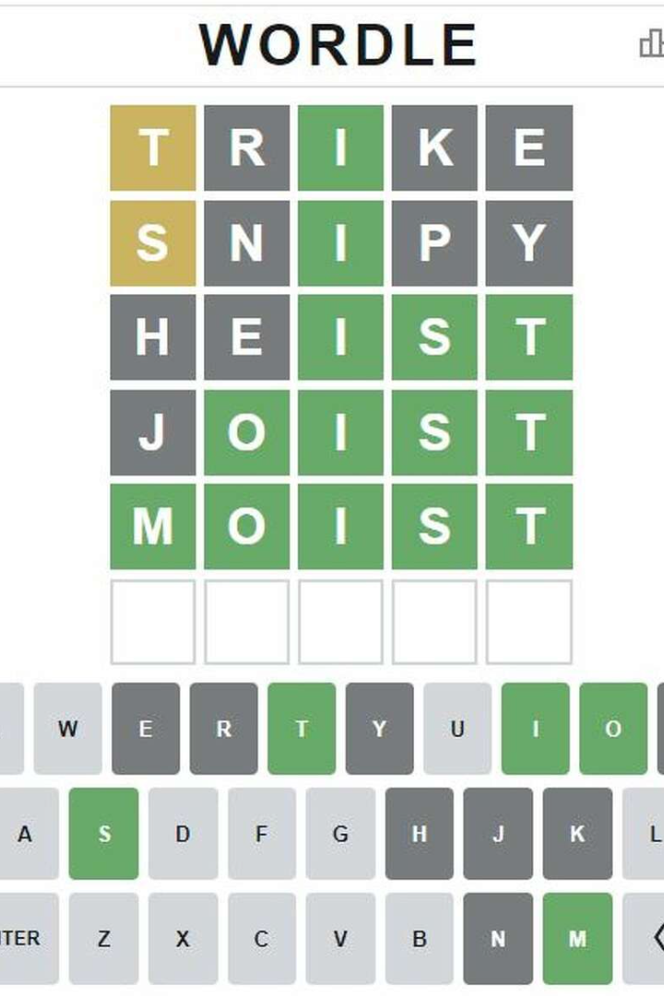
Wordle Game
Welcome to the world of Wordle, an exciting word-guessing game that will challenge your vocabulary and deduction skills. In this presentation, we'll explore everything you need to know to become a pro in Wordle.

Slide 2
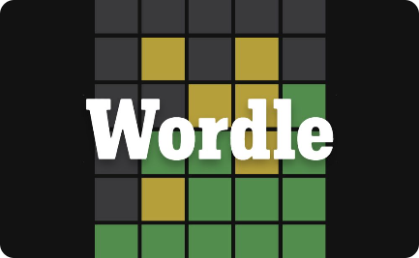
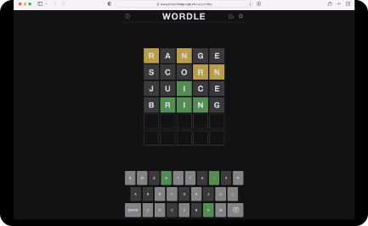

What is Wordle?
The Basics
How It Looks
Victory!
Wordle is a simple yet addictive online word game in which you must guess a five-letter word provided by the computer. The goal is to guess the word in as few attempts as possible and as quickly as you can.
It's a colorful and minimalistic game that looks like a blank canvas, making it easy on the eyes while you focus on guessing the right letters and completing the word.
Once you guess the word correctly, you'll win, and a trophy will pop up on the screen, giving you a sense of accomplishment and encouraging you to play more.

Slide 3
How to Play Wordle
1
Start Small
2
Explore
To start, guess a five-letter word. Type in your guess to start the game.
After submitting a word, the game will tell you how many letters you've guessed correctly. Use this information to try out different possibilities.
3
Leverage Your Knowledge
4
Time Management
As you progress, patterns will start to appear. Draw on these to eliminate possible words and guess more accurately.
Don't waste time guessing obscure words. Instead, try to guess the more common ones, as they're likely to have appeared before in the game.

Slide 4
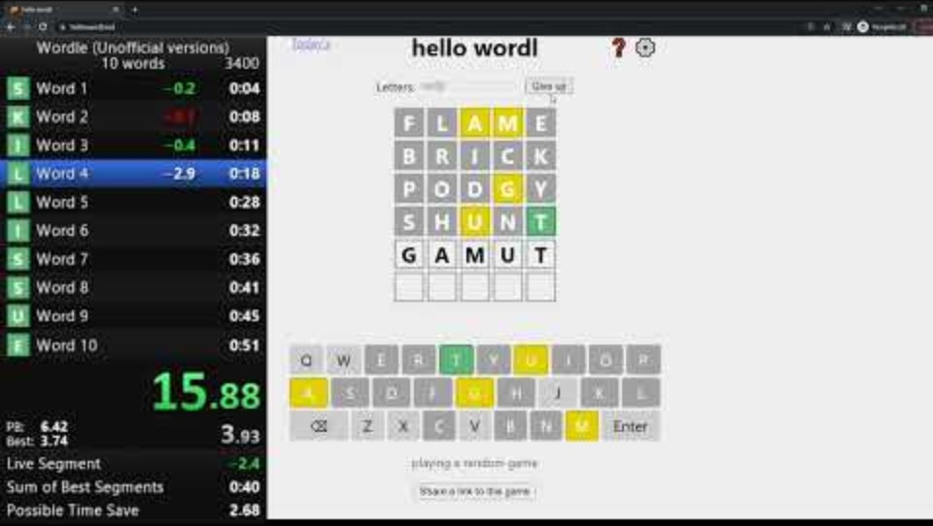
How do speedruns look like

Slide 5
Wordle Strategies
1
Start with Common Consonants
Try beginning with common consonants, such as 's', 't', 'n', and 'r'. They're more likely to appear in the word.
2
Eliminate Unlikely Possibilities
As you guess more letters, eliminate words that are less likely. This way, you can focus on more plausible options.
3
Use Letter Frequency Charts
Familiarize yourself with the most commonly used letters in the English language. These charts can help you make better word guesses.

Slide 6

Benefits of Playing Wordle
Improves Vocabulary
Exercises Your Brain
Through regular play, Wordle can help you develop your vocabulary and improve your language skills.
Playing word games like Wordle can help keep your brain sharp and improve your mental agility.
Relieves Stress
Playing games can be a great way to unwind and reduce stress levels, making Wordle an excellent option for some fun downtime.

Slide 7
Conclusion
Wordle is an engaging word-guessing game that challenges your vocabulary and deduction skills.
Strategies such as starting with common consonants and eliminating unlikely possibilities can help you win.
Playing Wordle can improve your language skills, relieve stress, and keep your brain sharp.
It has become a sensation in popular culture, inspiring memes and even appearing in literature.
Now that you know everything there is to know about Wordle, put your skills to the test and become a Wordle champion!

