Slide 1
AI IMPACT ON JOBS
Layoff Risk Prediction Using Machine Learning
Supervised Multi-Class Classification • XGBoost • Streamlit
DATASET
20,000
records
TARGET
3
risk classes
BEST MODEL
95.975%
Tuned XGBoost
01

Slide 2
Project Overview
From job-profile data to an interpretable layoff-risk prediction
INPUT
Job Profile
Demographic, educational, occupational, organisational, task and AI attributes
Data
ML Pipeline
Risk
TASK
3-Class Classification
Predict High, Medium or Low Layoff_Risk
20,000 records • 16 columns • 15 predictors
Clean target distribution: High 33.98%, Low 33.01%, Medium 33.01%
Best reported test accuracy: 95.975% with tuned XGBoost
Notebook experiment + separate interactive Streamlit application
OUTPUT
Risk + Probability
Interactive analytical estimate through Streamlit
02

Slide 3
Problem Statement
Why predict layoff-risk categories?
CONTEXT
AI + Automation
Routine tasks and job structures are changing.
Preprocessing
+ Classifier
Job Profile
Layoff_Risk
CHALLENGE
Unequal Exposure
Different roles depend differently on routine work, creativity and human interaction.
The project is designed for analytical workforce-risk research.
It combines numerical and categorical predictors rather than relying on a single factor.
The output is a model estimate—not a guaranteed employment outcome.
ML FORMULATION
High / Medium / Low
A multiclass classification problem using job-profile attributes.
03

Slide 4
Project Objectives
OBJECTIVE 01
Explore dataset structure and target distribution
OBJECTIVE 02
Build a reproducible preprocessing pipeline
OBJECTIVE 03
Train and compare multiple classifiers
OBJECTIVE 04
Evaluate accuracy, precision, recall, F1 and confusion matrices
OBJECTIVE 05
Validate XGBoost with five-fold StratifiedKFold
OBJECTIVE 06
Tune XGBoost using RandomizedSearchCV
OBJECTIVE 07
Interpret the final model using feature importance
OBJECTIVE 08
Extend the workflow through an interactive Streamlit dashboard
04

Slide 5
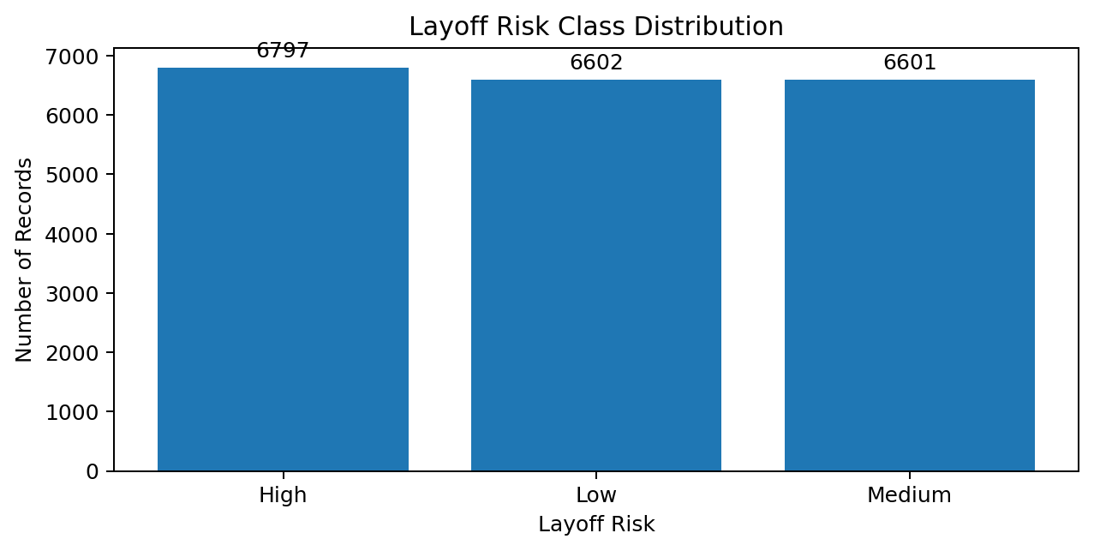
Dataset Overview
20,000 records • 16 columns • 3 target classes
RECORDS
20,000
employee/job records
COLUMNS
16
15 predictors + target
MISSING
0
reported
DUPLICATES
0
reported
Target: Layoff_Risk
High = 6,797 (33.98%)
Low = 6,602 (33.01%)
Medium = 6,601 (33.01%)
Approximately balanced classes
05

Slide 6
Feature Space & Representation
Numerical and categorical branches are handled differently
NUMERICAL FEATURES
Age
Years_of_Experience
Routine_Task_Percentage
Creativity_Requirement
Human_Interaction_Level
Number_of_AI_Tools_Used
AI_Usage_Hours_Per_Week
Tasks_Automated_Percentage
AI_Training_Hours
CATEGORICAL FEATURES
Education_Level
Industry
Job_Role
Company_Size
Job_Level
AI_Adoption_Level
NUMERICAL →
StandardScaler
CATEGORICAL →
OneHotEncoder
COMBINE →
ColumnTransformer
06

Slide 7
Data Preprocessing
Reproducible preprocessing inside the modelling pipeline
X / y
01
Separate Layoff_Risk
Split
02
80:20 stratified
Scale
03
StandardScaler
Encode
04
OneHotEncoder
Combine
05
ColumnTransformer
Pipeline
06
Preprocessing + Model
test_size = 0.2
random_state = 42
stratify = y
OneHotEncoder(handle_unknown='ignore') supports unseen categories
07

Slide 8
End-to-End ML Architecture
The project moves from raw data to an interactive application
Dataset
Inspection
Preprocessing
Train Models
Evaluation
Cross-Validation
Tuning
Final XGBoost
Streamlit
Validation strategy: five-fold StratifiedKFold with macro F1 scoring
Model selection: tuned XGBoost based on the strongest reported performance
Interpretation: transformed feature names paired with XGBoost feature_importances_
08

Slide 9
Classification Models
A broad comparison across model families
Linear / Margin
Logistic Regression
SVM (RBF)
Tree / Bagging
Decision Tree
Random Forest
Distance / Probabilistic
KNN (k=5)
Gaussian Naive Bayes
Boosting
Gradient Boosting
AdaBoost
XGBoost
Tuned XGBoost
The notebook's executed comparison contains 10 model results.
The strongest result is tuned XGBoost.
The Streamlit dashboard is intentionally a smaller interactive model set.
NOTEBOOK
10 models
broader experiment
DASHBOARD
4 models
interactive layer
KEY DISTINCTION
Baseline XGBoost
dashboard ≠ tuned notebook model
09

Slide 10
How the Models Were Evaluated
Metrics answer different questions about classification quality
Accuracy
Overall fraction of correct predictions
Precision
Reliability of predicted class labels
Recall
Ability to capture actual class members
F1-score
Balance of precision and recall
Macro F1
Equal weight to High, Low and Medium
Confusion Matrix
Where class-level errors occur
Because the target has three classes, macro-level metrics provide a useful class-balanced view.
10

Slide 11
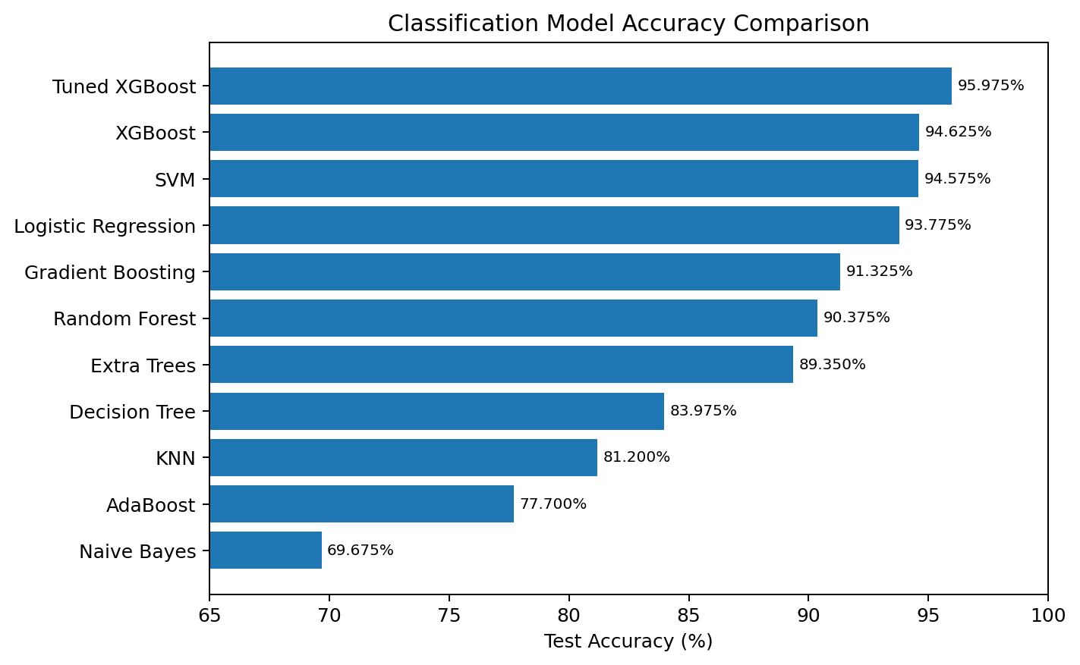
Model Performance Comparison
Test accuracy from the executed notebook comparison
BEST MODEL
95.975%
Tuned XGBoost
BASELINE
94.625%
XGBoost
TUNING GAIN
+1.35 pp
95.975% − 94.625%
Ranking: Tuned XGBoost → XGBoost → SVM → Logistic Regression → Gradient Boosting → Random Forest → Decision Tree → KNN → AdaBoost → Naive Bayes
11

Slide 12
Model Comparison: What the Results Tell Us
Performance pattern across different modelling assumptions
BOOSTING
Strongest
Tuned XGBoost leads the comparison; default XGBoost follows closely.
Gradient Boosting and Random Forest provide solid ensemble baselines.
KNN performance is lower in the high-dimensional one-hot encoded feature space.
Naive Bayes is lowest among the executed comparison, consistent with a restrictive independence assumption.
The tuning stage adds measurable improvement to XGBoost.
MARGIN
Strong challenger
SVM (RBF) reaches 94.575% and is close to baseline XGBoost.
BASELINE
Still competitive
Logistic Regression reaches 93.775% with a simpler modelling assumption.
12

Slide 13
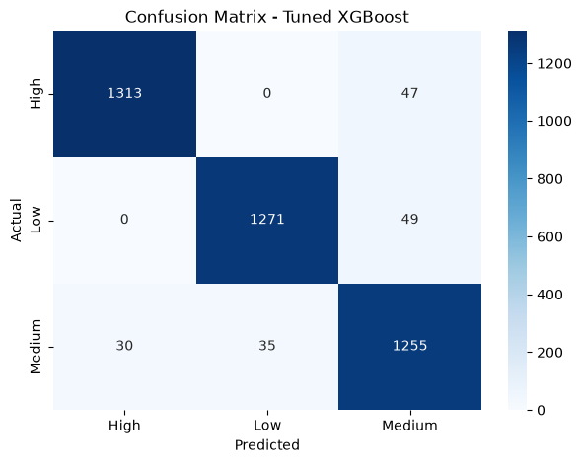
Confusion Matrix: Tuned XGBoost
Actual notebook output — class-level performance of the final model
HIGH
0.98 / 0.97 / 0.97
precision / recall / F1
LOW
0.97 / 0.96 / 0.97
precision / recall / F1
MEDIUM
0.93 / 0.95 / 0.94
precision / recall / F1
The Medium class is the most challenging class in several model outputs; the final model still reaches 0.94 F1 for Medium.
13

Slide 14
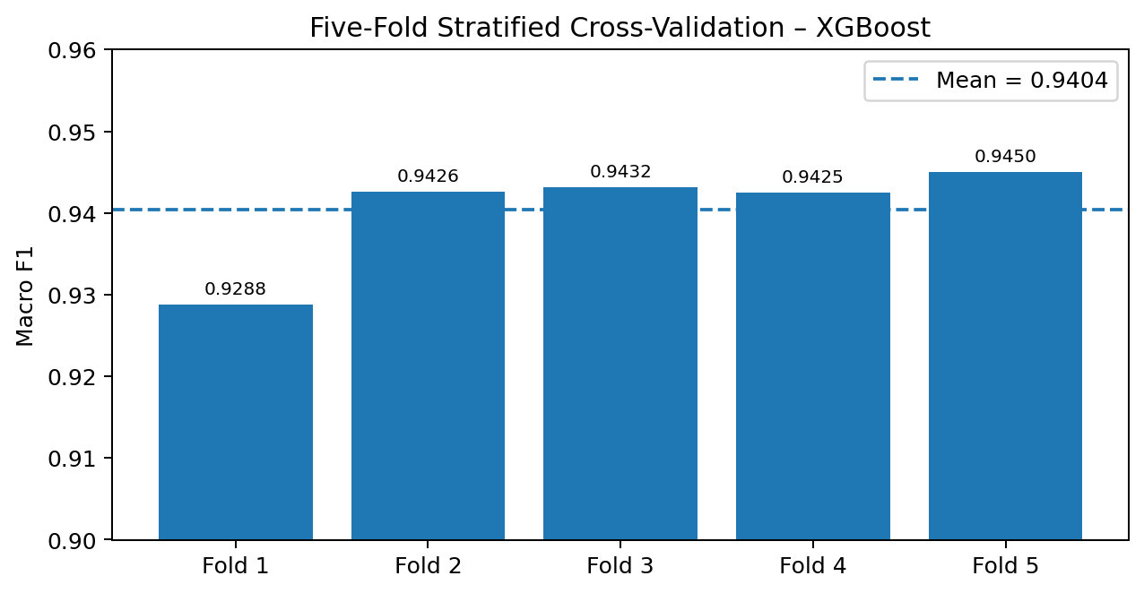
Five-Fold Stratified Cross-Validation
Baseline XGBoost stability check using macro F1
MEAN
0.9404
macro F1
STD. DEV.
0.00727
fold variation
Fold 1: 0.9288
Fold 2: 0.9426
Fold 3: 0.9432
Fold 4: 0.9425
Fold 5: 0.9450
StratifiedKFold preserves the relative class composition across folds, making the validation estimate more consistent for this multiclass target.
14

Slide 15
Hyperparameter Tuning with RandomizedSearchCV
Targeted search for a stronger XGBoost configuration
SEARCH
20 candidates
RandomizedSearchCV
VALIDATION
5 folds
StratifiedKFold
SCORING
f1_macro
model selection
RESULT
0.953790
best CV macro F1
SELECTED PARAMETERS
n_estimators = 400
max_depth = 5
learning_rate = 0.1
subsample = 0.8
colsample_bytree = 0.8
min_child_weight = 7
gamma = 0
TUNING IMPACT
Baseline XGBoost
94.625%
Tuned XGBoost
95.975%
Improvement: +1.35 percentage points
The tuned model was selected after cross-validated hyperparameter search, then evaluated on the held-out test set.
15

Slide 16
Tuned XGBoost: Final Test Results
Held-out test set: 4,000 records
TEST ACCURACY
95.975%
strongest reported result
MACRO F1
≈ 0.96
balanced across classes
WEIGHTED F1
≈ 0.96
overall test-set performance
CLASS
PRECISION
RECALL
F1
High and Low are classified strongly; Medium remains the more difficult boundary class.
The final model improves over baseline XGBoost while preserving strong class-level F1.
High
0.98
0.97
0.97
Low
0.97
0.96
0.97
Medium
0.93
0.95
0.94
16

Slide 17
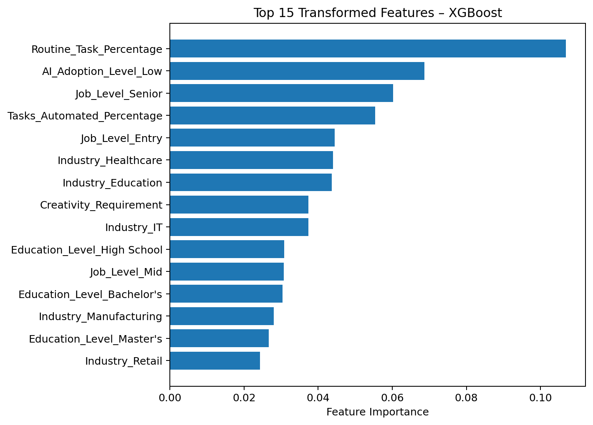
Feature Importance
Top transformed features from the tuned XGBoost model
TOP FEATURE
Routine_Task_Percentage
importance = 0.099726
Job_Level_Senior — 0.051596
Tasks_Automated_Percentage — 0.049553
Industry_Education — 0.045797
Industry_Healthcare — 0.045344
Job_Level_Entry — 0.043095
17

Slide 18
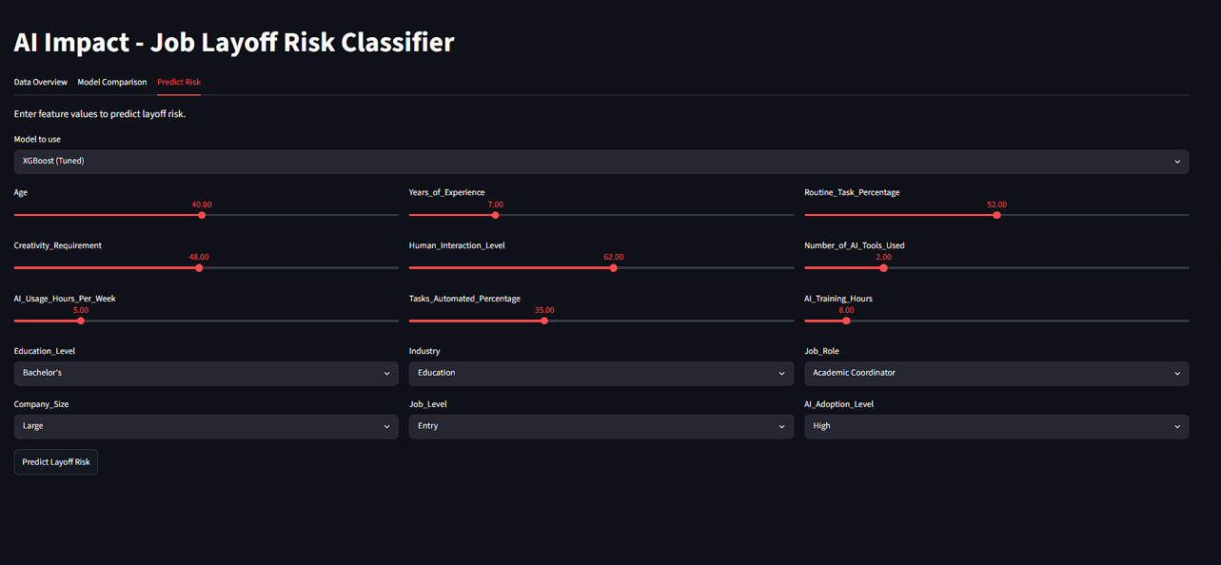
Streamlit Dashboard
Interactive application layer over the modelling workflow
AI Impact - Job Layoff Risk Classifier
TAB 1
Data Overview
metrics, charts, first 20 rows
Data Overview
Model Comparison
Predict Risk
TAB 2
Model Comparison
accuracy, report, confusion matrix
Layoff Risk Distribution
Model Accuracy
TAB 3
Predict Risk
sliders, selectboxes, prediction
Prediction / report / confusion matrix
Uses Streamlit, pandas, NumPy, Plotly, scikit-learn and XGBoost.
Uses @st.cache_data and @st.cache_resource to reduce repeated computation.
18

Slide 19
Streamlit Workflow, Requirements & Use Cases
What the deployed layer actually does
Load Excel
DataFrame
Identify X/y
Feature lists
Preprocess
ColumnTransformer
Train models
Pipelines
Compare
Accuracy + reports
Predict
Risk + probabilities
FUNCTIONAL
Accept job profile → return risk + class probabilities
FR-01 … FR-14 are documented in the project.
NON-FUNCTIONAL
Usability • caching • reproducibility • robustness
random_state=42; cached loading/training.
APPLICATIONS
Workforce planning • reskilling • research
Analytical support, not automatic employment decisions.
19

Slide 20
Limitations, Future Scope & Conclusion
Responsible interpretation is part of the project
LIMITATIONS
• Association, not causation
• External/future data may differ
• Dashboard trains models at runtime
• Dashboard uses baseline XGBoost
• Probability chart is not automatically calibrated
• Employment use requires fairness + human oversight
FUTURE SCOPE
• Save/load trained pipeline
• Deploy tuned XGBoost in dashboard
• Add full notebook model library
• Add SHAP explanations
• Calibrate probabilities
• Add fairness/subgroup evaluation
• Add validation, export, versioning and monitoring
• External and future-period testing
CONCLUSION
The project develops a complete supervised-learning workflow for High, Medium and Low layoff-risk prediction.
Tuned XGBoost achieves 95.975% test accuracy.
Streamlit extends the work into an interactive analytical application.
Use the system as decision support—not as an automatic employment decision mechanism.
THANK YOU
20

