Slide 1
Data Analyst Intern at Data Glacier
Cross Selling Recommendation
Project:
Deliverables
Week 11
Name:
Kumkum Chakraborty
University:
Dr.B.R.Ambedkar University
Country:
U.S.A
Email:
kumkumchakraborty2016@gmail.com
Specialization:
Data Analyst

Slide 2
Batch Code:
LISUM41
Date:
03/16/2025
Submitted to:
Data Glacier

Slide 3
Problem Statement:
XYZ credit union in Latin America is performing very well in selling the Banking products (e.g.: Credit card, deposit account, retirement account, safe deposit box etc) but their existing customer is not buying more than 1 product which means bank is not performing good in cross selling (Bank is not able to sell their other offerings to existing customer). XYZ Credit Union decided to approach ABC analytics to solve their problem
Objective:
This project aims to analyze customer behavior and provide data-driven recommendations to improve cross-selling without using machine learning.

Slide 4
Project Plan:
WEEK | DATE | PLAN
Week7 | 02/19/2025 | 1. Business understanding
Week8 | 02/26/2025 | 2. Data Understanding
Week9 | 03/02/2025 | 3. Data Cleansing and Transformation
Week10 | 03/02/2025 | 4. Exploratory data analysis
Week11 | 03/16/2025 | 5. EDA Recommendation (ppt)
Week12 | 03/23/2025 | 6. business insight in taking decision.
Week13 | 03/30/2025 | 7. Prepare a final presentation

Slide 5
Info. About Data:
This data about XYZ credit union Company in Latin America which contains 48 features and 13647309 Number of Observations.
Total Number of Observations | 13647309
Total Number of Files | 1
Total Number of Features | 48
Base Format of The File | CSV
Size of The Data | 310MB

Slide 6
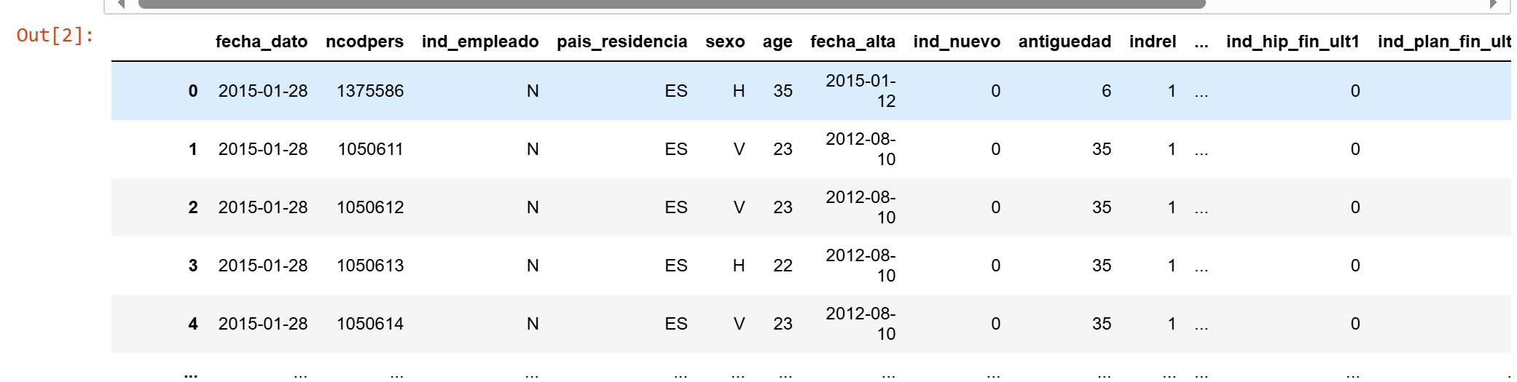
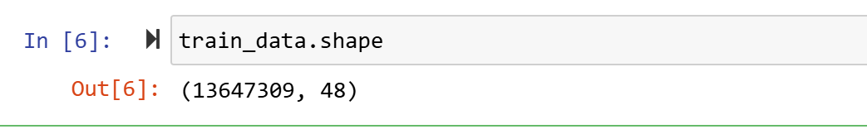
Data Understanding
This data set contains 13647309 rows and 48 columns

Slide 7
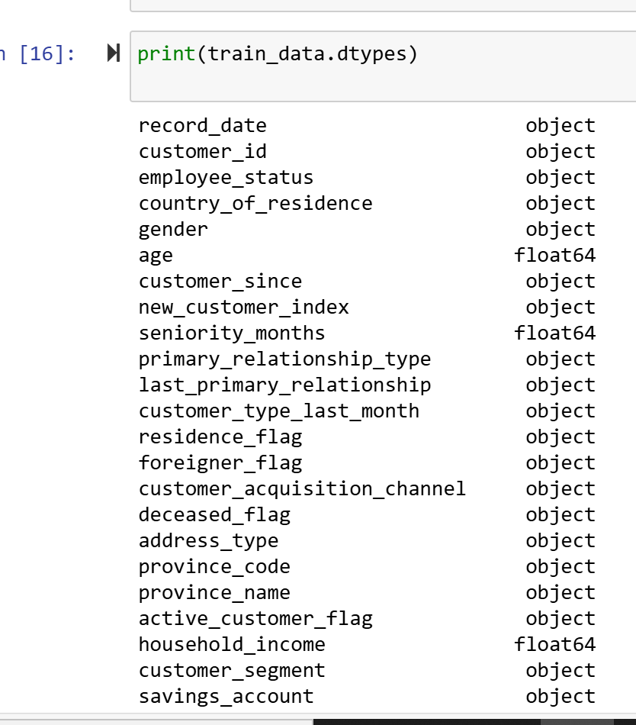
Data Understanding
All the data types was object but now few column’s data types has been changed float64

Slide 8
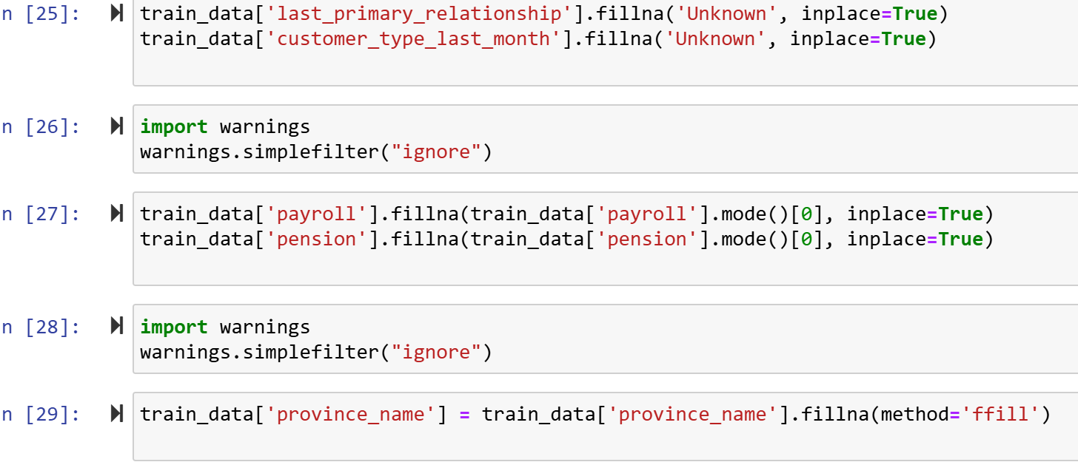
Data Understanding
Missing Value Filling

Slide 9
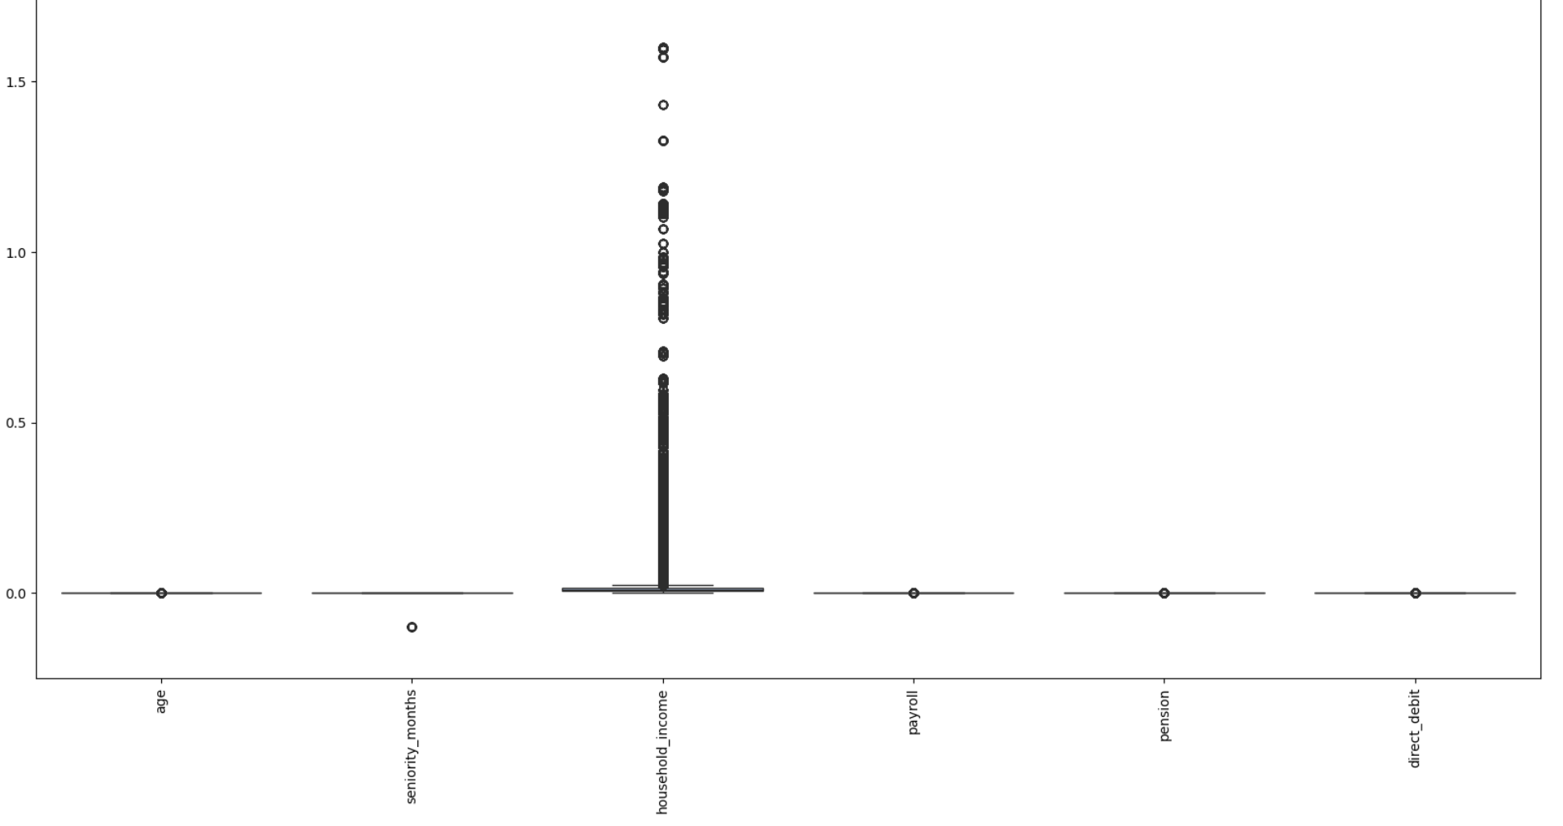
Data Understanding
Outlier Detection

Slide 10
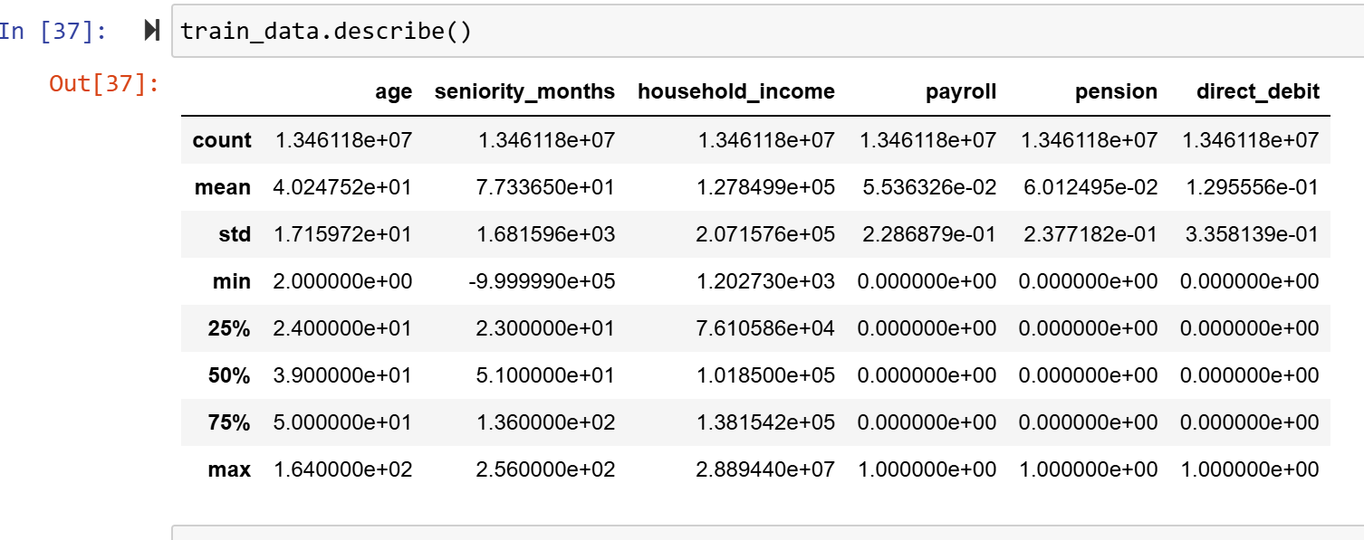
Exploratory Data Analysis (EDA)
Data Describe

Slide 11
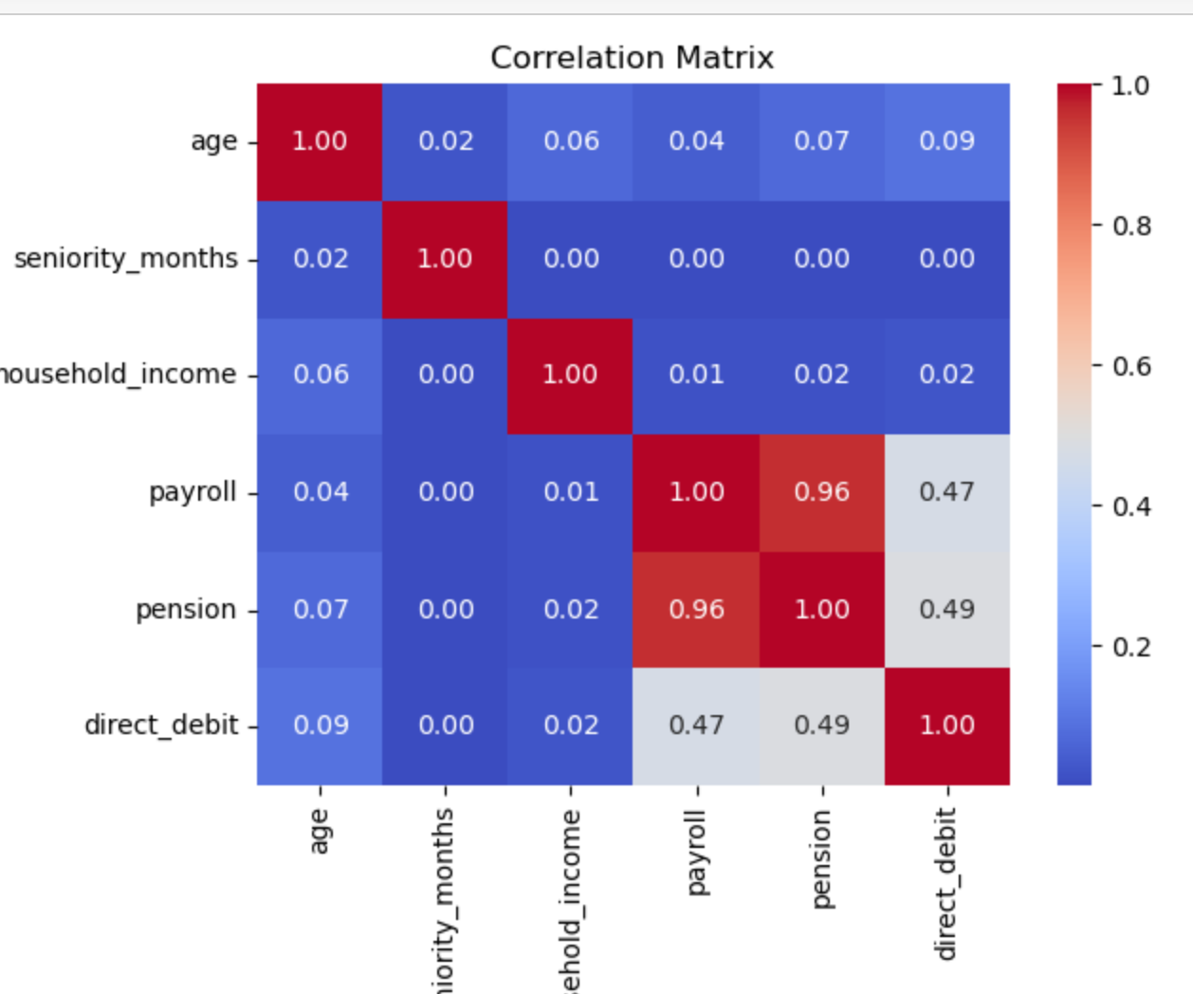
Exploratory Data Analysis (EDA)
A strong correlation (0.96) between payroll and pension accounts suggests a high cross-selling opportunity, enabling the bank to target payroll account holders for pension products

Slide 12
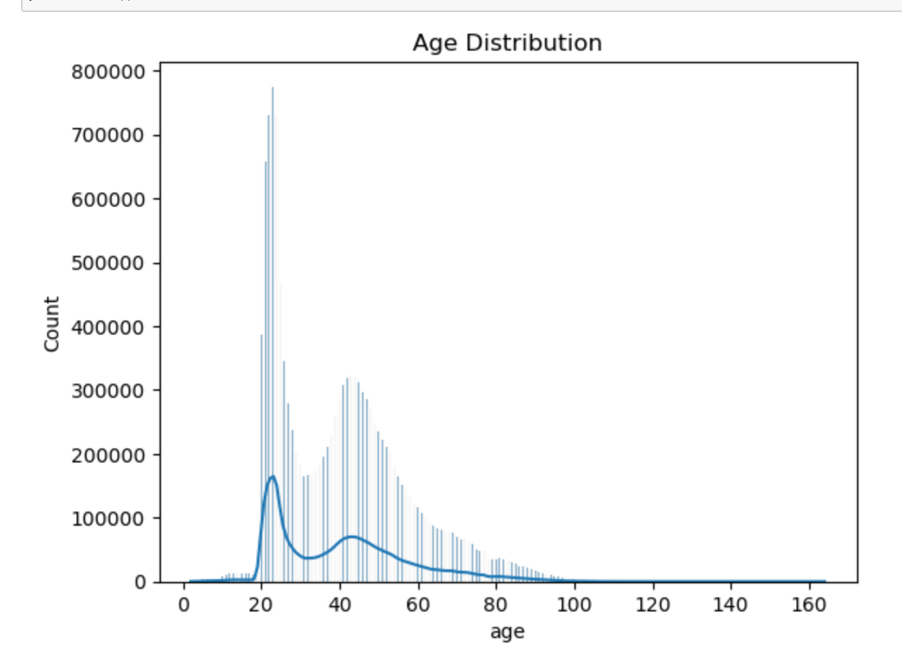
Exploratory Data Analysis (EDA)
1.The majority of customers are between 19 to 25 years old, as shown by the highest frequency in this range.
2. The age distribution is right-skewed, indicating fewer older customers in the dataset

Slide 13
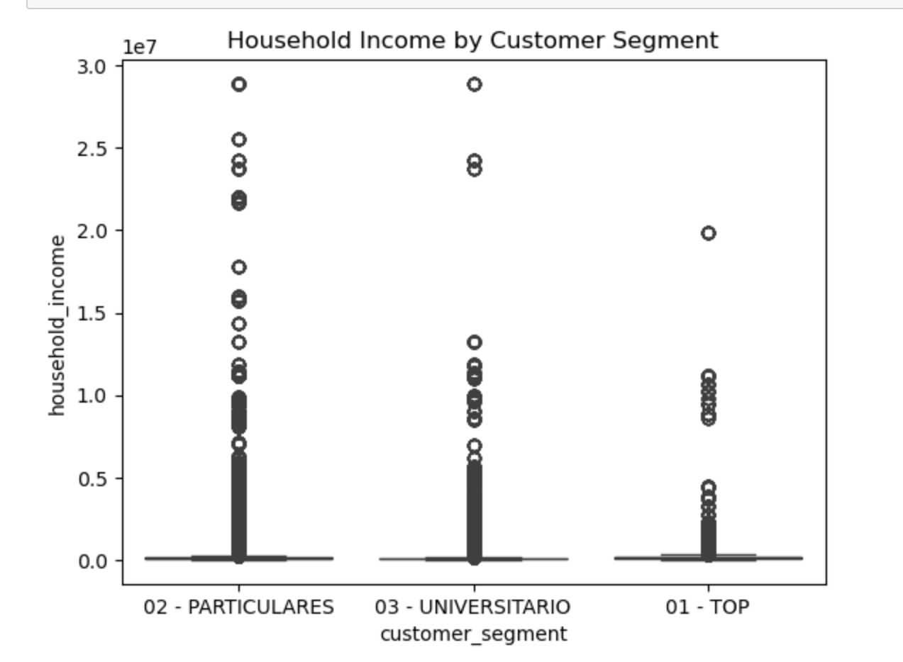
Exploratory Data Analysis (EDA)
1.The 02 (Particulars) segment has the highest concentration of household income up to 1.0, with some high-income outliers reaching 3.0
2. The 03 (Universitario) segment has most customers with household income below 0.6, but a few outliers extend beyond 3.0
3. The 01 (Top) segment has lower household income distribution, mainly below 0.6, with very few high-income customers reaching 2.0
This suggests that the VIP segment has fewer high-income customers, while the Particulars and Universitario segments show a wider spread of income levels, which could impact cross-selling strategies

Slide 14
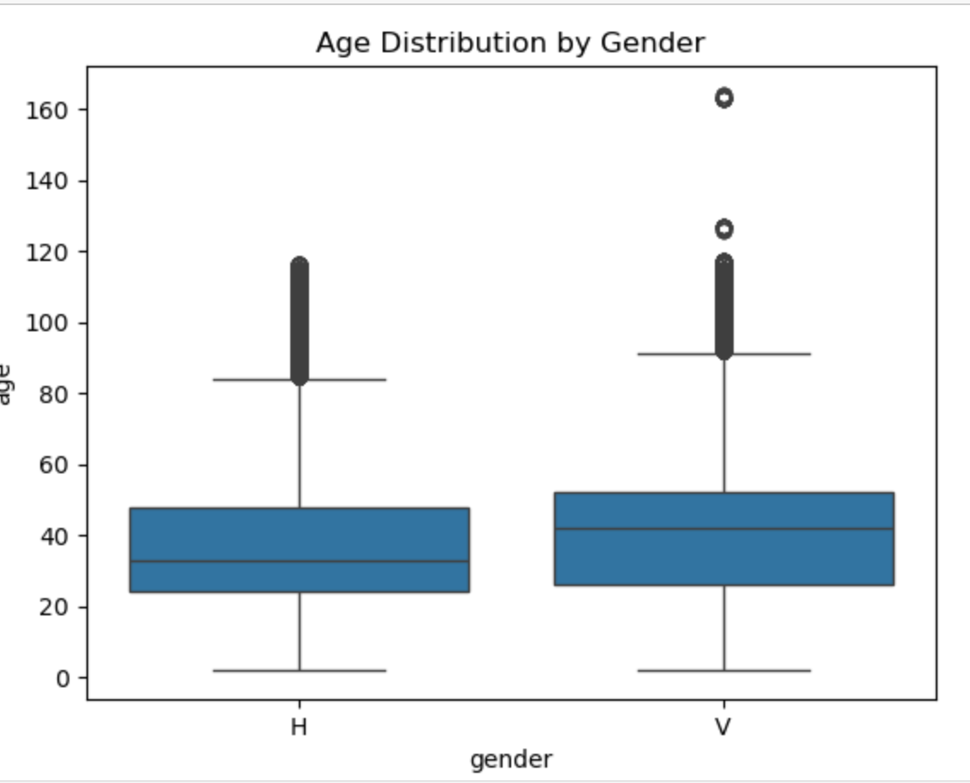
Exploratory Data Analysis (EDA)
1. The median age for gender 'H' is around 30, while for gender 'V,' it is around 40
2. Both genders have a similar upper range (90-120), but gender 'V' has more extreme outliers at ages 120 and 160.
3. Gender 'H' has a more compact distribution, whereas gender 'V' shows a wider spread in age

Slide 15
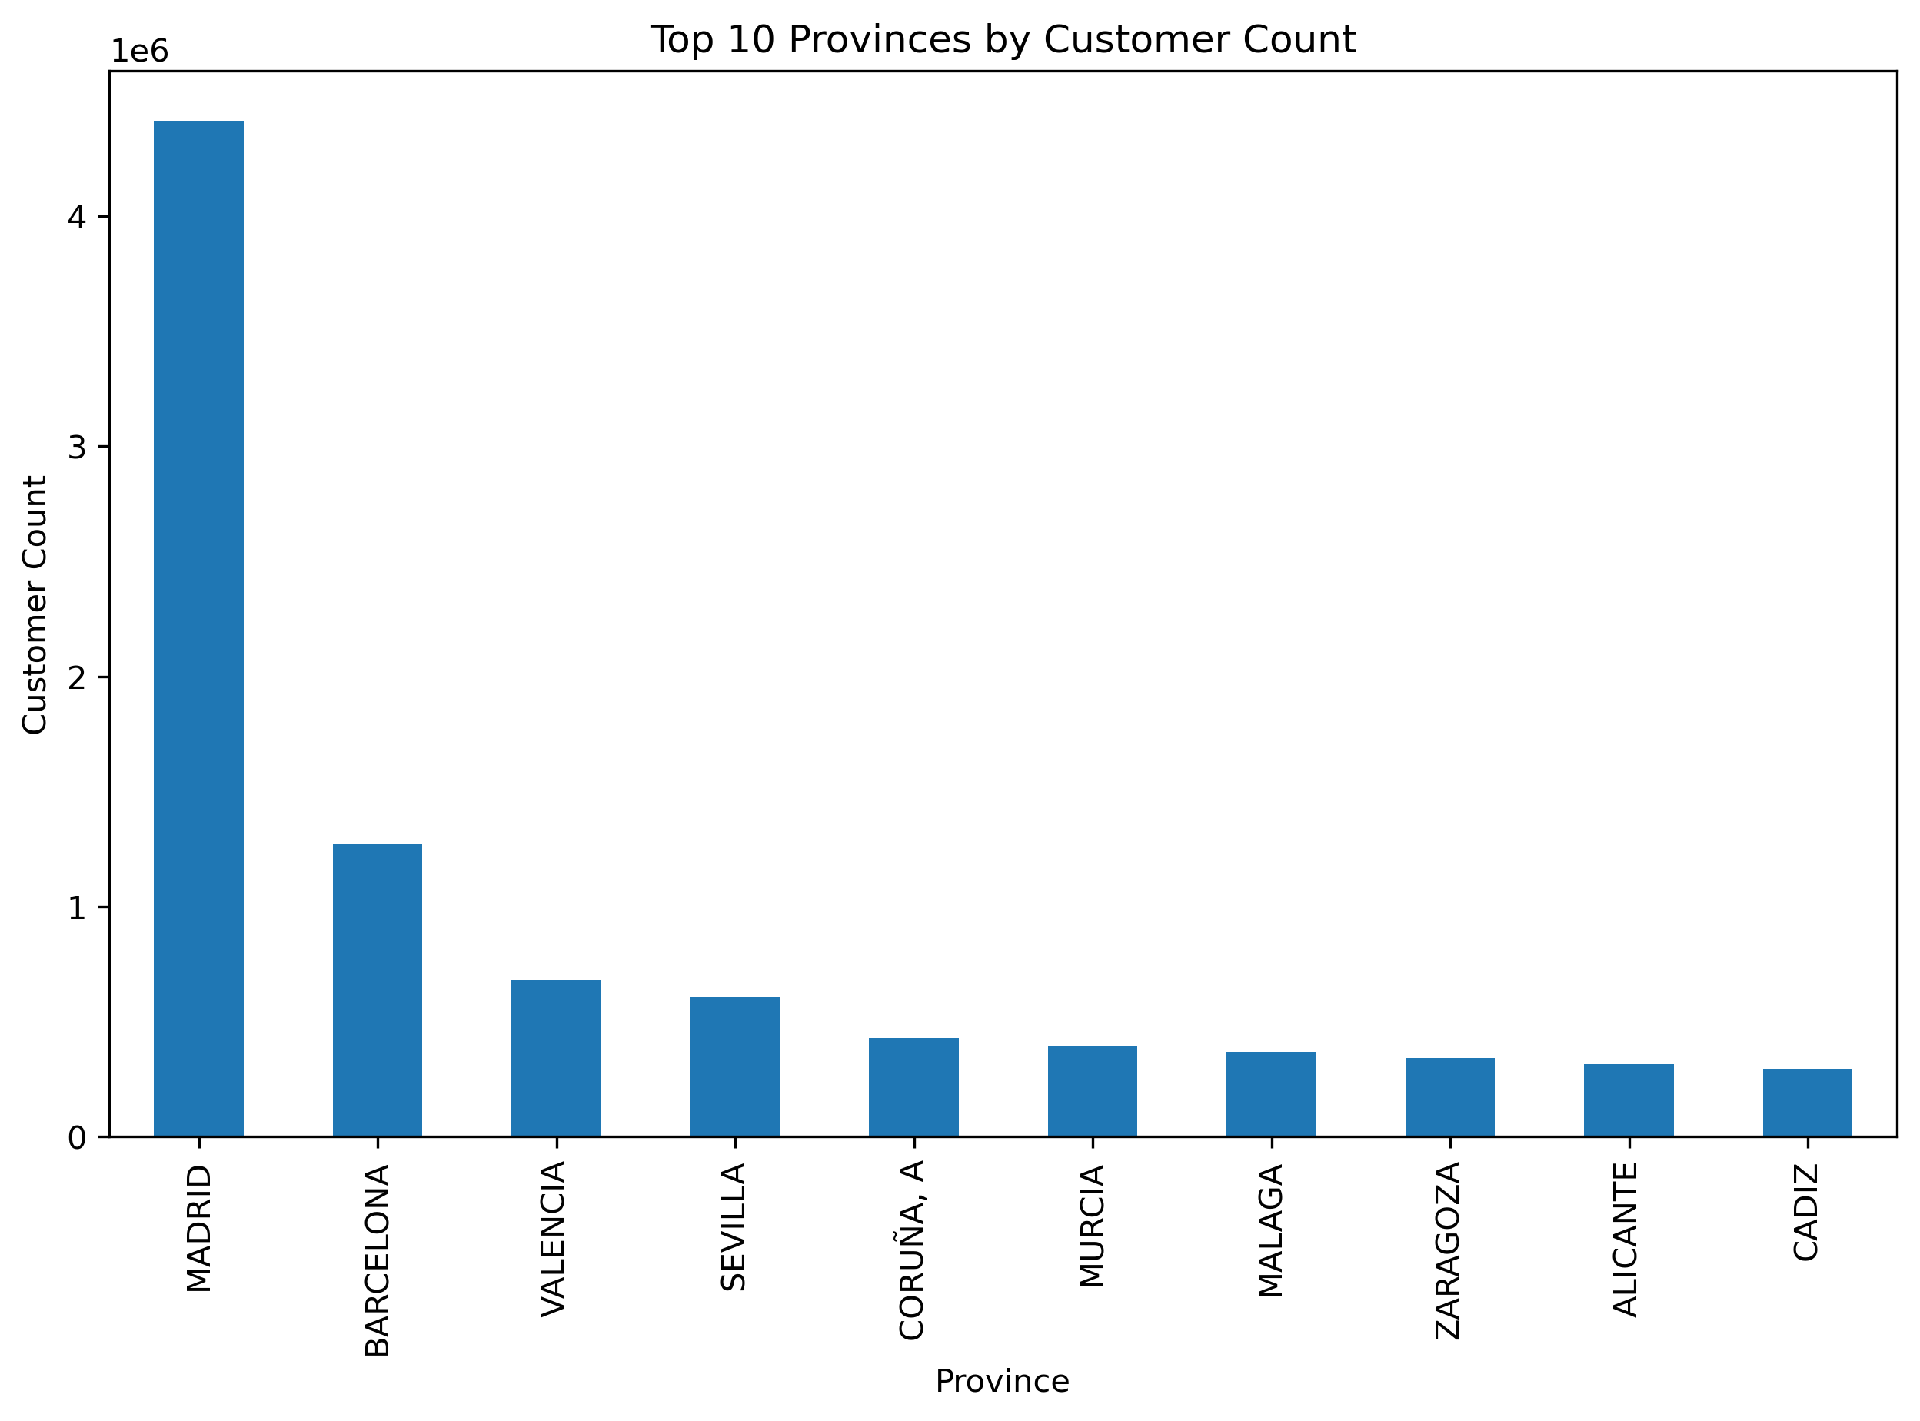
Exploratory Data Analysis (EDA)
1.Madrid has the highest number of customers, with its count exceeding 400,000, significantly higher than other provinces
2. Other provinces have less than 200,000 customers, indicating that Madrid is the primary market for the bank’s products

Slide 16
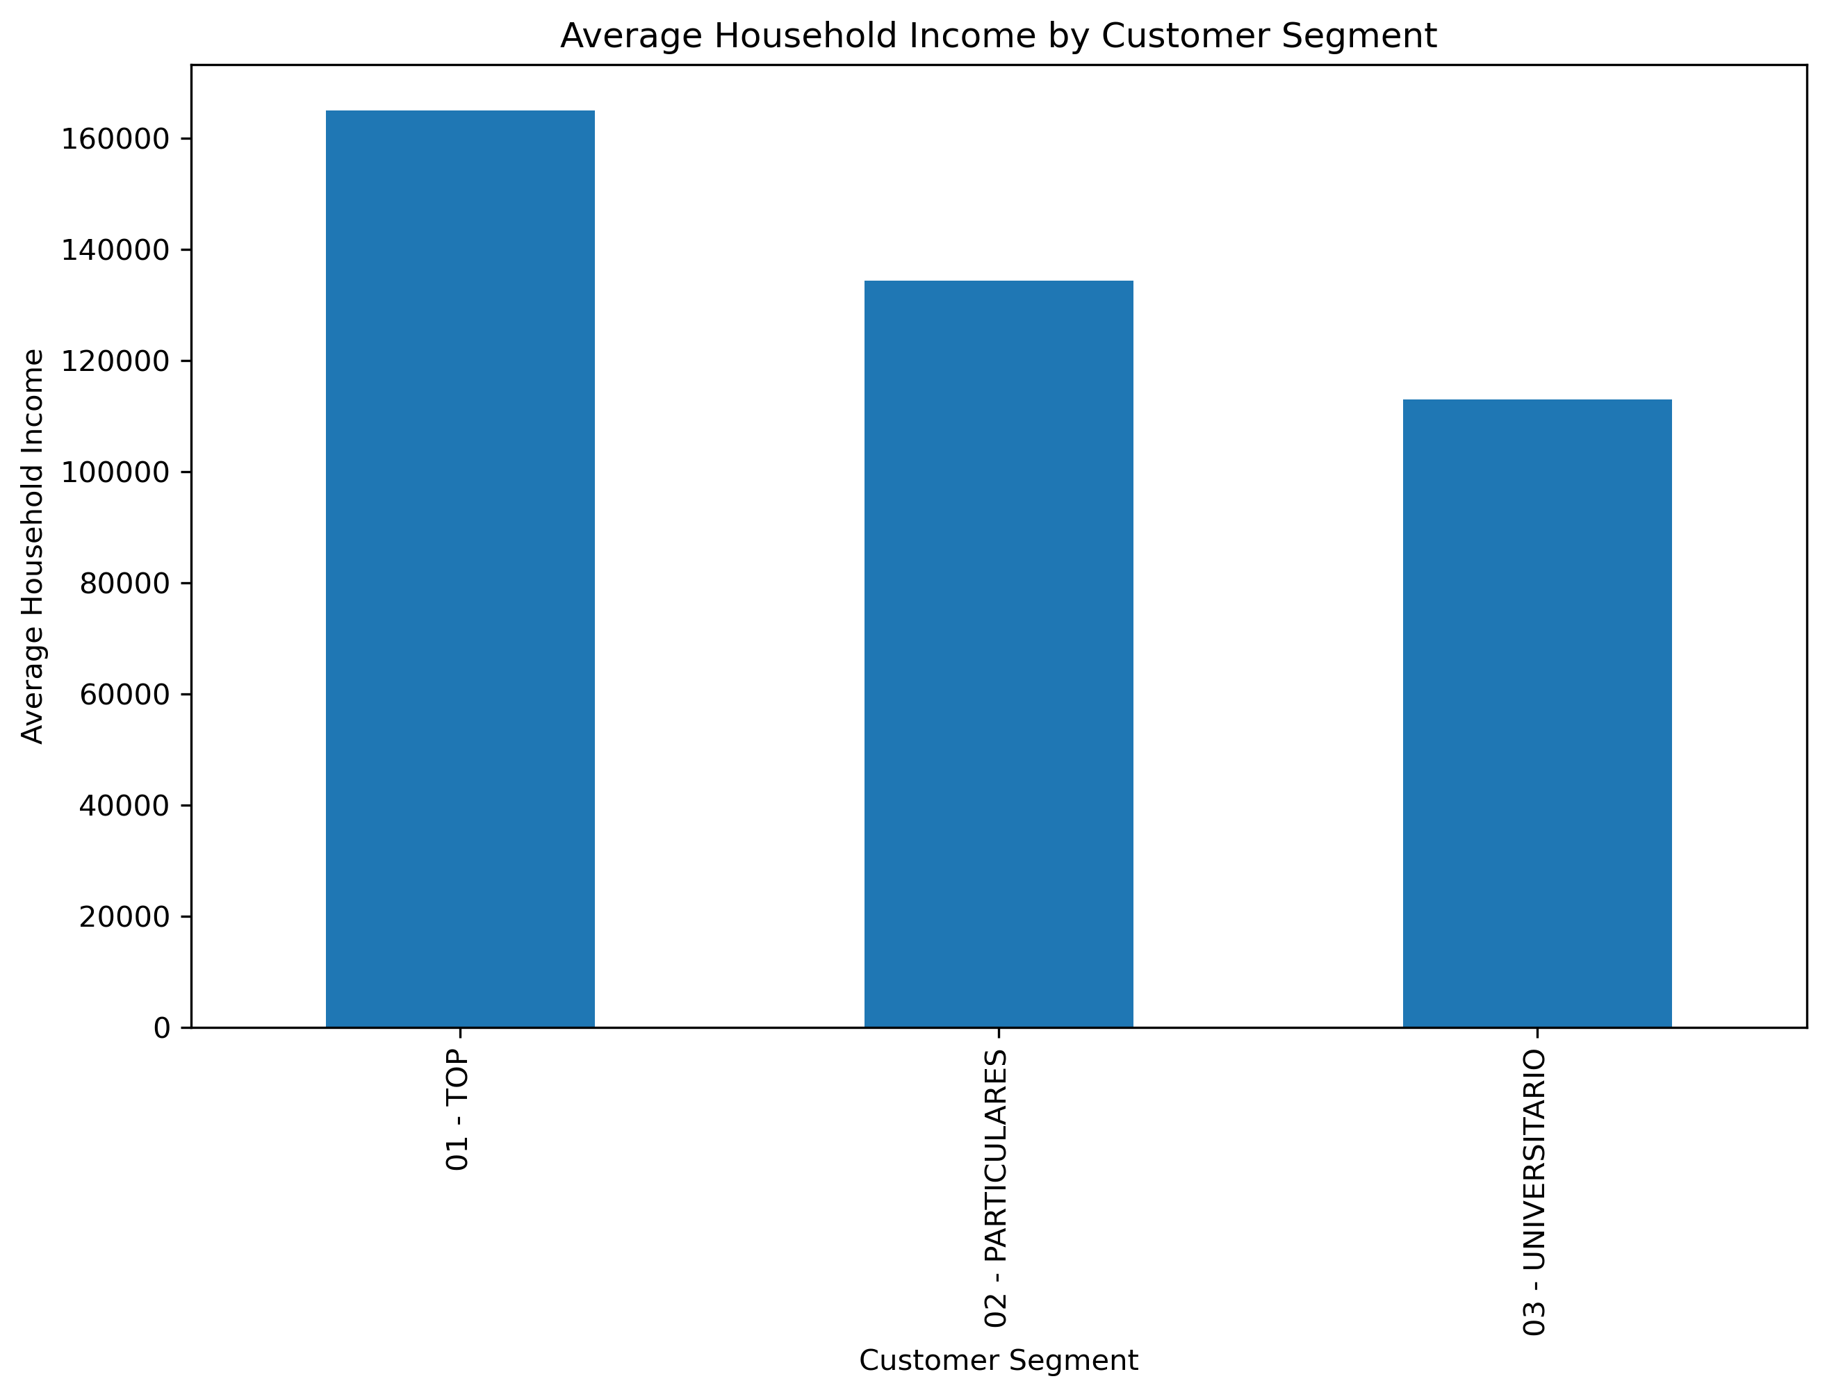
Exploratory Data Analysis (EDA)
1.The top (01) segment has the highest average household income, reaching 160,000
2. The Particular (02) segment follows with 120,000,
while the University (03) segment has the lowest at 100,000

Slide 17
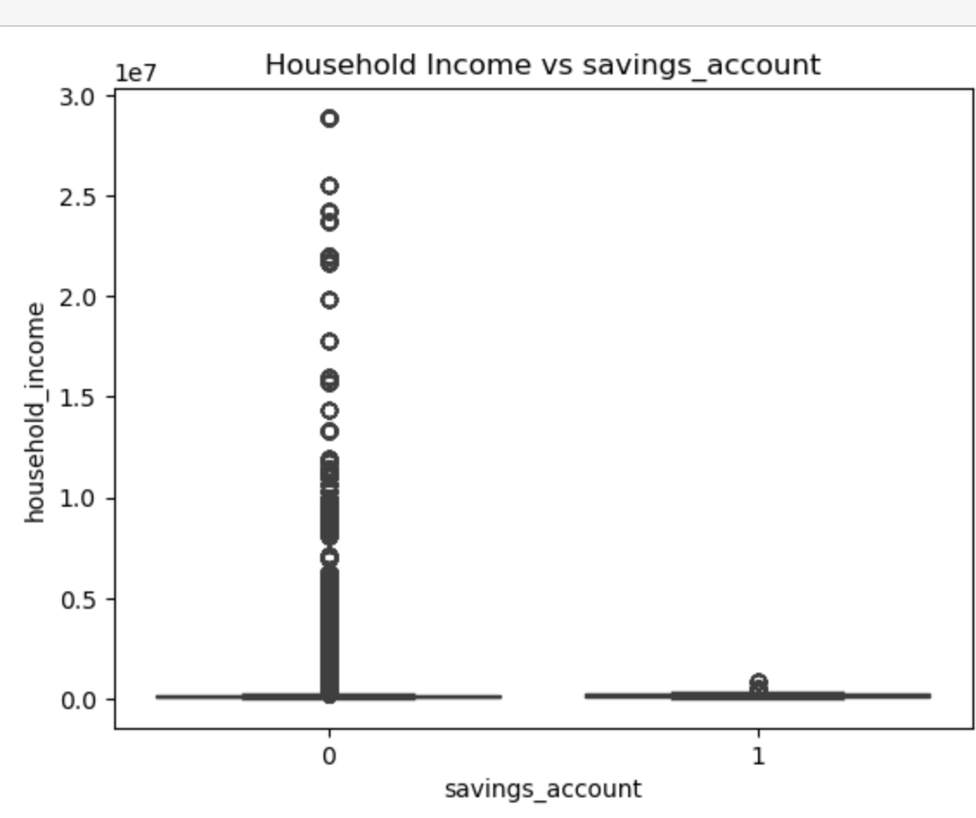
Exploratory Data Analysis (EDA)
1.Customers without a savings account (0) show a wide income distribution, with most data points concentrated below 1.3le7 and a few outliers reaching 3.0le7
2. Customers with a savings account (1) have significantly lower income distribution, with most values clustered below 0.2le7, indicating a trend where higher-income individuals may not prioritize savings accounts.

Slide 18
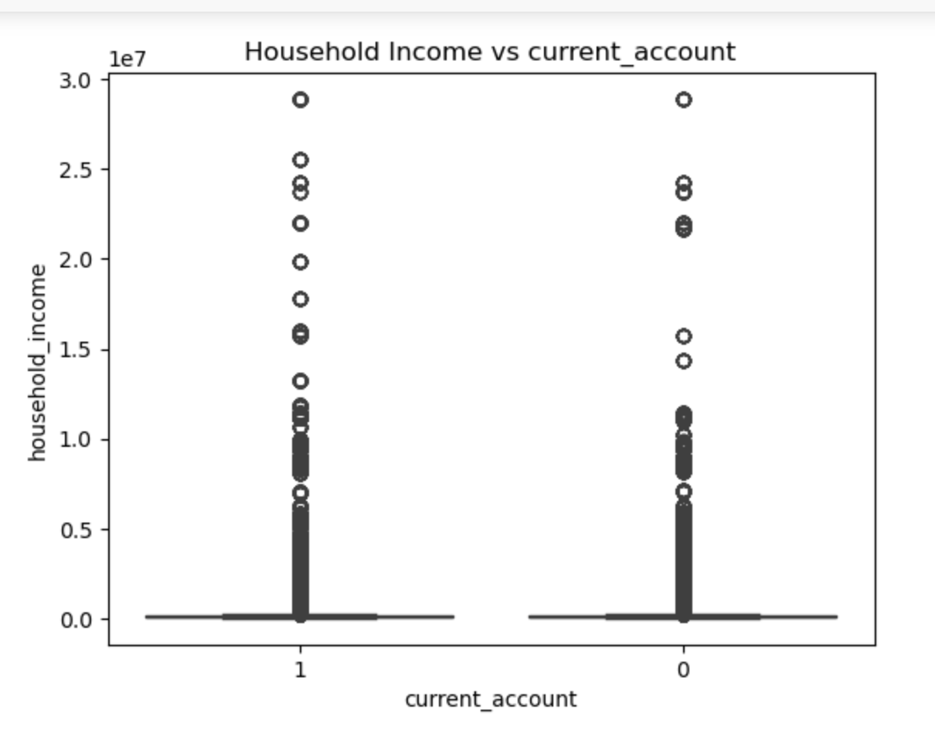
Exploratory Data Analysis (EDA)
1.Customers without a current account (0) have a wide income distribution, with most values densely concentrated below 1.3 le7, while a few outliers reach 3.0 le7
2. Customers with a current account (1) also show a similar pattern, with most incomes below 1.2le7, but outliers extend up to 3.0le7, suggesting that income level alone may not strongly determine current account ownership

Slide 19
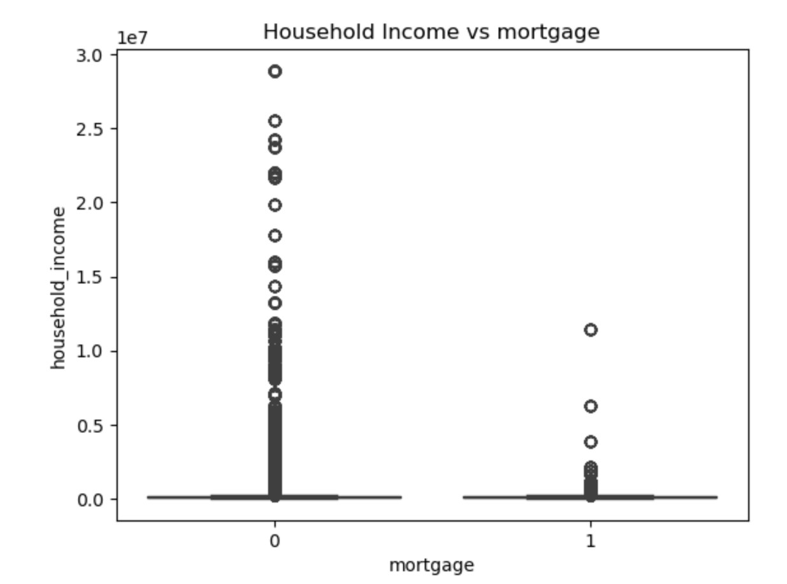
Exploratory Data Analysis (EDA)
Customers without a mortgage (0) have household income densely concentrated below 1.3 le7, with scattered high-income outliers reaching 3.0 le7.
Customers with a mortgage (1) have household income densely concentrated below 0.3 le7, with a few scattered high-income cases up to 1.2 le7

Slide 20
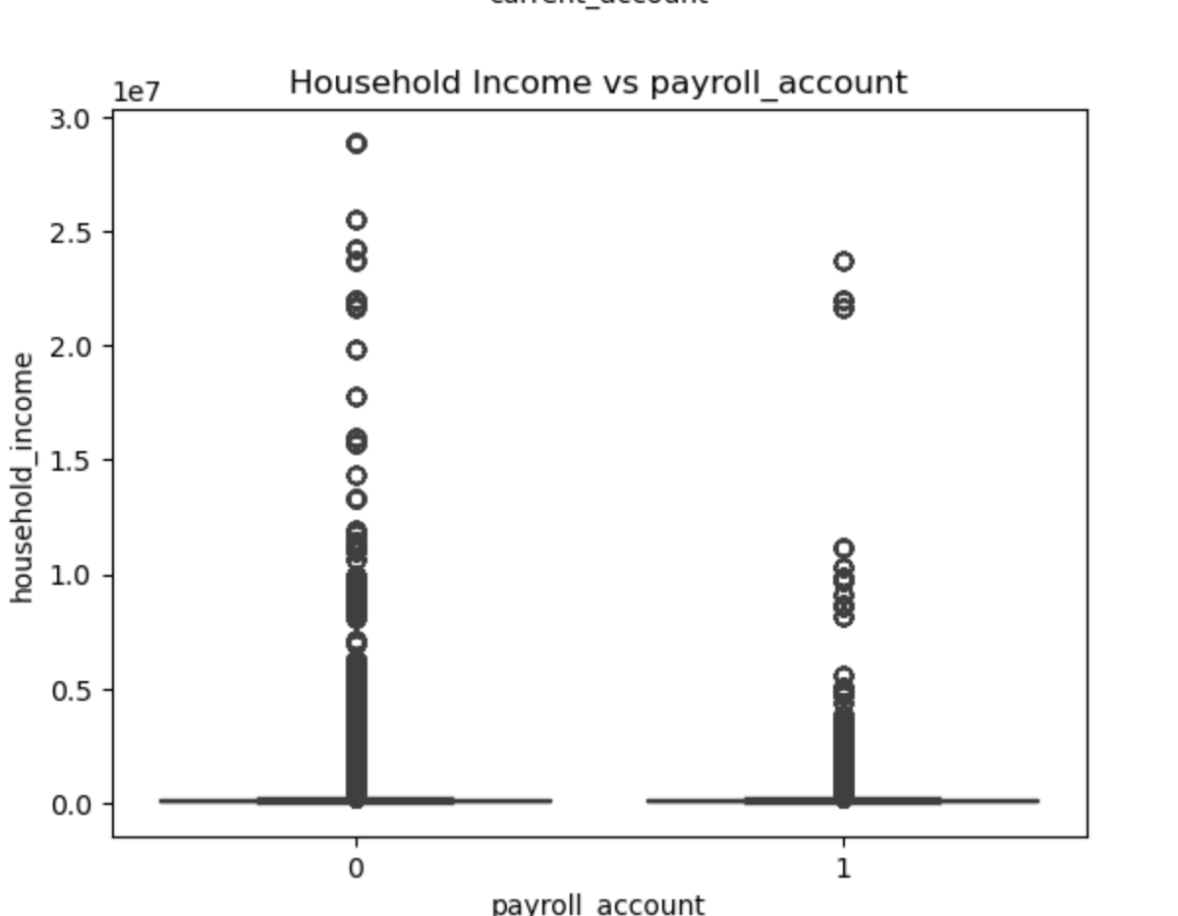
Exploratory Data Analysis (EDA)
1.Customers without a payroll account (0) have household income densely concentrated below 1.3 le7, with scattered high-income outliers reaching 3.0 le7.
Customers with a payroll account (1) have household income densely concentrated below 0.6 le7

Slide 21
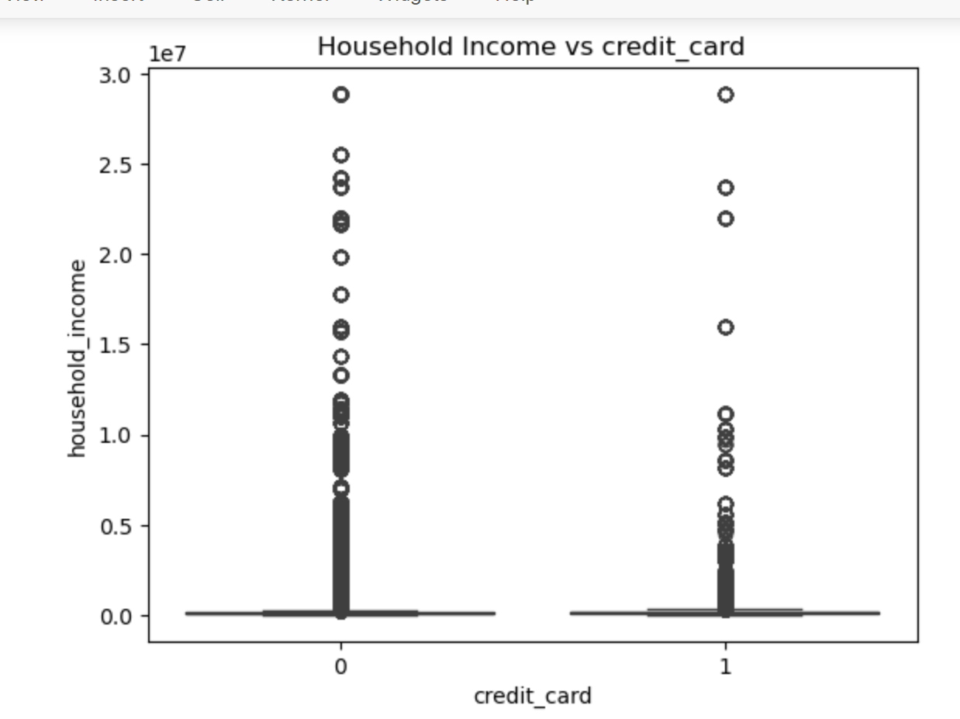
Exploratory Data Analysis (EDA)
Household income is densely concentrated below 1.2 le7, with scattered high-income outliers reaching 3.0 le7
Household income is densely concentrated below 0.5 le7, with some overlapping values till 1.2 le7, and a few high-income cases up to 3.0 le7.

Slide 22
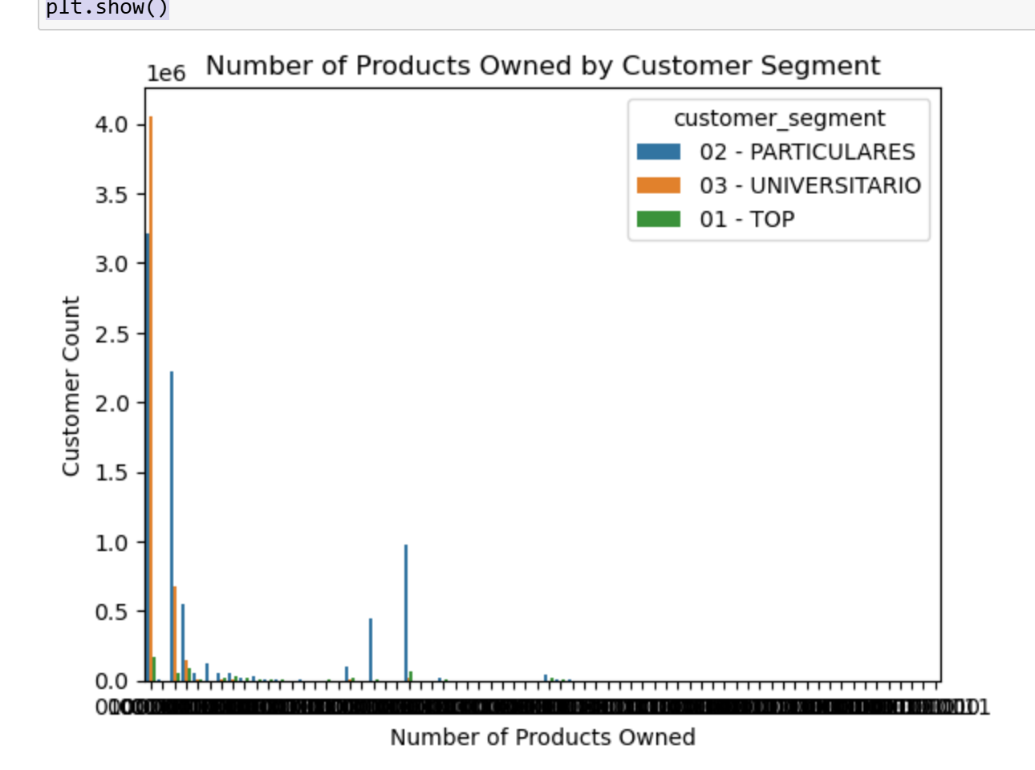
Exploratory Data Analysis (EDA)
Customers owning four products are predominantly from the Universitario, indicating a strong preference for multiple banking products in this group

Slide 23
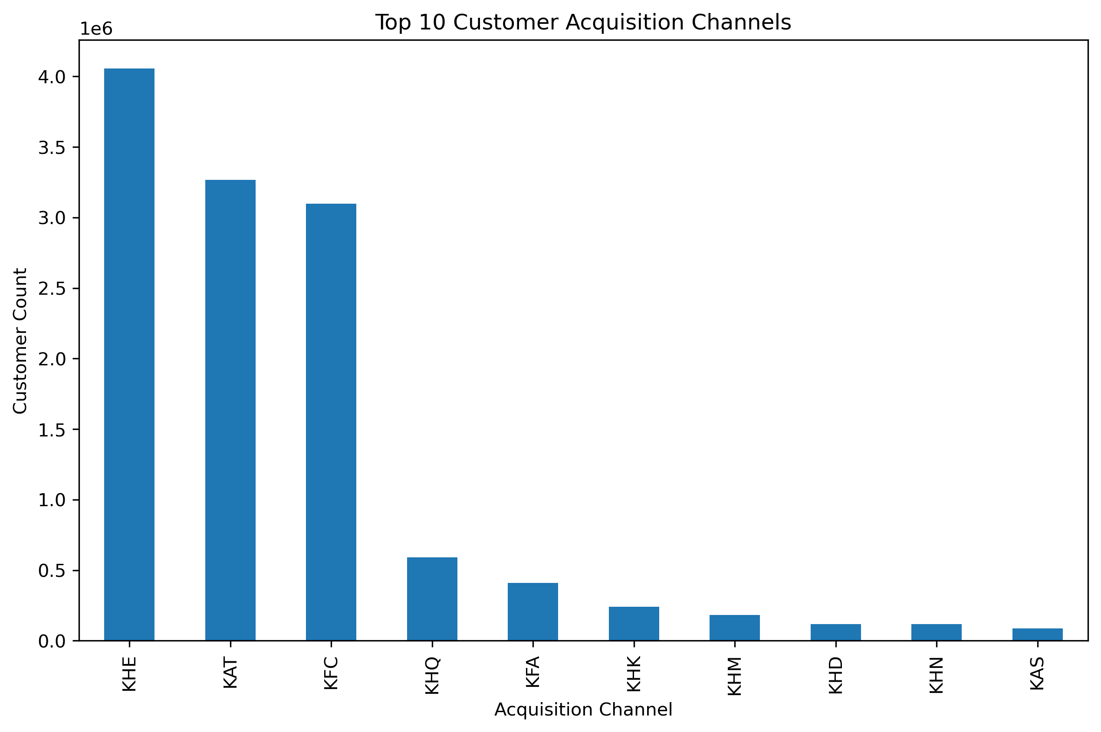
Exploratory Data Analysis (EDA)
Customer acquisition is primarily driven by a few key channels, with 'KHE' being the most dominant, bringing in around 4.0 le6 customers. Other significant channels include 'KAT' (3.5le6) and 'KFC' (3.3le6)

Slide 24
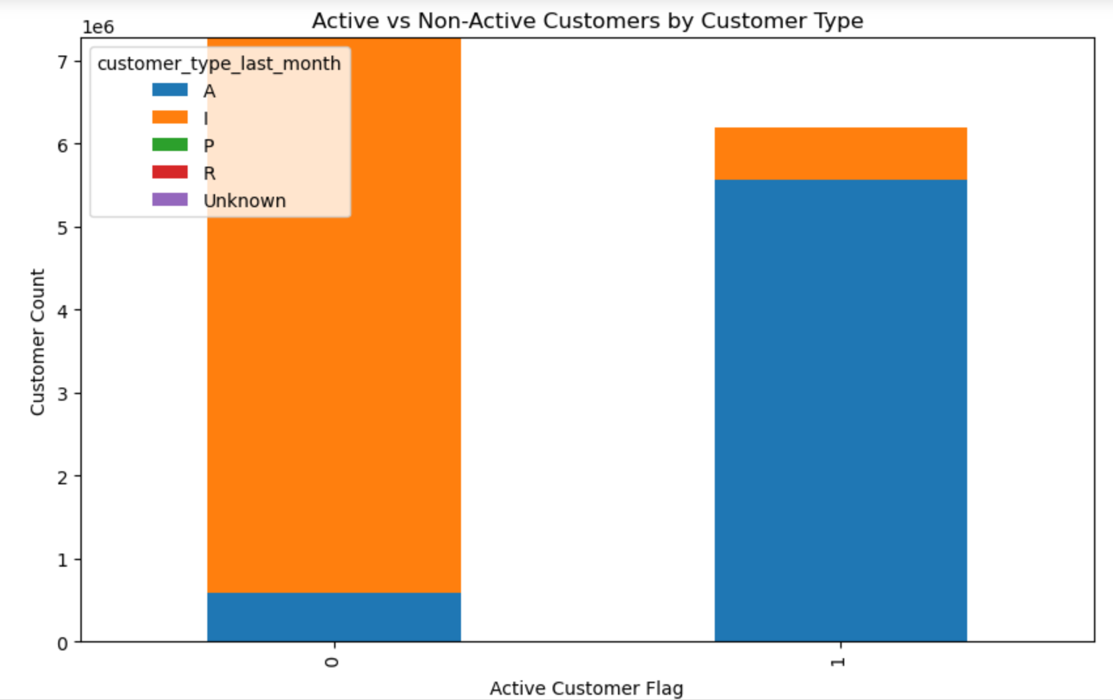
Exploratory Data Analysis (EDA)
We see active customer flag is A and few I.

Slide 25
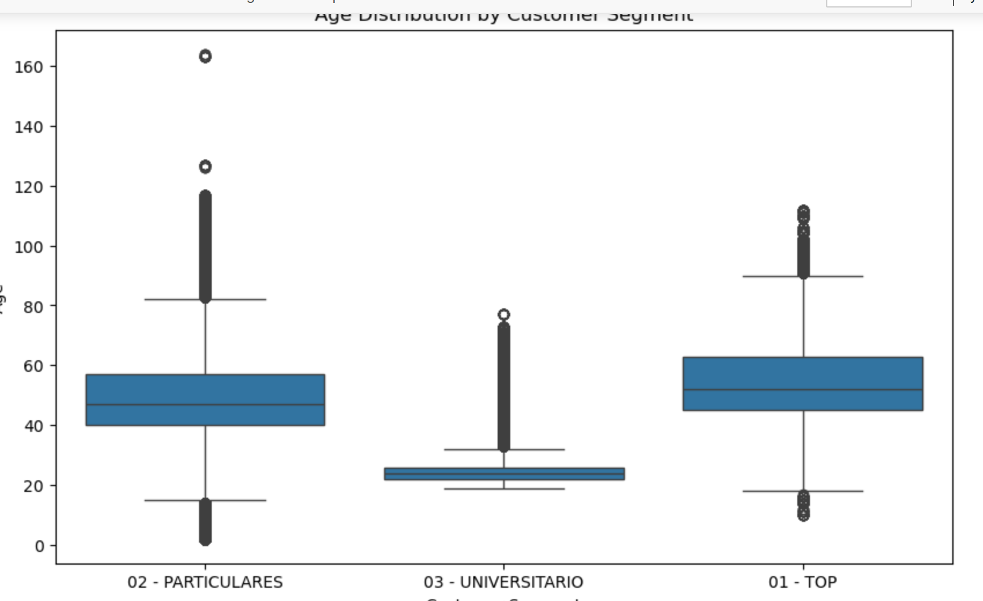
Exploratory Data Analysis (EDA)
1.Customers in Segment 01 (Top) and Segment 02 (Particulars) have a similar age distribution, with most customers around 45 years old, but some older customers (82-120 years) are present.
2.Segment 03 (University students) has a younger age group, with most customers around 25 years old, and very few customers above 75 years
Age Distribution by Customer

Slide 26
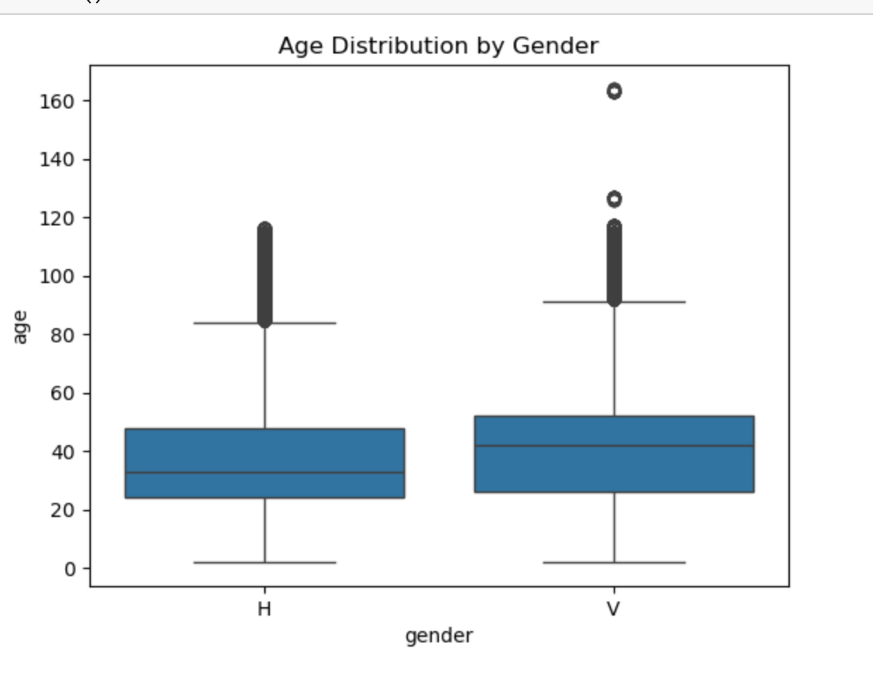
Exploratory Data Analysis (EDA)
From this graph, we see gender ‘V’ Aage is higher than H

Slide 27
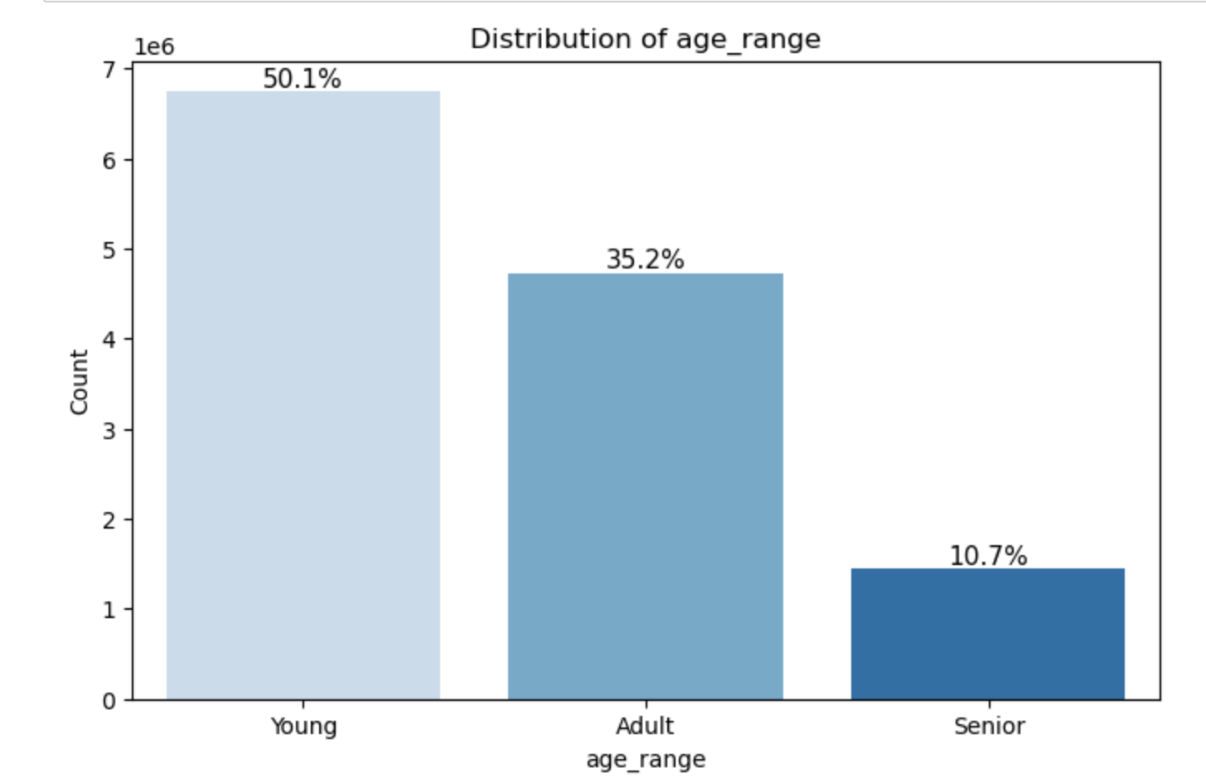
Exploratory Data Analysis (EDA)
Young age is more than half and then adult.

Slide 28
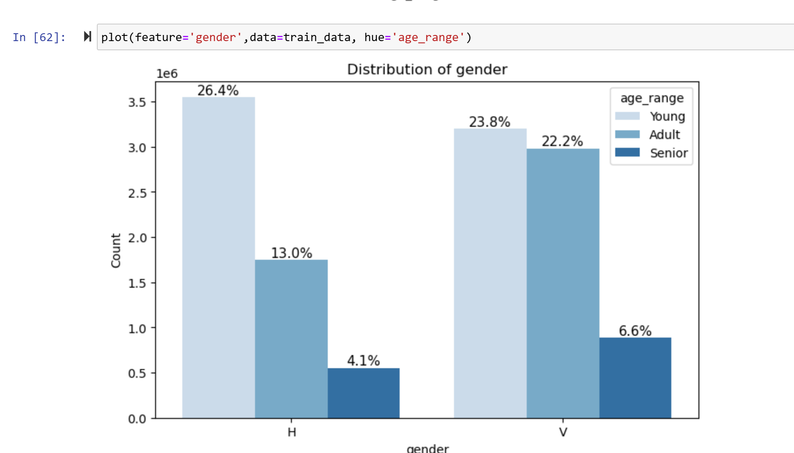
Young customers are slightly more H (26.4%) than V (23.0%)

Slide 29
Final Recommendations
Prioritize High-Income Customers (Segment 01) for Premium Products
Provide Incentives for Low-Income Customers (Segment 03) to Adopt More Products
Offer low income customers with exclusive credit cards, investment accounts, and premium banking services
Focus Marketing Efforts on Madrid (Largest Customer Base)
Increase branch promotions and personalized marketing in this Madrid
Target Young Customers (19-25) with Digital Banking & Student Loans,
Promote mobile banking, student credit cards, and small personal loans for them

Slide 30
Thank you

