Slide 1
Cross selling recommendation
Virtual Internship
Kumkum Chakraborty
01/01/2025

Slide 2
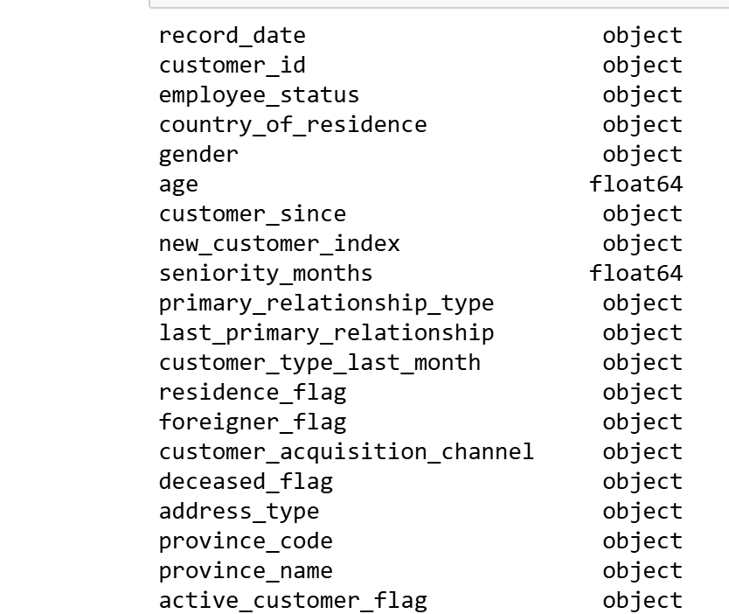
Data Understanding
All data types are seen as 'objects'. These data types have been changed as datetime64[ns] (2), float64 (3), int64 (29)

Slide 3
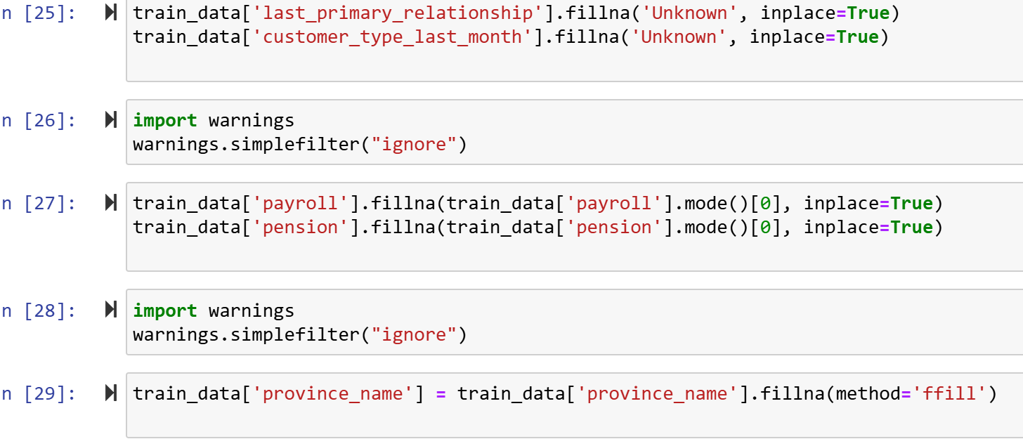
Data Understanding
To fill the data, I have used Fillna method

Slide 4
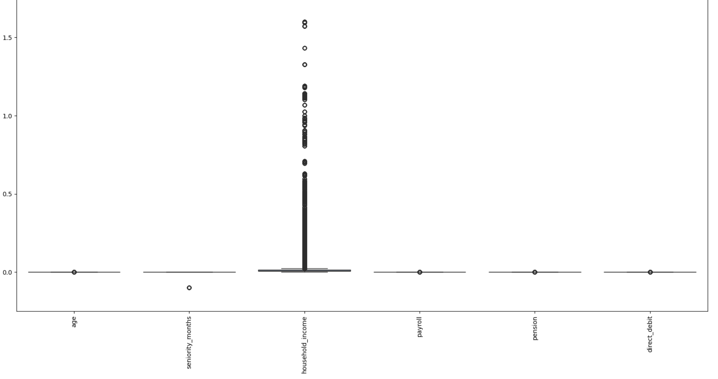
Data Understanding
Outlier Detection

Slide 5
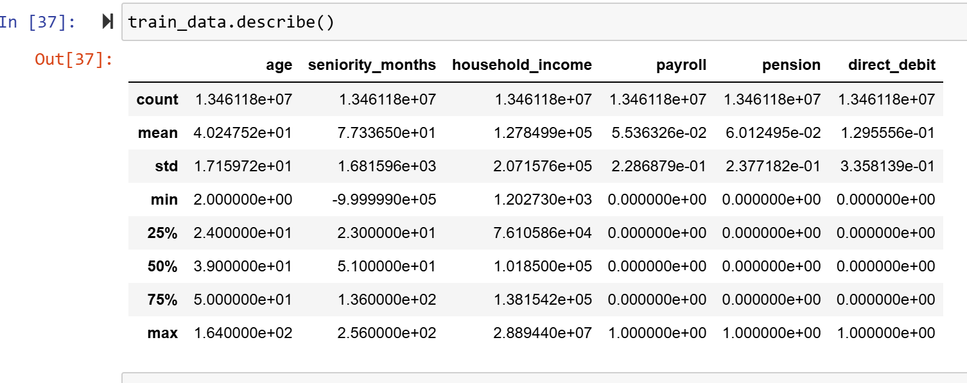
Exploratory Data Analysis (EDA)

Slide 6
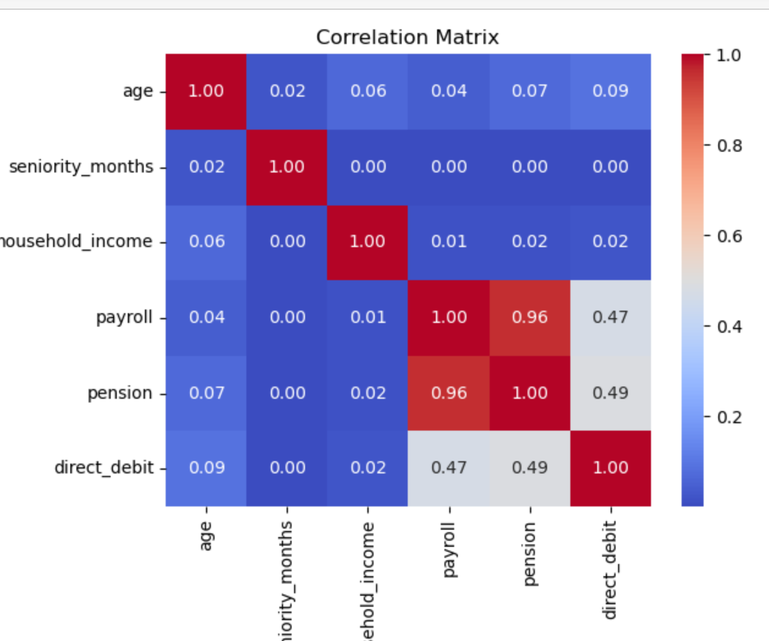
Exploratory Data Analysis (EDA)

Slide 7
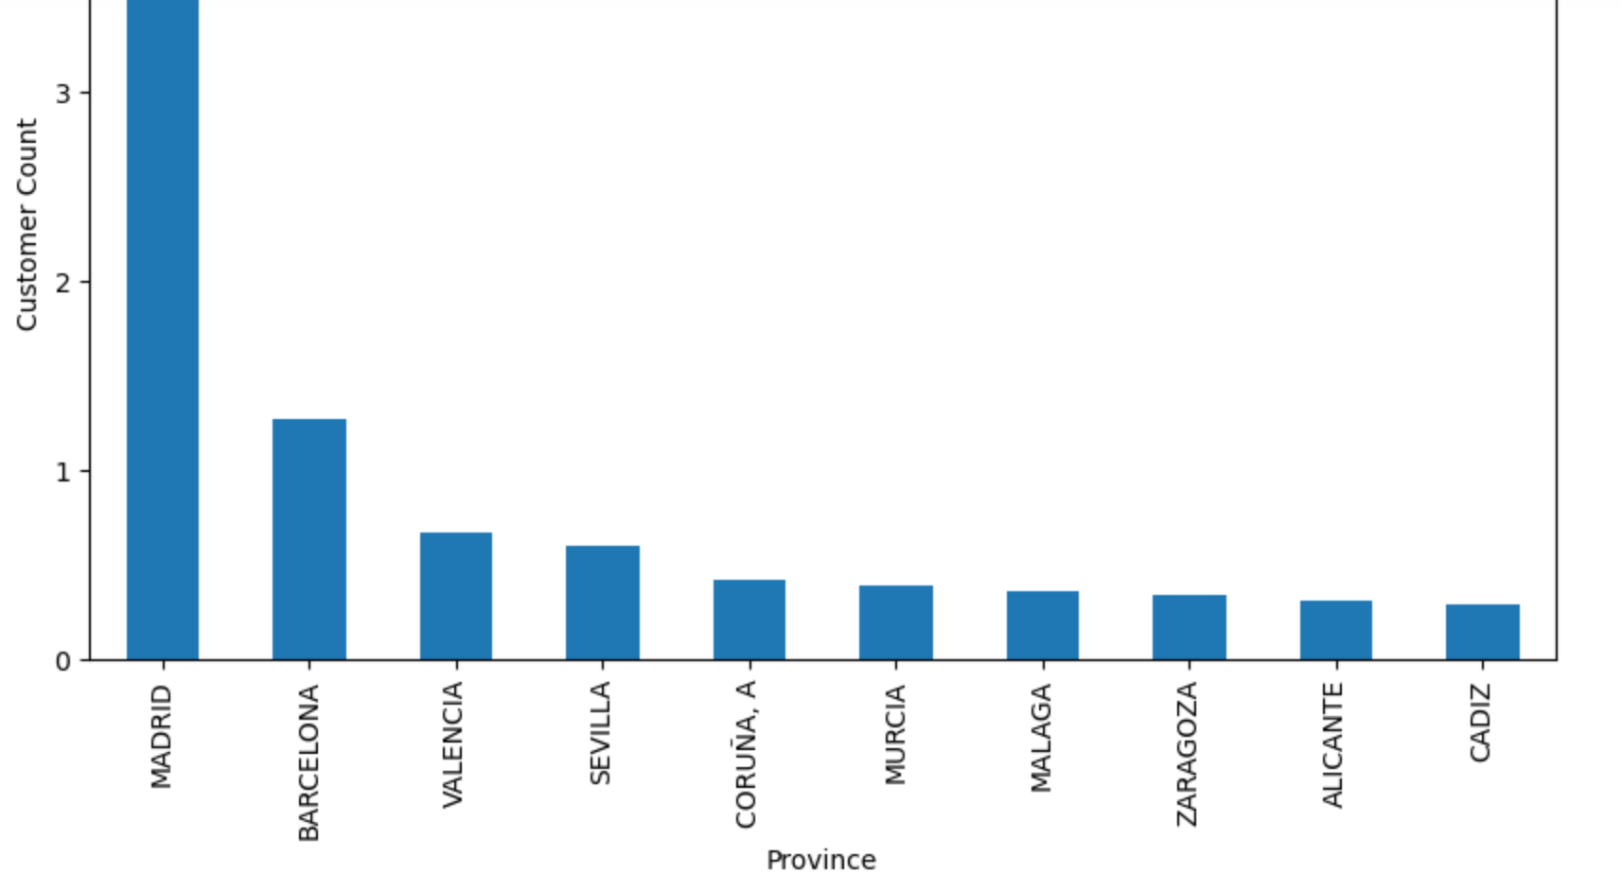
Exploratory Data Analysis (EDA)
Madrid hold more customer

Slide 8
Recommendation
Use customer segmentation (e.g., VIP or students) to send tailored offers based on the products they have or don’t have. For example, target students with special offers on student accounts, credit cards, or loans. For VIP customers, upsell higher-value products like Mortgage or Investment Plans.

