Slide 1


Restaurant Expansion Analysis
This Zomato analyzes restaurant data to identify opportunities for expansion. It provides insights into countries and cities with less competition and high customer satisfaction.
by Naveen Kumar M

Slide 2
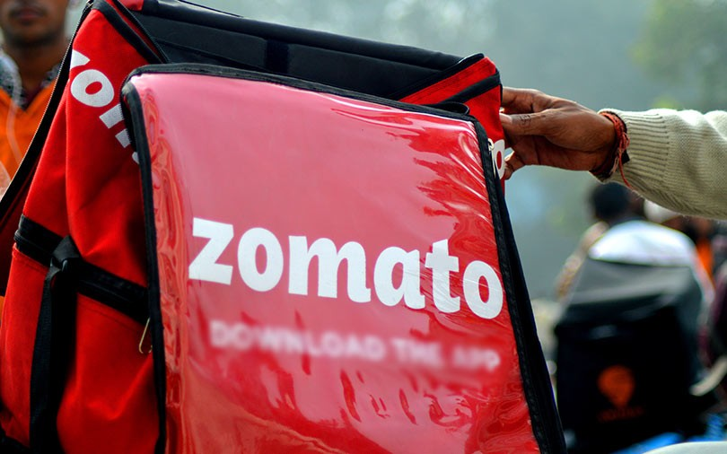
About
Zomato is a popular online platform that provides services related to food delivery, restaurant discovery, and dining experiences. Founded in 2008, it originally began as a restaurant review and recommendation website, before expanding into food delivery, takeout, and restaurant reservations. Zomato is available in numerous countries worldwide, providing users with the ability to explore local restaurant menus, read reviews, and place food orders from their mobile app or website.
Key Features
1
Food Delivery
2
Dine-In and Table Reservations
3
Restaurant Search
4
Reviews and Ratings
5
Subscription Service

Slide 3

Data Overview
🔹 RestaurantID: Unique identifier for each restaurant.
🔹 RestaurantName: Name of the restaurant.
🔹 CountryCode: Code representing the country where the
restaurant is located.
🔹 City: City where the restaurant is located.
🔹 Address: Specific street address of the restaurant.
🔹 Locality: Area or neighborhood within the city where the restaurant is situated.
🔹 LocalityVerbose: A more detailed description of the locality.
🔹 Longitude: Geographic coordinate (longitude) of the restaurant's location.
🔹 Latitude: Geographic coordinate (latitude) of the restaurant's location.
🔹 Cuisines: Types of cuisines offered at the restaurant (e.g., Italian, Indian, etc.).
🔹 Currency: Currency used for pricing in the restaurant (e.g., USD, EUR).
🔹 Has_Table_booking: Indicates whether the restaurant offers table booking.
🔹 Has_Online_delivery: Indicates whether the restaurant offers online delivery.
🔹 Is_delivering_now: Indicates whether the restaurant is currently delivering food.
🔹 Switch_to_order_menu: Flag for switching to the menu for online orders (could be a feature for ordering).
🔹 Price_range: Price range for meals at the restaurant (e.g., 1-3, 1-5).
🔹 Votes: Number of votes the restaurant has received from customers.
🔹 Average_Cost_for_two: Average cost for two people dining at the restaurant.
🔹 Rating: Average rating of the restaurant based on reviews.
🔹 Datekey_Opening: The opening date of the restaurant.

Slide 4

Methodology for Restaurant Data Analysis
Steps Taken in Analysis:
🔹 Data Cleaning: Removed duplicates, handled missing values using Find & Select.
🔹 Data Analysis: Used Pivot Tables & Charts to analyze restaurant trends.
🔹 Trend Analysis: Identified year-wise restaurant openings & price range distribution.
Functions & Features Used:
🔹 Pivot Tables: Restaurant count by country, price range, and ratings.
🔹 Charts: Bar & Line charts for restaurant distribution, rating trends.
🔹 Slicers: Interactive dashboard filters for year & country selection.
Final Dashboard:
🔹 Interactive tool with filters, charts, and data insights for decision-making.
🔹 Business Impact: Data-driven recommendations for expansion & market strategy.

Slide 5
Country-Wise Restaurant Distribution & Ratings
India
United States
Other Countries
8652 restaurants
434 restaurants
Less than 100 restaurants each.
✅ Highest number of restaurants in India, USA, UK, and Brazil.
✅ Countries like New Zealand, Indonesia, and Philippines have fewer restaurants (low competition).
✅ Expand into underpenetrated markets like New Zealand, Australia, Indonesia, where restaurant density is low but demand is growing.

Slide 6
Yearly Restaurant Openings – Identifying Growth Trends
2010-2018
1
Approximately 1000-1100 restaurants opened each year.
✅ Restaurant openings peaked in certain years, showing growth trends.
✅ Expansion opportunities exist in emerging markets with steady growth

Slide 7
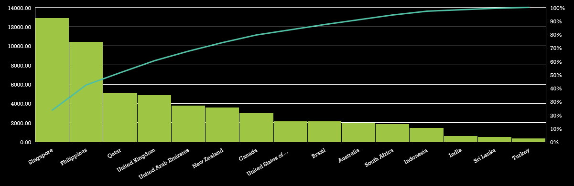
Average Cost for Two – Understanding Market Affordability
✅ Restaurants offering online delivery have higher average ratings.
✅ Many low-rated restaurants do not provide online services, suggesting a need for improvement.

Slide 8
Price Range Distribution – Understanding Market Spending Behavior
✅ Cities like Armidale, Balingup, Beechworth, Dicky Beach have fewer restaurants per capita, indicating low competition. ✅ Urban areas with high foot traffic but fewer restaurants present great business opportunities.
✅ Recommendation: Expand into less saturated markets where demand is growing but supply is low.

Slide 9
Table Booking and Online Delivery Details
✅ Higher-priced restaurants (Price Range 4) receive better ratings, indicating a willingness to pay for premium experiences. ✅ Recommendation: Implement competitive pricing strategies while maintaining quality, and ensure digital convenience features like online booking & delivery.

Slide 10

Top Cuisines – Understanding Customer Preferences
✅ Prioritize online delivery & table booking, as data shows higher customer satisfaction for restaurants offering these services.
✅ Expected Impact: Higher customer engagement, better brand reputation, increased revenue from digital orders.

Slide 11
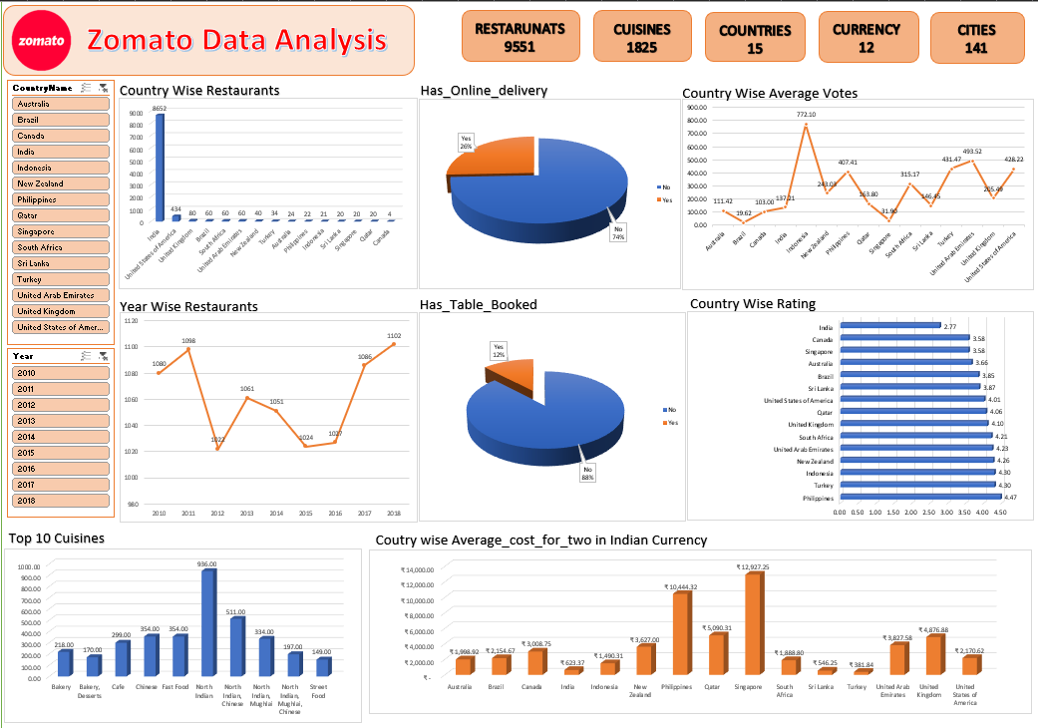
Dashboard

Slide 12

Conclusion
📊 Implications for Decision-Making:
✔️ Increased Market Share by expanding into underpenetrated regions.
✔️ Higher Customer Satisfaction by offering top-rated cuisines & optimized services.
✔️ Revenue Growth by leveraging digital orders & premium pricing strategies.

Slide 13

Acknowledgements & References
✅ Special thanks to Rasheed Ahmed, Rishabh Verma and all Newton Mentors for guidance and support.
✅ Recognition of Excel & BI Tools (Pivot Tables, Lookups, Charts, Conditional Formatting) for analysis.
📑 Primary Data: Internal restaurant dataset provided for analysis. 📑 Tools Used: Microsoft Excel, Pivot Tables, Charts, LookUp Functions, Conditional Formatting, Data Visualization Techniques.

Slide 14


