Slide 1

CUSTOMER BEHAVIOUR ANALYSIS AND REVENUE OPTIMIZATION USING ONLINE RETAIL TRANSACTION DATA
RAKESH KUMMARI - 23029280
SUPERVISED BY - MAN TANG

Slide 2
INTRODUCTION
This project focuses on analyzing a comprehensive dataset of over 1 million transactions from a UK-based online retailer, spanning December 1, 2009, to December 9, 2011.
By applying clustering techniques, the project aims to segment customers based on purchasing behaviors, facilitating targeted marketing strategies. Additionally, regression analysis will be utilized to predict future sales trends by examining historical transaction data. Integrating these methods enhances understanding of customer patterns and optimizes revenue strategies.

Slide 3
IMPORTANCE OF THE STUDY
This study is crucial for understanding customer purchasing behavior and optimizing revenue strategies in online retail. By applying clustering for segmentation and regression for sales prediction, businesses can enhance decision-making in marketing, inventory management, and customer retention. Insights from this research help improve profitability, personalize customer experiences, and drive data-driven business growth in e-commerce.

Slide 4
PROJECT AIM
This study intends to forecast future sales patterns by means of regression analysis and examine consumer buying behaviour using clustering methods. The study aims to improve knowledge of consumer trends and create methods to maximise income by looking at a complete dataset of over 1 million transactions from an online retailer with UK headquarters.

Slide 5
RESEARCH QUESTIONS
How accurately can regression models predict future sales based on historical transaction data?
What factors most significantly influence revenue fluctuations in online retail transactions?

Slide 6
DATASET INFORMATION
The Online Retail II dataset contains over 1 million transactions from a UK-based online retailer between December 1, 2009, and December 9, 2011. Specializing in unique giftware for both wholesalers and individual customers, the dataset's multivariate, sequential, and time-series data support analyses like regression and clustering. These insights aid in customer segmentation, sales forecasting, and revenue optimization.

Slide 7
PROPOSED METHODOLOGY
The research methodology involves data collection and preprocessing to clean and prepare the dataset. Exploratory Data Analysis (EDA) will identify patterns and trends. Clustering techniques will segment customers based on purchasing behavior, while regression models will predict future sales trends. Model evaluation and refinement will ensure accuracy, followed by insights generation for revenue optimization strategies.

Slide 8
ETHICAL CONSIDERATIONS
Data Privacy and Confidentiality: Ensuring consumer privacy is crucial due to the sensitive transaction data. Personally identifiable information (PII), such as customer IDs, should be encrypted or anonymized. Compliance with GDPR ensures responsible data handling and maintains user trust.
Fair and Unbiased Analysis: The project must prevent biases in data interpretation and model development. Clustering and regression algorithms should ensure fairness, promoting ethical decision-making and equal opportunities for all customers.

Slide 9
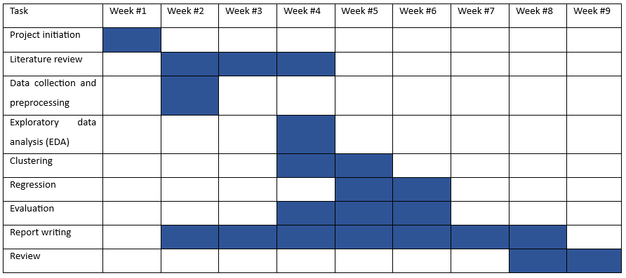
PROJECT PLAN

Slide 10
THANK YOU

