Slide 1
Yelp Data Analysis
&
Brunch Review
Jiaming Zhou, Hongyi Jin, Jingyu Ji

Slide 2
Text processing
Convert uppercase letters to lowercase.
Replace all commas with periods.
Convert words with negative meaning: n'/n't → not
Keep special symbols including ! and combination of !, ., ..., !?, :)
Delete stopwords based on 'nltk.stopwords.words', except:
words with negative meaning: not, no, nor
words that represents a third person: he, him, his, himself, she, her, she's, her, hers, herself, they, them, their, theirs, themselves
Lemmatization: ate →eat, timing → time
Negation: add _NEG to each word between the negation and the following first period.

Slide 3
Goal Two
Predict Star Rates based on the review text

Slide 4
Star Prediction
Feature extraction:
CountVectozier: count the word frequency
TF-IDF: scale down the impact of words with high frequency
Model: multinomial logistics regression with TF-IDF model
RMSE: 0.81245.

Slide 5
Goal One
Useful, analytical insights
Attributes
Reviews

Slide 6
Attribute
Two datasets:
all brunch reviews, all restaurant reviews
Decomposition of Attributes:
cut out the nested character leveled attributes
Find corresponding attributes for every reviews

Slide 7
Attribute
Select by Random Forest Feature Importance score:
Use two datasets respectively
Calculate based on mean decrease impurity
A measure of the information one attribute contains

Slide 8
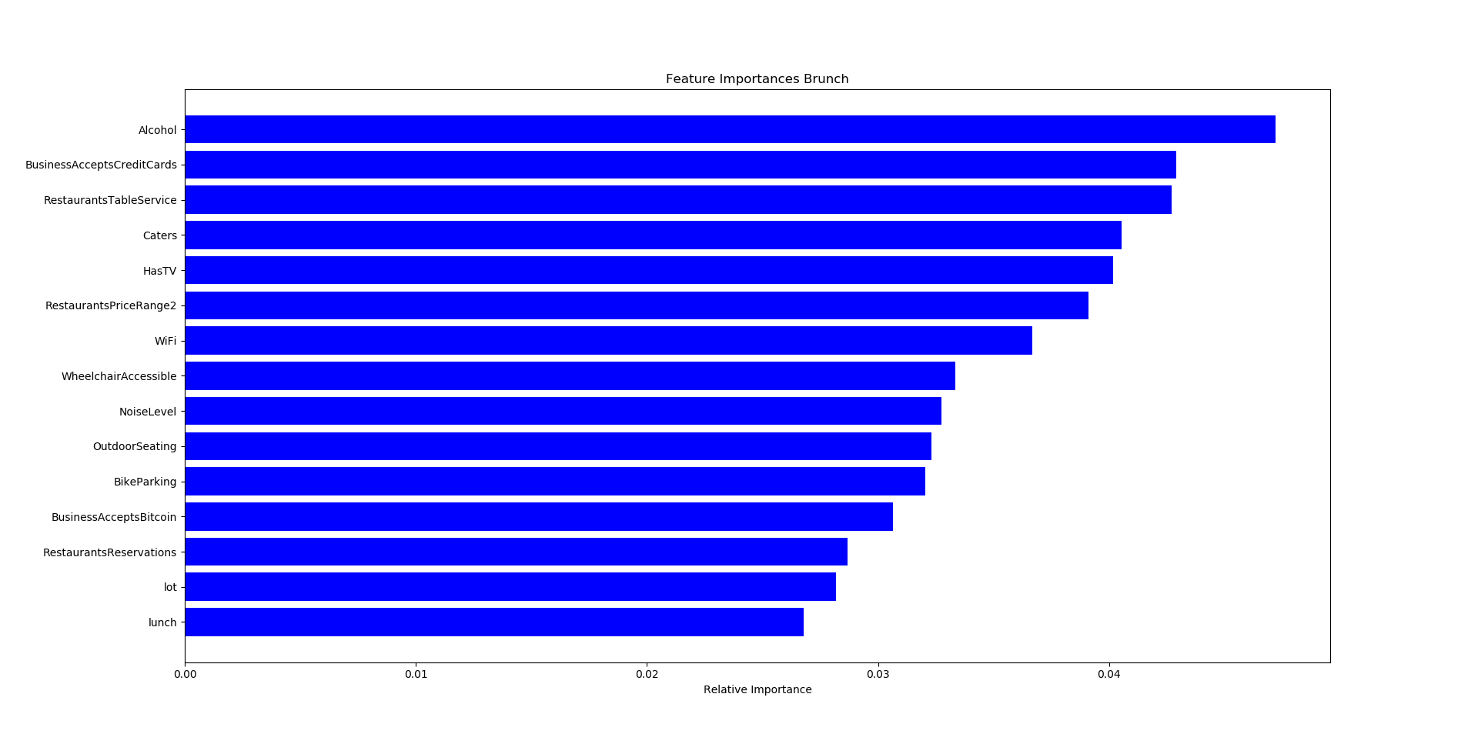

Slide 9
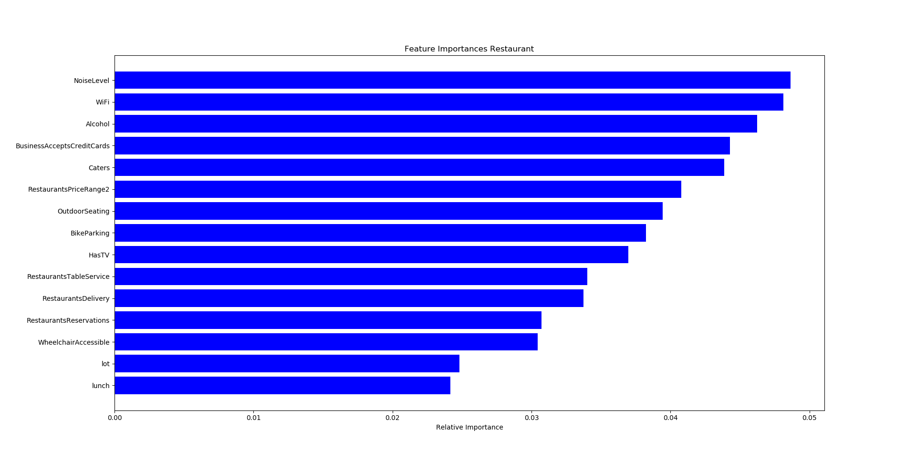

Slide 10
Attribute
Use Linear regression to dig into the information:
Choose one attributes at a time
Convert to dummy variable
Check the coefficients and p-value

Slide 11
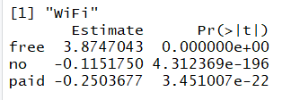



Slide 12
Suggestion
Beer and wine is the best option for alcohol, even better than a full bar.
The restaurants which are able to cater tend to have better reviews.
The restaurants have TVs, free Wifi, out door seating options and wheel chair accessiblilty tend to have better reviews.
And expensive restaurants and quite restaurants tend to have better reviews.
The restaurants which don't accept credit cards tend to have better reviews.

Slide 13
Select keywords
Use word frequency to select keywords in three directions:
Food: chicken, egg, fry, sandwich, cheese, salad, pancake, burger, potato, waffle, sauce, bread, dessert, steak, cream, taco, meat, cake, crepe, beef, benedict
Drink: coffee, chocolate, soup, wine, water, juice, cocktail, beer
Atmosphere: friendly, pretty, server, waitress, waiter, manager, kid, atmosphere, location, walk, check, selection, free, patio, diner, decor, kitchen, party, din, drive, music, counter, vegan, reservation, busy, quick, attentive, clean, cold, yummy, warm, slow, dry, crowd

Slide 14
Select Reviews
Keep the current and next sentences that contain the specific word
For the keyword: cocktail
“come saturday night dinner celebrate birthday best place. drink cucumber cocktail. fantastic. bring u mini brownie….”
“drink cucumber cocktail. Fantastic”

Slide 15
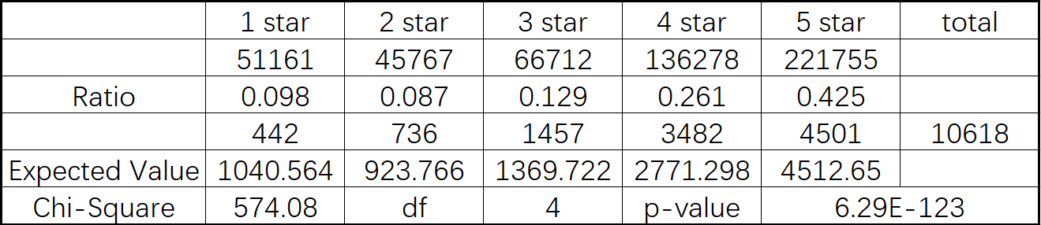
Chi-squared test
Test whether the star rates distribution of the reviews that contain the keyword the same with the star rates distribution of whole brunch reviews
All words have significant difference!

Slide 16
T-test
mean(brunch review star rates) = 3.8275
Test whether the mean of star rates of the reviews that contain the keyword the same with the mean of star rates of whole brunch reviews
Two-side test & One-side test
no significant: sauce, beef
positive: chicken, sandwich, pancake, waffle, cream, cake, cocktail, music...
negative: egg, fry, cheese, salad, water, potato, waitress, waiter, kids...

Slide 17
Latent Dirichlet Allocation (LDA)
LDA model treats documents as a mixtures of topics that constructed by words with certain probabilities.
Decide the number of words in the topic.
Choose a mixture of documents with different topics.
Give a topic, and choose words based on a conditional distribution.

Slide 18
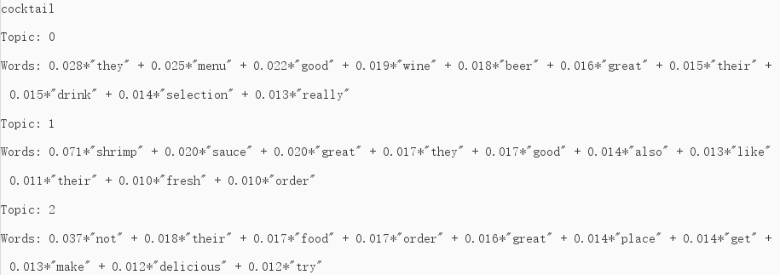
Latent Dirichlet Allocation (LDA)

Slide 19
Bigram & Trigram
Check bigram and trigram
Sort them by frequency and tfidf
Shrimp cocktail, signature cocktail, cocktail sauce, wine cocktail, delicious cocktail, happy hour, cocktail menu, specialty cocktail

Slide 20
Suggestion(cocktail)
A brunch restaurant that supplies cocktail usually have a higher rate.
Multiple selections of alcohol and a cocktail menu usually means a higher rate.
If appetizer is available, shrimp cocktail is a good selection.
Special cocktail sauce and signature cocktail are essential conditions for a good brunch in a cocktail business.

Slide 21
Thank you

