Slide 1
Cost of Change

Slide 2
Cost of Change
Under certain circumstances, the exponential rise in the cost of changing software over time can be flattened. If we can flatten the curve, old assumptions about the best way to develop software no longer hold.

Slide 3
Assumptions of cost of change (1)
One of the universal assumptions of software engineering is that the cost of changing a program rises exponentially over time.

Slide 4
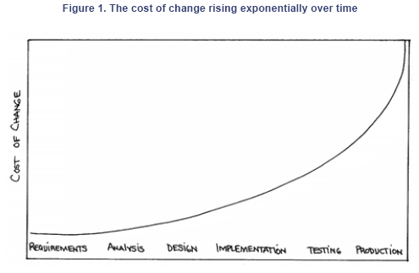
Assumptions of cost of change (2)

Slide 5
Assumptions of cost of change (3)
"The cost to fix a problem in a piece of software rises exponentially over time. A problem that might take a dollar to fix if you found it during requirements analysis might costs thousands to fix once the software is in production."

Slide 6
Change cost little -- an example(1)
A life insurance contract management system
1700 -- A single transaction can have debits from several accounts and credits to several accounts simply isn't used. Each transaction comes from one account and goes to one other.

Slide 7
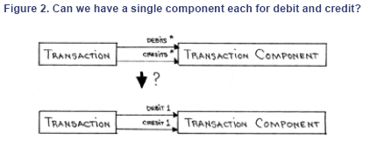
Change cost little -- an example(2)

Slide 8
Change cost little -- an example(3)
1702—Out of the 300,000 transactions in the system, every single one of them has a single debit and a single credit account.
1705—We would change the interface of the Transaction and change the implementation. We write the required four methods and start the tests.

Slide 9
Change cost little -- an example(4)
1715—The tests (more than 1,000 unit and functional tests) still run 100%.
1720—The nightly batches are finished and the database has been backed up. We install the new versions of the code and run the migration.
1730 -- Everything we can think of works. we go home.

Slide 10
Change cost little -- an example(5)
The next day—The error logs are clear. No complaints from the users. The change worked.
Conclusion: Change cost little under some conditions

Slide 11
Techs for reduce the cost of change
The software development community has spent enormous resources in recent decades trying to reduce the cost of change—better languages, better database technology, better programming practices, better environments and tools, new notations.

Slide 12
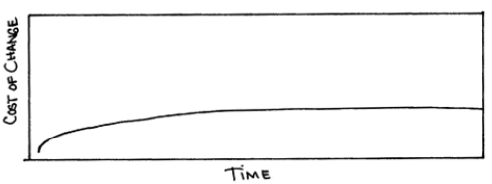
The cost of change may not rise dramatically over time

Slide 13
Technical premise of XP
If the cost of change rose slowly over time, you would act completely differently from how you do under the assumption that costs rise exponentially.

Slide 14
What do you do if change cost little
  1. You would make big decisions as late in the process as possible, to defer the cost of making the decisions and to have the greatest possible chance that they would be right.
  2. You would only implement what you had to, in hopes that the needs you anticipate for tomorrow wouldn't come true.
  3. You would introduce elements to the design only as they simplified existing code or made writing the next bit of code simpler.

Slide 15
Keeping the cost of change low (1)
On the technology side, objects are a key technology.

Slide 16
Keeping the cost of change low (2)
A simple design, with no extra design elements—no ideas that weren't used yet but were expected to be used in the future.
Automated tests, so we had confidence we would know if we accidentally changed the existing behavior of the system.
Lots of practice in modifying the design, so when the time came to change the system, we weren't too afraid to try it.

