Slide 1
How Could This Work?
Dong SHAO

Slide 2
How Could This Work?
The practices support each other. The weakness of one is covered by the strengths of others.
Dong SHAO

Slide 3
How this chapter are organized?
None of the practices described above is unique or original.
They have all been used for as long as there have been programs to write.
Most of these practices have been abandoned for more complicated, higher overhead practices, as their weaknesses have become apparent.
what if those weaknesses were now made up for by the strengths of other practices?
Dong SHAO

Slide 4
The Planning Game (1)
You couldn't possibly start development with only a rough plan.
You couldn’t constantly update the plan- that would take too long and upset the customers.
  The customers did the updating of the plan themselves, based on estimates provided by the programmers.
  You had enough of a plan at the beginning to give the customers a rough idea of what was possible over the next couple of years.
Dong SHAO

Slide 5
The Planning Game (2)
  You made short releases so any mistake in the plan would have a few weeks or months of impact at most.
  Your customer was sitting with the team, so they could spot potential changes and opportunities for improvement quickly.
Dong SHAO

Slide 6
Short Releases (1)
You couldn't possibly go into production after a few months.
  The Planning Game helped you work on the most valuable stories, so even a small system had business value.
  You were integrating continuously, so the cost of packaging a release was minimal.
Dong SHAO

Slide 7
Short Releases (2)
  Your testing reduced the defect rate enough so you didn't have to go through a lengthy test cycle before allowing software to escape.
  You could make a simple design, sufficient for this release, not for all time.
Dong SHAO

Slide 8
Metaphor
You couldn't possibly start development with just a metaphor. There isn't enough detail there, and besides, what if you're wrong?
  You quickly have concrete feedback from real code and tests about whether the metaphor is working in practice.
  Your customer is comfortable talking about the system in terms of the metaphor.
  You refactor to continually refine your understanding of what the metaphor means in practice.
Dong SHAO

Slide 9
Simple Design (1)
You couldn't possibly have just enough design for today's code. You would design yourself into a corner and then you'd be stuck, unable to continue evolving the system.
  You were used to refactoring, so making changes was not a worry.
Dong SHAO

Slide 10
Simple Design (2)
  You had a clear overall metaphor so you were sure future design changes would tend to follow a convergent path.
  You were programming with a partner, so you were confident you were making a simple design, not a stupid design.
Dong SHAO

Slide 11
Testing
You couldn't possibly write all those tests. It would take too much time. Programmers won't write tests.
  The design is as simple as it can be, so writing tests isn't all that difficult.
  Pair programming-partner stress
  You feel good when you see the tests all running.
  Your customer feels good about the system when they see all of their tests running.
Dong SHAO

Slide 12
Refactoring (1)
You couldn't possibly refactor the design of the system all the time. It would take too long, it would be too hard to control, and it would most likely break the system.
  You are used to collective ownership, so you don't mind making changes wherever they are needed.
  You have coding standards, so you don't have to reformat before refactoring.
Dong SHAO

Slide 13
Refactoring (2)
  You program in pairs, so you are more likely to have the courage to tackle a tough refactoring, and you are less likely to break something.
  You have a simple design, so the refactorings are easier.
  You have the tests, so you are less likely to break something without knowing it.
  You have continuous integration, so if you accidentally break something at a distance, or one of your refactorings conflicts with someone else's work, you know in a matter of hours.
  You are rested, so you have more courage and are less likely to make mistakes.
Dong SHAO

Slide 14
Pair Programming (1)
You can't possibly write all the production code in pairs. It will be too slow. What if two people don't get along?
  The coding standards reduce the picayune squabbles.
  Everyone is fresh and rested, reducing further the chance of unprofitable ... uh ... discussions.
Dong SHAO

Slide 15
Pair Programming (2)
  The pairs write tests together, giving them a chance to align their understanding before tackling the meat of the implementation.
  The pairs have the metaphor to ground their decisions about naming and basic design.
  The pairs are working within a simple design, so they can both understand what is going on.
Dong SHAO

Slide 16
Collective Ownership (1)
You couldn't possibly have everybody potentially changing anything anywhere. Folks would be breaking stuff left and right, and the cost of integration would go up dramatically.
  You integrate after a short enough time, so the chances of conflicts go down.
Dong SHAO

Slide 17
Collective Ownership (2)
  You write and run the tests, so the chance of breaking things accidentally goes down.
  You pair program, so you are less likely to break code, and programmers learn faster what they can profitably change.
  You adhere to coding standards, so you don't get into the dreaded Curly Brace Wars.
Dong SHAO

Slide 18
Continuous Integration (1)
You couldn't possibly integrate after only a few hours of work. Integration takes far too long and there are too many conflicts and chances to accidentally break something.
Dong SHAO

Slide 19
Continuous Integration (2)
You can run the tests quickly so you know you haven't broken anything.
You program in pairs, so there are half as many streams of changes to integrate.
You refactor, so there are more smaller pieces, reducing the chance of conflicts.
Dong SHAO

Slide 20
40-Hour Week
You couldn't possibly work 40-hour weeks.
  The Planning Game is feeding you more valuable work to do.
  The combination of the Planning Game and testing reduces the frequency of nasty surprises, where you have more to do than you thought.
  The practices as a whole help you program at top speed, so there isn't any faster you can go.
Dong SHAO

Slide 21
On-Site Customer
You couldn't possibly have a real customer on the team, sitting there full-time. They can produce far more value for the business elsewhere.
  They can produce value for the project by writing functional tests.
  They can produce value for the project by making small-scale priority and scope decisions for the programmers.
Dong SHAO

Slide 22
Coding Standards
You couldn't possibly ask the team to code to a common standard. Programmers are deeply individualistic, and would quit rather than put their curly braces somewhere else.
  The whole of XP makes them more likely to be members of a winning team.
Dong SHAO

Slide 23
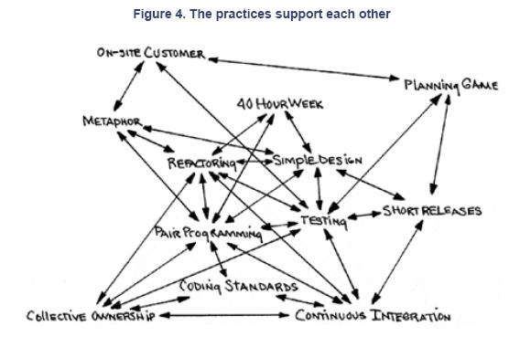
Conclusion
Dong SHAO

