Slide 1
Unlocking Consumer Patterns: Predictive Analytics for CredPal’s Credit Ecosystem
GROUP TWO WORK

Slide 2
Table of Content
Average Monthly Income by Region
Monthly Expenditure by Region
Average Disposable Income /Saving Rates
Consumer Preference
Consumer Expenditure
Relationship Between Income, Expenditure, and Savings
Overall Market Interpretation
Overall Dashboard
Recommendations
Conclusion

Slide 3
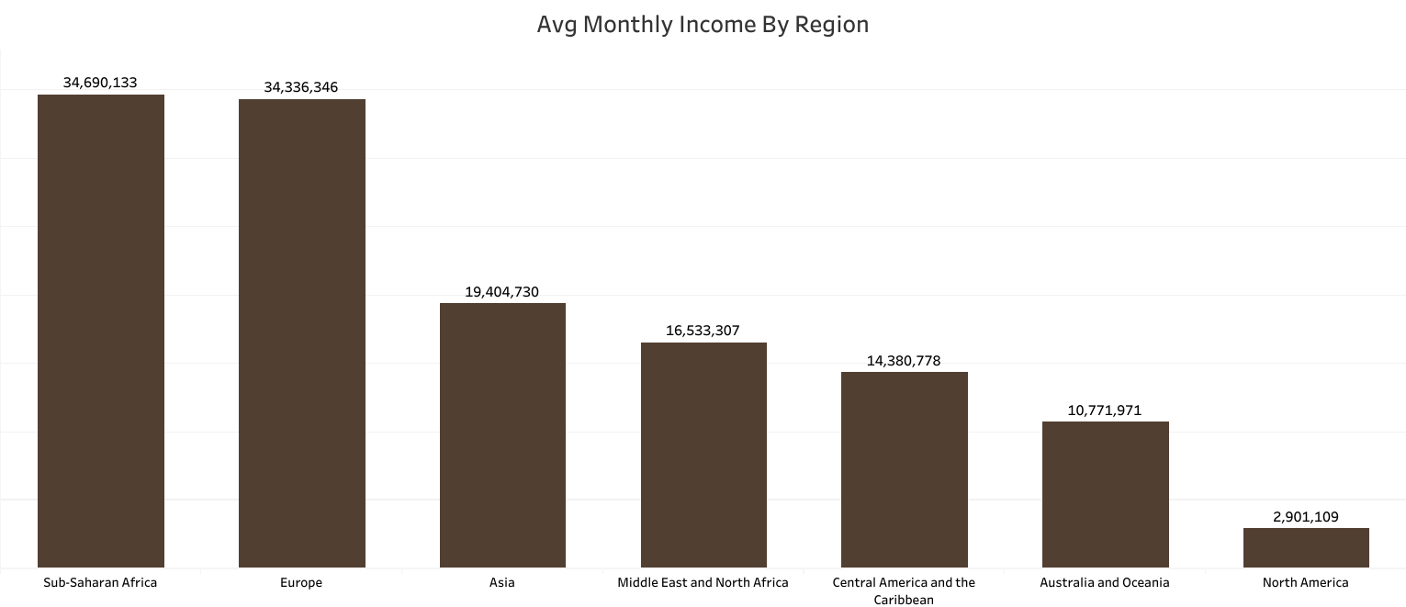
Average Monthly Income by Region
The analysis shows that Sub-Saharan Africa ($34.7M) and Europe ($34.3M) record the highest average monthly income among all regions.
These regions significantly outperform others such as Asia ($19.4M) and North America ($2.9M).
This suggests stronger earning potential and possibly larger active consumer markets within Sub-Saharan Africa and Europe two key zones for CredPal’s credit-driven retail expansion.

Slide 4
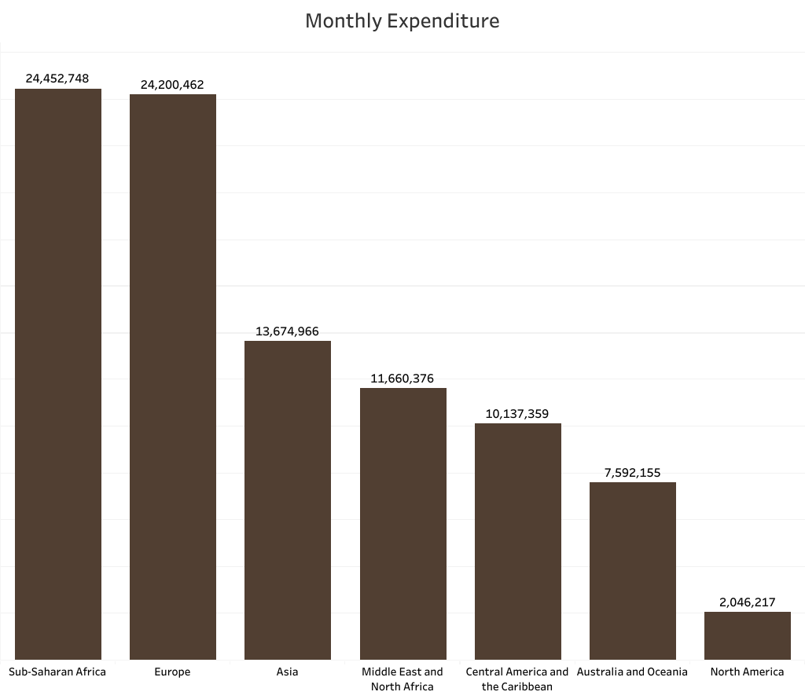
Monthly Expenditure by Region
Sub-Saharan Africa ($24.45M) and Europe ($24.20M) again lead in spending, while North America and Australia record the lowest.
This indicates that higher-income regions also exhibit high spending propensities, which supports the business model of providing on-demand consumer credit as spending activity is strong and credit utilization potential is high

Slide 5

Average Disposable Income/Saving Rates
Sub-Saharan Africa ($10.24M) and Europe ($10.13M) record the highest disposable incomes and savings rates of 26.10% and 25.86%, indicating strong earning power and repayment capacity.
Asia and MENA follow moderately, showing potential for credit growth but with tighter saving margins.

Slide 6
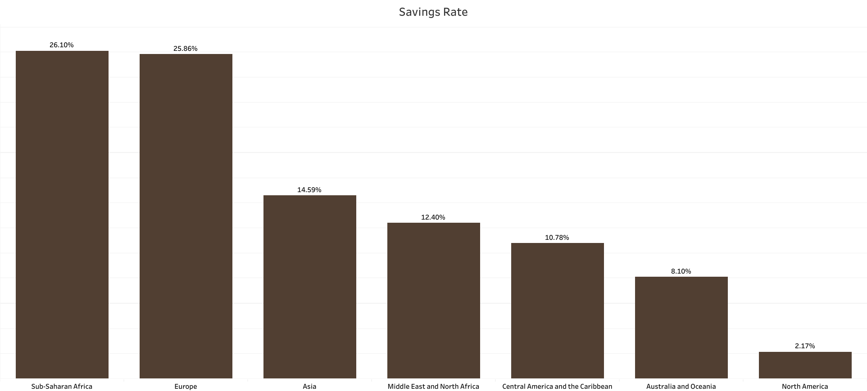
Average Disposable Income /Saving Rates
North America lags behind with low disposable income of $854K and a 2.17% savings rate, reflecting weaker credit scalability.
Overall, the data highlights Sub-Saharan Africa and Europe as CredPal’s strongest markets, balancing high spending potential with solid financial discipline.

Slide 7
Average Disposable Income/Saving Rates
The analysis validates that consumer credit infrastructure can thrive in regions where disposable income and spending patterns remain strong. CredPal’s impact on increasing merchant sales (up to 23%) could further scale in Sub-Saharan Africa and Europe, where both consumer demand and repayment ability are solid.

Slide 8
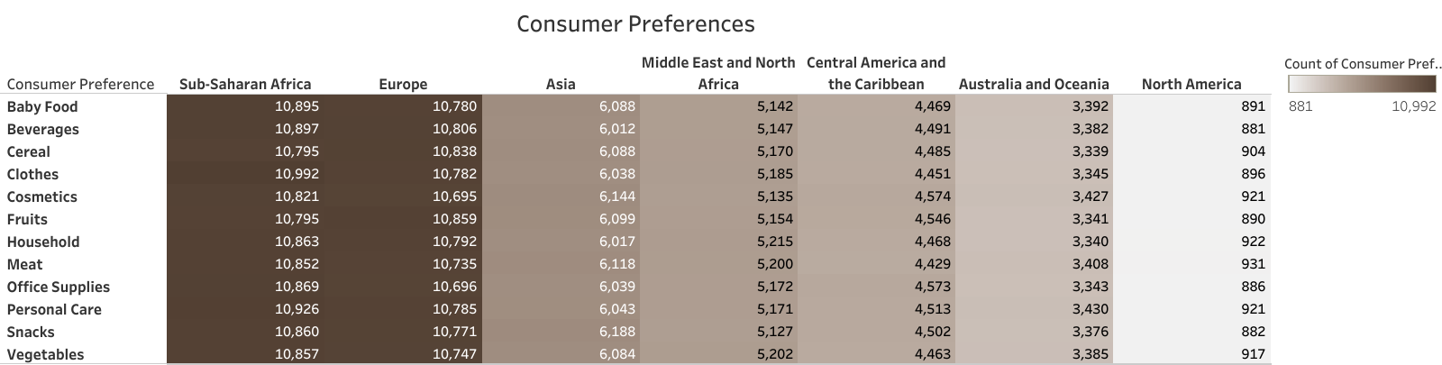
Consumer Preference
The analysis reveals that Sub-Saharan Africa and Europe exhibit the highest levels of consumer preference across nearly all product categories, particularly in Clothes, Cosmetics, and Personal Care, each recording counts above 10,700.
This indicates a broad and active interest in diverse consumer goods. In contrast, Central America and Australia show the lowest preference levels, averaging around 4,500–4,600, while Asia and the Middle East display moderate engagement.
Overall, both developing and developed markets in Africa and Europe maintain stronger consumer enthusiasm, signaling higher product demand and market responsiveness.

Slide 9
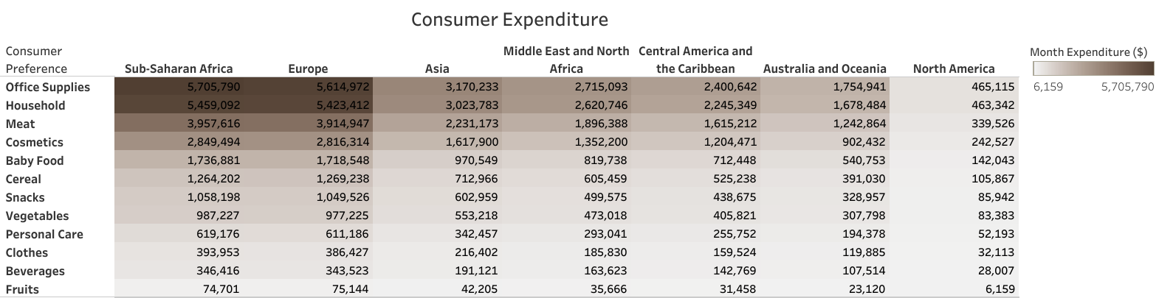
Consumer Expenditure
Spending patterns show that Office Supplies and Household Products account for the highest expenditure across regions, with Sub-Saharan Africa leading at $5.7M and $5.4M respectively.
Expenditure gradually decreases across Europe and Asia, while Middle Eastern, Central American, and Australian markets show significantly lower spending.
Categories such as Fruits, Beverages, and Personal Care record minimal spending, indicating these are lower-priority or underdeveloped markets. Overall, essential and work-related goods dominate consumer budgets, highlighting the importance of necessity-driven consumption.

Slide 10
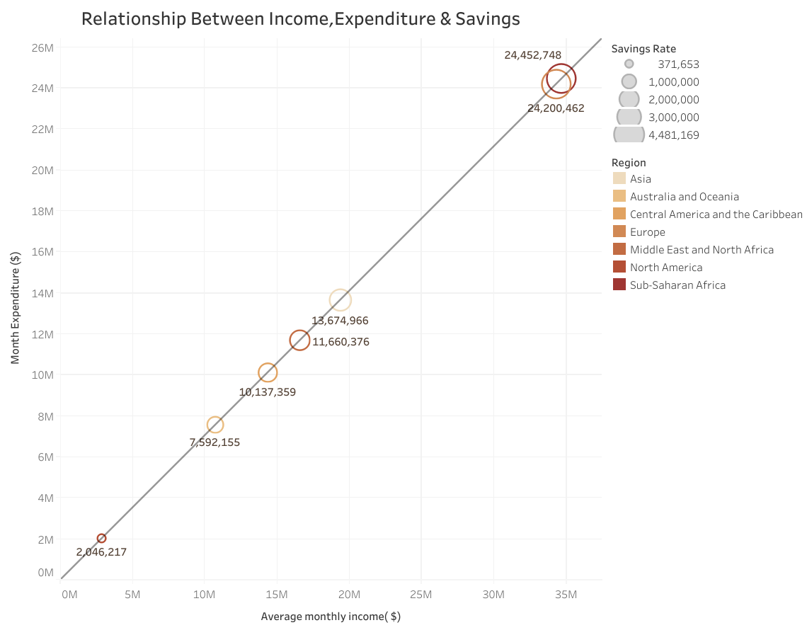
Relationship Between Income, Expenditure, and Savings
The chart highlights how income, expenditure, and savings interact across region. A strong positive relationship is evident as income increases, expenditure also rises. However, savings rates differ notably across regions, reflecting varying financial behaviors.​
Regions like Sub-Saharan Africa, Europe and Asia exhibit higher income and spending levels, yet still maintain moderate-to-high savings rates, signaling financial discipline and stability. In contrast, Australia and Oceana North America record lower income and expenditure levels, with smaller savings rates indicating tighter financial margins.​
This trend reinforces that higher income supports both increased consumption and stronger savings capacity, emphasizing the dual role of income growth in enhancing consumer spending power and financial resilience across global regions.

Slide 11
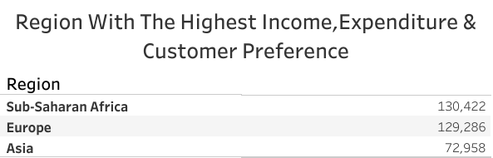
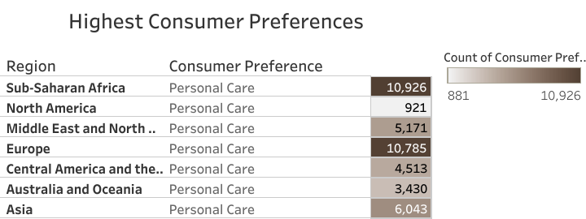
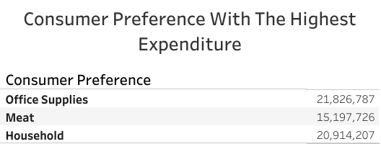
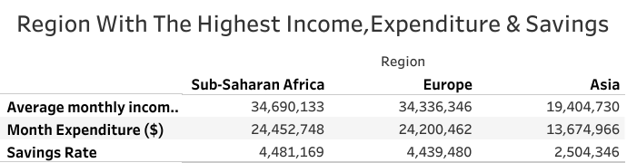
​
Overall Market Interpretation
Sub-Saharan Africa recorded the highest income ($34.7M), expenditure ($24.5M), and savings rate ($4.48M), indicating strong financial performance.​
Europe followed closely with similar spending and saving patterns, while Asia showed moderate figures.​
Personal Care emerged as the most preferred consumer category across all regions.​
Sub-Saharan Africa and Europe had the highest consumer preference counts for Personal Care products.​
Top categories by expenditure include Office Supplies, Meat, and Household Items — reflecting a balance of professional, nutritional, and domestic spending needs.​
The data shows a positive correlation between income, expenditure, and savings, with consistent consumer interest in essential personal products.

Slide 12
Recommendations
1. Prioritize Market Expansion in Sub-Saharan Africa and Europe
These regions show the highest average income, expenditure, and savings rates, indicating strong consumer purchasing power and repayment capacity.
Their high consumer preference across diverse product categories (especially Personal Care, Clothes, and Cosmetics) suggests vibrant retail ecosystems primed for credit utilization.
2. Tailor Credit Products to Necessity-Driven Categories
Focus credit offerings on Office Supplies, Household Products, and Meat, which dominate expenditure across regions.
These categories reflect essential and recurring spending, increasing the likelihood of consistent credit usage and repayment.

Slide 13
Recommendations
3. Segment Credit Strategies by Financial Behavior
Sub-Saharan Africa & Europe: Offer flexible credit lines with loyalty incentives, given their strong financial discipline and high savings rates.
Asia & MENA: Introduce moderate credit limits with educational campaigns to boost financial literacy and savings behavior.
North America & Australia: Consider alternative models (e.g., BNPL with strict repayment terms) due to low disposable income and savings rates.
4. Leverage Consumer Preference Data for Targeted Marketing
Use high engagement in Clothes, Cosmetics, and Personal Care to design product-specific credit bundles and promotions.
Implement region-specific campaigns that highlight popular categories to drive adoption and retention.

Slide 14
Recommendations
5. Use Predictive Analytics to Optimize Credit Risk Models
Integrate regional income-expenditure-savings correlations into risk scoring algorithms.
This will help differentiate creditworthiness across markets and reduce default rates by aligning credit limits with financial behavior.
6. Strengthen Data Partnerships for Continuous Insights
Collaborate with merchants and financial institutions in high-performing regions to gather real-time consumer data.
This will enhance dynamic credit adjustments and support investment decisions with up-to-date market intelligence.

Slide 15
Conclusion
Our analysis demonstrates that Credpal's model has significant room to grow, particularly in Sub Saharan Africa & Europe, where consumer demand, repayment capacity and saving discipline align strongly.
With targeted credit products, data driven risk management and continuous analytics, CredPal can push merchant growth well beyond the current 23% average and unlock new frontiers in consumer credit

Slide 16
OVERALL DASHBOARD

Slide 17
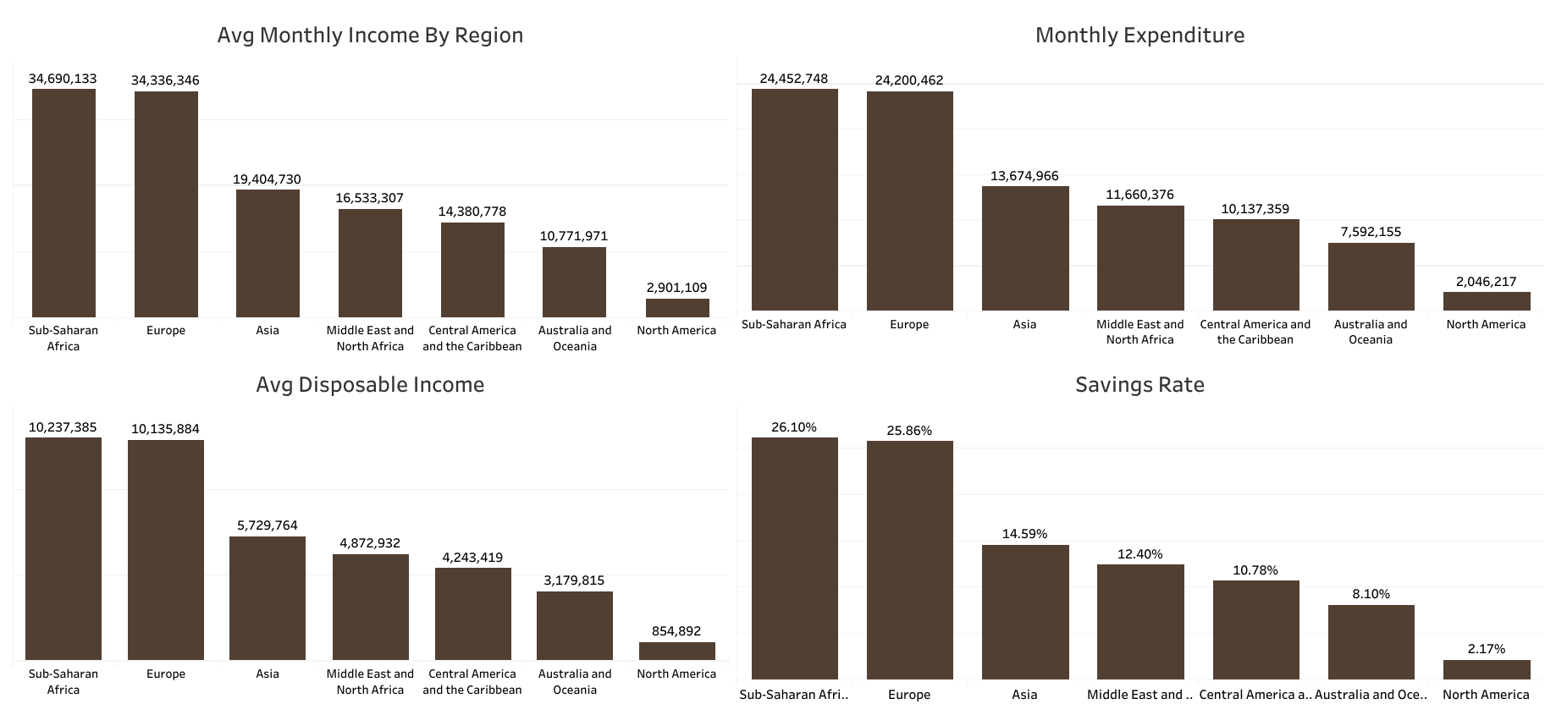

Slide 18
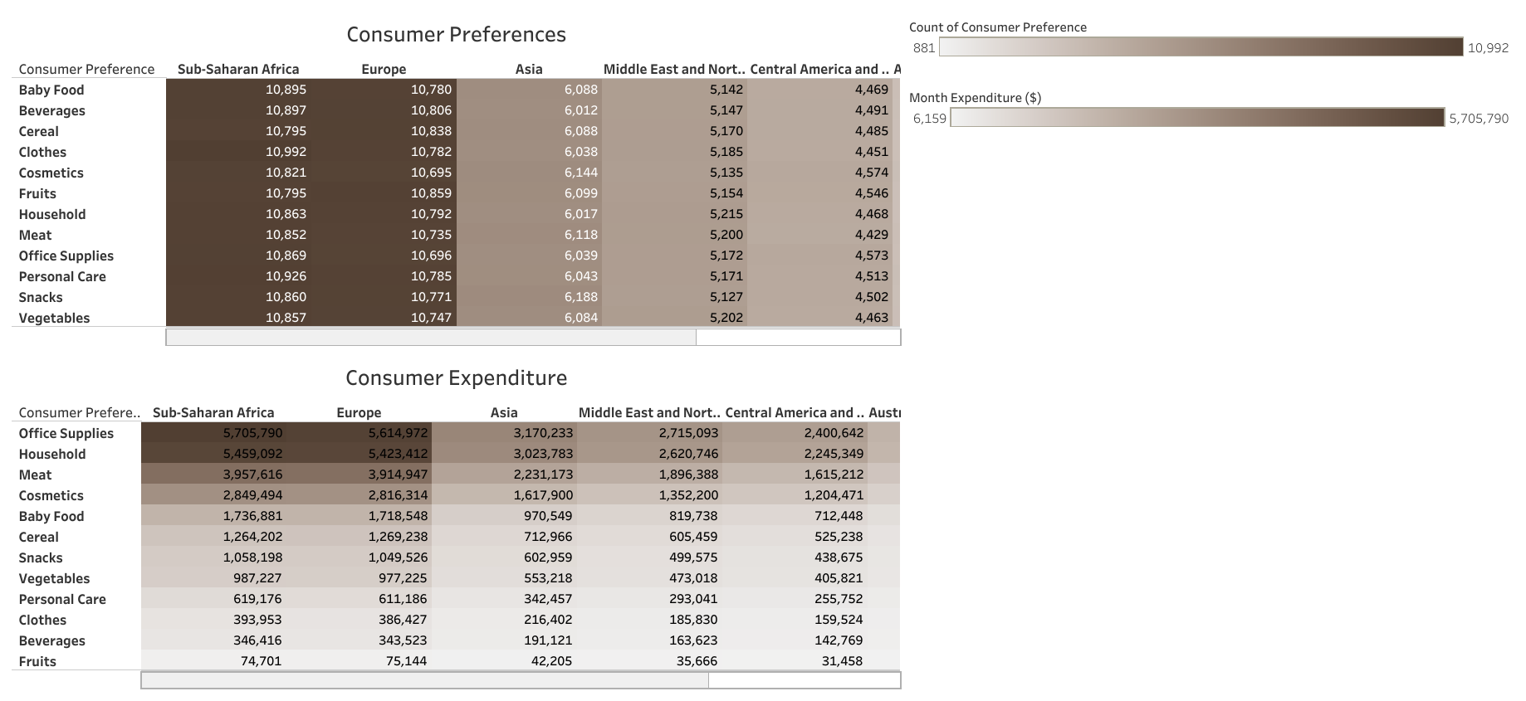

Slide 19
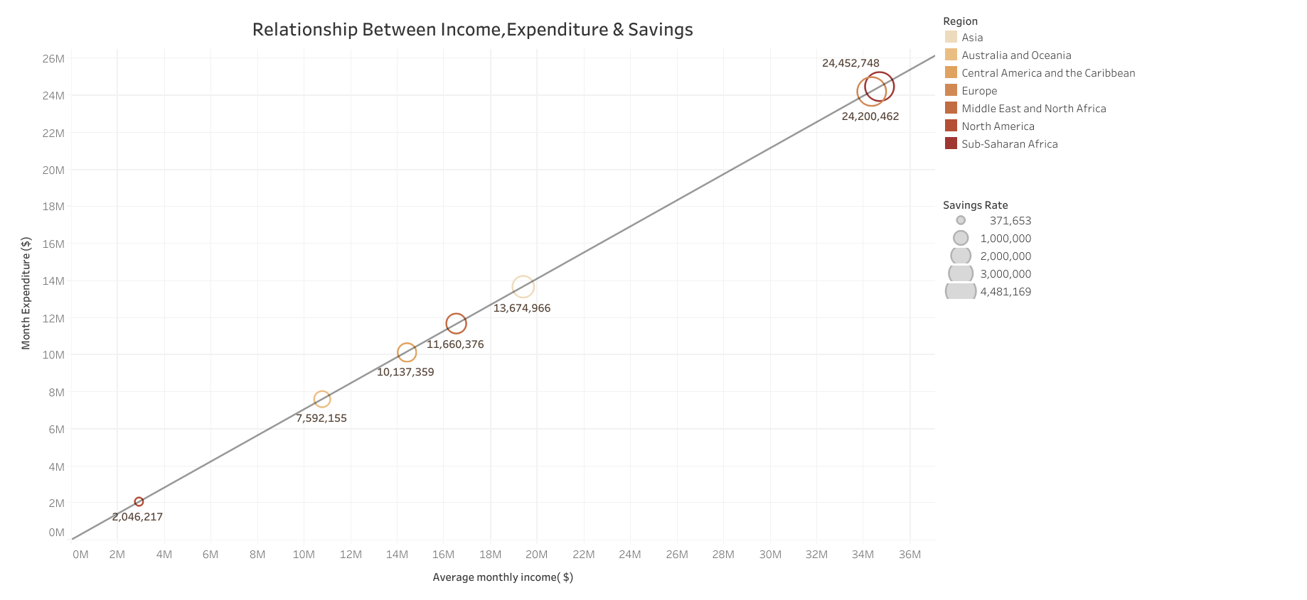

Slide 20
