Slide 1
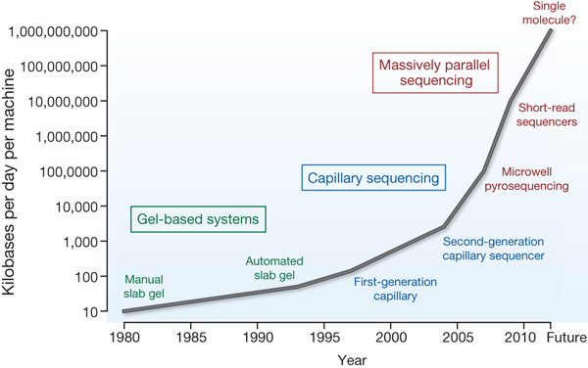

Improvements in the rate of DNA
sequencing over the past 30 years and into the future.
MR Stratton et al. Nature 458, 719-724 (2009) doi:10.1038/nature07943

