Slide 1
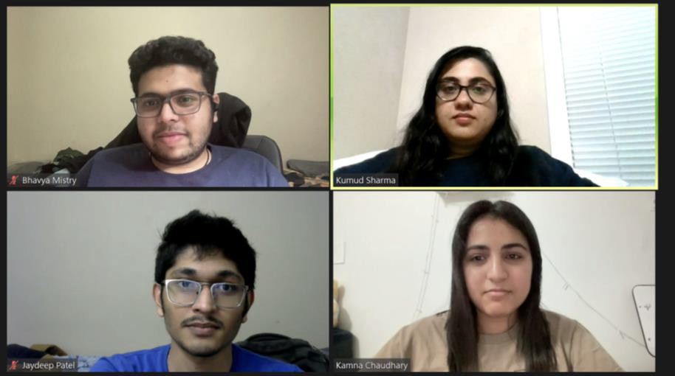
Home Credit Default Risk Prediction
GROUP 11 - Phase 2
Kumud Sharma (kumsharm@iu.edu)
Kamna Chaudhary (kamchau@iu.edu)
Bhavya Mistry (brmistry@iu.edu)
Jaydeep Patel (jp157@iu.edu)

Slide 2
Project Phase 2 - Outline
Project Goal and Description
Visual Exploratory Data Analysis
Modeling Pipeline
Performance metrics for baseline models
Kaggle submissions and score
Conclusion and Next Steps

Slide 3
Project Goal and Description:
The goal of our project is to create a model that can forecast if a potential borrower of a new mortgage will be a "default risk" or not.
Home Credit uses extensive transactional and demographic data analysis to offer the unbanked population a secure borrowing environment.
Loan acceptance based solely on credit score is frequently not a practical choice.
Thus, our model seeks to take into account a number of other variables, including monthly income, prior loan applications, financial issues, etc.
In this phase 2, we have examined the HCDR data and conducted the exploratory data analysis and built baseline pipeline.
Also, we are attempting to preprocess the data and establish baseline results for several models.

Slide 4
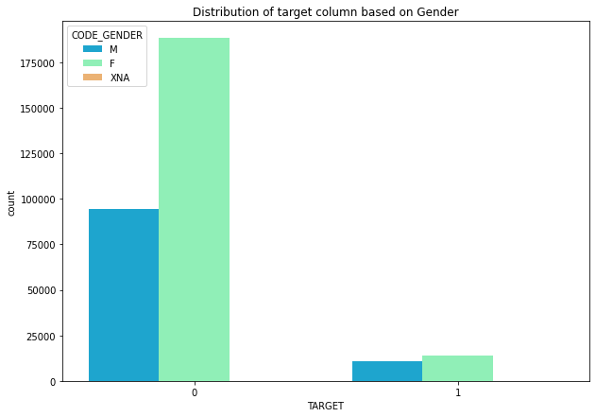
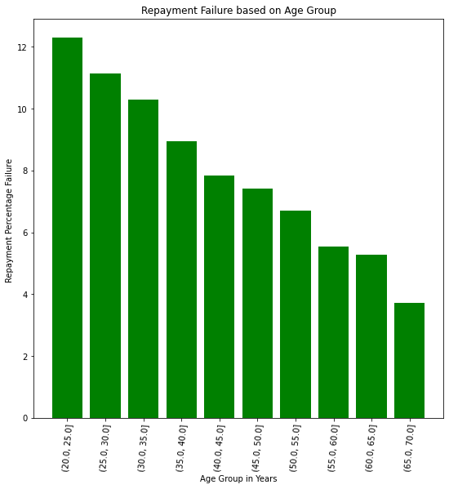
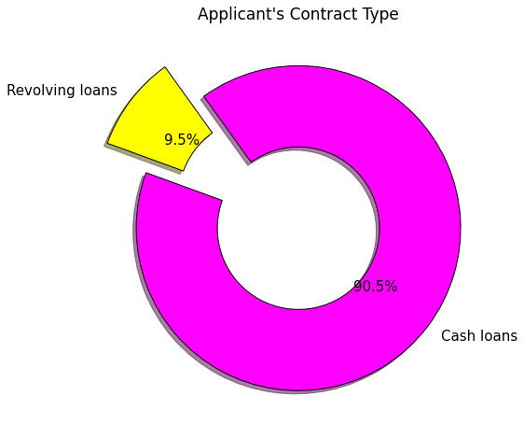
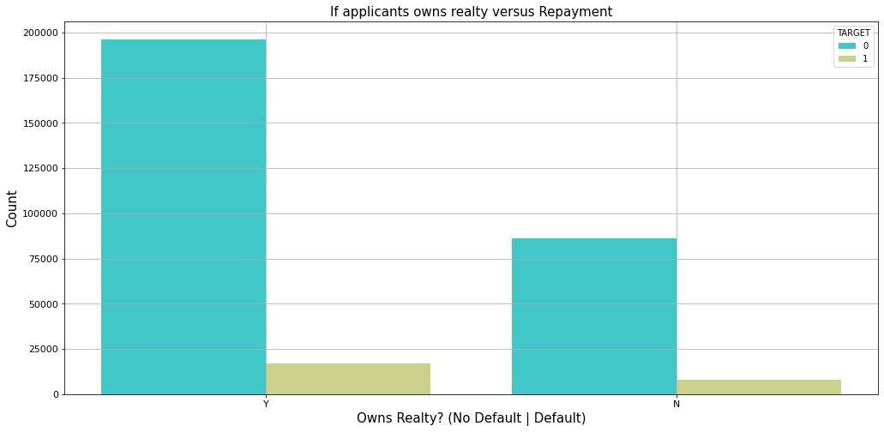
Visual Exploratory Data Analysis

Slide 5
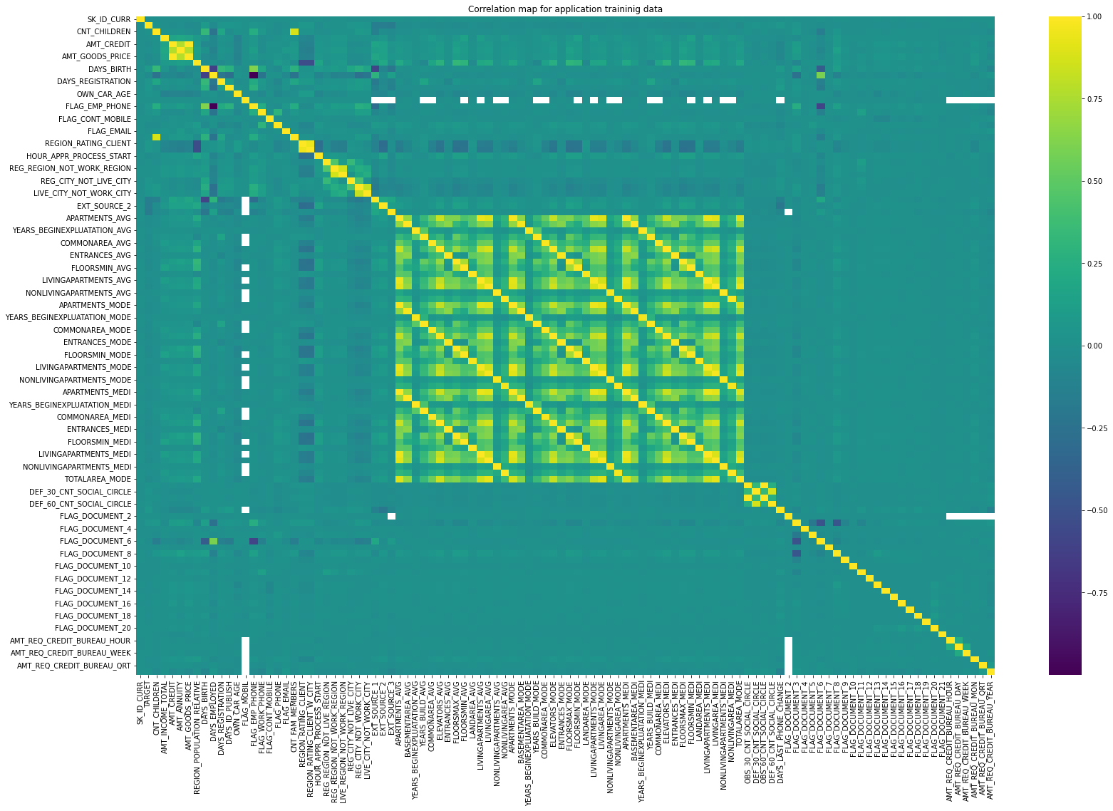
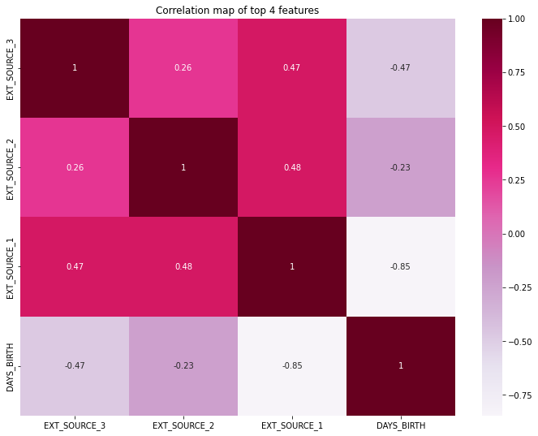
Correlation with the TARGET column

Slide 6
Modeling Pipeline
Feature
Scaling
Train-Test Validation Split
Imputation of missing values
Baseline model training
Model evaluation and comparison

Slide 7
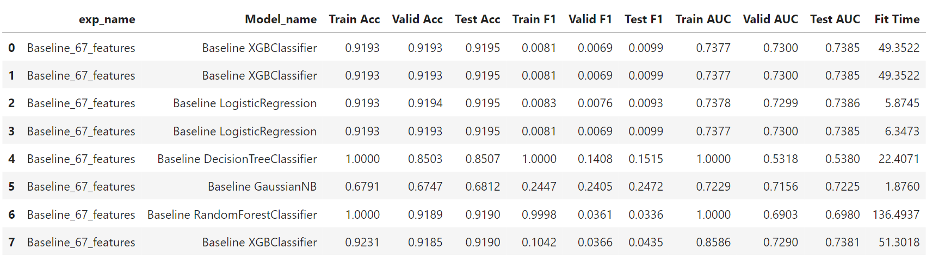
Performance metrics for baseline models

Slide 8
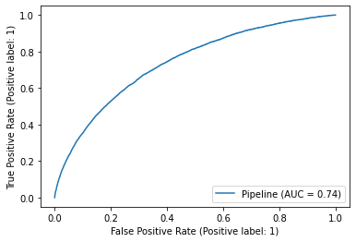

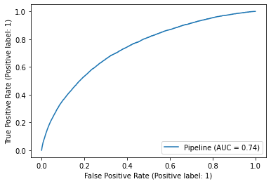
Performance metrics comparison for different models
Logistic Regression
Gaussian NB
XGBoost

Slide 9
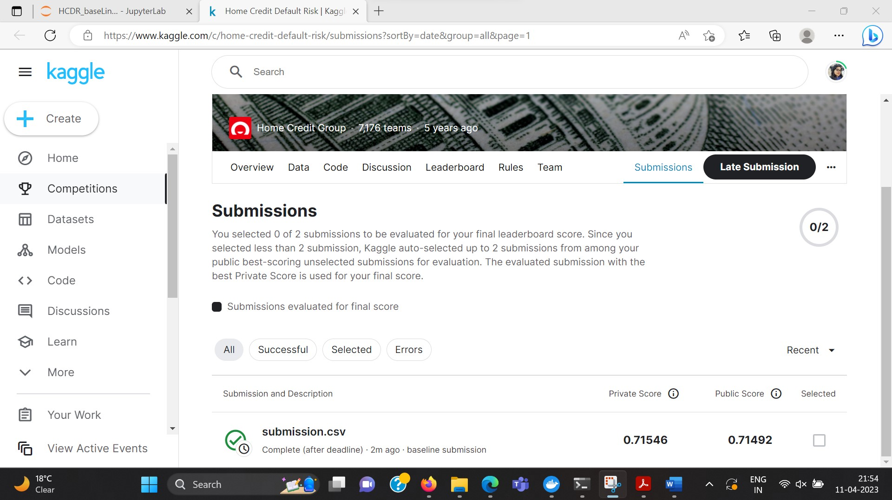
Kaggle submission and score
After submitting to Kaggle, we received an AUC private score of 71.54% and a public score of 71.49%.

Slide 10
Conclusion
Processed raw HCDR data using EDA and data preprocessing and built baseline pipeline.
When submitted to Kaggle, the baseline Ridge Logistic Regression model generated private scores of 71.54% and roughly 71.49% for public.Constructed and examined baseline models - Random Forest Logistic Regression.
We have concluded that our best baseline model is Logistic Regression and XGBoost.
Further feature engineering and the incorporation of new features through other tables are suggested. adding more neural network-based classifiers. tweaking hyper-parameters to enhance performance.

Slide 11
Summary of this Phase and next Steps
Past : Understood the project requirements in the past and Built Project plan.
Present : Exploratory Data Analysis, comprehending the relationships between features, developing new features, and creating foundational models are currently being done.
Planned : Further feature engineering and the incorporation of new features through other tables are suggested. adding more neural network-based classifiers. tweaking hyper-parameters to enhance performance.
Problems: Training our models necessitates a significant amount of computational power and RAM. We also had some docker issues with training our model on Macbook M1 chip so for now our models were trained on windows platform.

