Slide 1
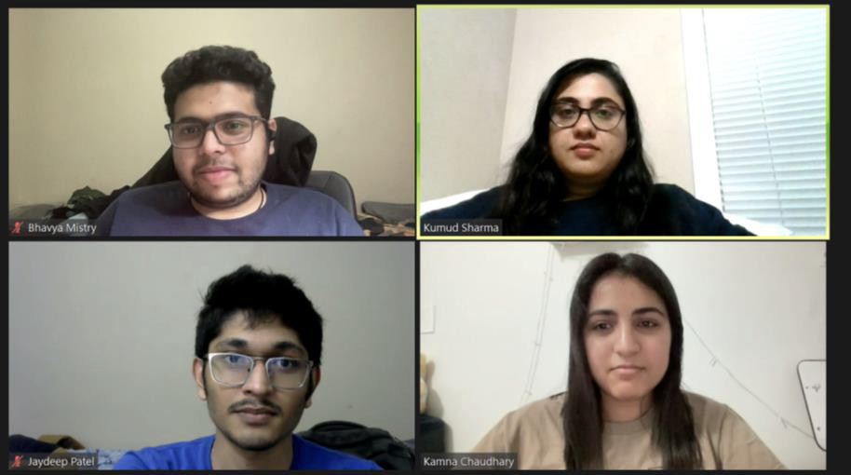
Home Credit Default Risk Prediction
GROUP 11 - Phase 3
Kumud Sharma (kumsharm@iu.edu)
Kamna Chaudhary (kamchau@iu.edu)
Bhavya Mistry (brmistry@iu.edu)
Jaydeep Patel (jp157@iu.edu)

Slide 2
Project Phase 3 - Outline
Project Goal and Description
Feature Engineering
Hyperparameter tuning
Performance metrics for models
Results - After Hyperparameter Tuning
Kaggle Submission and scores
Conclusion and Next Steps

Slide 3
Project Goal and Description:
The goal of our project is to create a model that can forecast if a potential borrower of a new mortgage will be a "default risk" or not.
Phase 1 and Phase 2 work -
Understanding the problem statement.
Exploration of dataset.
Discussion of potential machine learning methods that could be used in the project.
Carried out a visual exploratory data analysis to identify elements important for the target variable's prediction.
Baseline model training and assessment of several models using chosen performance indicators.

Slide 4
Feature Engineering
The application_train.csv and application_test.csv datasets were the only ones used in the prior phase's feature engineering, which introduced 3rd-degree polynomial features. To train and test the baseline models, we used a portion of the fresh data.
In this stage, we prepare features from additional secondary tables that the HCDR dataset offers us. In this article, the previous_application.csv and bureau.csv tables have received the most of our attention.
This phase will be divided into the following three sections:
Feature Engineering in the previous_application.csv table.
Feature Engineering in the brueau.csv table.
Combining the two secondary tables with the application_train.csv and application_test.csv tables.

Slide 5
Hyperparameter Tuning
We employed an indirect approach to efficiently carry out a hyperparameter tuning grid search and random search.
We evaluated the following classifiers: Gradient Boosting Classifier, Decision Tree Classifier, Random Forest Classifier, Logistic Regression Classifier, and XG Boost Classifier, AdaBoost Classifier.
We used ensemble classifiers such as: Gradient Boosting Classifier, Random Forest Classifier, XG Boost Classifier, AdaBoost Classifier.
Non-ensemble classifiers such as: Decision Tree Classifier, Logistic Regression Classifiers.
For each of these models, we also tested a large number of hyperparameters for both grid search and random search and compared the results, where grid-search were slightly better than RandomSearch for AUC-ROC score.

Slide 6
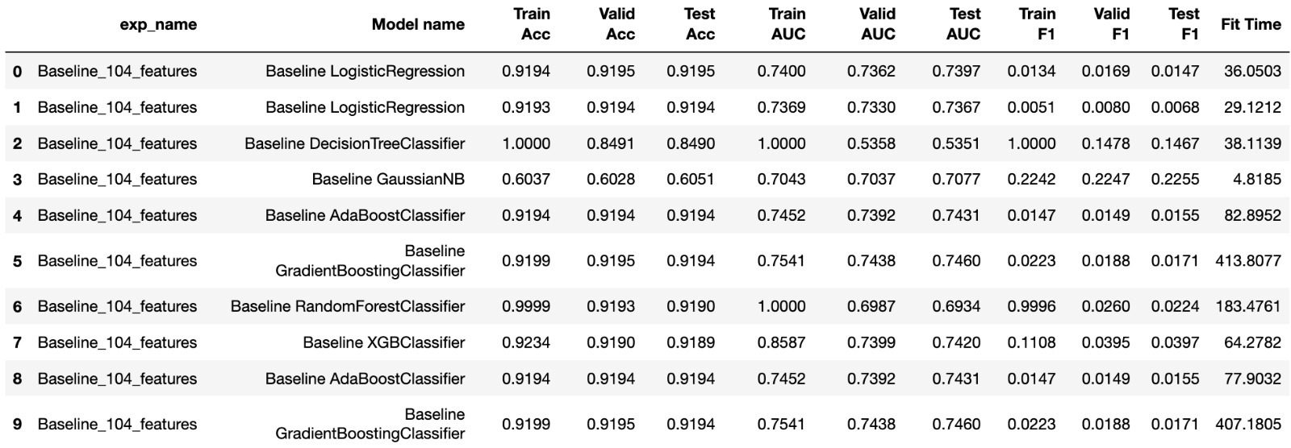
Performance metrics for models

Slide 7
Results - After Hyperparameter Tuning
Grid Search
Random Search

Slide 8
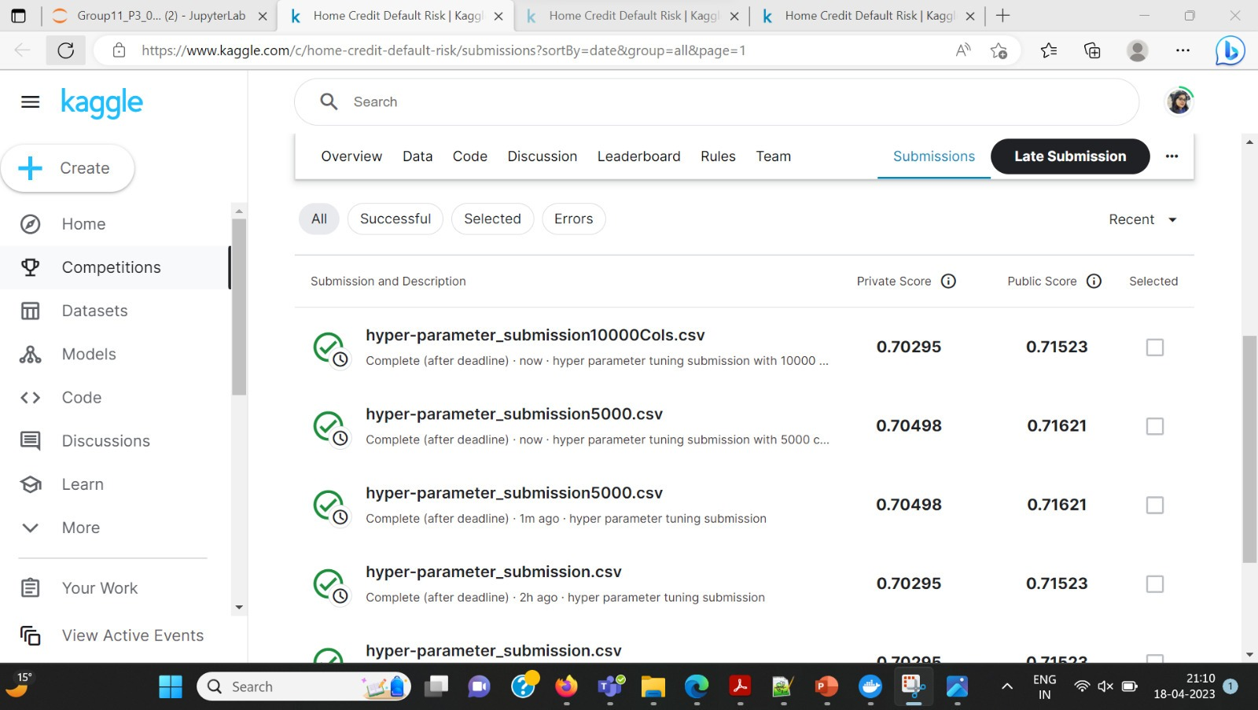
Kaggle submission and score
After submitting to Kaggle, we received an AUC private score of 70.4% and a public score of 71.6%.

Slide 9
Conclusion and next Steps
Past :
Exploration of Datasets, Exploratory Data Analysis, Feature Engineering, and Baseline Model Development
Present :
In this phase, the datasets were combined, and the most important properties for the target variable's prediction were derived.
We have performed Feature Engineering deriving Polynomial Features (with degree = 3) for highly correlated features.
We performed Hyperparameter tuning using GridSearchCV with best results being obtained for ADABoost classifier.
We have also performed submissions on Kaggle and best results were obtained for ADABoost classifier with a ROC-AUC score of 71.6%.

Slide 10
Proposed :
To ensure that the dataset is balanced for the following stage, we first intend to undersample the data.
We will also introduce dimensionality reduction to handle underfitting and develop Multilayer Perceptron for achieving better accuracy on the predicted results.
Finally, we will compare all the models based on the performance metrics and the best model will be chosen.
Problems:
Training our models necessitates a significant amount of computational power and RAM. Due to memory problems, the notebook had to be run on IU BigRed because the kernel was frequently crashing and generating problems.
Choose the proper engineering features, and deal with missing and null values.

