Slide 1

Customer Trends Data Analysis
Using Python, SQL & Power BI to uncover purchasing patterns and sales trends from retail transaction data.

Slide 2




DATASET OVERVIEW
3,900 Customer Records
Each row represents the latest purchase by one customer. The dataset spans demographics, product purchases, payment methods, subscriptions, discounts, shipping, and reviews.
18 columns capturing the full shopping journey.
Demographics
Age, gender, location
Products
Category, size, color, amount
Payment
Method, discount, promo code
Shipping
Type, frequency, season

Slide 3
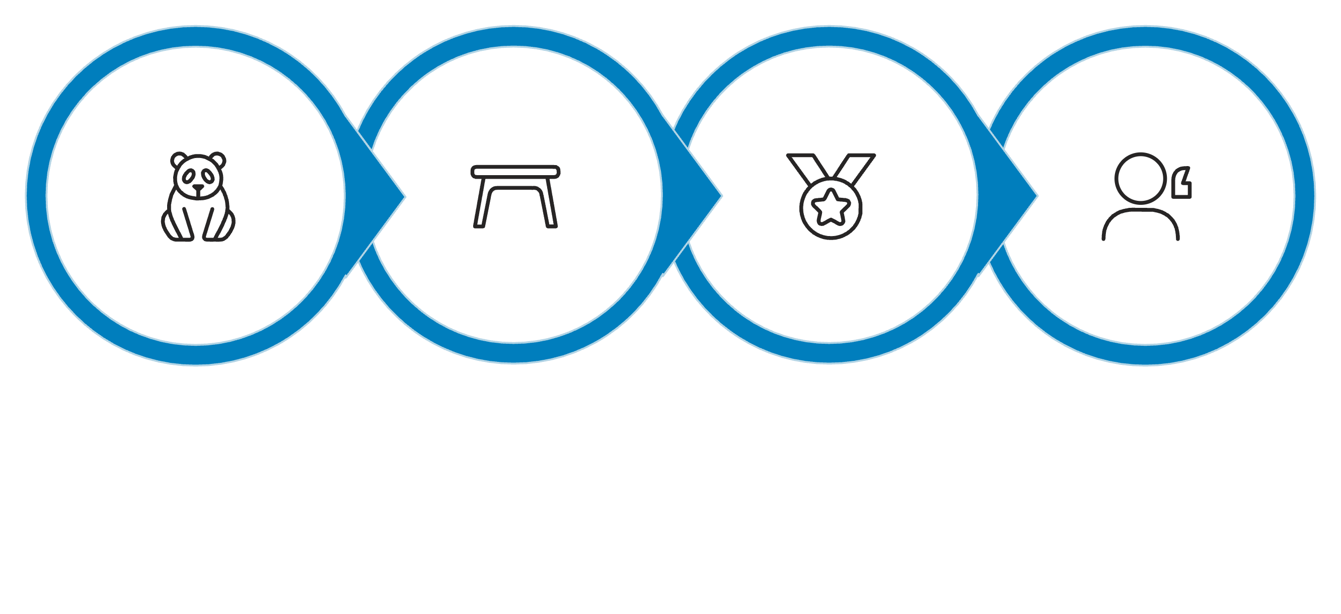
DATA CLEANING
Python Preprocessing Pipeline
Treat Missing Values
Inspect Structure
Standardize Columns
Load Dataset
Missing review ratings imputed with category-specific medians — robust to outliers and preserving behavior patterns.

Slide 4

FEATURE ENGINEERING
Engineered Features
1
2
3
Age Groups
Purchase Frequency
Redundancy Removed
Customers segmented into Young Adult, Adult, Middle-aged, and Senior using quartile-based binning.
Text labels converted to numerical days — Weekly=7, Fortnightly=14, Monthly=30, Quarterly=90, Annually=365.
Promo code column dropped — identical to discount applied. Consistent types and clean naming throughout.

Slide 5
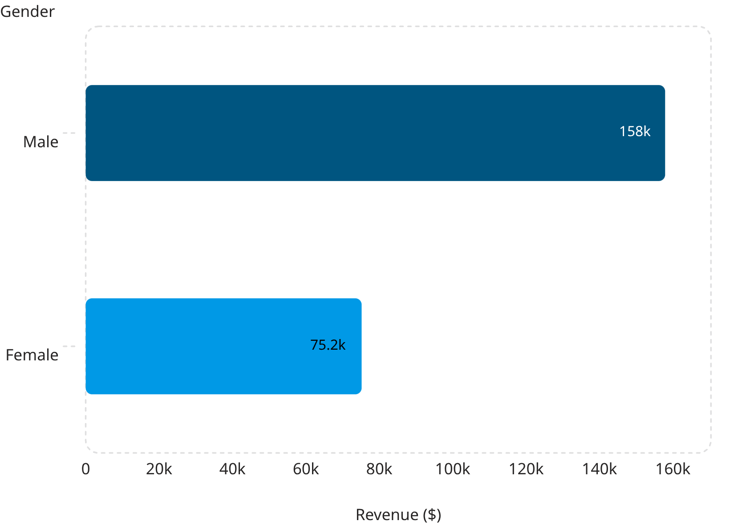
SQL ANALYSIS
Revenue by Gender
Male customers generate 2.1× more revenue than female customers.
SQL queries also identified high-spending customers who remain above average despite receiving discounts.

Slide 6
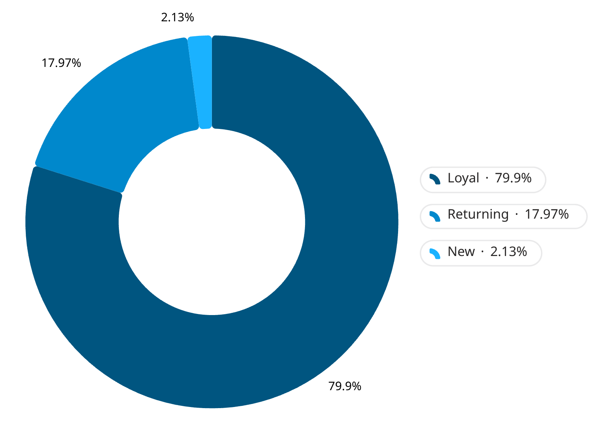
SQL ANALYSIS
Customer Segmentation
Customers classified by purchase history using SQL conditions. The vast majority are loyal repeat buyers.
Top products ranked within each category using ROW_NUMBER() window functions.

Slide 7
POWER BI DASHBOARD
Interactive Dashboard
3.9K
$59.76
Total Customers
Avg Purchase
3.75
27%
Avg Rating
Subscribed
Interactive slicers for subscription, gender, category, and shipping type enable dynamic exploration of customer segments.

Slide 8
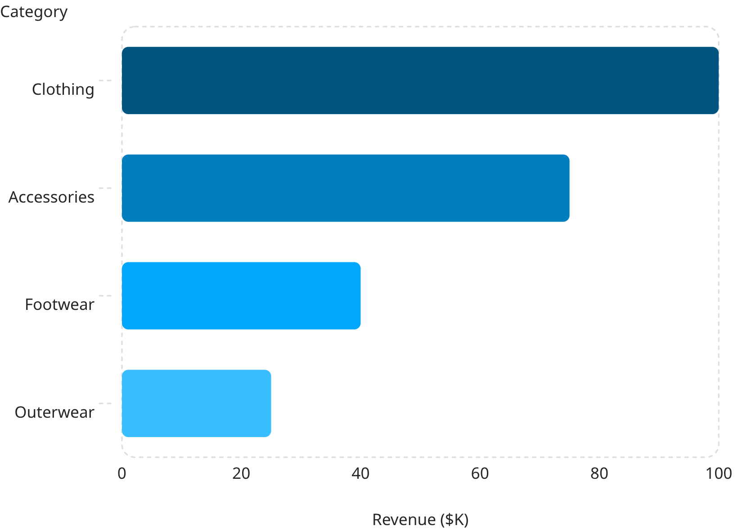
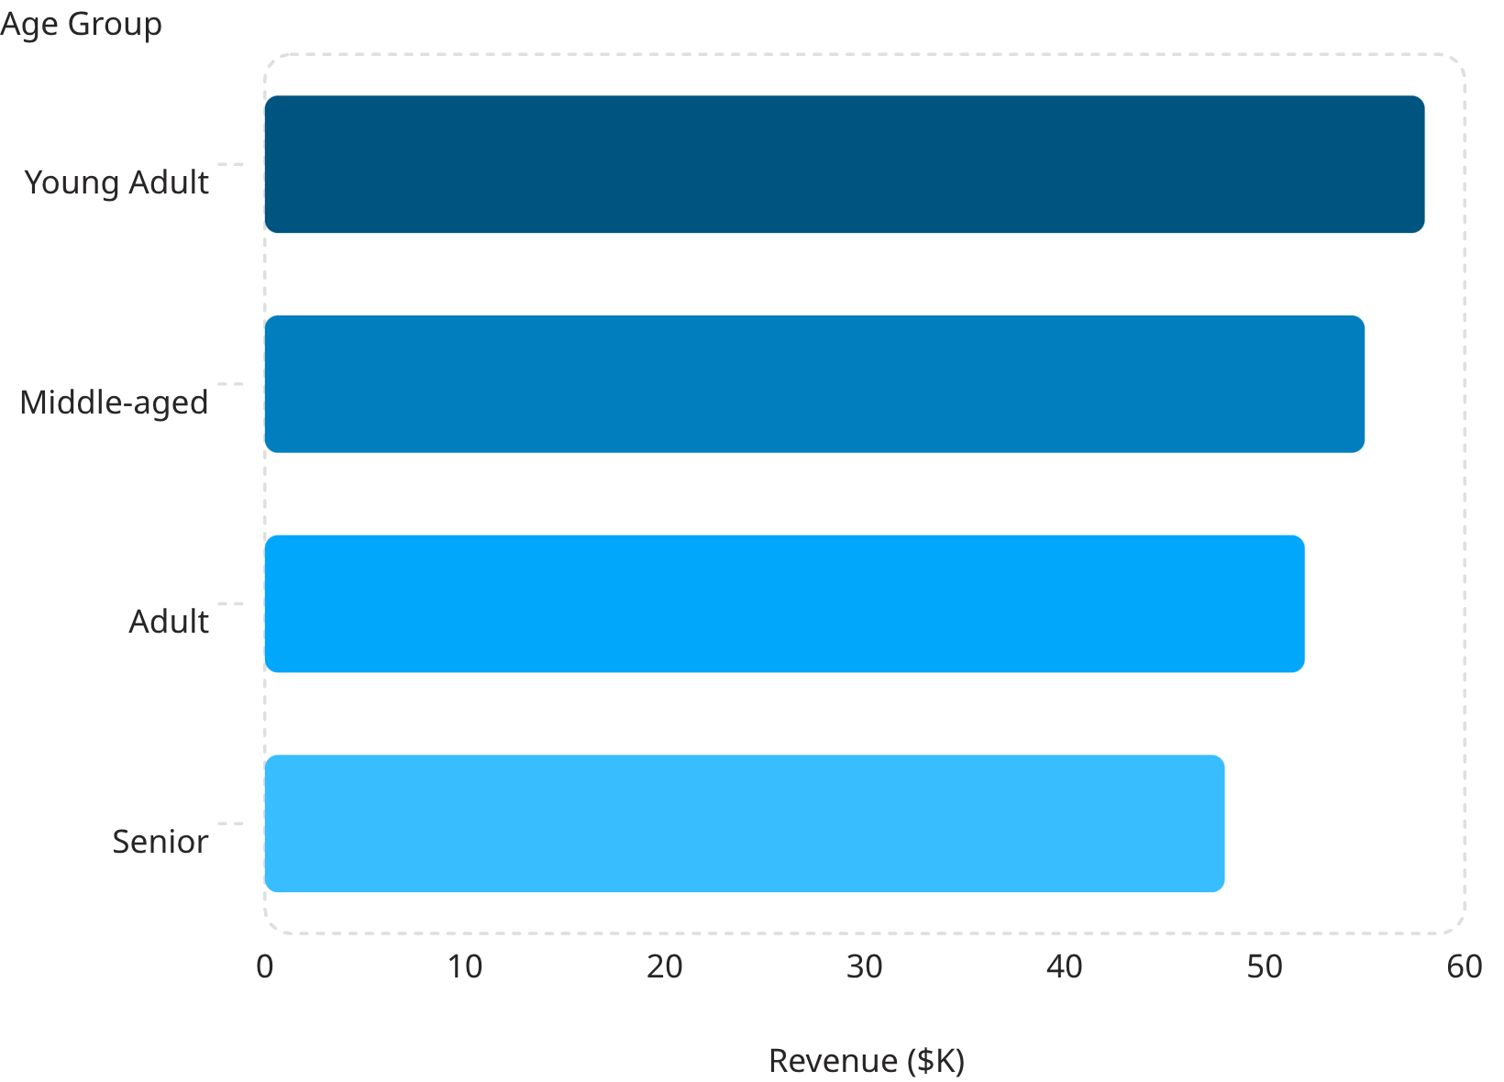
POWER BI DASHBOARD
Revenue by Category & Age

Slide 9
KEY INSIGHTS
Six Business Insights
Express Shipping
Young Adults
Higher avg purchase amount vs standard shipping
Highest revenue across all age groups
Loyal Not Subscribed
Top Categories
Targeted subscription campaigns needed
Clothing & Accessories outperform — focus marketing
Discounts
Ratings & Spend
Boost frequency, not always revenue — optimize carefully
Higher ratings linked to higher purchase values

Slide 10




End-to-End Analytics
From raw data to actionable insights — improving marketing, satisfaction, and profitability.
Python
Cleaning & feature engineering
SQL
Business analysis & segmentation
Power BI
Interactive dashboard & insights

