Slide 1
Closed System Can Cooler Via Forced Convection
Kun Qiu, Robert Polk, John Henry Campbell

Slide 2
Design Process

Slide 3
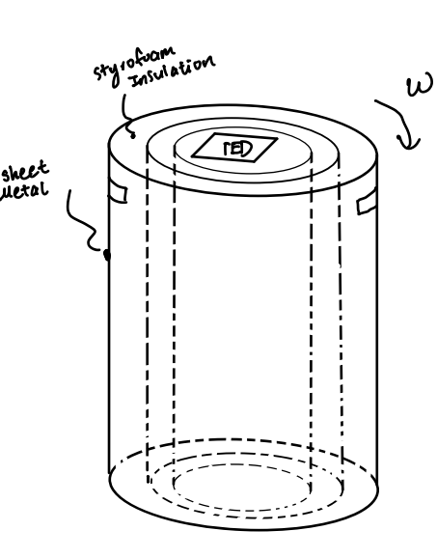
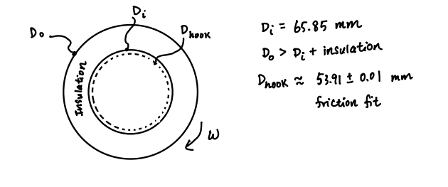
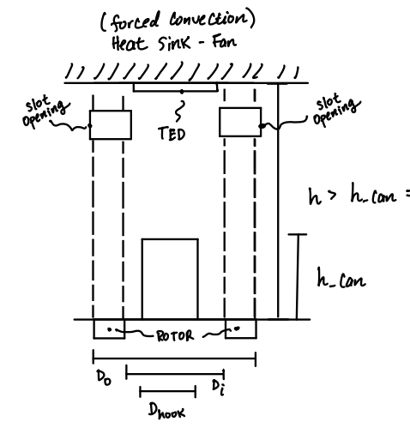
Initial Design
Notes:
Explain Cons of this design. Open to system, cold air is not trap in the system.

Slide 4
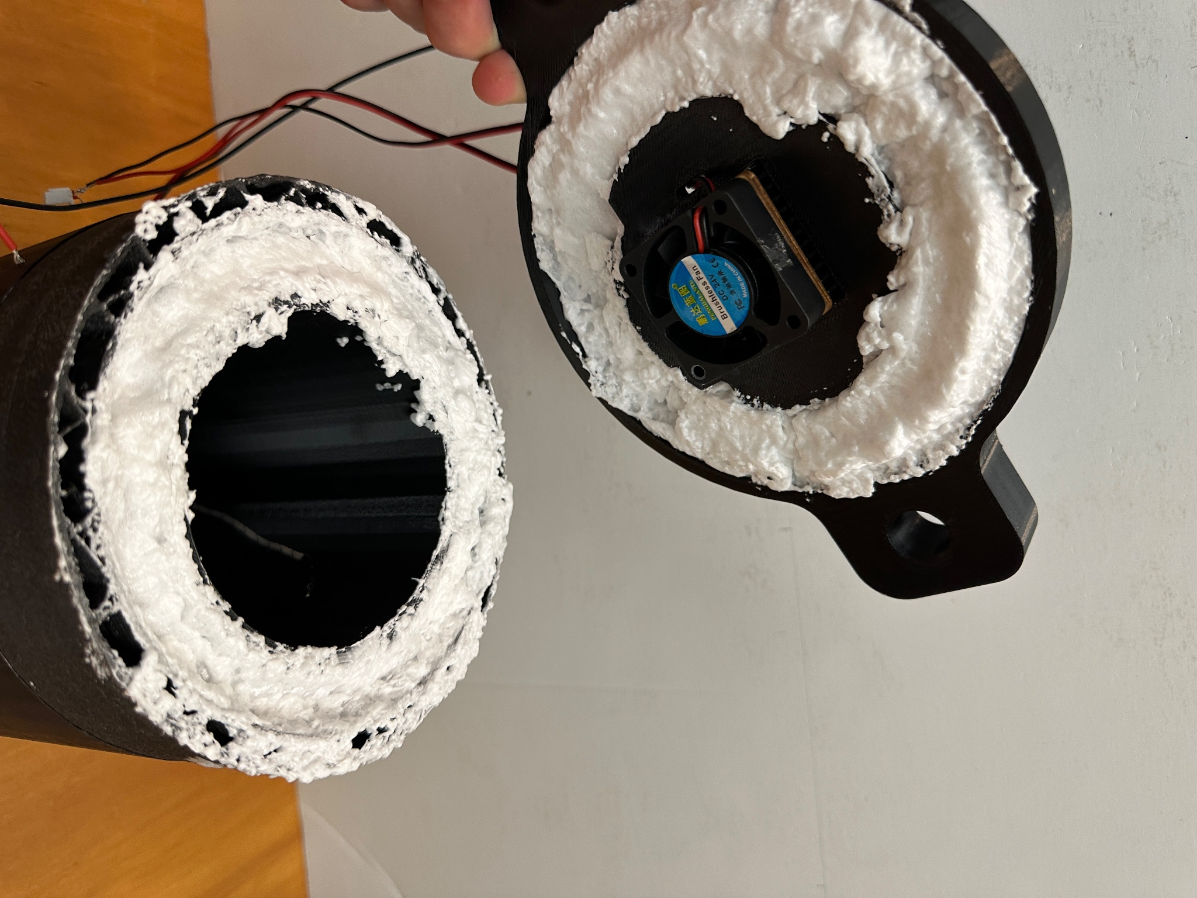
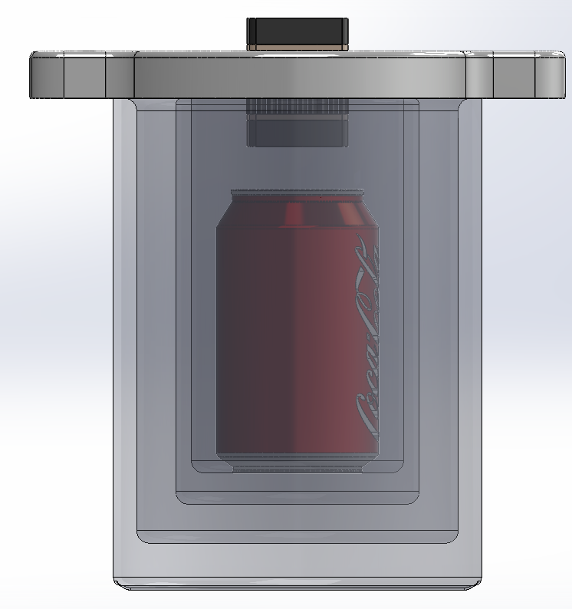
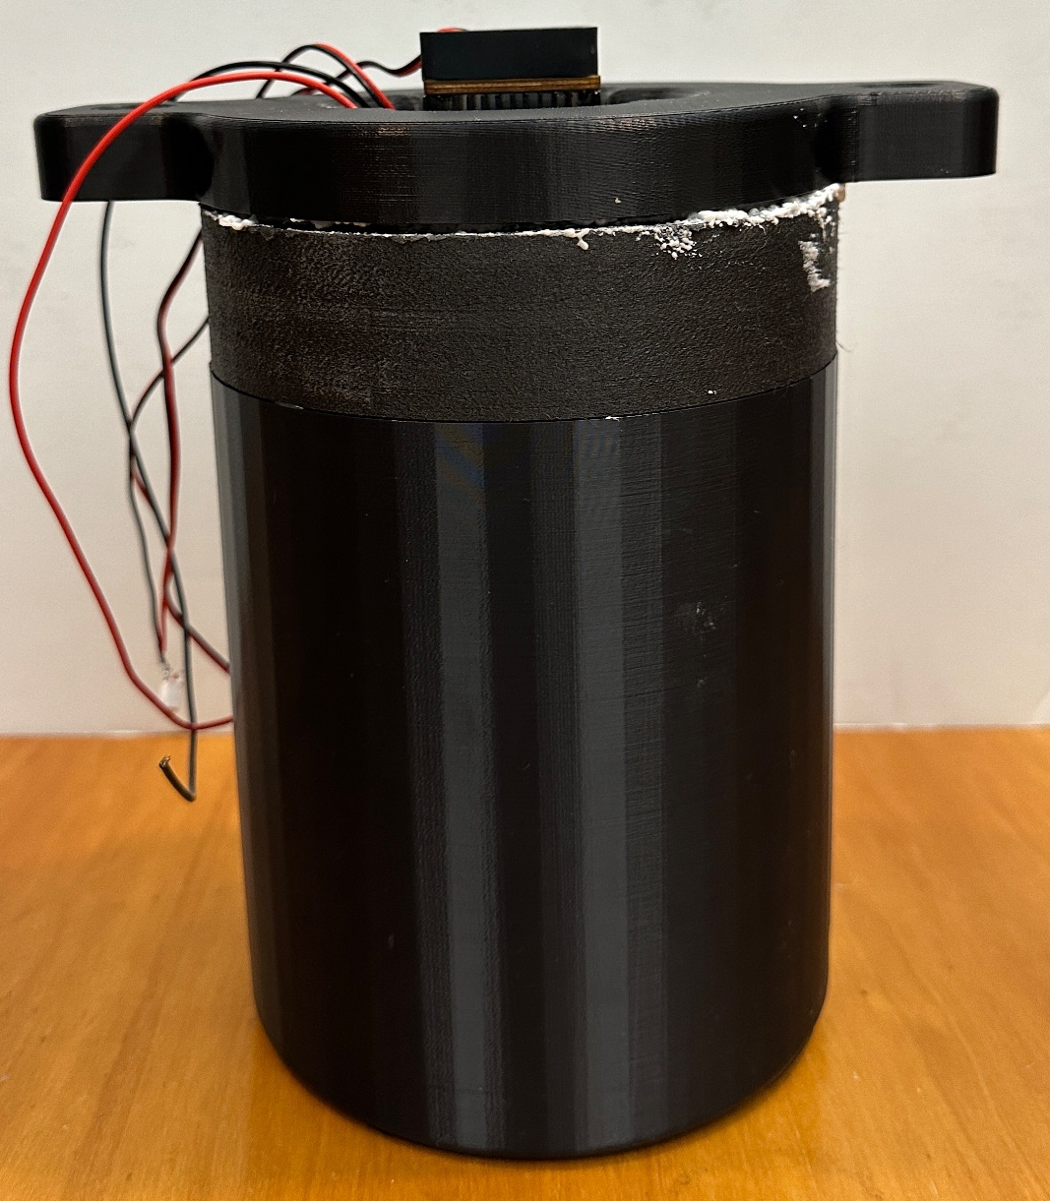
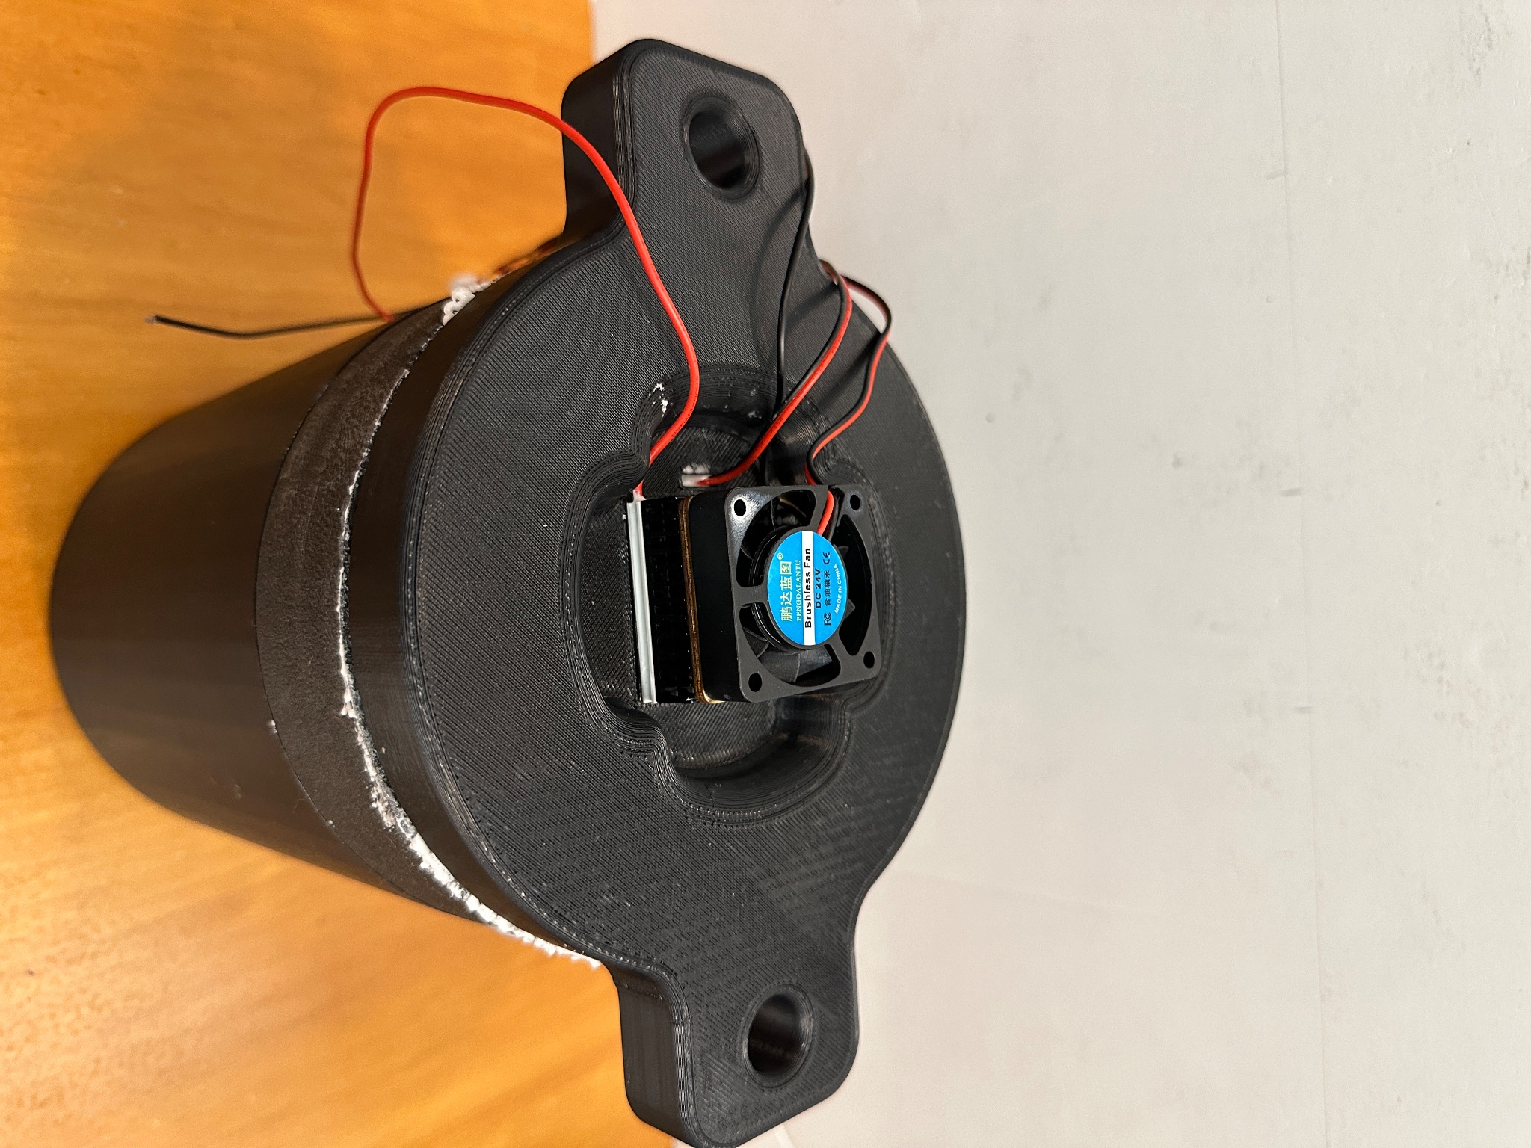
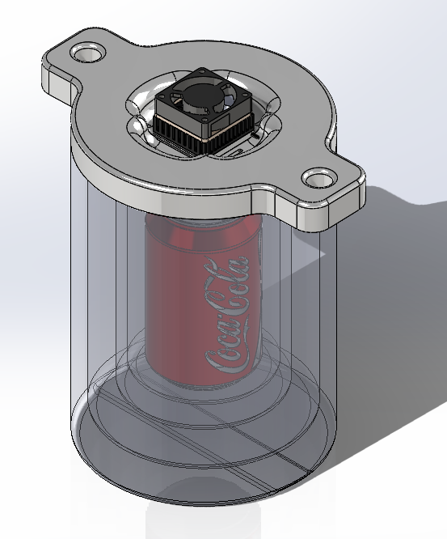
Final Design and Prototype
Notes:
Explain the benefit of this design

Slide 5
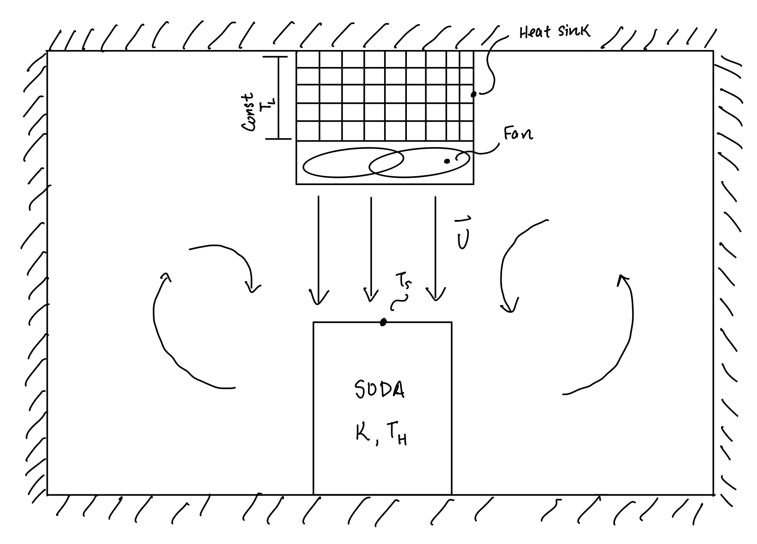
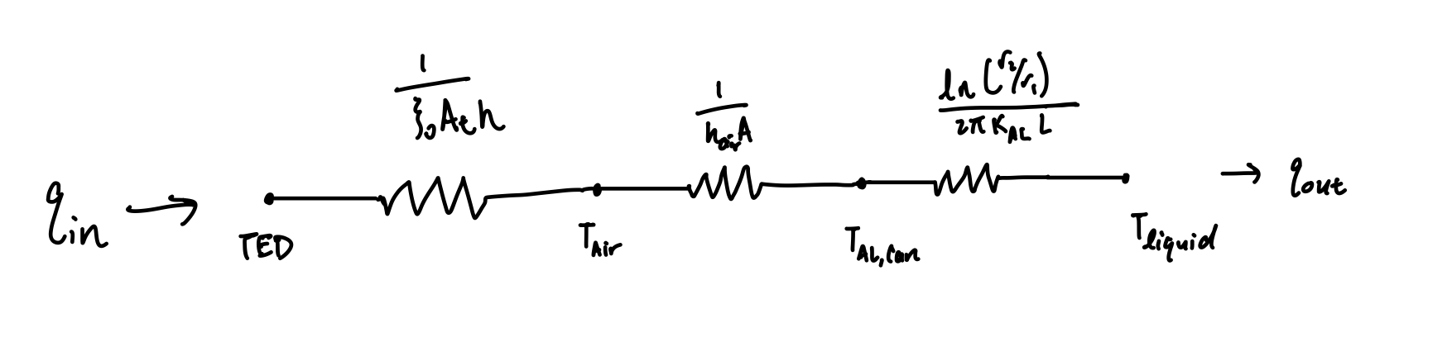
Schematic for Cooling Operation
Constant temperature near fins
Forced convection of fluid flow over the cylinder
Warm air are brought to the TED through natural convection
The warm air are chilled to low temperature through the fins
Process will repeat until the temperature of soda is equal to the chilling temperature

Slide 6
Modeling of the Cooling Device

Slide 7
Assumptions
Cooling device is a closed system
All external surfaces of cooling system are perfectly insulated
Assume aluminum layer of can is infinitesimally thin → direct thermal contact between soda liquid and the cooling fluid.
Soda is assumed to have the same physical properties as water.
Thermoelectric provides a constant heat flux.
Fully developed laminar flow and concentric tube annulus.
Constant material properties

Slide 8
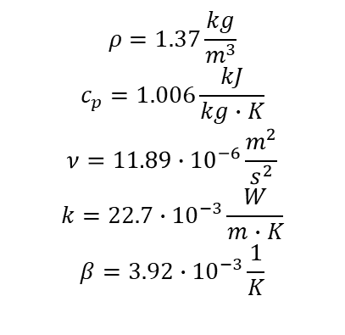
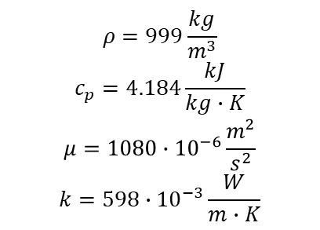
Material Properties
Air @ -15 C
Water @ 15 C

Slide 9
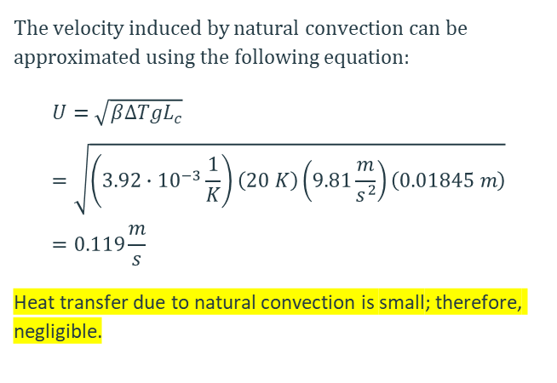
Heat Transfer Via Natural Convection

Slide 10
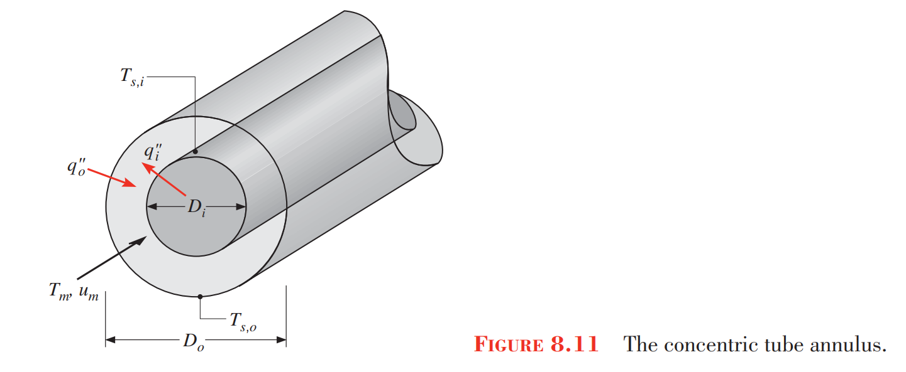

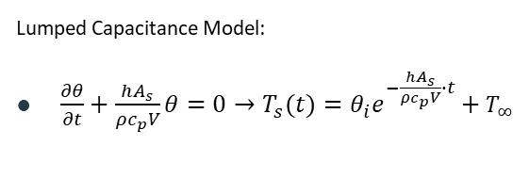
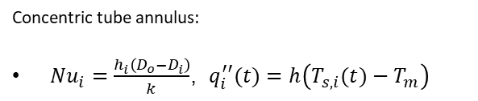
Heat Transfer Via Fluid Motion – Internal Forced Convection
Assume h is invariant with surface temperature 🡪 To obtain a lower time bound for soda to cool to 5 C

Slide 11
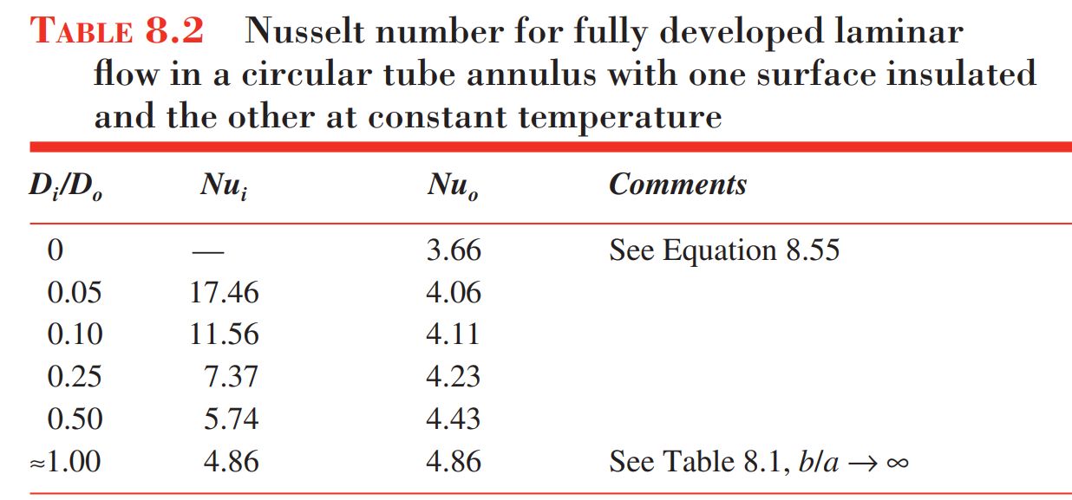
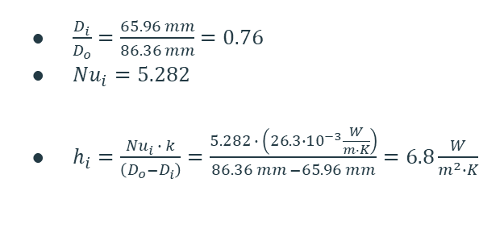
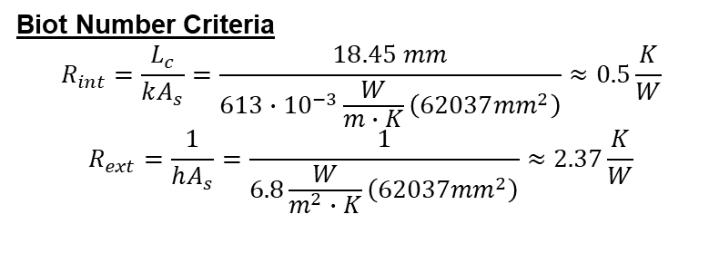
Internal Forced Convection Cont.
Notes:
Although the biot number criterion was not hold, we can still use this to model our system because in actuality the flow diameter is much smaller than D0 – Di since not the entire channel has a consistent flow.

Slide 12
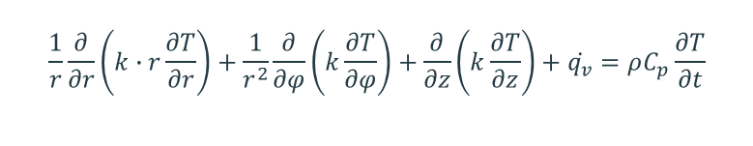
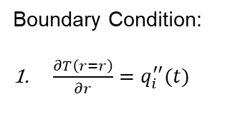
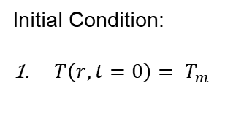
Heat Transfer @ Soda Interior – Transient State Heat Conduction
q
Cross Sectional View
q(t)
q(t)
Temperature Profile 🡪 Symmetric about Axis of Rotation

Slide 13
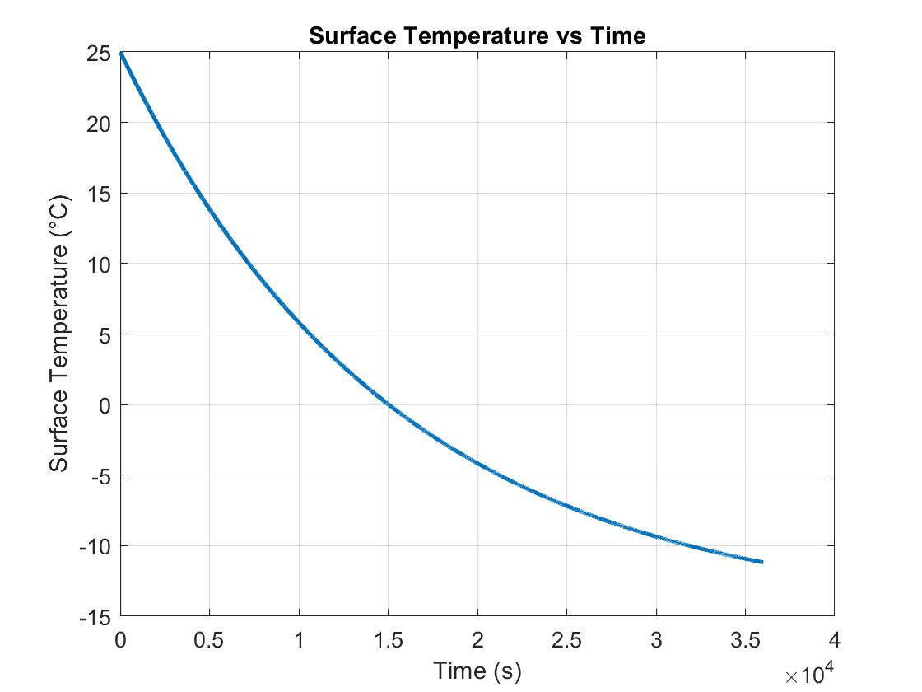
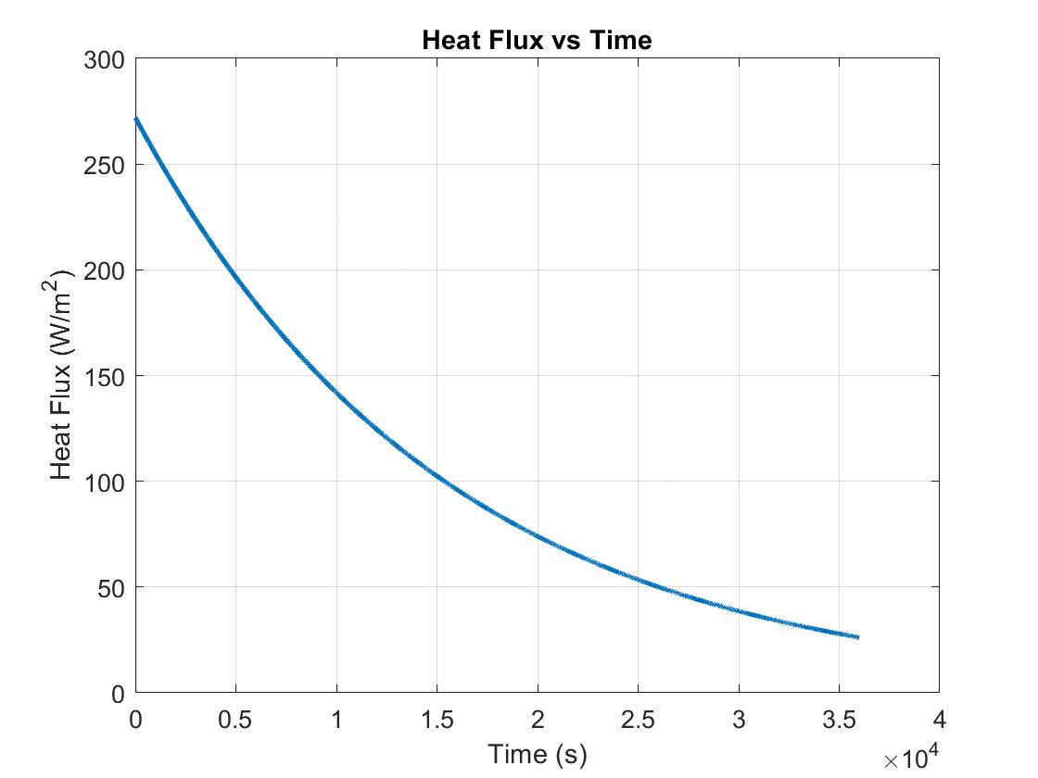
MATLAB Simulation Results [Lumped Capacitance]🡪 t ⊆ [0, 10 hr]
To reach approximate 6 C on surface, requires 10,000 seconds which is equivalent to 2.77 hr.
Boundary Condition: Heat flux from can surface to surrounding air

Slide 14
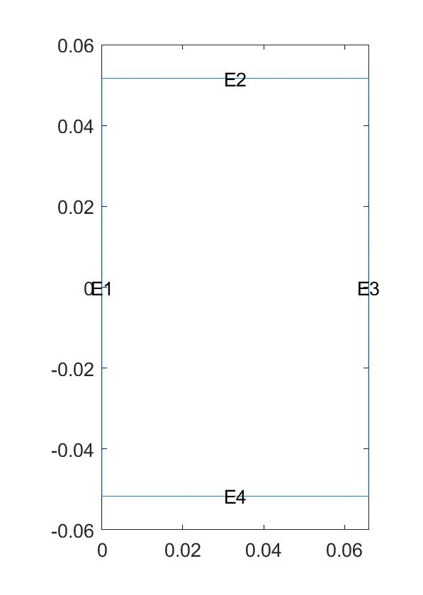
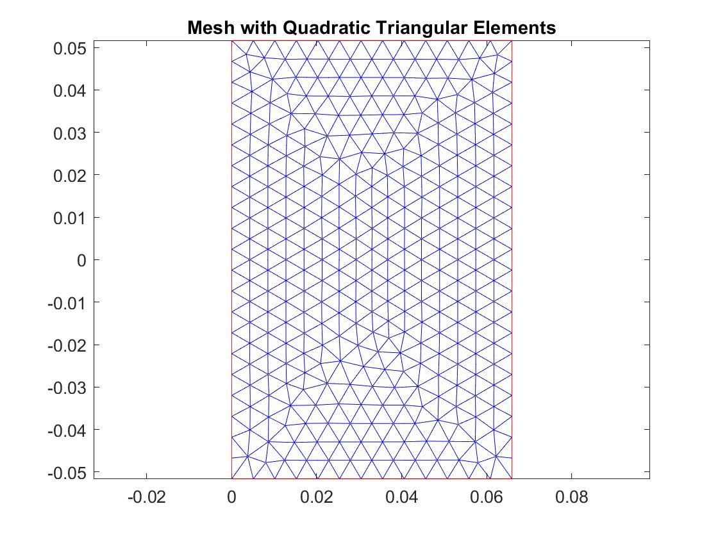
Modeling of Transient Cooling Process in Soda
q_out
q_out
Geometric Setup
Discretization - Mesh Generation

Slide 15
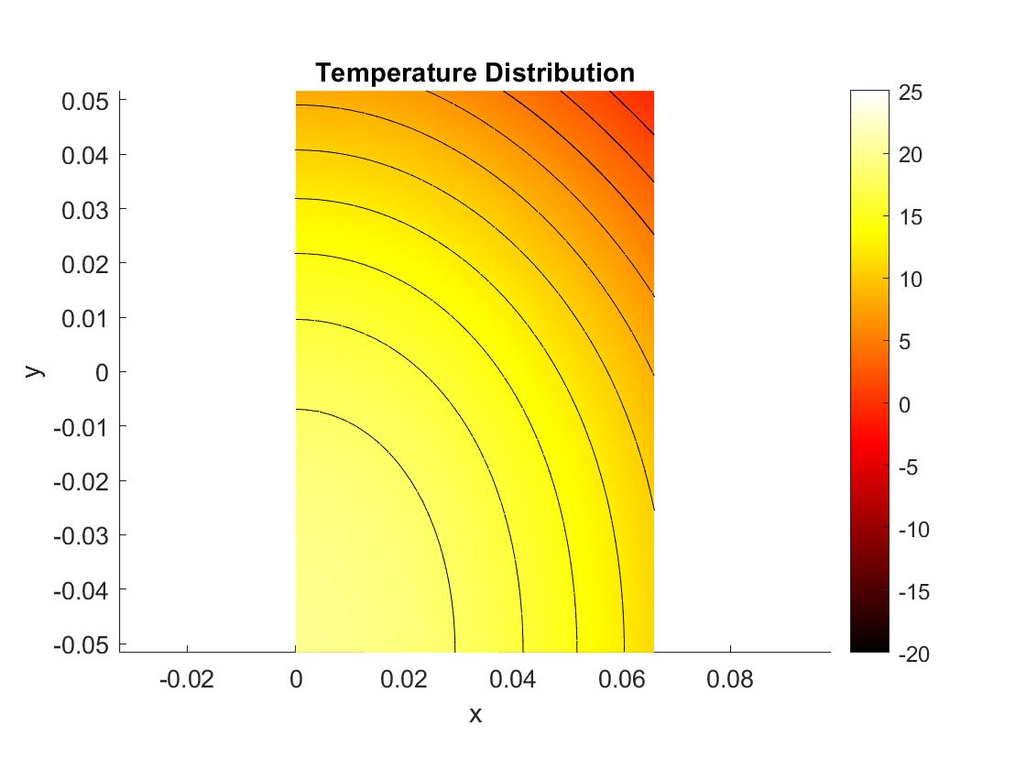
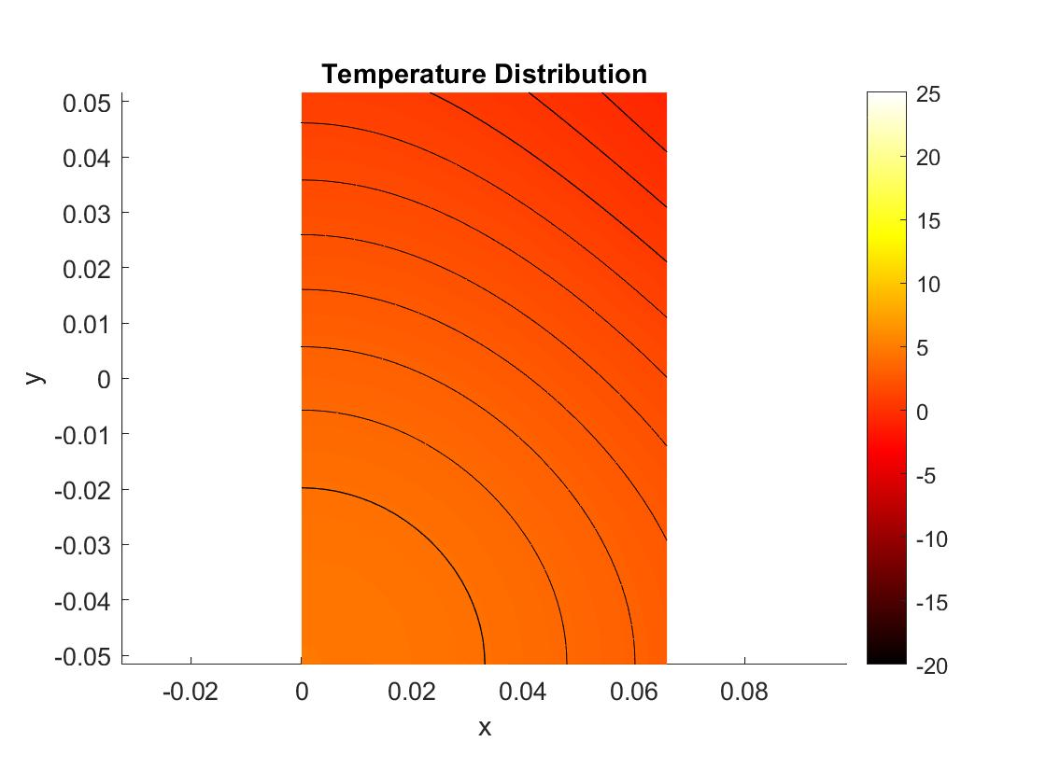
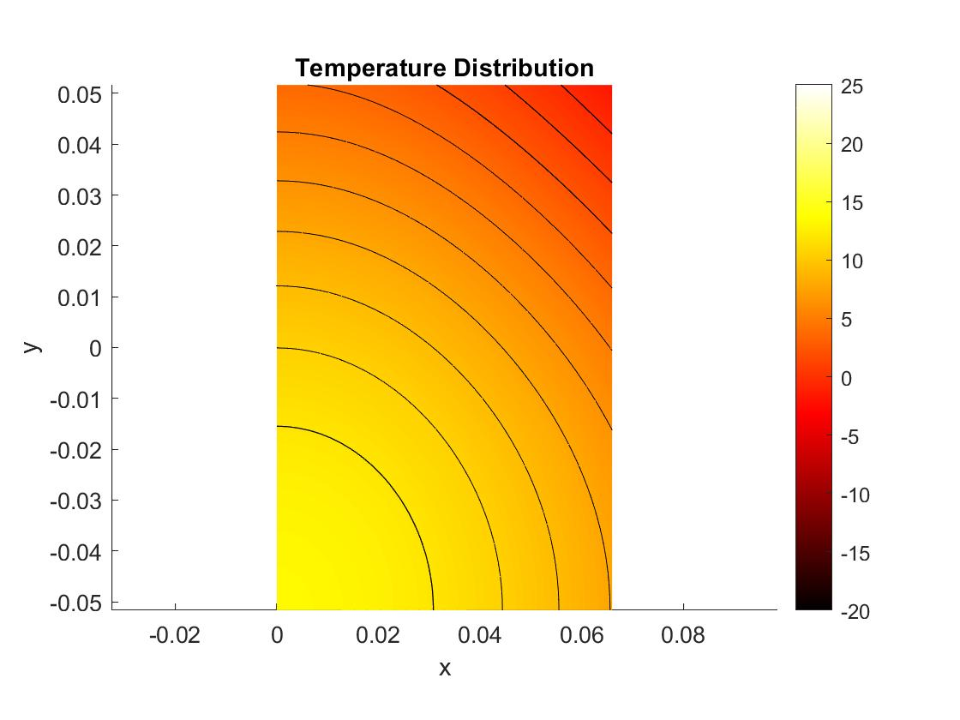
Temperature Profile of Cylinder
t = 5 hr
t = 2.77 hr
t = 10 hr

Slide 16
Experimental Performance of Cooling Device

Slide 17
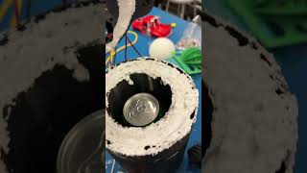
Experiment

Slide 18
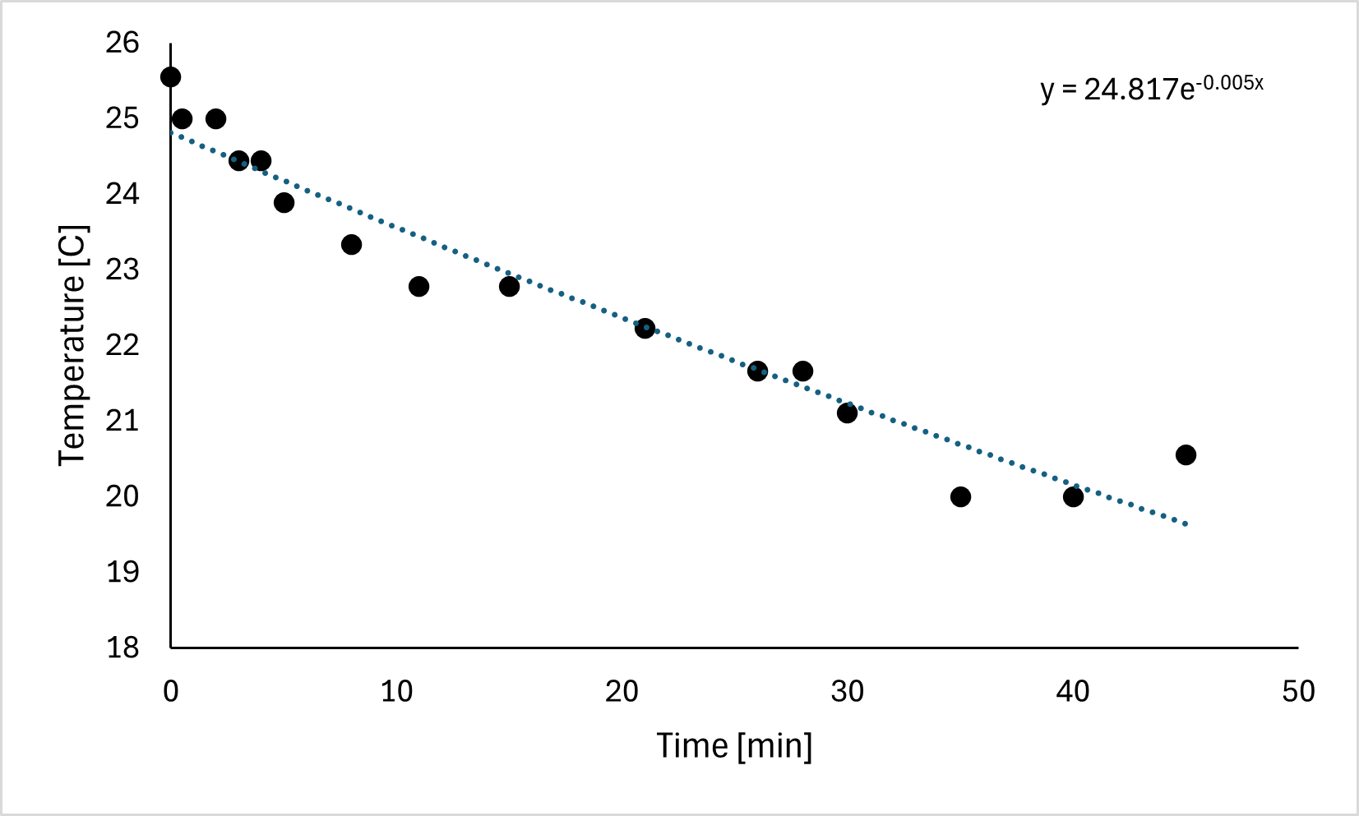
Data Analysis
Time [min] | Fahrenheit | Celsius
45 | 69 | 20.55556
40 | 68 | 20
35 | 68 | 20
30 | 70 | 21.11111
28 | 71 | 21.66667
26 | 71 | 21.66667
21 | 72 | 22.22222
15 | 73 | 22.77778
11 | 73 | 22.77778
8 | 74 | 23.33333
5 | 75 | 23.88889
4 | 76 | 24.44444
3 | 76 | 24.44444
2 | 77 | 25
0.5 | 77 | 25
0 | 78 | 25.55556
Notes:
Base on the trend, it will take 4.7 hr to reach 6 C 🡪 Therefore, the modeling is consistent with the experimental data by providing a lower bound. Diminishing return.

Slide 19
Conclusion
Mathematical model provides a good lower bound for the estimated time needed
Cooling with forced convection is not the optimal way of cooling a soda can
Reduced effectiveness as the transfer coefficient decrease with surface temperature
TED is not efficient for cooling
The system can be improved by a smaller ratio between the inner and outer tube diameter 🡪 Increased Nusselt number and heat transfer coefficient

