Slide 1




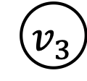

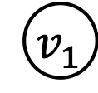
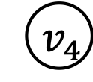
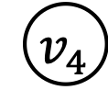
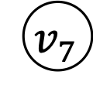

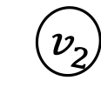


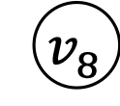

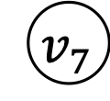
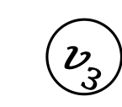



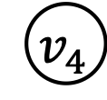






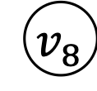


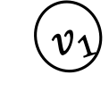
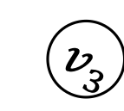
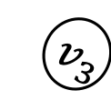
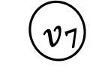
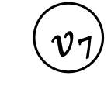


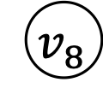
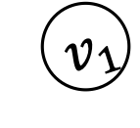






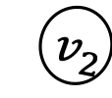



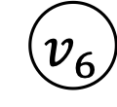
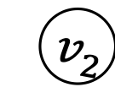
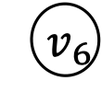
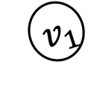
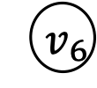
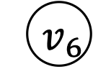

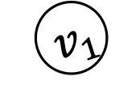
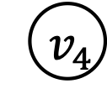


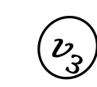

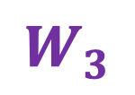

Disentangled Graph Convolutional Networks Jianxin Ma ( https://jianxinma.github.io ), Peng Cui ( http://cuip.thumedialab.com ), Kun Kuang, Xin Wang, Wenwu Zhu Department of Computer Science and Technology, Tsinghua University, Beijing, China
ICML | 2019
3
6
1
(Implementation Details)
Neighborhood Routing
The proposed layer takes in a set of node features $\left\{x_{u}\right\}∪\left\{x_{v}:\left(v,u\right)∈G\right\}$, and outputs $K$ representations $\left\{c_{1},c_{2},…,c_{K}\right\}$, where $c_{k}$ describes the aspect related with factor $k$.
Phase I: To extract factor-specific features.
For node $i∈\left\{u\right\}∪\left\{v:\left(v,u\right)∈G\right\}$ and factor $k∈\left\{1,2,…,K\right\}$, we compute:
$z_{i,k }=\frac{σ(W_{k}^{⊤}{ x}_{i}+b_{k})}{{\left|\left|σ(W_{k}^{⊤}{ x}_{i}+b_{k})\right|\right|}_{2}}$.
$z_{i,k }$ stands for node $i$’s aspect $k$. Each $z_{i,k }$ may be incomplete or inaccurate. We are hence required to look at the whole picture by convoluting the neighborhood.
Phase II (Neighborhood Routing): To identify the factor that causes the link between node $u$ and a neighbor $v$.
Initialize $c_{k}←z_{u,k}$ for each factor $k$.
Iteratively update $c_{k}$ for $T≈5$ times:
$p_{v,k}←\frac{\exp\left(z_{v,k}^{⊤} c_{k} /τ\right)}{\sum_{k^{′}}{\exp\left(z_{v,k^{′}}^{⊤} c_{k^{′}} /τ\right)}}$
$c_{k}←\frac{z_{u,k}+\sum_{v: \left(v,u\right)∈G}{p_{v,k} z_{v,k}}}{{\left|\left|z_{u,k}+\sum_{v: \left(v,u\right)∈G}{p_{v,k} z_{v,k}}\right|\right|}_{2}}$
$c_{k}$ ($k=1,2,…,K$) is a representation that describes the neighborhood’s aspect $k$.
Remark:
It is differentiable, and therefore can be trained in an end-to-end manner.
It supports real-time processing of new nodes, i.e., inductive learning.
(Experiment)
Disentanglement
The absolute correlations between 64 output neurons, on a graph with eight factors. The eight channels of our model are capturing mutually exclusive information, as Fig. b exhibits eight clear diagonal blocks.
(Motivation) Many Latent Factors behind a Graph
The neighborhood of a node is formed due to many latent factors.
Existing graph convolutional networks convolute the
neighborhood of a node as a whole, i.e., they do not
distinguish between the latent factors. As a result:
The node representations are not robust, and hardly interpretable.
$${ v}_{1}$$
$$u$$
$${ v}_{1}$$
$${ v}_{3}$$
$${ v}_{2}$$
$${ v}_{3}$$
$${ v}_{4}$$
$${ v}_{6}$$
$${ v}_{2}$$
$$u$$
$${ v}_{5}$$
$$v_{8}$$
$${ v}_{7}$$
$${ v}_{4}$$
$$u$$
Latent factor: Family
Latent factor: Hobby
$$u$$
$${ v}_{5}$$
Latent factor: Work
$${ v}_{6}$$
$$v_{8}$$
$${ v}_{7}$$
2
(Method Overview) Disentangled Graph Convolutional Layers
Our work is related with disentangled representation learning, which aims to identify and separate the underlying explanatory factors behind the observed data. ^{[Bengio et al., 2013]}
We propose a disentangled graph convolutional layer. Given a neighborhood as input:
We infer the latent factors, and segment the neighborhood accordingly.
Each segment, related with an isolated factor, is then convoluted separately.
4
Intuitions & Theoretic Analysis
Intuitions: Neighborhood routing is based on two hypotheses.
$p\left(\begin{aligned}\text{Factor} k \text{is} \text{the} \text{one} \text{that} \text{causes} \\ \text{the} \text{links} \text{between} \text{node} u \text{and} \text{a} \text{segment}\end{aligned}\right)$ $∝$ The segment contains a large number of nodes that are similar w.r.t. aspect $k$.
$p\left(\begin{aligned}\text{Factor} k \text{is} \text{the} \text{one} \text{that} \text{causes} \\ \text{the} \text{link} \text{between} \text{node} u \text{and} \text{a} \text{neighbo}r v\end{aligned}\right)$ $∝$Node $u$ and the neighbor $v$ are similar w.r.t. aspect $k$.
Theory: Neighborhood routing is equivalent to an expectation-maximization (EM) algorithm that performs probabilistic inference under a von Mises-Fisher subspace clustering model.
It searches for one large cluster in each of the $K$ subspaces, assuming that each neighbor belongs to one cluster.
Feed back to improve neighborhood routing.
$${ v}_{1}$$
$${ v}_{3}$$
$${ v}_{1}$$
$${ v}_{3}$$
$${ v}_{1}$$
$${ v}_{2}$$
$${ v}_{3}$$
$$W_{1}$$
$${ v}_{1}$$
$${ v}_{2}$$
$${ v}_{3}$$
convolution
$${ v}_{2}$$
$${ v}_{2}$$
$${ v}_{4}$$
$${ v}_{4}$$
$${ v}_{4}$$
$${ v}_{5}$$
$$W_{2}$$
$${ v}_{4}$$
$${ v}_{5}$$
convolution
For the center node $u$,
$$z_{u,k}∼vMF\left(c_{k} ,1/τ\right),$$
$$k=1,2,…,K.$$
For $v∈\{v:\left(v,u\right)∈G\}$,
$$r_{v}∼Categorical(1/K),$$
$$z_{v,r_{v}} | r_{v}∼vMF(c_{r_{v}} ,1/τ),$$
$$and$$
$$z_{v,k^{′}} |{ r}_{v}∼vMF\left(μ,0\right),$$
$$k^{′}=1,2,…,K, and k^{′}≠r_{v}.$$
$$u$$
$${ v}_{5}$$
$$u$$
$${ v}_{5}$$
$${ v}_{6}$$
$${ v}_{6}$$
$$W_{3}$$
convolution
$$v_{8}$$
$${ v}_{7}$$
$$v_{8}$$
$${ v}_{7}$$
$${ v}_{6}$$
$${ v}_{7}$$
$${ v}_{8}$$
$${ v}_{6}$$
$${ v}_{7}$$
$${ v}_{8}$$
concatenate
Layer Input
Neighborhood Routing
Extract features specific to each factor.
$$u$$
Layer Output
5
(Experiment)
Multilabel Node
Classification
(a) BlogCatalog, Macro-F1. (b) POS, Macro-F1. (c) PPI, Macro-F1. (d) BlogCatalog, Micro-F1. (e) POS, Micro-F1. (f) PPI, Micro-F1.
Notes:
Board size is 4 ft x 8 ft. This poster is of A0 size.

