Slide 1
Disentangled Graph Convolutional Networks
Jianxin Ma, Peng Cui, Kun Kuang, Xin Wang, Wenwu Zhu
Tsinghua University

Slide 2









Motivation
The neighborhood of a node is formed due to many latent factors.
Existing GCNs convolute the neighborhood as a whole.
They do not distinguish between the latent factors.
Their node representations are thus not robust, and hardly interpretable.
$${ v}_{1}$$
$${ v}_{3}$$
$${ v}_{1}$$
$$u$$
$${ v}_{2}$$
$${ v}_{3}$$
$${ v}_{4}$$
$${ v}_{6}$$
$${ v}_{2}$$
$${ v}_{4}$$
$$u$$
$${ v}_{5}$$
$$v_{8}$$
$${ v}_{7}$$
$$u$$
$${ v}_{5}$$
$$u$$
Latent factor: Family
Latent factor: Work
Latent factor: Hobby
$${ v}_{6}$$
$$v_{8}$$
$${ v}_{7}$$

Slide 3


















Disentangled GCNs
Disentangled representation learning aims to identify and separate the underlying explanatory factors behind the observed data (Bengio et al., 2013).
We identify the latent factors, and segment the neighborhood accordingly.
Each segment is related with an isolated factor, and is convoluted separately.
Feed back to improve neighborhood routing.
$${ v}_{1}$$
$${ v}_{1}$$
$$W_{1}$$
convolution
$${ v}_{3}$$
$${ v}_{3}$$
$${ v}_{1}$$
$${ v}_{2}$$
$${ v}_{3}$$
$${ v}_{1}$$
$${ v}_{2}$$
$${ v}_{3}$$
$${ v}_{2}$$
$${ v}_{2}$$
$${ v}_{4}$$
$${ v}_{4}$$
$$W_{2}$$
convolution
$$u$$
$${ v}_{4}$$
$${ v}_{5}$$
$${ v}_{4}$$
$${ v}_{5}$$
$${ v}_{5}$$
$$u$$
$${ v}_{5}$$
convolution
$${ v}_{6}$$
$${ v}_{6}$$
$$W_{3}$$
$${ v}_{6}$$
$${ v}_{7}$$
$${ v}_{8}$$
$${ v}_{6}$$
$${ v}_{7}$$
$${ v}_{8}$$
$$v_{8}$$
$$v_{8}$$
concatenate
$${ v}_{7}$$
$${ v}_{7}$$
Layer Input
Layer
Output
$$u$$
Neighborhood Routing
Extract features specific to each factor.

Slide 4
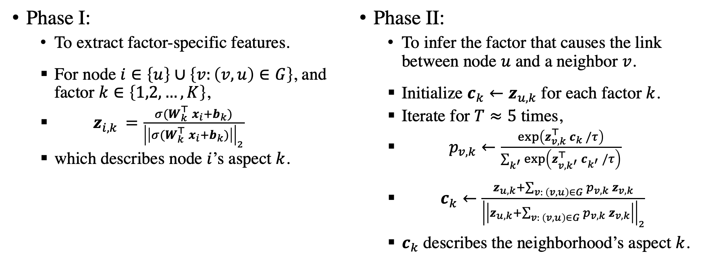
Neighborhood Routing
We propose neighborhood routing, to segment a neighborhood.
Dynamic & differentiable. Similar to capsule networks’ dynamic routing.
Phase I:
To extract factor-specific features.
For node $i∈\left\{u\right\}∪\left\{v:\left(v,u\right)∈G\right\}$, and factor $k∈\left\{1,2,…,K\right\}$,
$z_{i,k }=\frac{σ(W_{k}^{⊤}{ x}_{i}+b_{k})}{{\left|\left|σ(W_{k}^{⊤}{ x}_{i}+b_{k})\right|\right|}_{2}}$
which describes node $i$’s aspect $k$.
Phase II:
To infer the factor that causes the link between node $u$ and a neighbor $v$.
Initialize $c_{k}←z_{u,k}$ for each factor $k$.
Iterate for $T≈5$ times,
$p_{v,k}←\frac{\exp\left(z_{v,k}^{⊤} c_{k} /τ\right)}{\sum_{k^{′}}{\exp\left(z_{v,k^{′}}^{⊤} c_{k^{′}} /τ\right)}}$
$c_{k}←\frac{z_{u,k}+\sum_{v: \left(v,u\right)∈G}{p_{v,k} z_{v,k}}}{{\left|\left|z_{u,k}+\sum_{v: \left(v,u\right)∈G}{p_{v,k} z_{v,k}}\right|\right|}_{2}}$
$c_{k}$ describes the neighborhood’s aspect $k$.

Slide 5
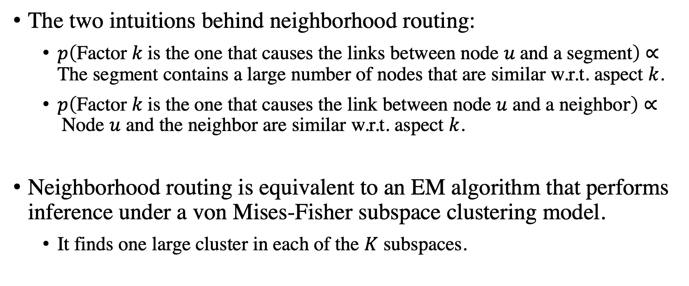
Intuitions & Theories
The two intuitions behind neighborhood routing:
$p\left(\text{Factor} k \text{is} \text{the} \text{one} \text{that} \text{causes} \text{the} \text{links} \text{between} \text{node} u \text{and} \text{a} \text{segment}\right)$ $∝$ The segment contains a large number of nodes that are similar w.r.t. aspect $k$.
$p\left(\text{Factor} k \text{is} \text{the} \text{one} \text{that} \text{causes} \text{the} \text{link} \text{between} \text{node} u \text{and} \text{a} \text{ne}\text{ighbo}r\right)$ $∝$Node $u$ and the neighbor are similar w.r.t. aspect $k$.
Neighborhood routing is equivalent to an EM algorithm that performs inference under a von Mises-Fisher subspace clustering model.
It finds one large cluster in each of the $K$ subspaces.

Slide 6
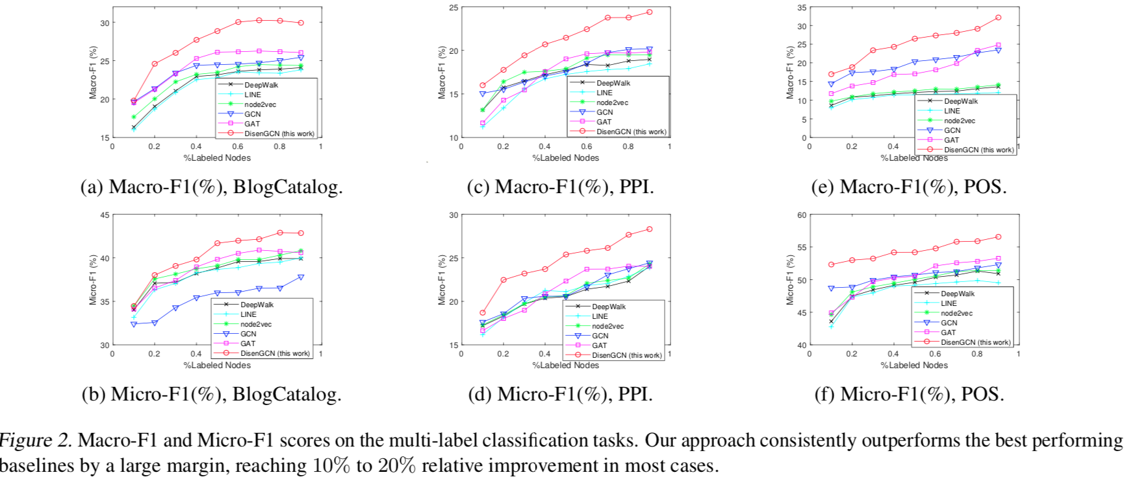
Results: Multi-label Node Classification

Slide 7


Results: Disentangled Node Representations
Correlations between the 64 dimensions, on a graph with eight factors.

