Slide 1



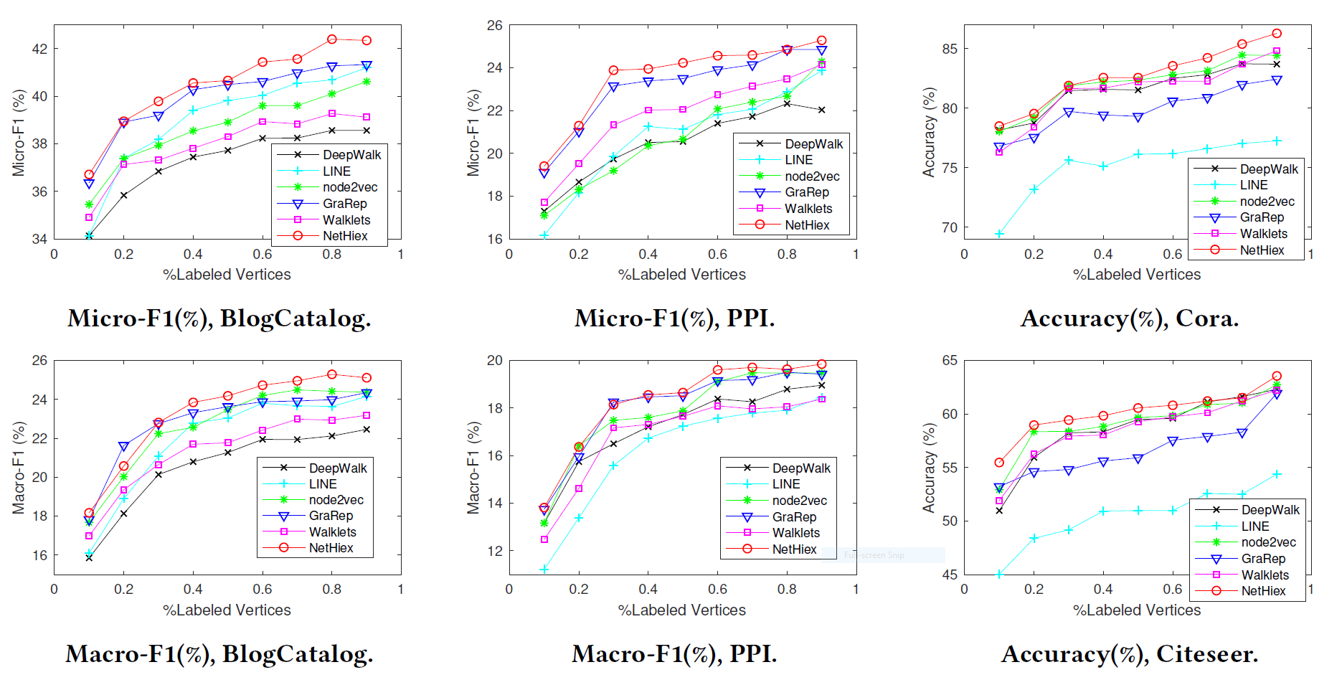
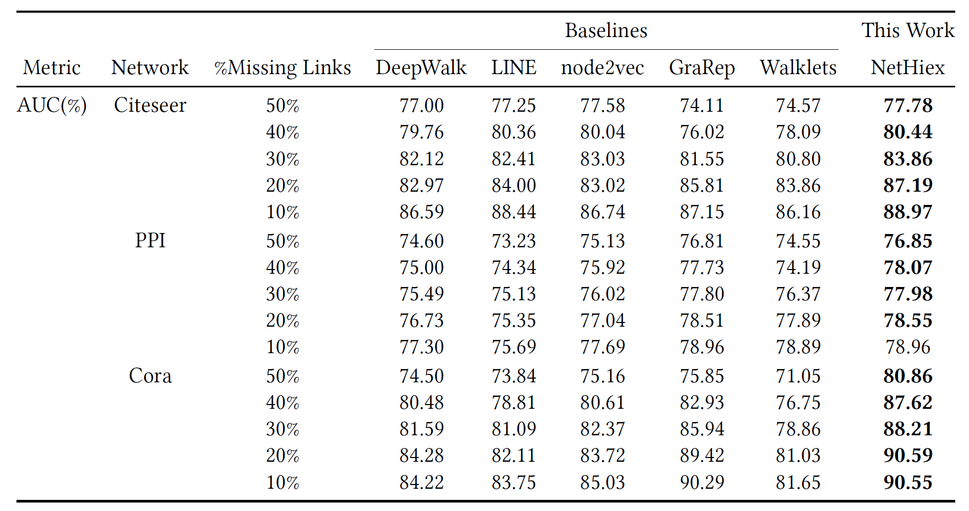
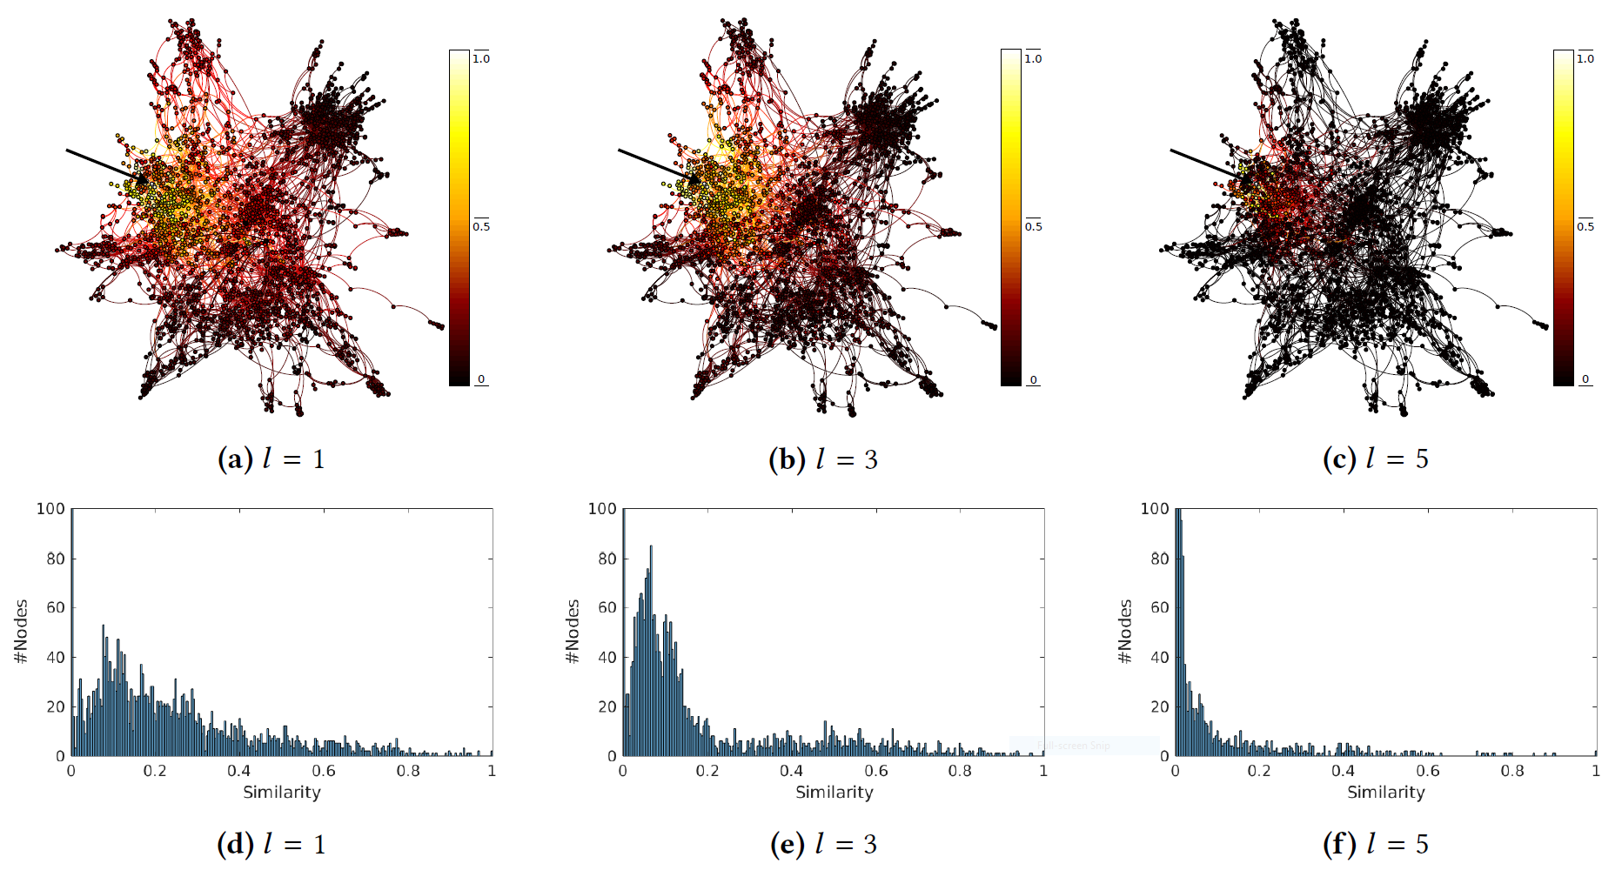
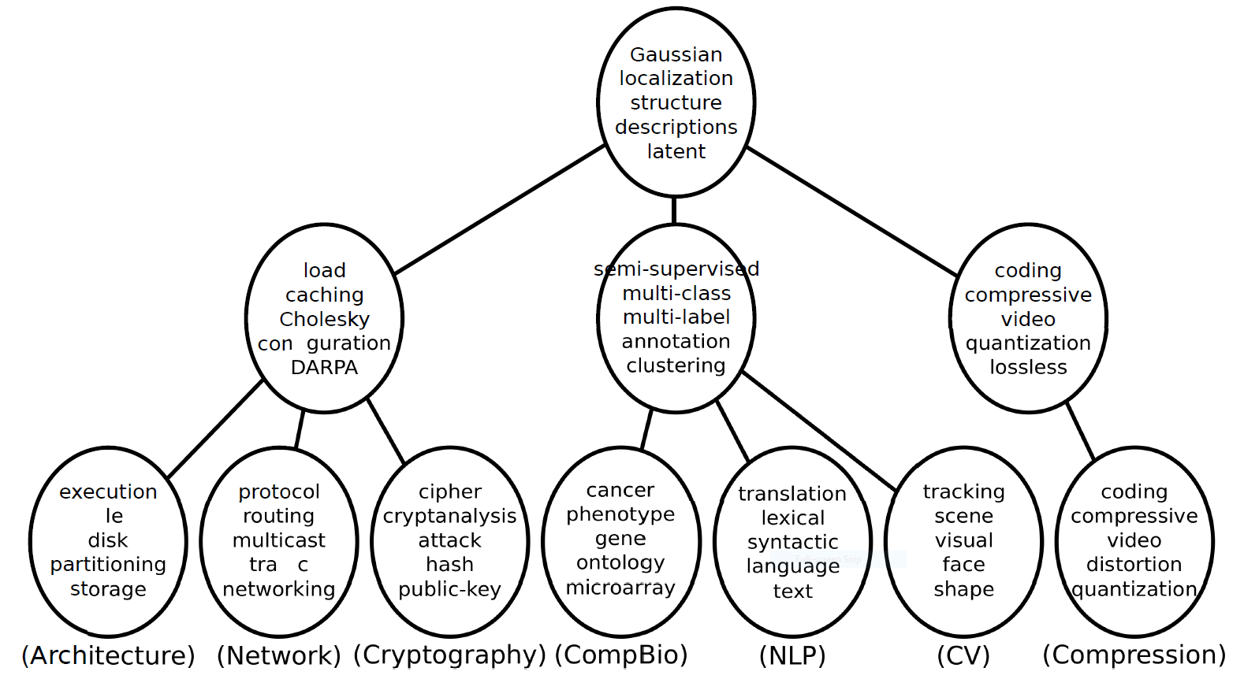



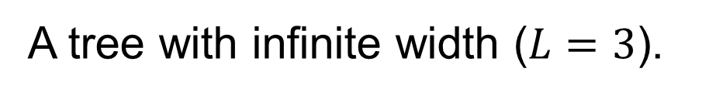



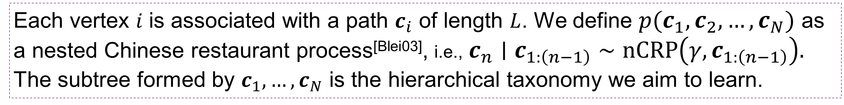






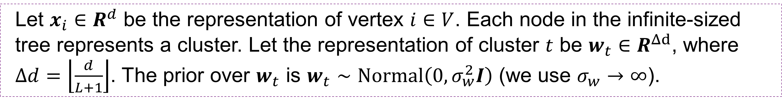



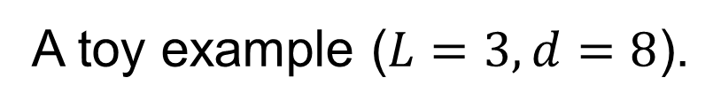





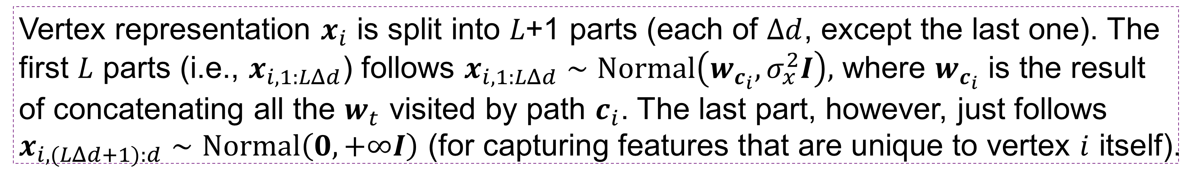



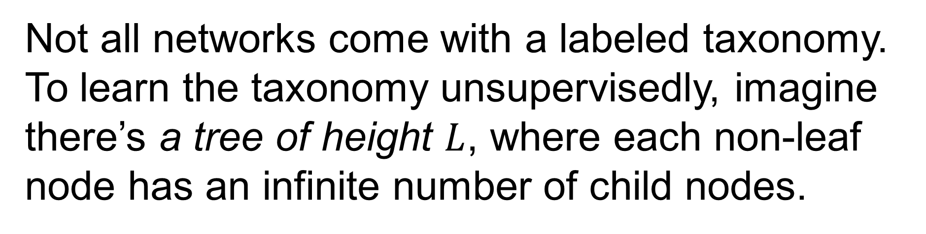


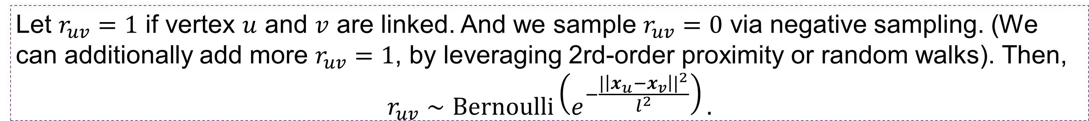


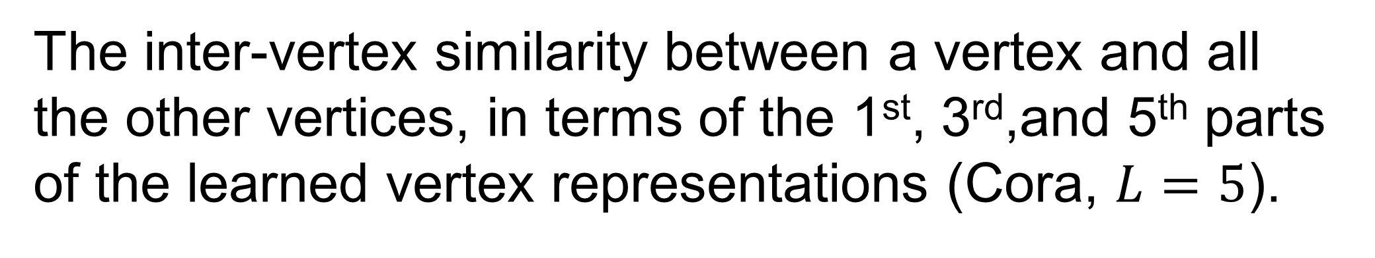

Hierarchical Taxonomy Aware Network Embedding Jianxin Ma ( https://jianxinma.github.io ), Peng Cui, Xiao Wang, Wenwu Zhu Department of Computer Science and Technology, Tsinghua University, Beijing, China
1
2
(Background) Network Embedding
To learn a $d$-dimensional vector representation $x_{i}∈R^{d}$ for each vertex $v_{i}∈V$ in the network$G=(V,E)$.
(Motivation) Hierarchical Taxonomy
5
(Experiments) Performance
Computer Science
Hierarchical taxonomy is a tree structure in which the entities (e.g. papers of a citation network) are classified hierarchically.
Node Classification
$$v_{8}$$
AI
System
$$v_{1}$$
$$v_{9}$$
1. Multiple Levels of Granularity
coarse-grained $→$ paper i and j are similar (both about AI)
fine-grained $→$ paper i and j are different (NLP $≠$ CV)
2. Better Interpretability
$$v_{7}$$
$$v_{2}$$
$$v_{6}$$
Robotics
NLP
CV
OS
Compiler
$$v_{4}$$
$$v_{3}$$
$$v_{5}$$
from a non-Euclidean space
$$G=(V,E)$$
to a vector space
$$R^{d}$$
paper i
paper j
3
(Method) A Generative Model
Link Prediction
4
Not all networks come with a labeled taxonomy. To learn the taxonomy unsupervisedly, imagine there’s a tree of height $L$, where each non-leaf node has an infinite number of child nodes.
(Method) How to Optimize
EM Algorithm + Truncated Tree^{[Wang-Blei-09]}
To find $x_{i}$ and $w_{t}$ that maximize $\log{\sum_{C}{p(X,W,C)}}$, where $C=\{c_{1},c_{2},…, c_{n}\}$ and $p\left(X,W,C\right)=$
$$\prod_{t}{p\left(w_{t}\right)}⋅\prod_{i}{p\left(c_{i} ∣ c_{1:\left(i−1\right)}\right)p\left(x_{i} ∣ w_{c_{i}}\right)}⋅\prod_{uv}{{p(r}_{uv}∣x_{u},x_{v})}.$$
coarse-grained
$$w_{CS}$$
$$x_{i,1:2}$$
$$x_{i,3:4}$$
$$w_{AI}$$
$$x_{i,5:6}$$
$$w_{NLP}$$
$$⋯$$
$$x_{i,7:8}$$
6
fine-grained
paper i
(Visualization) Multiple Levels of Granularity
$$⋯$$
$$⋯$$
$$⋯$$
$$x_{i}$$
$$c_{i}$$
$$c_{j}$$
A tree with infinite width ($L=3$).
A toy example ($L=3, d=8$).
The inter-vertex similarity between a vertex and all the other vertices, in terms of the 1st, 3rd,and 5th parts of the learned vertex representations (Cora, $L=5$).
7
Each vertex 𝑖 is associated with a path $c_{i}$ of length $L$. We define $p(c_{1},c_{2},…,c_{N})$ as a nested Chinese restaurant process^{[Blei03]}, i.e., $c_{n}∣c_{1:\left(n−1\right)}∼nCRP\left(γ,c_{1:\left(n−1\right)}\right).$ The subtree formed by $c_{1},…,c_{N}$ is the hierarchical taxonomy we aim to learn.
(Vis.) Finding Out the Taxonomy
We can uncover the hierarchical taxonomy, unsupervisedly, from a word co-occurrence network.
Let $x_{i}∈R^{d}$ be the representation of vertex $i∈V$. Each node in the infinite-sized tree represents a cluster. Let the representation of cluster $t$ be $w_{t}∈R^{Δd}$, where $Δd=\left\lfloor \frac{d}{L+1}\right\rfloor$. The prior over $w_{t}$ is $w_{t}∼Normal\left(0, σ_{w}^{2}I\right)$ (we use $σ_{w}→∞$).
Vertex representation $x_{i}$ is split into 𝐿+1 parts (each of $Δd$, except the last one). The first $L$ parts (i.e., $x_{i,1:LΔd}$) follows $x_{i,1:LΔd}∼Normal\left(w_{c_{i}}, σ_{x}^{2}I\right),$ where $w_{c_{i}}$ is the result of concatenating all the $w_{t}$ visited by path $c_{i}$. The last part, however, just follows $x_{i,(LΔd+1):d}∼Normal\left(0, +∞I\right)$ (for capturing features that are unique to vertex $i$ itself).
Let $r_{uv}=1$ if vertex $u$ and $v$ are linked. And we sample $r_{uv}=0$ via negative sampling. (We can additionally add more $r_{uv}=1$, by leveraging 2rd-order proximity or random walks). Then,
$$r_{uv}∼Bernoulli\left(e^{−\frac{|\left|x_{u}−x_{v}\right||^{2}}{l^{2}}}\right).$$
The different components of the vertex representations indeed reflect the different levels of granularity.
(The word co-occurrence network is constructed from CS paper titles. The words with a low TF-IDF score are removed.)

