Slide 1
Hierarchical Taxonomy Aware Network Embedding
Jianxin Ma, Peng Cui, Xiao Wang, Wenwu Zhu
Tsinghua University
Notes:
Hello everyone, I’m Jianxin Ma, from Tsinghua University. I’m from Peng Cui’s research group. This presentation is about our work, hierarchical taxonomy aware network embedding.

Slide 2
Motivation

Slide 3











Network Embedding
Vertex $v_{i}∈V$ $→$ Feature vector $x_{i}∈R^{d}$
$$v_{8}$$
$$v_{9}$$
$$v_{7}$$
$$v_{1}$$
$$v_{2}$$
$$v_{6}$$
$$v_{4}$$
$$v_{3}$$
$$v_{5}$$
From a non-Euclidean space
$$G=(V,E)$$
To a vector space
$$R^{d}$$
Notes:
Given a network G, a network embedding algorithm maps each vertex to a point in the d-dimensional vector space.

Slide 4
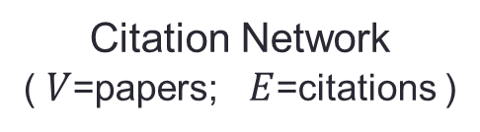
Hierarchical Taxonomy
A tree structure of classifications for a given set of objects
Computer Science
paper i
AI
System
Robotics
NLP
CV
OS
Compiler
Hierarchical Taxonomy
( a hierarchy of categories)
Citation Network
( $V$=papers; $E$=citations )
Notes:
The hierarchal taxonomy is a tree structure of categories. It’s a way to classify a given set of objects hierarchically. You can think of it as the result of hierarchical clustering. For example, this is a paper in a citation network. It’s classified into the category NLP, which is a subcategory of AI, which is a subcategory of Computer Science.

Slide 5
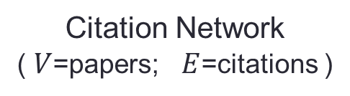
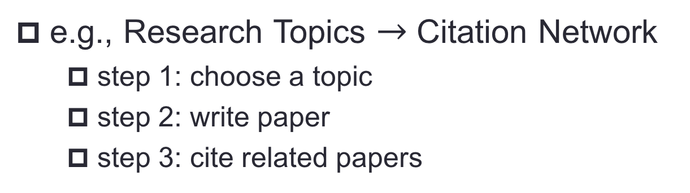
Network is likely generated from a Taxonomy
e.g., Research Topics $→$ Citation Network
step 1: choose a topic
step 2: write paper
step 3: cite related papers
Computer Science
Computer Science
a NLP paper
AI
System
AI
Robotics
NLP
CV
OS
Compiler
NLP
Hierarchical Taxonomy
( a hierarchy of research topics )
Citation Network
( $V$=papers; $E$=citations )
Notes:
It turns out that, underlying many network, there’s a hierarchical taxonomy, and the network is very likely generated from the hierarchical taxonomy. Take a citation network as an example. Let’s imagine how the network is generated. First, a researcher decides what research topic he’s going to write on. This is equivalent to selecting a path in the taxonomy of topics. So he chooses NLP, and writes the paper. And he sees if there’re related papers and cite them. This is how the citation network is generated from the taxonomy of topics.

Slide 6
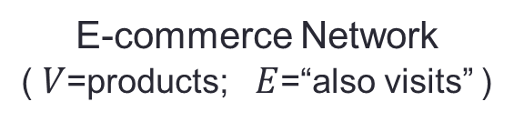
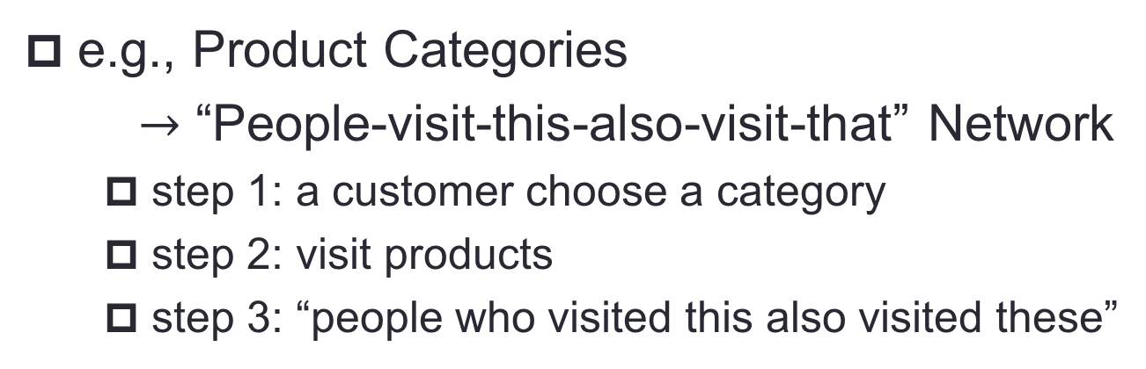
Network is likely generated from a Taxonomy
e.g., Product Categories
$→$ “People-visit-this-also-visit-that” Network
step 1: a customer choose a category
step 2: visit products
step 3: “people who visited this also visited these”
All Products
All Products
TV#1
Electronics
Electronics
TV
TV
TV#2
Hierarchical Taxonomy
( a hierarchy of product categories )
E-commerce Network
( $V$=products; $E$=“also visits” )
Notes:
Another example is an e-commerce network, where the nodes are products, and the links represents the “people-who-visits-this-also-visits-that” relationship. So how’s this network generated? First, a customer goes to Amazon dot com, and decides what kinds of products he wants to buy. This is equivalent to sampling a path in the hierarchical taxonomy of product categories. So he chooses TV, a subcategory of Electronics. Then he browses through a bunch of TVs of different brands. Then the network is generated from the co-visiting event.

Slide 7

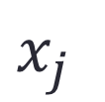
This Work
Goal #1: To preserve the taxonomy & the network in $X$.
Computer Science
AI
System
?
?
Robotics
NLP
CV
OS
Compiler
paper j
paper i
$$x_{i}$$
$$x_{j}$$
Notes:
As a result, a natural question is, how can we preserve the structure of the hierarchical taxonomy in the vector space.

Slide 8
This Work
Goal #2: The taxonomy is unknown $→$ To learn it unsupervisedly.
Computer Science
?
AI
System
Robotics
NLP
CV
OS
Compiler
paper j
paper i
$$x_{i}$$
$$x_{j}$$
Notes:
Our second problem is that, though we know that the hierarchical taxonomy does exist, many networks don’t come with a labeled hierarchical taxonomy, because it’s expensive to label the taxonomy. So ideally we wanna discover the hierarchical taxonomy in an unsupervised way, while performing network embedding.

Slide 9

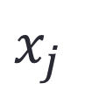


This Work
Probabilistic Generative Model
taxonomy $→$ embedding $→$ network
taxonomy $→$ embedding
taxonomy
Computer Science
AI
System
Robotics
NLP
CV
OS
Compiler
paper j
paper i
$$x_{i}$$
$$x_{j}$$
Notes:
To this end, we propose a new network embedding algorithm. Our algorithm is a probabilistic generative model, and it mimics the generating process we have just mentioned. In our model, we first generate the taxonomy. And from this taxonomy, we decide the category of each vertex and generate vertex embeddings. Then we generate the network from the vertex embeddings.

Slide 10

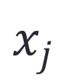
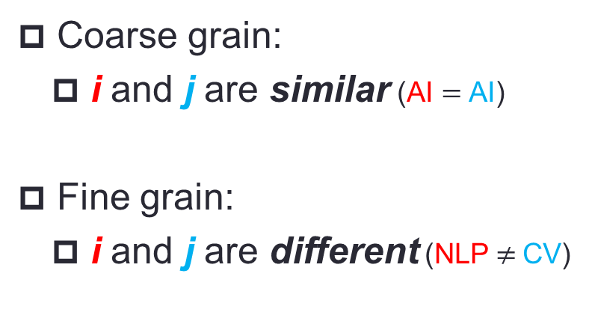
Benefit #1
Multiple Levels of Granularity
coarse
Computer Science
Coarse grain:
i and j are similar (AI $=$ AI)
Fine grain:
i and j are different (NLP $≠$CV)
AI
System
Robotics
NLP
CV
OS
Compiler
paper j
paper i
fine
$$x_{i}$$
$$x_{j}$$
Notes:
The generative model is intuitive. It also has many practical advantages over the existing methods. Firstly, the hierarchical taxonomy captures the fact that similarity actually has many levels of granularity. Consider a paper on NLP, and a paper on Computer Vision. You can say that the two are similar, because they’re both about AI. But at a finer-grained level, they are different, because they’re from two different subfields of AI. If we make the different components of the embeddings correspond to the different levels of the hierarchy. Then we can conveniently capture these different levels of granularity.

Slide 11

Benefit #2
Robust to network sparsity
No hierarchical taxonomy:
$dist\left(i,j\right)=4$
i $→$ a $→$ b $→$ c $→$ j
paper j
paper i
b
c
a
Notes:
Secondly, our approach is more robust, in the face of extremely sparse networks. To illustrate this point, let’s investigate this toy example. If there’s no hierarchical taxonomy, and we wanna propagate information from vertex I to vertex J, then we need to go through a long path, whose length is four.

Slide 12
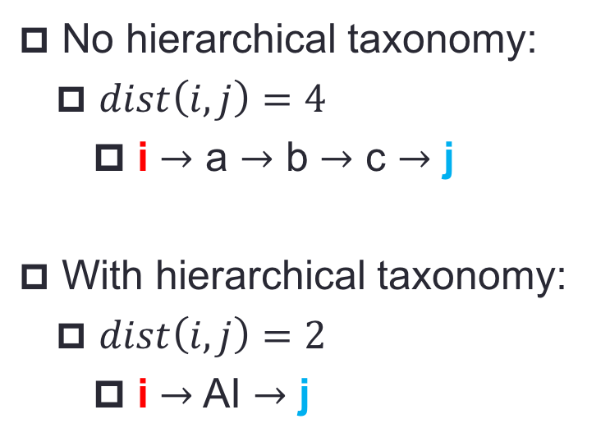
Benefit #2
Robust to network sparsity
Computer Science
No hierarchical taxonomy:
$dist\left(i,j\right)=4$
i $→$ a $→$ b $→$ c $→$ j
With hierarchical taxonomy:
$dist\left(i,j\right)=2$
i $→$ AI $→$ j
AI
System
Robotics
NLP
CV
OS
Compiler
paper j
paper i
b
c
a
Notes:
However, if we have the hierarchical taxonomy, we can go through a shortcut, whose length is just two. This makes our approach less sensitive to the sparseness of a network.

Slide 13
Benefit #3
Better Interpretability
Computer Science
AI
System
Diagnosis
Explanation
Robotics
NLP
CV
OS
Compiler
paper j
paper i
$$x_{i}$$
$$x_{j}$$
Notes:
Finally, preserving the hierarchical taxonomy also makes our approach more interpretable. Each components of a vertex embedding is closely related with a category in the hierarchical taxonomy. So we can more easily check if they make sense. This facilitates diagnosis and explanation.

Slide 14
Model

Slide 15







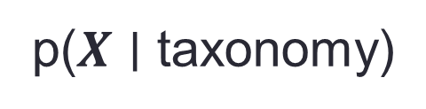
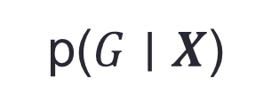






The Generative Model: Overview
p(taxonomy)
p($X$ $∣$ taxonomy)
p($G$ $∣$ $X$)
$$w_{1}$$
$$x_{i,1:2}$$
$$x_{i,3:4}$$
$$w_{2}$$
$$w_{6}$$
$$x_{i,5:6}$$
$$w_{4}$$
$$w_{3}$$
$$w_{5}$$
$$w_{7}$$
$$w_{8}$$
$$x_{i,7:9}$$
vertex i
$$x_{i}$$
Notes:
Now let’s get into the details of our approach. Here’s an overview of our probabilistic generative model. It has three main components. The first component is a probabilistic process that describes how the hierarchical taxonomy is generated. And for each category in the tree hierarchy, we also generate a continuous vector representation for it, denoted by W. This probabilistic process also decides the categories of each vertex. That is, it associates a vertex with a path in the hierarchy of categories. The second main component, describes how the vertex embeddngs are generated. Take vertex I as an example, its associated with three categories, W1, W2, and W3, and the first three parts of its embedding is generated by slightly perturbing W1, W2, and W3, respectively. We also generate some additional bits for vertex I, which are not associated with any categories. So these last bits represent the finest-grained features that are unique to vertex I itself. The final component, then, describes how the network is generated from the vertex embeddings. Now let’s get into details of the three components.

Slide 16







p( Taxonomy )
The-rich-get-richer effect $→$ Nested Chinese restaurant process^{[Blei03]}
A infinite tree of height $L$ (non-leaf nodes have$∞$ children).
Each $v_{i}$ is assigned a path $c_{i}$(of length $L$).
$c_{1},c_{2}…,c_{N}$ ($N=|V|$) forms the hierarchy taxonomy.
The nCRP decides the distribution of $c_{i}$:
$$p\left(c_{1},c_{2}…,c_{N}\right)=nCRP(c_{1},c_{2}…,c_{N};γ)$$
$$⋯$$
$$⋯$$
$$⋯$$
$$⋯$$
$$c_{i}$$
$$c_{j}$$
Notes:
First, how to generate the taxonomy. The results of clustering usually has the rich-get-richer effect, so we decide to use the nested Chinese restaurant process as the generating process, which is proposed by David Blei in 2003. Let’s imagine that there’s a tree of height L. And this tree is extremely large. In fact, every node in this tree has an infinite number of children, except the leaf nodes. In the nCRP, each vertex is assigned an path in the tree hierarchy, denoted by CI. So the N paths collectively form a subtree. And the subtree is the hierarchical taxonomy we’re looking for. Defining the probability of a tree taxonomy is then equivalent to defining the probability of these N paths. Here gamma is the hyper-parameter of the nCRP.

Slide 17
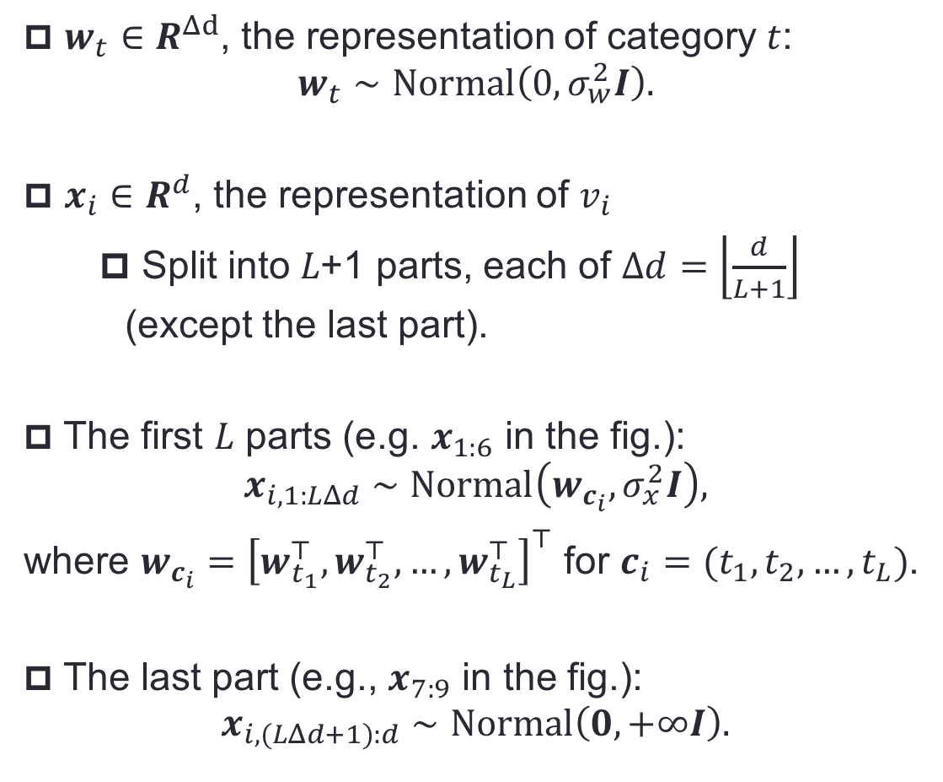





p( X | Taxonomy )
$w_{t}∈R^{Δd}$, the representation of category $t$:
$$w_{t}∼Normal\left(0, σ_{w}^{2}I\right).$$
$x_{i}∈R^{d}$, the representation of $v_{i}$
Split into 𝐿+1 parts, each of $Δd=\left\lfloor \frac{d}{L+1}\right\rfloor$ (except the last part).
The first $L$ parts (e.g. $x_{1:6}$ in the fig.):
$$x_{i,1:LΔd}∼Normal\left(w_{c_{i}}, σ_{x}^{2}I\right),$$
where $w_{c_{i}}={\left[w_{t_{1}}^{⊤},w_{t_{2}}^{⊤},…,w_{t_{L}}^{⊤}\right]}^{⊤}$ for $c_{i}=(t_{1},t_{2},…,t_{L})$.
The last part (e.g., $x_{7:9}$ in the fig.):
$$x_{i,(LΔd+1):d}∼Normal\left(0, +∞I\right).$$
Example ($d=9, L=3$):
$$w_{1}$$
$$x_{i,1:2}$$
$$x_{i,3:4}$$
$$w_{2}$$
$$x_{i,5:6}$$
$$w_{3}$$
$$x_{i,7:9}$$
paper i
$$x_{i}$$
Notes:
Now the second component, how the vector space is generated based on the taxonomy. Firstly, each categories in the tree hierarchy is associated with a category representation W T, which is generated from a normal distribution. We typically set the variance of the normal distribution to be very large, so that different categories can have very different representations. Each vertex, e.g. vertex I, then has a d-dimensional embedding XI. We split XI into L+1 parts, each part has delta d elements, except the last part. Remember that vertex I is associated with a path in the tree CI, which passes through several categories. So we concatenate the category representations that are visited by the path CI, and write the result as W CI. In this toy example, W CI is the concatenation of W1 W2 and W3. Then, the first L parts of XI, follows a normal distribution, whose mean is W CI. This is equivalent to generating the first L parts by adding small noise to W CI. Finally, there’s also a few elements of XI, that is, the last part of XI, they are not associated with any categories in the tree. So they simply follow a normal distribution with an infinitely large variance. They're about features that are unique to vertex I.

Slide 18
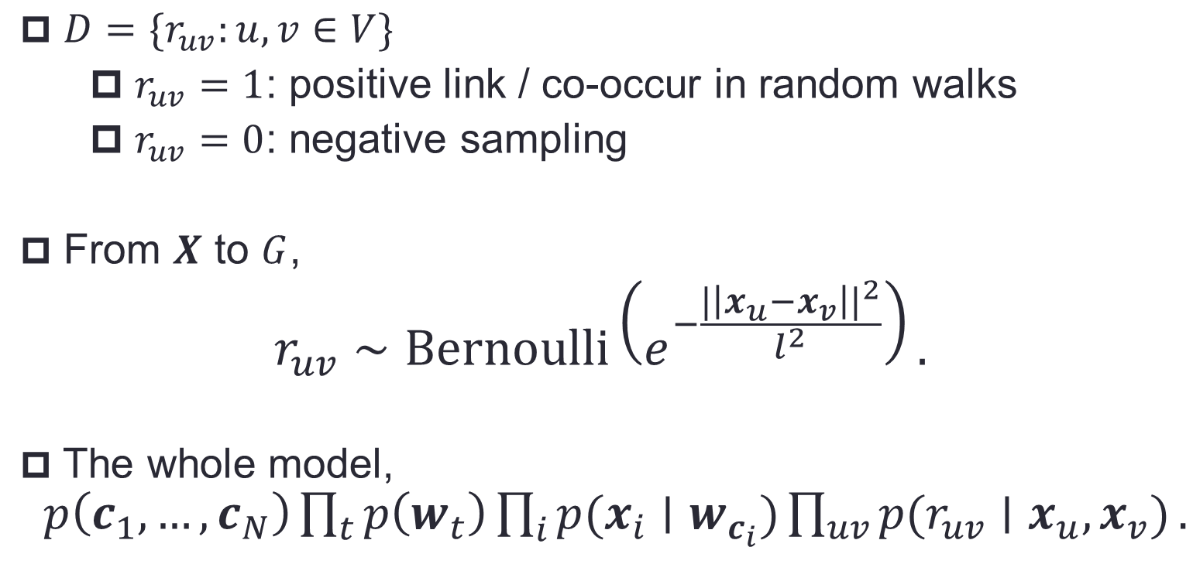
p( Network | X )
$D=\{r_{uv}:u,v∈V\}$
$r_{uv}=1$: positive link / co-occur in random walks
$r_{uv}=0$: negative sampling
From $X$ to $G$,
$$r_{uv}∼Bernoulli\left(e^{−\frac{|\left|x_{u}−x_{v}\right||^{2}}{l^{2}}}\right).$$
The whole model, $p\left(c_{1},…,c_{N}\right)\prod_{t}{p\left(w_{t}\right)}\prod_{i}{p(x_{i}∣w_{c_{i}})}\prod_{uv}{{p(r}_{uv}∣x_{u},x_{v})}.$
Notes:
Now comes the last component. How the network is generated from X. For simplicity, we focus on undirected unweighted networks.
Let D be the observed data. Its instance RUV equals one if u and v are connected, alternatively, we can also augment the dataset by adding positive links if two vertices co-occur in a random walk, similar to what’s done in Deep Walk. We also use negative sampling, again in a way similar to Deep Walk, to produce negative samples. Then we assume R UV follows a Bernoulli distribution, whose expectation is related with the distance between XU and XV. So this is how the network is generated from the vertex embeddings. The whole probabilistic model looks like this,

Slide 19
Optimization

Slide 20
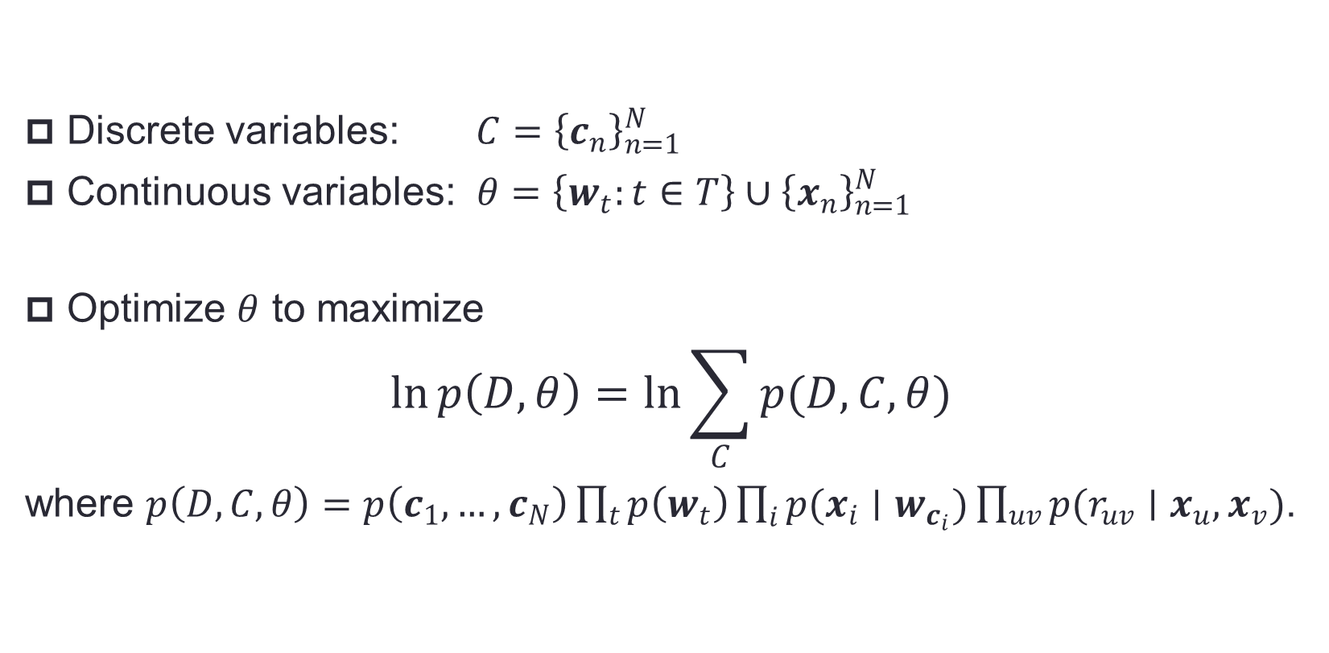
Objective
Discrete variables: $C={\left\{c_{n}\right\}}_{n=1}^{N}$
Continuous variables: $θ=\left\{w_{t}:t∈T\right\}∪{\left\{x_{n}\right\}}_{n=1}^{N}$
Optimize $θ$ to maximize
$$\ln{p\left(D,θ\right)=\ln{\sum_{C}{p(D,C,θ)}}}$$
where $p\left(D,C,θ\right)=p\left(c_{1},…,c_{N}\right)\prod_{t}{p\left(w_{t}\right)}\prod_{i}{p(x_{i}∣w_{c_{i}})}\prod_{uv}{{p(r}_{uv}∣x_{u},x_{v})}$.
Notes:
So we have two types of parameters to optimize. First, there’re the discrete variables, that is, the N paths, C1 up to CN. Second, there’re the continuous variables. Our training objective is to maximize the log likelihood. But we choose to marginalize out the discrete variables, because this makes the objective much more smooth to optimize.

Slide 21
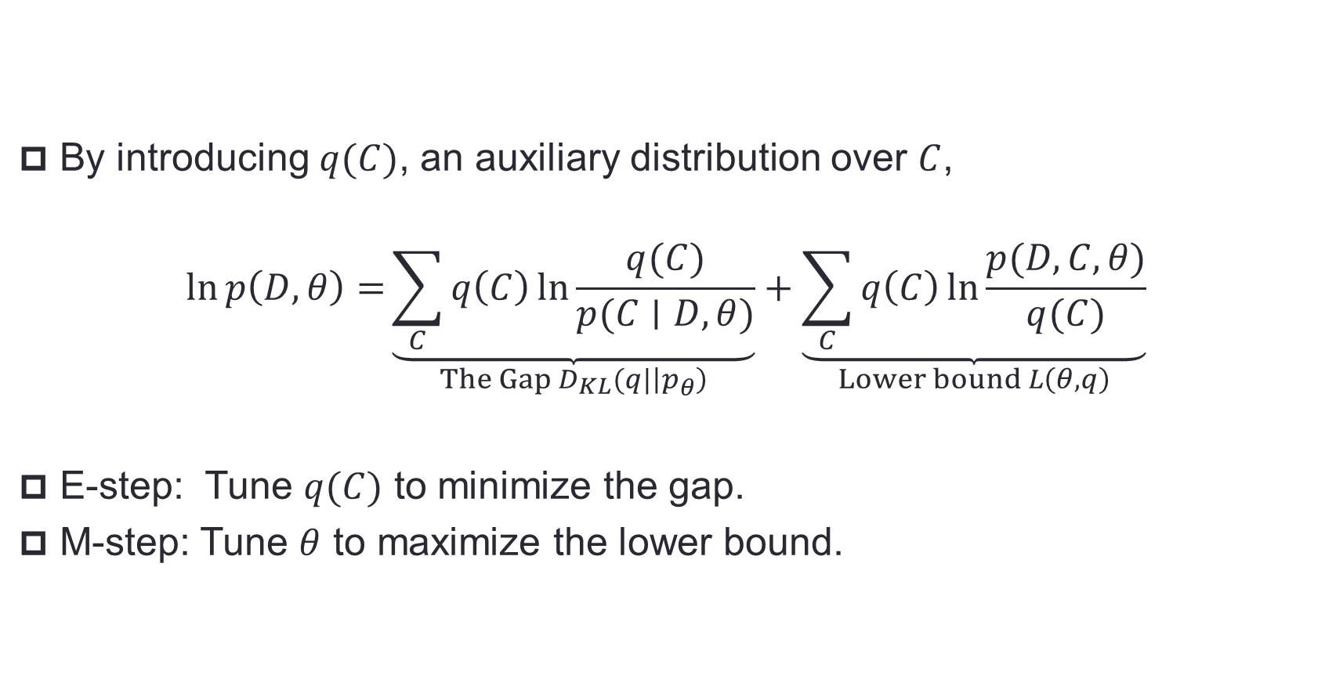
Expectation-Maximization (EM)
By introducing $q(C)$, an auxiliary distribution over $C$,
$$\ln{p\left(D,θ\right)=}\underset{The Gap D_{KL}(q|\left|p_{θ}\right)}{\underbrace{\sum_{C}{q\left(C\right)\ln{\frac{q(C)}{p(C∣D,θ)}}}}}+\underset{Lower bound L\left(θ,q\right)}{\underbrace{\sum_{C}{q\left(C\right)\ln{\frac{p(D,C,θ)}{q(C)}}}}}$$
E-step: Tune $q(C)$ to minimize the gap.
M-step: Tune $θ$ to maximize the lower bound.
Notes:
We optimize the objective with EM. To derive the EM algorithm, we rewrite the objective as the sum of two terms, the lower bound of the objective, and the gap between the objective and the lower bound, in fact, the gap is a KL divergence. Each iteration of the EM algorithm consists of a E step and a M step. During the E step, we minimize the gap. Then during the M step, we optimize the continuous parameters to maximize the lower bound.

Slide 22



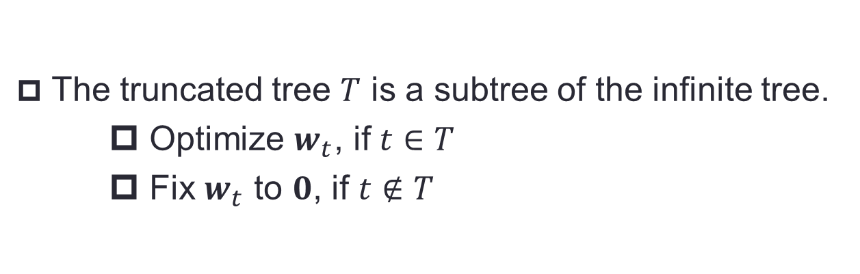





The Truncated Tree
The truncated tree $T$ is a subtree of the infinite tree.
Optimize $w_{t}$, if $t∈T$
Fix $w_{t}$ to $0$, if $t∉T$
$$w_{t}=0$$
$$⋯$$
$$w_{t}=0$$
$$w_{t}=0$$
$$w_{t}=0$$
$$⋯$$
$$⋯$$
$$⋯$$
* Variational Inference for the Nested Chinese Restaurant Process. Chong Wang & David Blei, NIPS 2009.
Notes:
Remember that the nCRP is related with an extremely large tree, in fact, an infinite-sized tree. This means that we have, theoretically, an infinite number of W T to optimize. To solve this problem, we use the truncated tree technique. We maintain a subtree of the infinite tree. We treat W T as optimizable parameters if category T is in the subtree. Otherwise, W T is simply set to zero. We now just need to optimize a small subset of W T.

Slide 23
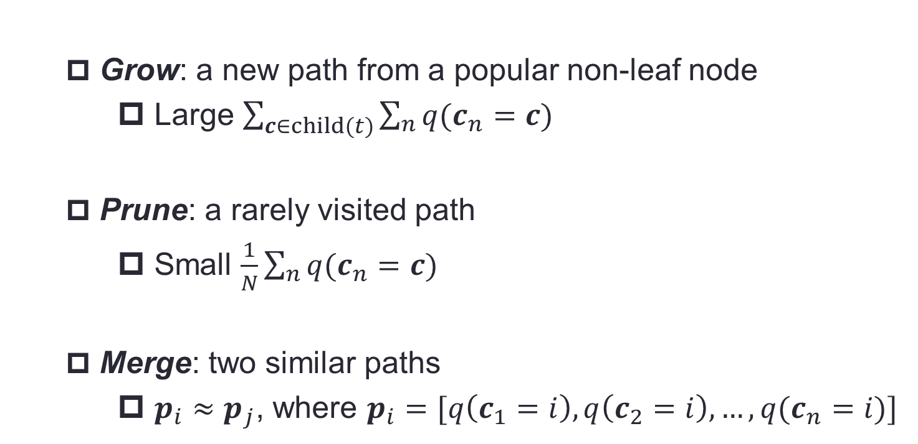
Adjusting the Truncated Tree
Grow: a new path from a popular non-leaf node
Large $\sum_{c∈child(t)}{\sum_{n}{q(c_{n}=c)}}$
Prune: a rarely visited path
Small $\frac{1}{N}\sum_{n}{q(c_{n}=c)}$
Merge: two similar paths
$p_{i}≈p_{j}$, where $p_{i}=[q\left(c_{1}=i\right),q\left(c_{2}=i\right),…,q(c_{n}=i)]$
* Variational Inference for the Nested Chinese Restaurant Process. Chong Wang & David Blei, NIPS 2009.
Notes:
We adjust the structure of the truncated subtree after every iteration of EM, in three ways. That is, growing a new path, pruning a bad path, and merging two similar paths.

Slide 24
Experiments

Slide 25
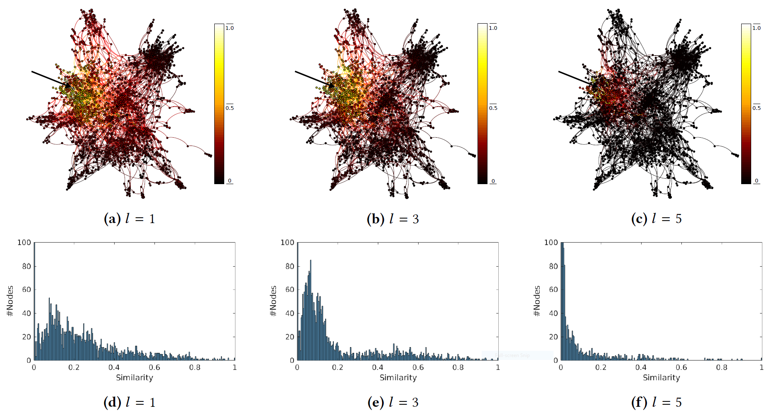
Visualization: Multiple Levels of Granularity
Notes:
We first visualized the different parts of the embeddings. In particular, we randomly selected a vertex, and computed the distance between this vertex and all the other vertices, in terms of the different parts of the embeddings. The left, middle, and right figures show the computed similarity in terms of the first part, the third part, and the fifth part of the embeddings, respectively. As we can see, the different components of the embeddings reflect different levels of granularity.

Slide 26
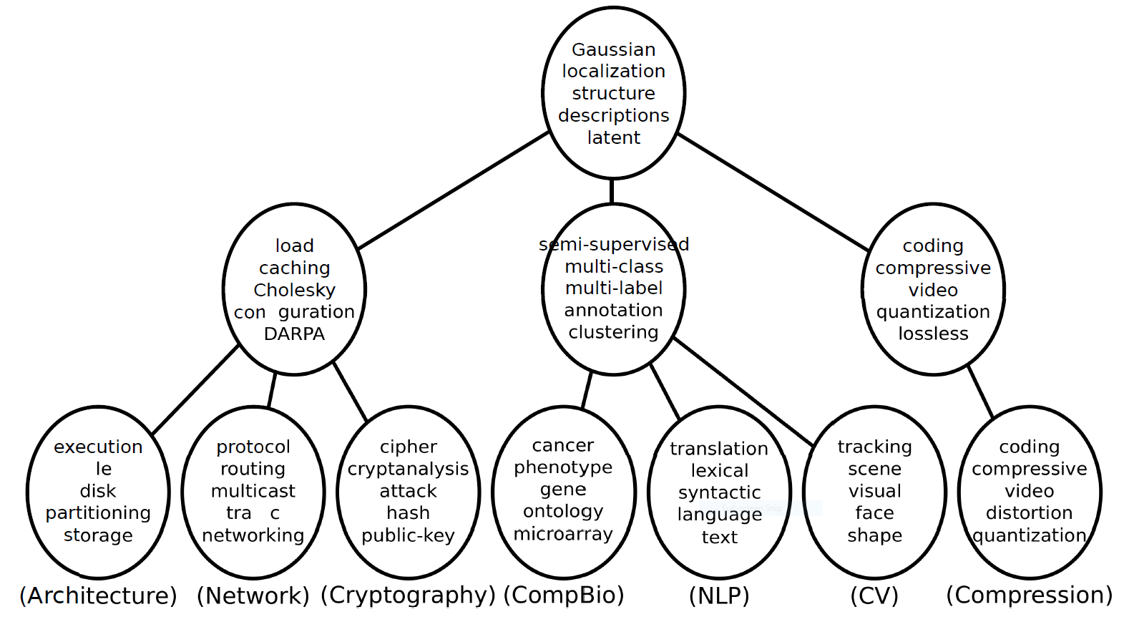
Learning the Hierarchical Taxonomy
from a keyword co-occurrence network
Notes:
We then constructed a word co-occurrence network from a bunch of computer science paper's titles. We removed the words that have low TF-IDF scores, so we’re left with a bunch of keywords. We then ran our algorithm on the word co-occurrence network. This is the hierarchal taxonomy discovered by our algorithm. In each circle, we show the words that have the most similar representations to the corresponding category. It’s interesting to see that each categories learned by our algorithm roughly represents a research subfield.

Slide 27
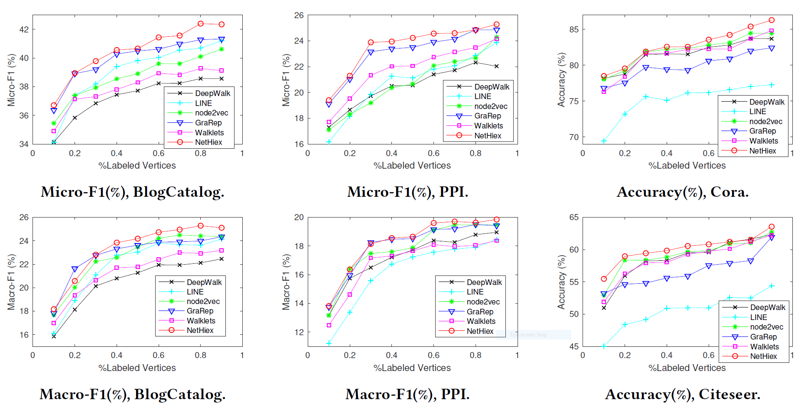
Node Classification
Notes:
We then evaluated our algorithm on the node classification benchmarks, …

Slide 28
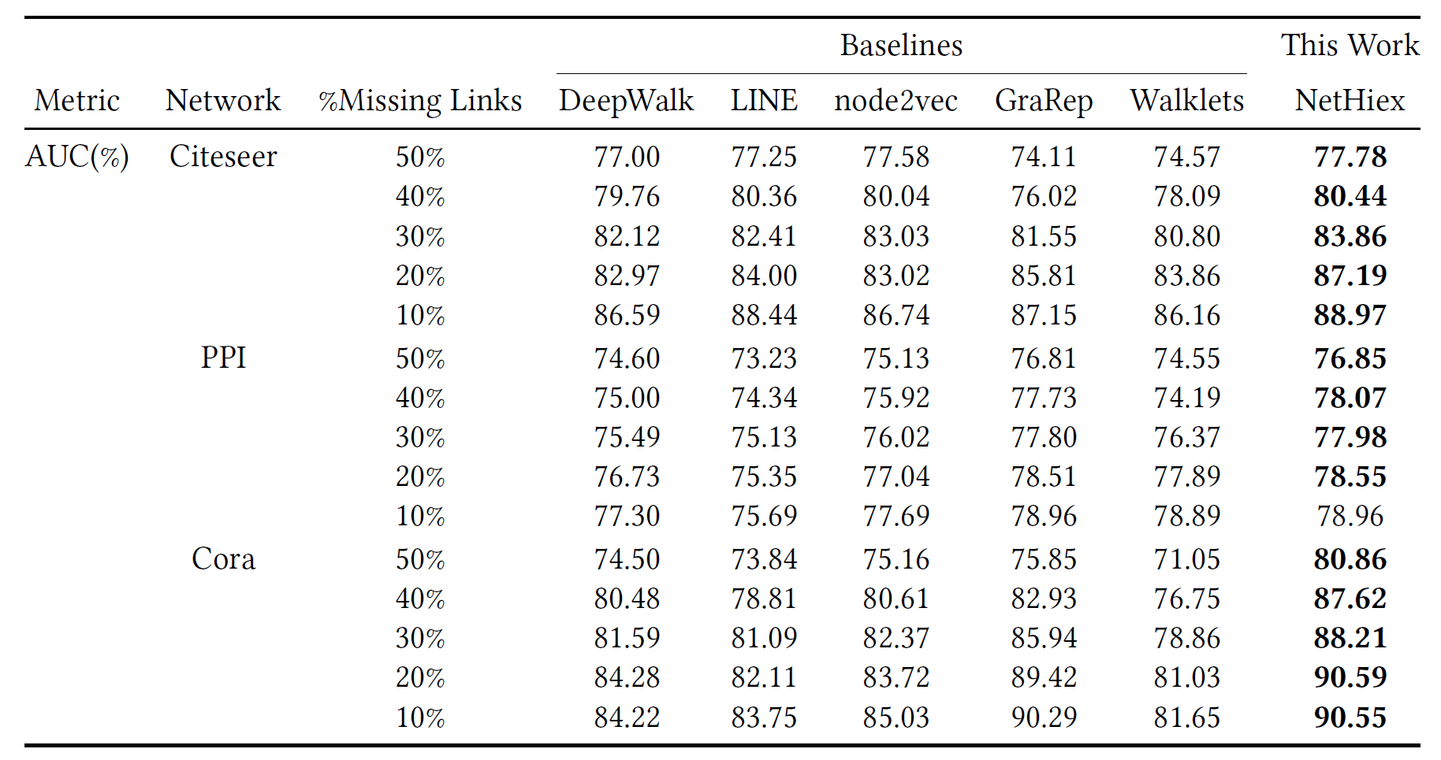
Link Prediction
Notes:
And the link prediction task. On both tasks, we see encouraging results.

Slide 29
Conclusion

Slide 30
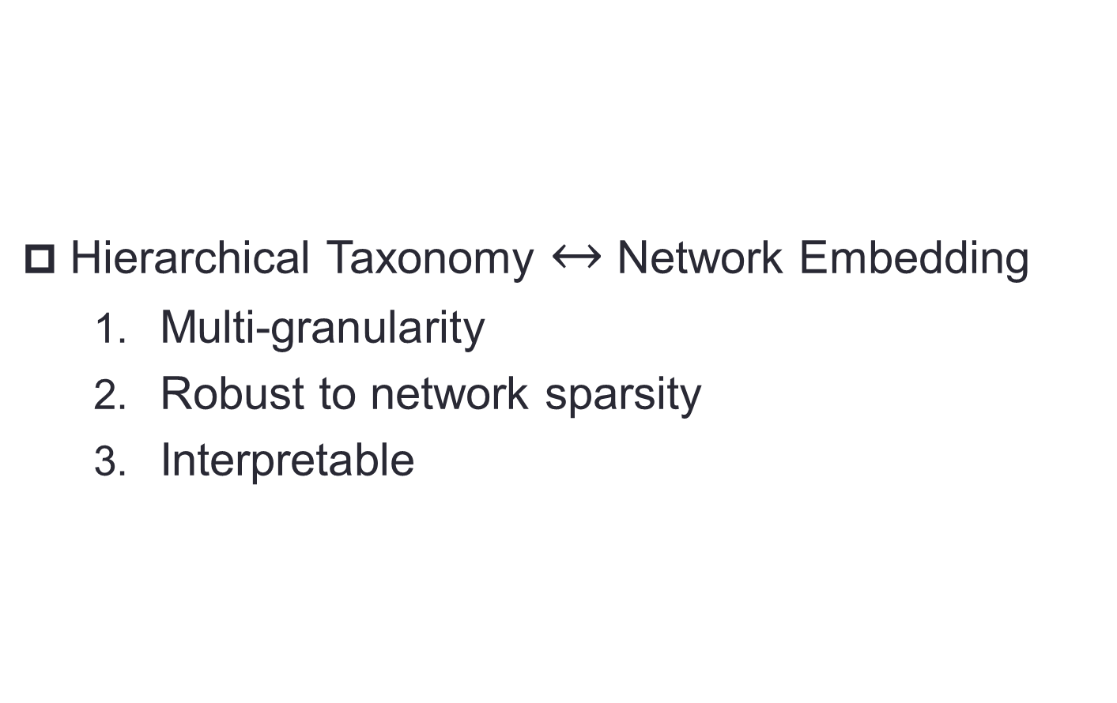
Conclusion
Hierarchical Taxonomy $↔$ Network Embedding
Multi-granularity
Robust to network sparsity
Interpretable
Notes:
In sum, we proposed a new network embedding algorithm. Our approach is a probabilistic generative model that mimics how a network is generated from its underlying hierarchical taxonomy. It has three main advantages, listed here. So this is our work, thank you.

