Slide 1
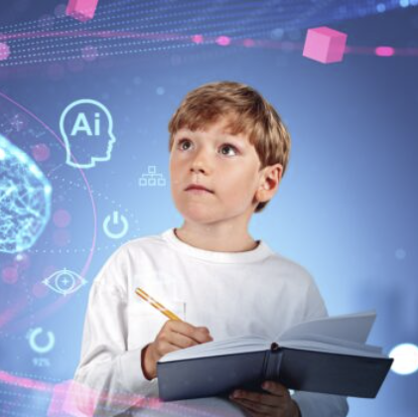
Impact of AI on education
Author : ZHANG KUNQI
Date : 2025/1/1

Slide 2
Artificial intelligence (AI)
intelligence exhibited by machines, particularly computer systems.
a field of research in computer science that develops and studies methods and software that enable machines to perceive their environment and use learning and intelligence to take actions that maximize their chances of achieving defined goals.
(Wikipedia)

Slide 3
Applications on Education
Personalized Learning
Assistive learning and special education for students with disabilities
Data analysis and educational decision-making for the educators
Virtual reality for the experiences for some subjects like engineering, biology
Equity for education

Slide 4
Challenge of AI in the education
Privacy and security of educations people during AI training
High implementation costs during deploying AI technologies
Acceptance for the unfamiliarity
Fairness for the data that train the AI system
Reduced social and emotional development
Different languages cause different adaptability
Lack of standardization

Slide 5
Goal
Find how AI can improve the efficiency and effectiveness of education in two main point :
--personalized learning
--educational equity

Slide 6
Personalized Learning
AI adapts learning content to individual student needs based on their skill levels and preferences. It helps in creating customized learning experiences, enabling students to progress at their own pace. Intelligent tutoring systems,
like the Duolingo , student can choose their own interest in different languages, and the education system will provide instant feedback to optimize learning outcomes. Sometimes will provide some review practice.

Slide 7
Educational Equity
AI-powered remote learning platforms bridge educational gaps by providing access to quality resources in underserved areas. For instance, online classrooms enhanced by AI tools allow students from rural regions to access lessons taught by top educators, improving overall learning opportunities.
Like ChatGpt, everyone can go to the website to ask for question that they don’t understand or interest.

Slide 8
Limitations
High cost
Lack of infrastructure
Low acceptance by educators and students
Limitation for student to express their ideas
Different language cause some people can’t use AI tools

Slide 9
Future Directions
Make sure the privacy of students and educators
Make sure every one can login in to the AI website
Reduce the cost of AI tools

Slide 10
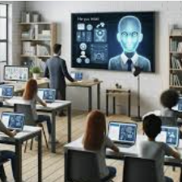
Conclusion
While AI enhances efficiency in education and ensures better resource distribution, it introduces significant privacy concerns. Large-scale data collection necessary for AI personalization may expose student information to potential risks. Addressing these concerns requires strict data protection policies and transparent practices.

