Slide 1
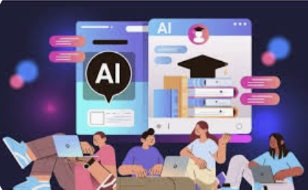
Impact of AI in education
Author: ZHANG KUNQI
Date : 2025/1/1
Introduction：This study explores how AI technology is applied in education to improve teaching efficiency and educational equity.
Background：Current education faces issues such as uneven resource distribution and challenges in personalized teaching. AI offers new solutions.
Goals： To explore how AI improves education.
Findings：
1: Personalized learning
2: Educational equity
Discussion：AI improves learning efficiency but raises data privacy concerns.
Limitations and Future Directions：
High costs, bias issues. Future directions: Improved data security, multilingual tools.
Conclusion：AI has great potential but requires addressing technical and ethical challenges.

