Slide 1
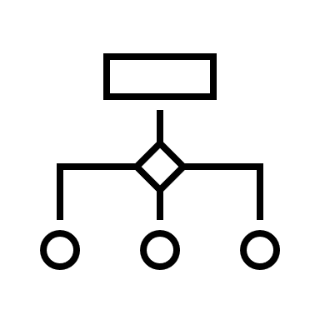
Decision Trees
Kunaal Naik

Slide 2
Topics
Decision Tree – both Regression and Classification
Tend to overfit
Train test split
Pre or Post Pruning
Decide how to create nodes - Purity Metrics
Gini
Entropy
Feature Importance

