Slide 1
Text Handling
Kunaal Naik

Slide 2
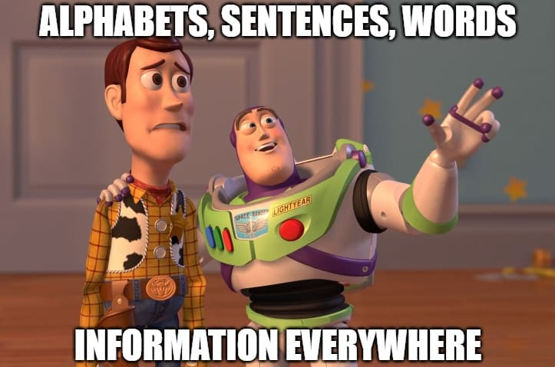
What is text?

Slide 3
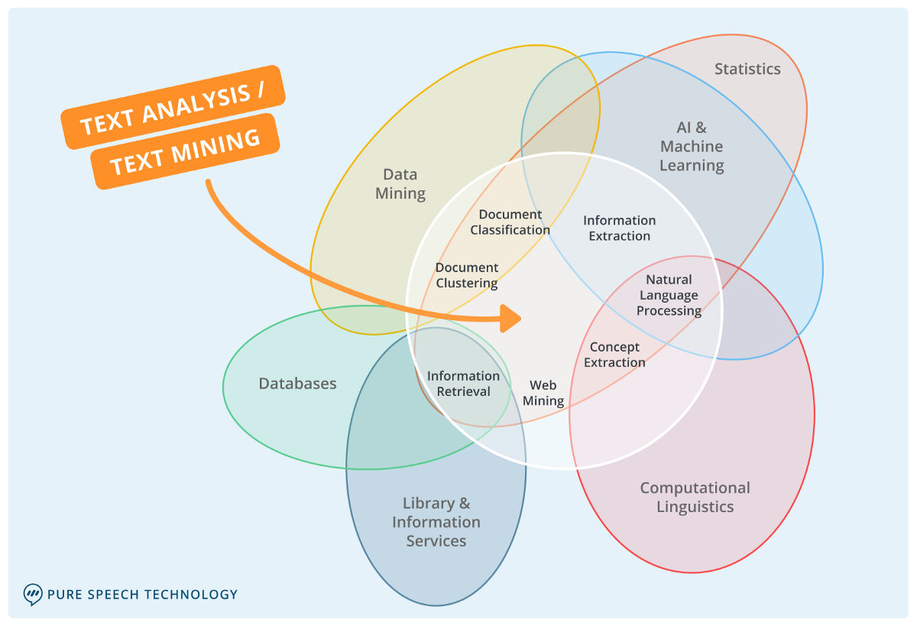

Slide 4
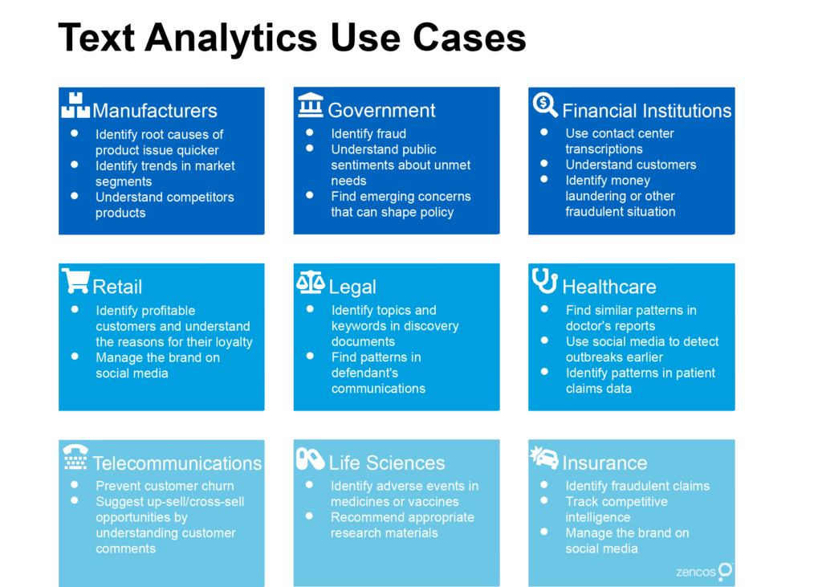

Slide 5
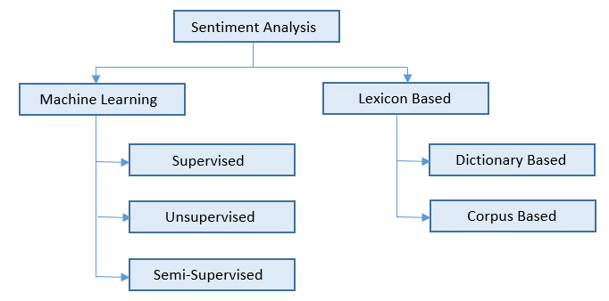

Slide 6
How does the process look like?
Very complicated!

Slide 7
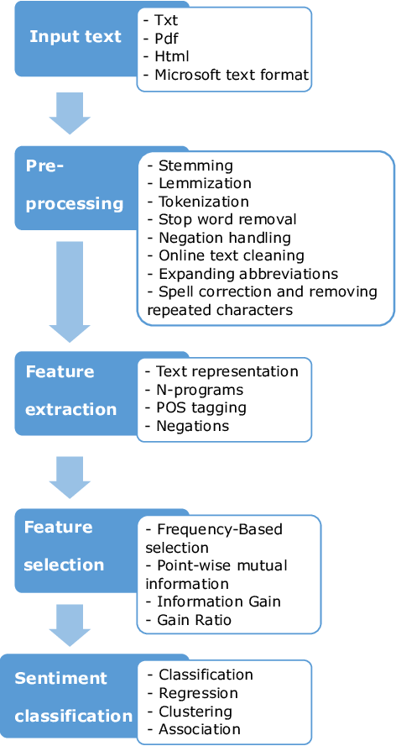






Slide 8
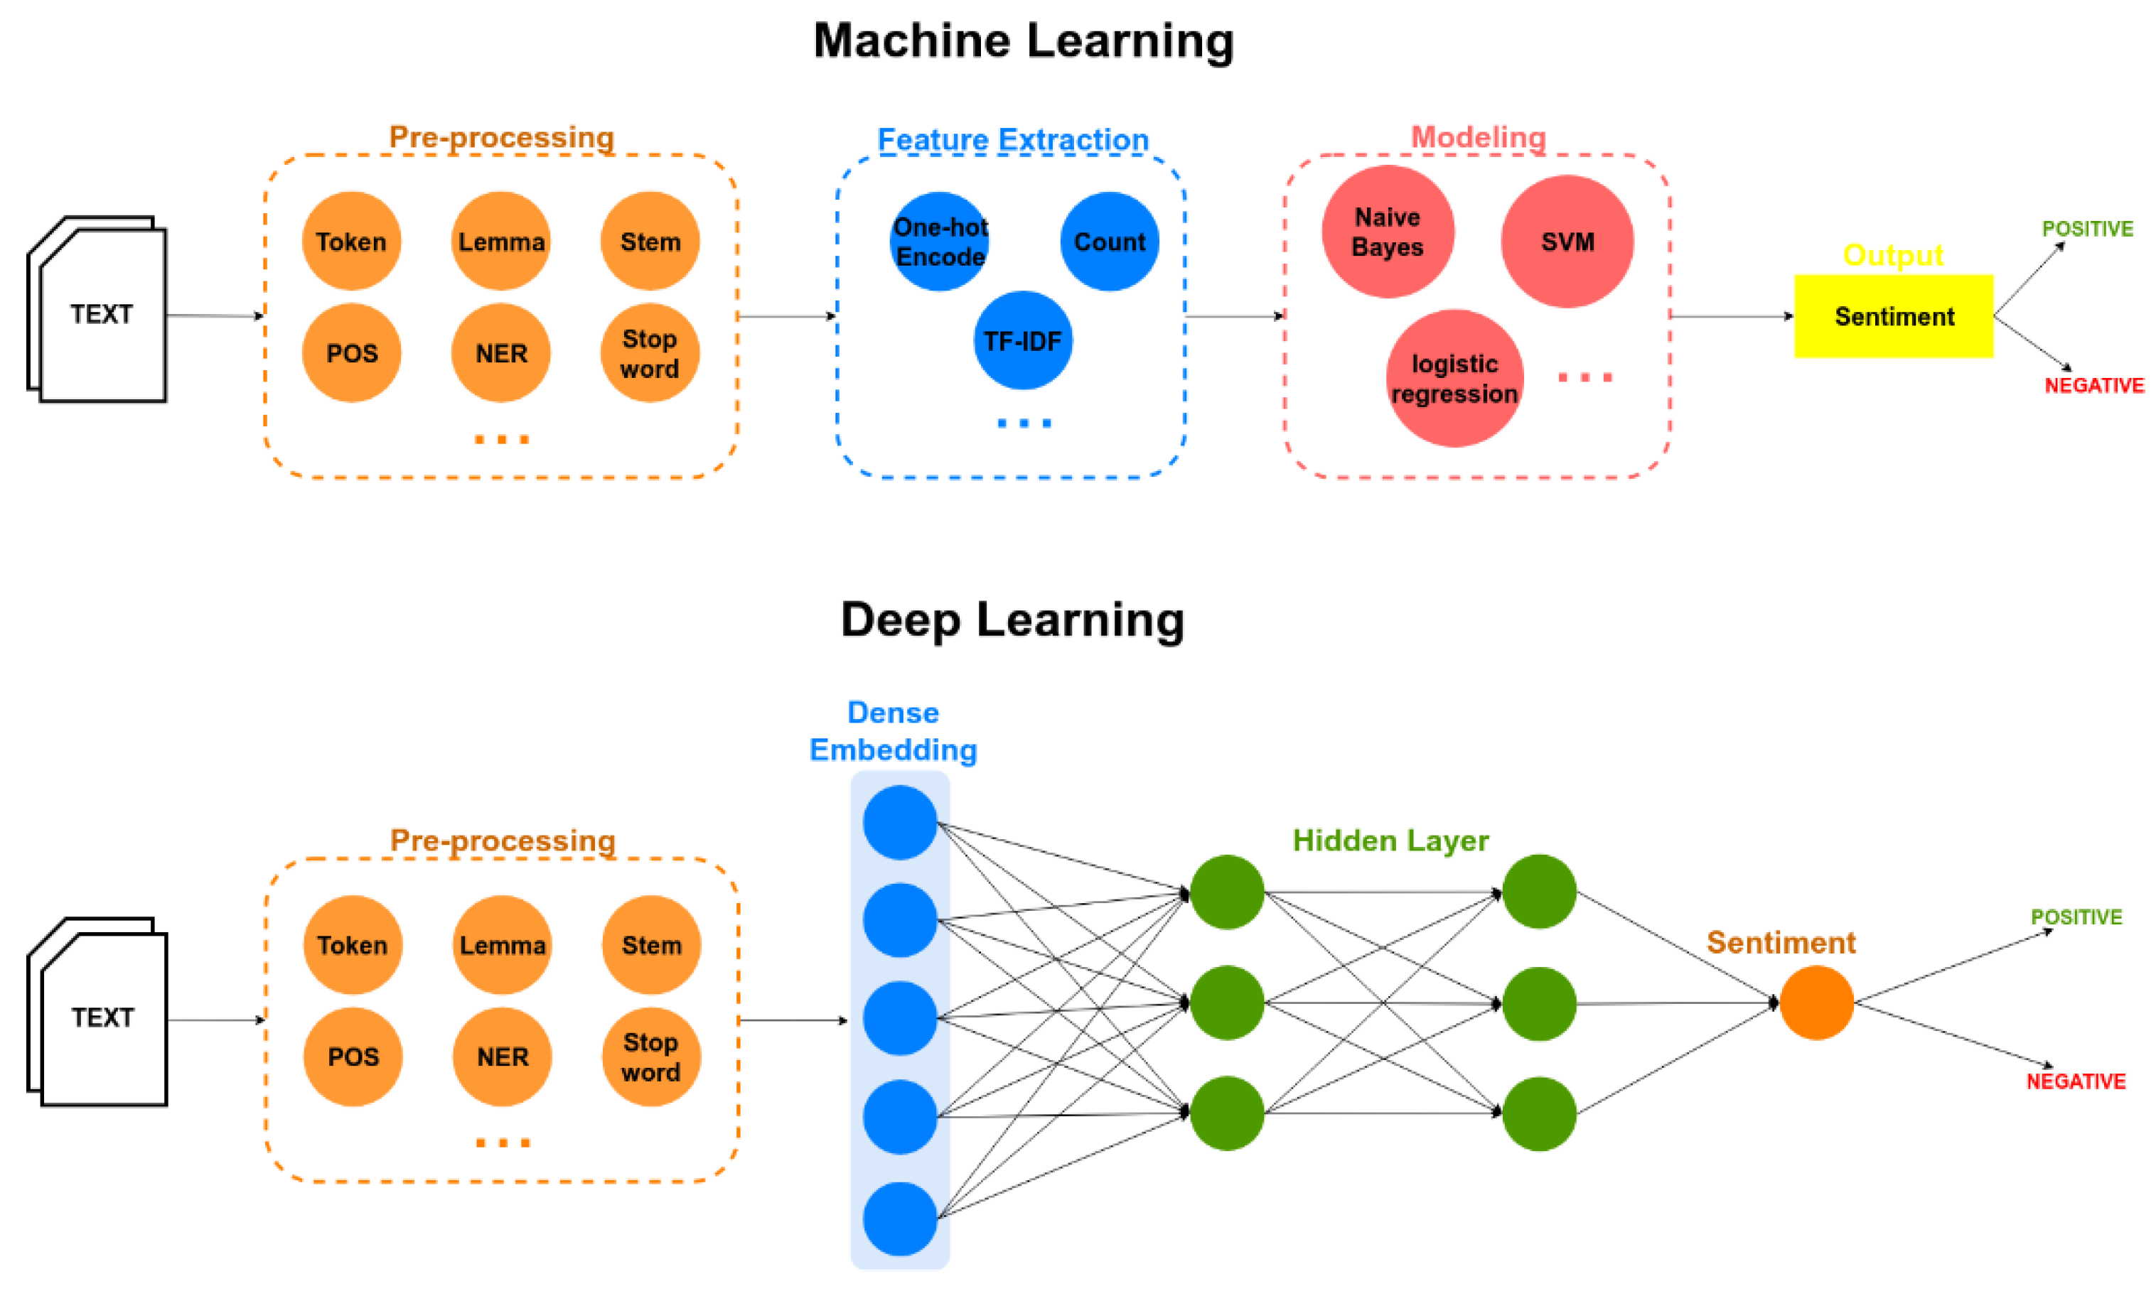

Slide 9
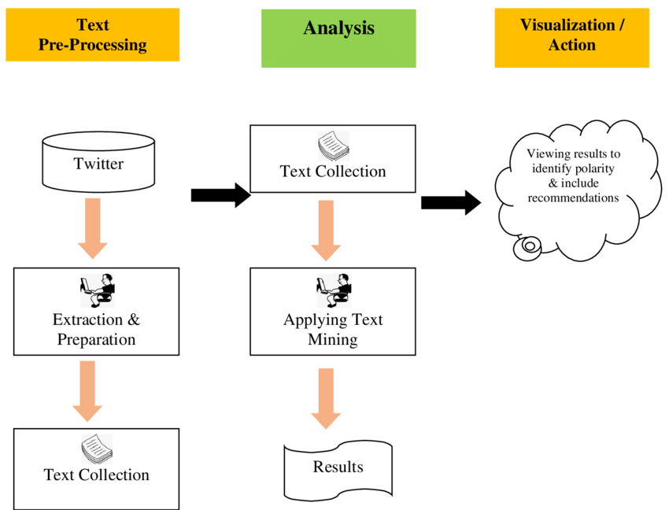

Slide 10
Breaking Down Text
Reading Corpus
Analytics
Interpret the converted Text
Get it ready for Analysis

Slide 11
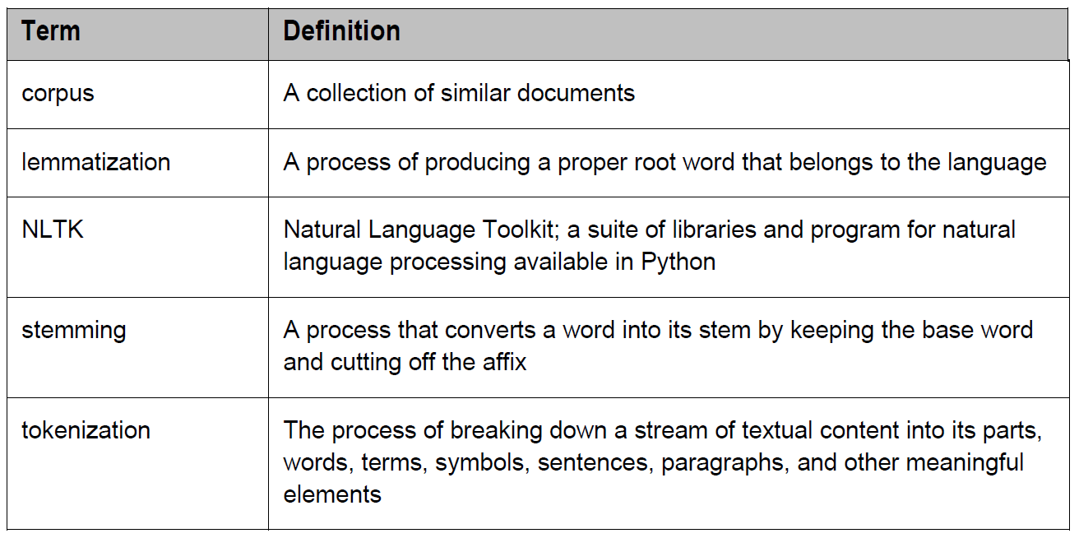
Text Pre-processing (New Terms!)
Punctuations
Stop Words

Slide 12
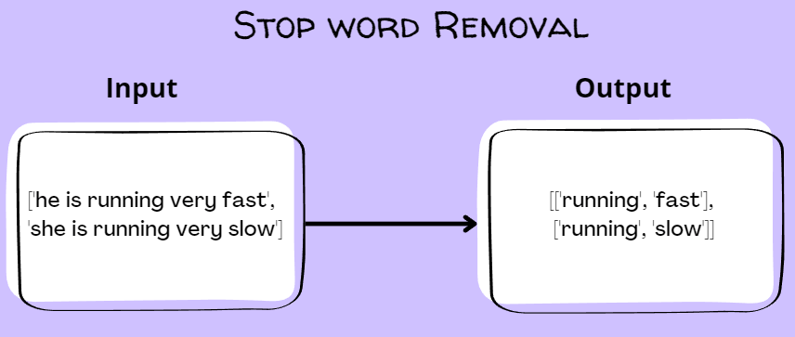

Slide 13
Corpus
A collection of similar documents

Slide 14
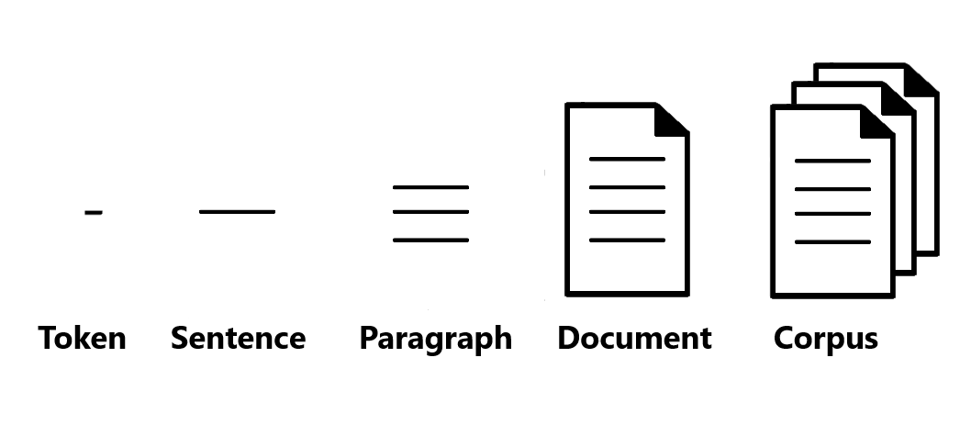
One Row in a table
Multiple Rows in a table

Slide 15
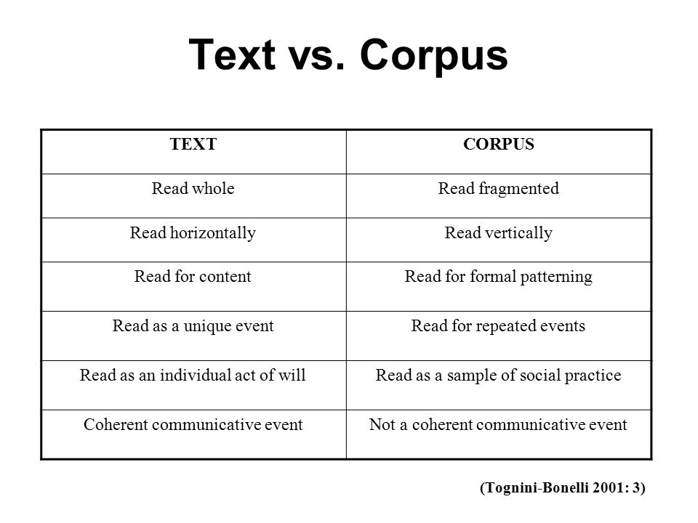

Slide 16
Lemmatization
A process of producing a proper root word that belongs to the language

Slide 17
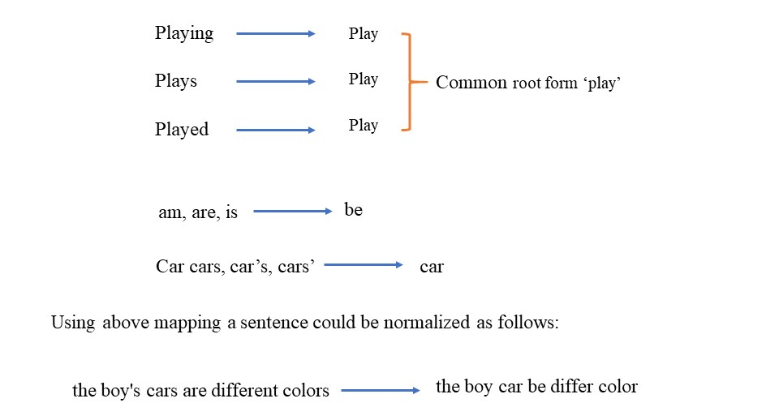

Slide 18
Stemming
A process that converts a word into its stem by keeping the base word and cutting off the affix

Slide 19
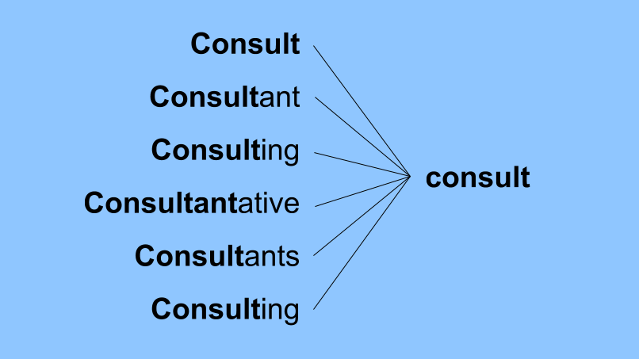

Slide 20
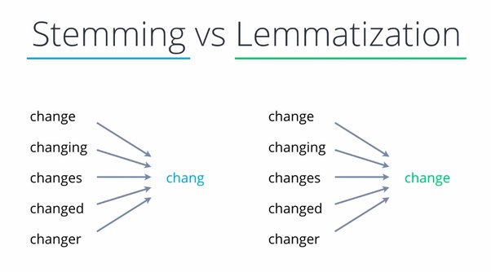

Slide 21
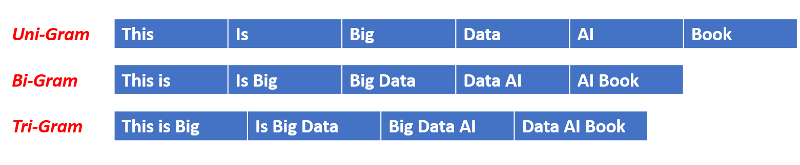
N-GRAM

Slide 22
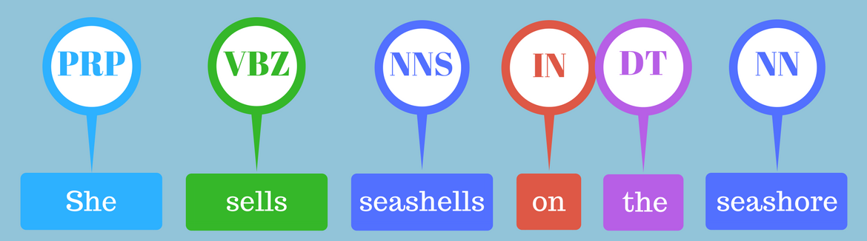
POS Tagging

Slide 23
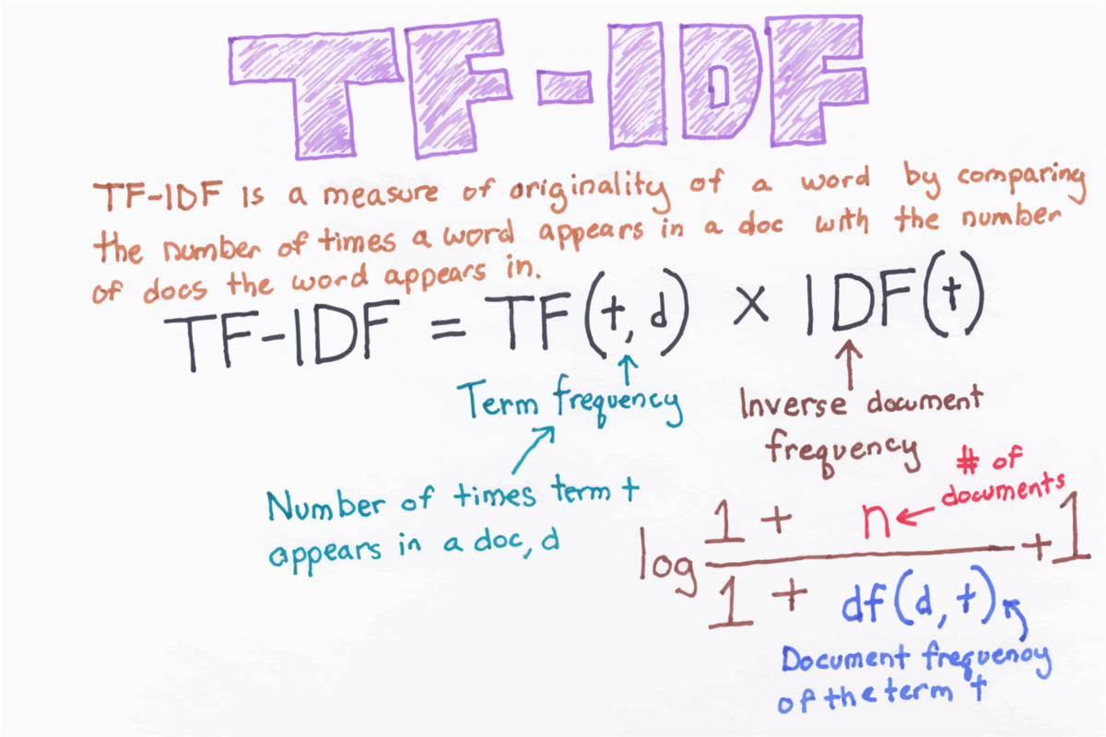
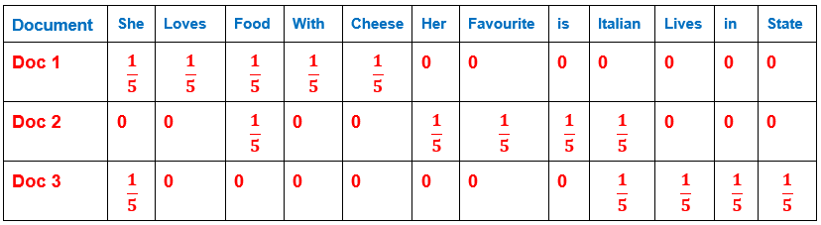

Slide 24
So how to you do all those fancy text mining stuff?

Slide 25
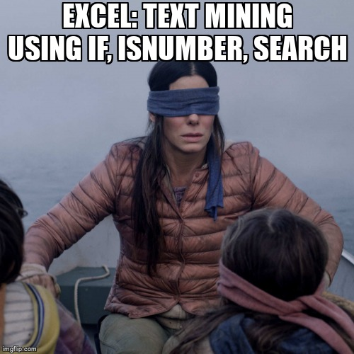

Slide 26
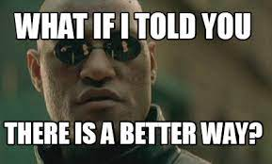

Slide 27
