Slide 1
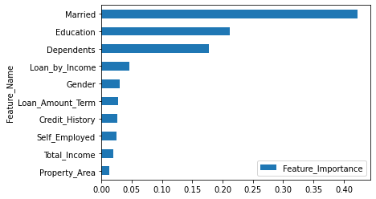

Predict Loan Eligibility for Dream Housing Finance company
Business Objective
Create a real-time process that helps customers instantly know their loan eligibility status after they have filled the application form.
Solution
Build and Deploy a Machine Learning Model that predicts Eligible Customers for the Home Loan after the form is filled by the customer
Approach
Business Understanding
Data Understanding
Perform EDA to identify features that help predict Eligible Customers for Home loan
Data preparation
Pre process data for Modelling, Create Training and Validation Data
Modelling
Create a Machine Learning Model that predicts Loan Eligibility
Evaluate
Use Accuracy Metric to evaluate the model performance
Deploy
Model Performance
Train Accuracy: 86.4%
Validation Accuracy: 81.3%
Who
Company Marketing Department
Where
Deploy the model on server
Take input from the Customer Application form and provide Eligibility status post submission
Name: Kunaal Naik
Email: me@kunaalnaik.com
Location: Bangalore
Outcomes
Business Outcome
Reduced Loan Validation Process from 10 days by making it real time (< 1 minute)
Model Outcome
Predicted Eligible Target Customers with 81% Accuracy using a Decision Tree Model

