Slide 1
KnowIT : Revolutionizing IT Training with AI
Empowering IT Enthusiasts

Slide 2

Introduction to KnowIT
What is KnowIT
An innovative IT training platform
Leverages the power of AI
Aims to revolutionize IT training
Why KnowIT?
Traditional methods are time consuming and inefficient.
Uses AI for personalized efficient, and effective training
Unique blend of technology and education

Slide 3
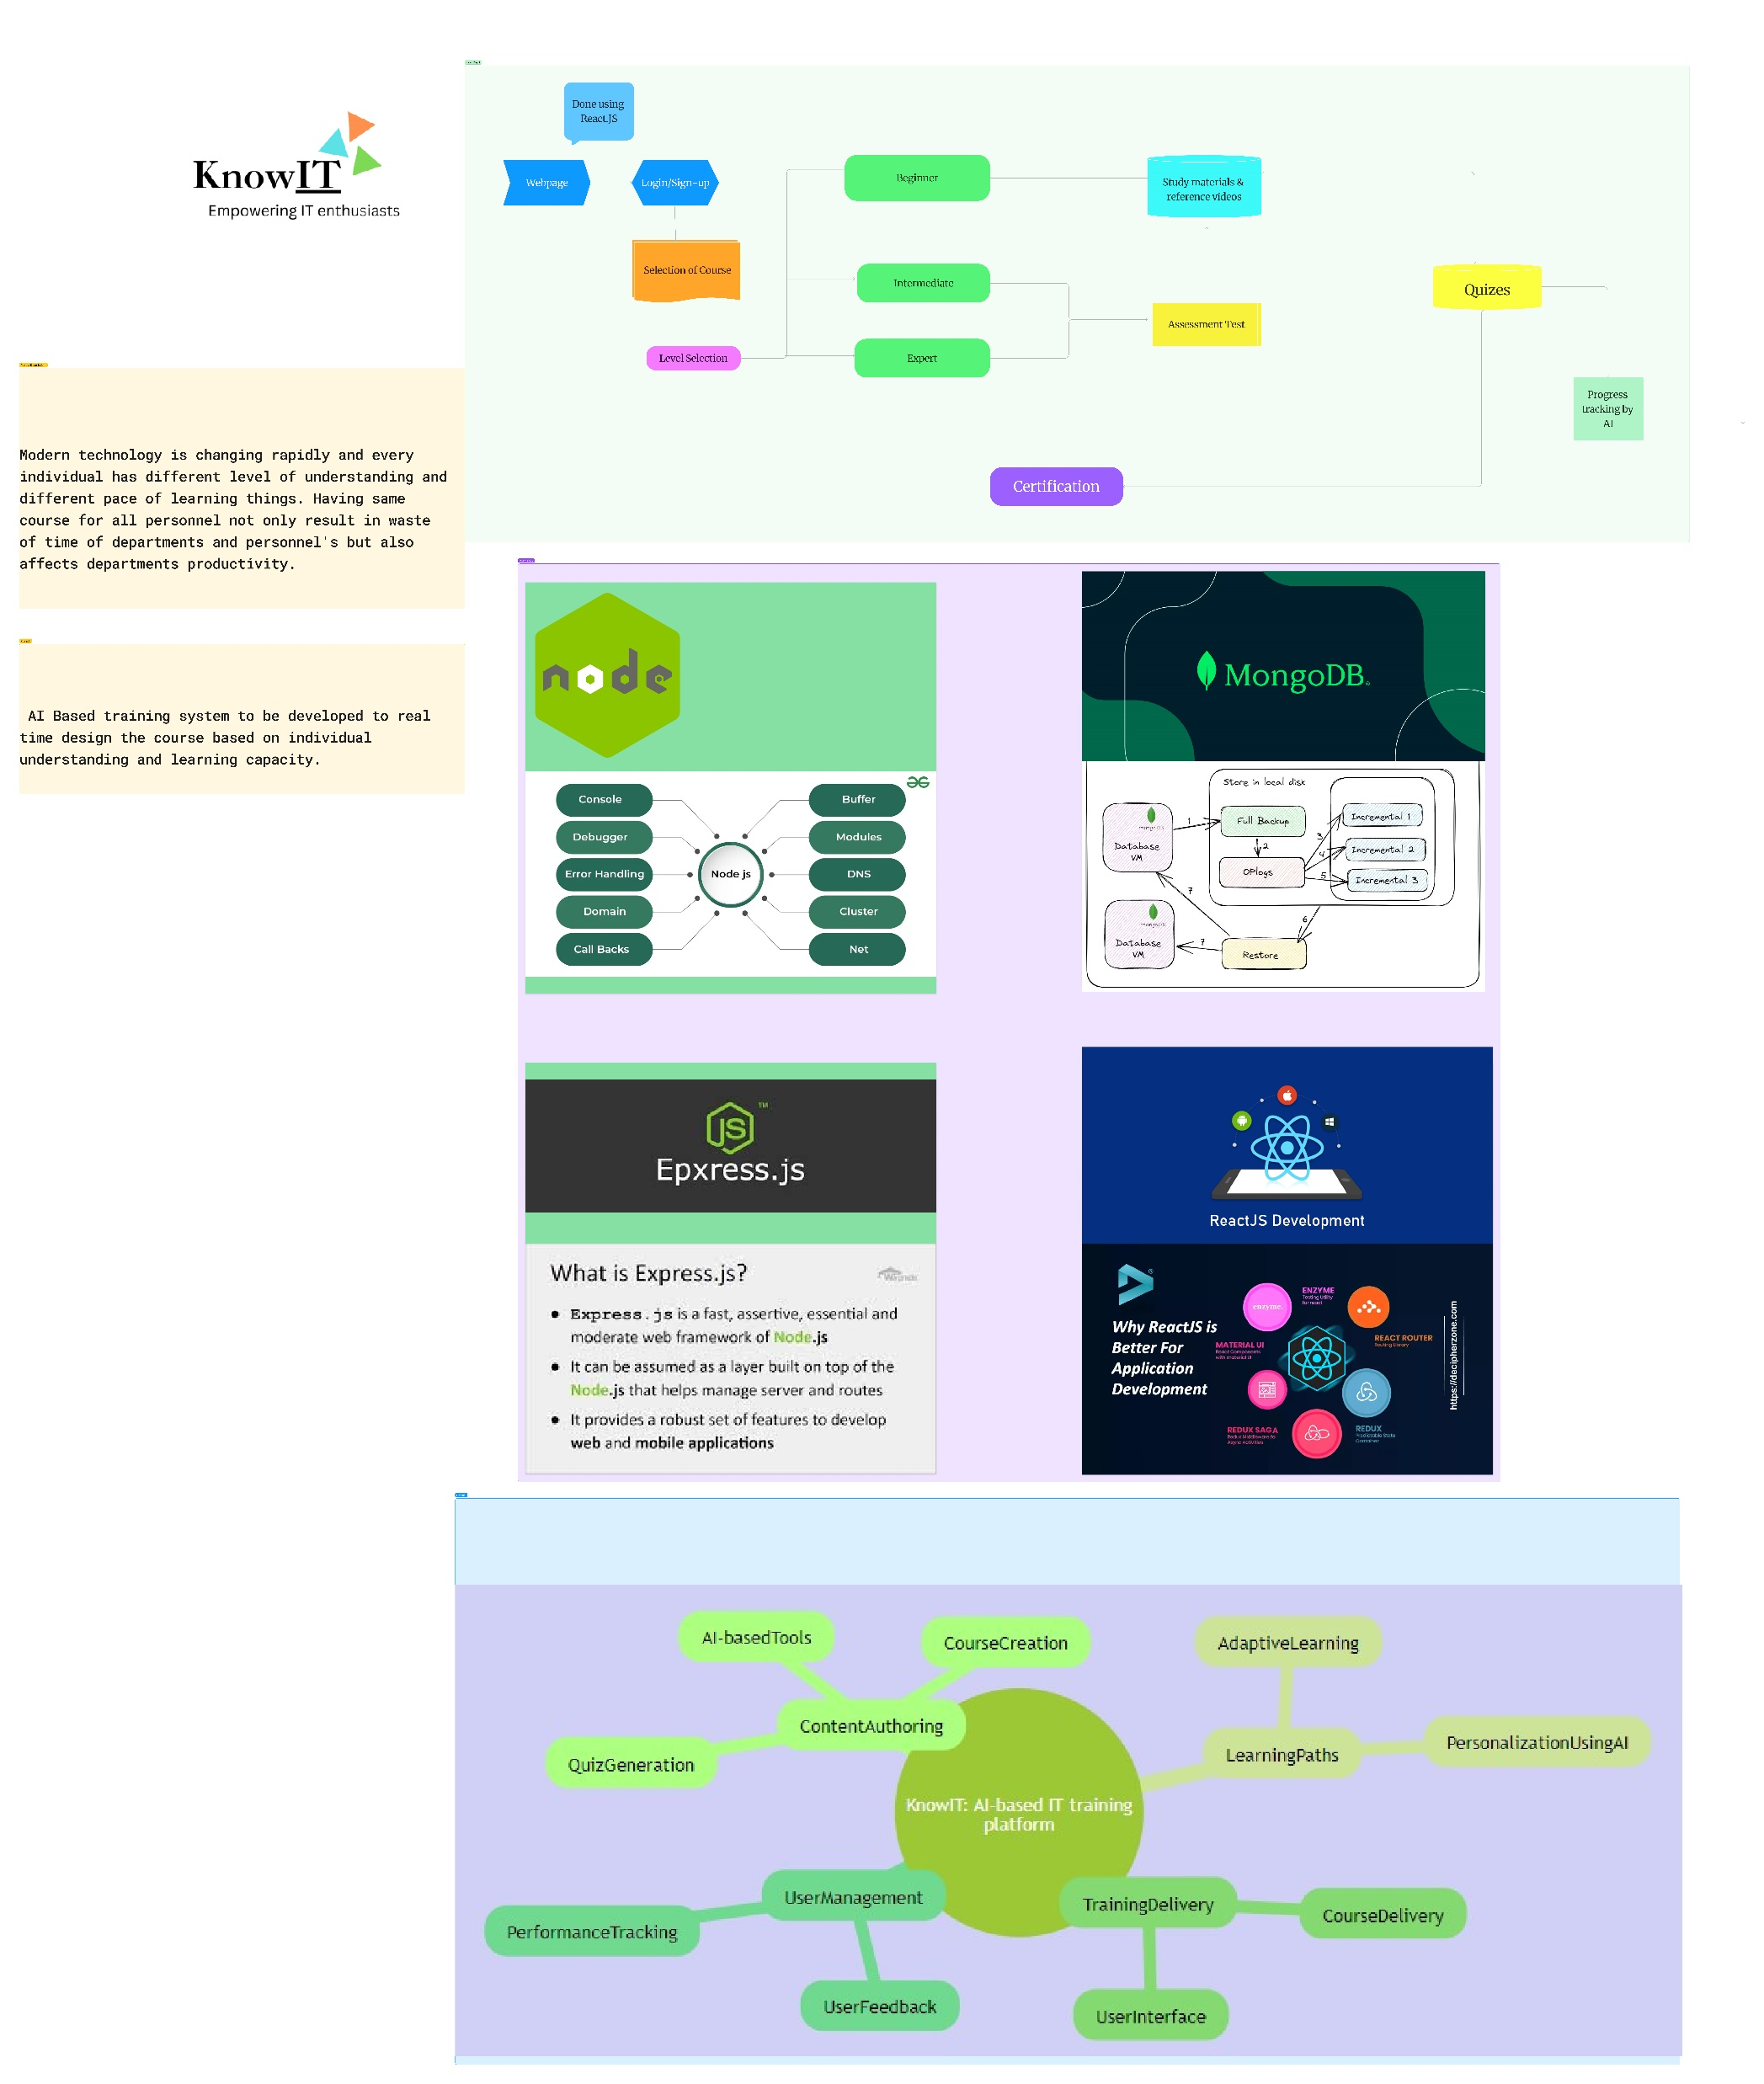

Slide 4
AI Revolutionizing IT training
The Power of AI in Training

Slide 5
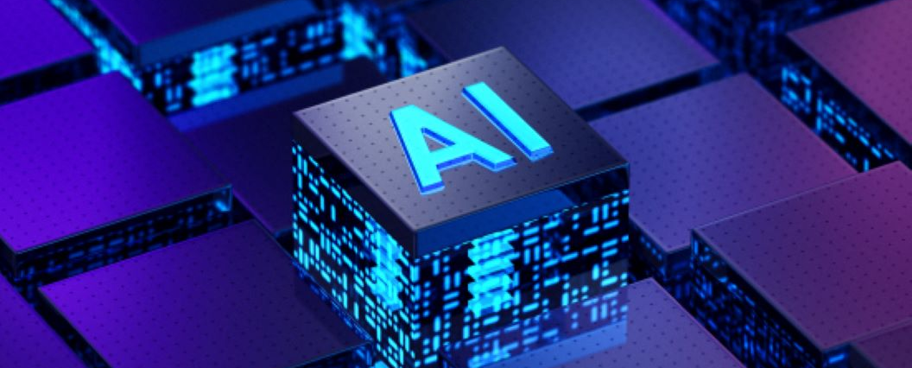
The Role of AI in IT Training
Analyse learner behaviour and preferences
Automate repetitive tasks
Provide real-time feedback and assessments

Slide 6

Features of KnowIT
Personalised learning with AI
Real time feedback and assessments
Daily and weekly assessments
Reference videos
Built in notes provided by AI
AI based selection of course

Slide 7

The benefits of AI in KnowIT
Tracks progress and provides feedback
Adaptive Assessments
Intelligent Content Recommendation
Real-time Feedback
Time Efficiency

Slide 8

Courses
Cloud computing
Cyber Security
Software development
App development
Web Development
Data science
Machine learning
Networking

Slide 9
Aims of KnowIT
To stabilise each user strongly in the course they select
To develop strategies for motivating and engaging employees.
Improving communication skills
Meet the learning style or needs of students
Improve user-accessibility and time flexibility to engage learners in the learning process

Slide 10
Thank You

