Slide 1
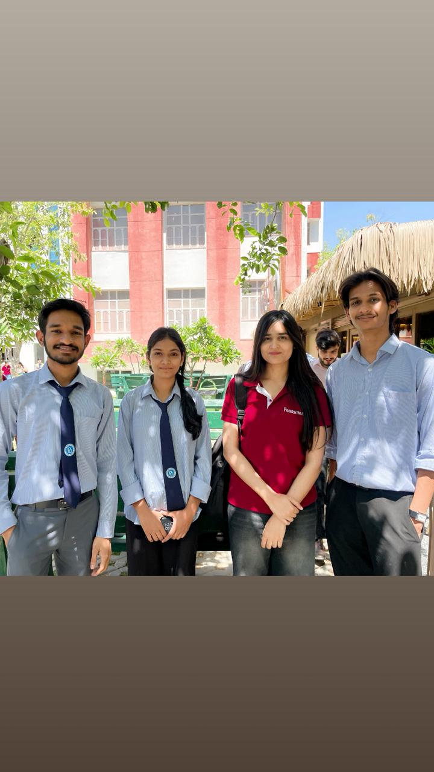
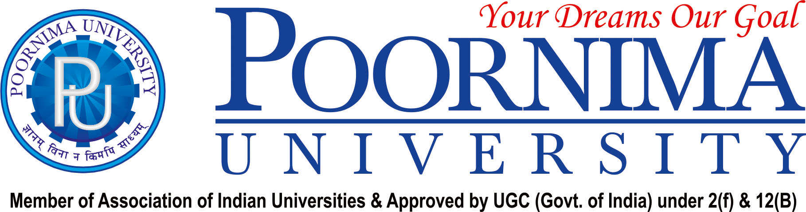
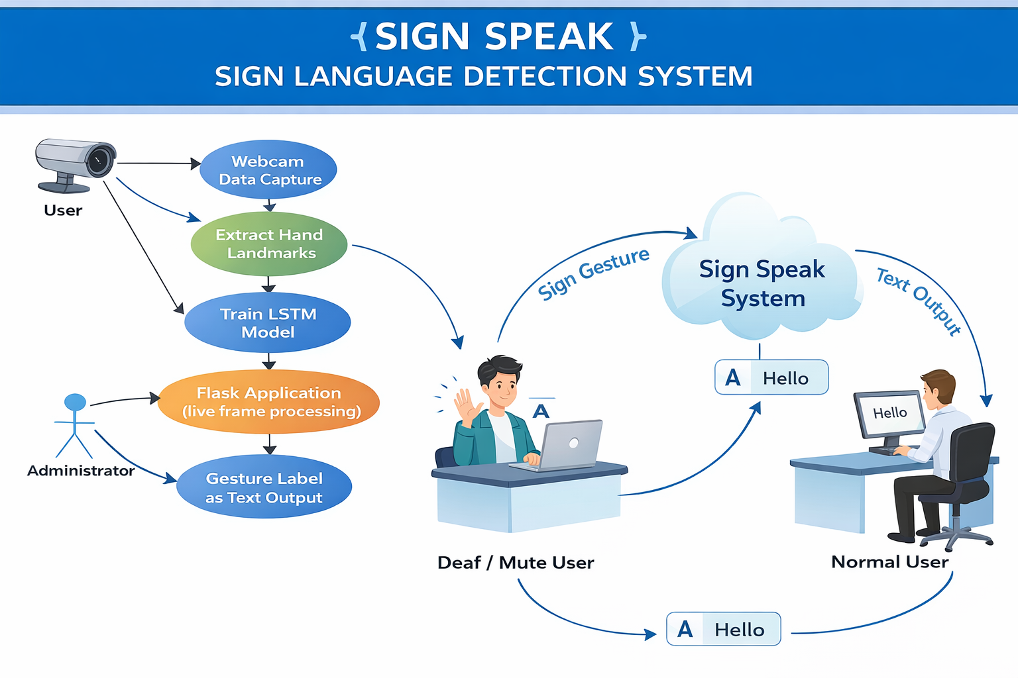
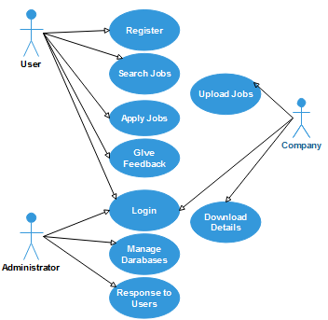
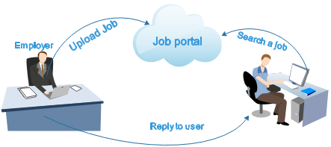
FACULTY OF COMPUTER SCIENCE & ENGINEERING
SIGN
SIGNAI – sign language detection system
OBJECTIVE
MODEL / PROJECT DIAGRAM/ GUI / FLOWCHART ETC.
The objective of our Sign Language Detection System is to recognize and interpret hand gestures used in sign language through visual input such as a camera or video feed. The system aims to convert these gestures into readable text in real time, making communication easier between deaf or mute individuals and others who do not understand sign language. It focuses on providing a simple and user-friendly interface while utilizing visual processing and basic machine learning techniques for accurate gesture detection. Overall, the system is designed to bridge the communication gap and make interaction more accessible, efficient and inclusive.
DETAILS OF INNOVATION
OUTCOME & FUTURE SCOPE
The main innovation of our Sign Language Detection System lies in its ability to provide real-time gesture recognition through a simple and user-friendly frontend interface. Unlike many traditional systems that rely on heavy hardware or complex setups, our system focuses on using standard camera input and efficient visual processing techniques, making it more accessible and cost-effective. It integrates basic machine learning concepts to improve the accuracy of gesture detection while maintaining smooth performance. Another key innovation is the use of interactive animations and visual feedback, which enhance user understanding and engagement. Additionally, the system is designed to be lightweight and easily deployable, making it suitable for educational and practical use. Overall, the combination of simplicity, real-time processing, and enhanced user experience makes our system more efficient and approachable compared to earlier solutions.
OUTCOMES:
The system successfully recognizes sign language gestures in real time and converts them into text, making communication easier and more accessible. It provides a simple interface and demonstrates the practical use of machine learning in solving communication barriers
FUTURE SCOPE:
The system can be improved by increasing accuracy, supporting more gestures and languages, and adding voice output. It can also be developed into a mobile app and integrated into real-time communication platforms for wider use
GUIDED BY : Mrs. Priyanka tiwari
TEAM MEMBERS:Kunal bairwa
Jhanvi kumar
Prateek sharma
Neha singhal

