Slide 1
Energy Usage & Savings
Presented by: Group 5
Group Members:-
Kunal Ahirrao
Sukhad Dnyanesh Joshi

Slide 2
Analysis approach
Explain
Basic statistics
Missing values
Duplicates
Interpret
Check accuracy
Interpret significant factors
Recommendations
Practical measures for the grater good
2
4
6
1
3
5
Process
Focus on relevant data
Aggregate daily
Merge
Model
Split the data
Compare several models
What-if scenario
Increase the temperature
Run the model
Evaluate the peak

Slide 3
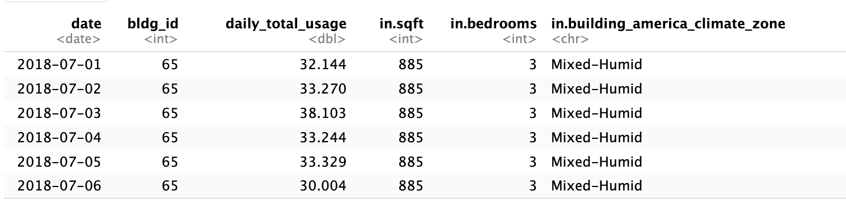
Data preparation
Clean the data and reduce the number of attributes
Aggregate the daily data for each house
Remove NAs and duplicates

Slide 4
Process infographic
Split the data
Build several models
Acknowledge
Interpret
80% for training
20% for testing
Several linear regression models with different number of parameters
The more data – the better. 51% of accuracy
10 important key take aways

Slide 5
Results
More square - more usage
Location and climate type matters
Use of clothes dryer and cooking appliances below 80% of usage saves energy
The higher the weather temperature, the more usage.
For humidity it’s wise versa.

Slide 6
What-if analysis
 | original | +5 degrees warmer
mean | 30.06 | 30.08
max | 117.599 | 79.8

Slide 7
Recommendations
Advocate for the design of smaller home
2
3
Improve insulation and HVAC efficiency
Promote energy-efficient appliance
1

Slide 8
Let’s compare now
Reduce sqr by 10%;
Increase frequency of cooking appliance with the usage over 80% by 25%
 | original | +5 degrees warmer | Square + appliance change
mean | 30.06 | 30.08 | 27.6
max | 117.599 | 79.8 | 75.5

Slide 9
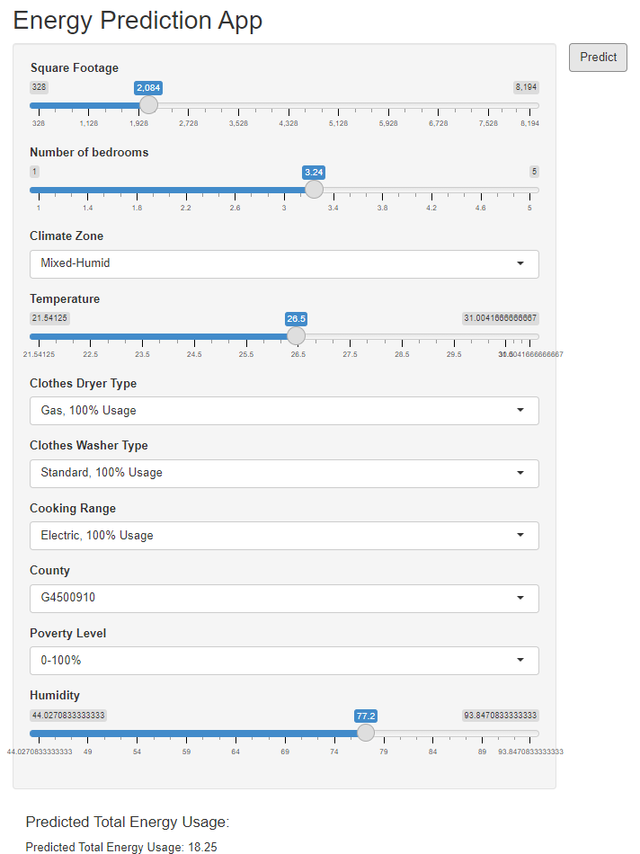
--Shiny App--

Slide 10

THANK YOU !

