Slide 1
e
ecommerce
Global Sales Analysis
Analyzing 2,000 orders across 20 countries and 3 years (2023–2025) to uncover revenue drivers, regional performance, and product trends.
$484.6K
$158.9K
2,000
20
Total Sales
Total Profit
Orders
Countries
01

Slide 2
Dataset at a Glance
Global e-commerce order records, cleaned and modeled for analysis
2,000
15
20
Orders
Data Fields
Countries
4
40
0
Categories
Unique Products
Missing Values
Fields span order details, geography, product category, pricing, discounts, shipping cost, profit, and payment method — covering Jan 2023 through Dec 2025.
02

Slide 3
Building the Dashboard
From raw CSV to a published Power BI report
01
02
03
04
Clean & Structure
Model with DAX
Design the Theme
Publish & Navigate
Enriched order data with Year, Quarter, and Month fields; exported to Excel for import.
Built core measures — Total Sales, Profit Margin %, AOV, YoY trend — in a dedicated measures table.
Applied a custom blue (#0E46EC) and yellow (#FFC107) Power BI theme across every visual.
Built Overview, Geography, and Products pages linked by a styled page navigator.
03

Slide 4
Revenue & Profit Overview
Strong, stable margins across all three years
$484.6K
$158.9K
32.8%
$242.28
Total Sales
Total Profit
Profit Margin
Avg Order Value
SALES & PROFIT BY YEAR
Key Insight
Revenue held steady across all three years (~$155–165K/year) with margin consistently above 32%. Profitability is not concentrated in one year — the business model scales predictably.
04

Slide 5
Furniture Leads Every Category
Sales, profit, and margin by product category
Category | Share of Sales | Margin
Furniture | 52.9% | 31.7%
Technology | 28.8% | 34.6%
Clothing & Accessories | 14.3% | 37.6%
Office Supplies | 4.0% | 17.1%
Category
Share
Margin
Clothing & Accessories carries the highest margin (37.6%) despite lower volume — a strong candidate for targeted growth alongside Furniture's scale.
05

Slide 6
Europe & North America Lead, Mexico Tops Countries
Regional and country-level sales distribution
SALES BY REGION
TOP 5 COUNTRIES
Region concentration is healthy — no single region exceeds 30% of sales, reducing geographic risk.
06

Slide 7
Standing Desk Converter Is the Top Seller
Top 10 products by sales
07

Slide 8
Consumers Drive Volume, Credit Card Leads Payments
Customer segment and payment method breakdown
CUSTOMER SEGMENT
PAYMENT METHOD
Credit Card
$192.7K
39.8%
PayPal
$143.1K
29.5%
Cash on Delivery
$77.1K
15.9%
Bank Transfer
$71.6K
14.8%
08

Slide 9
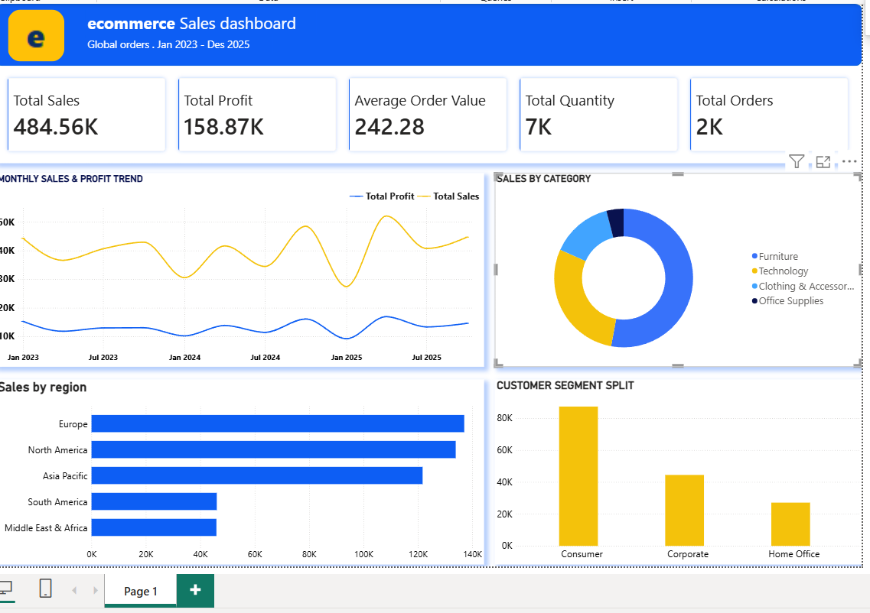
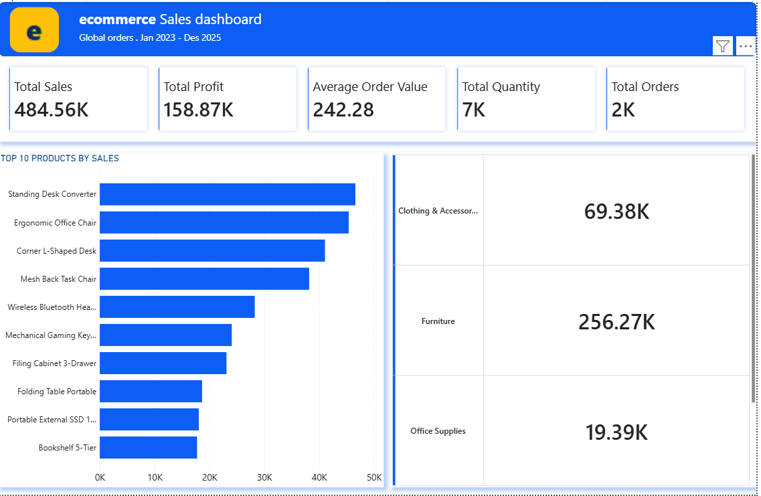
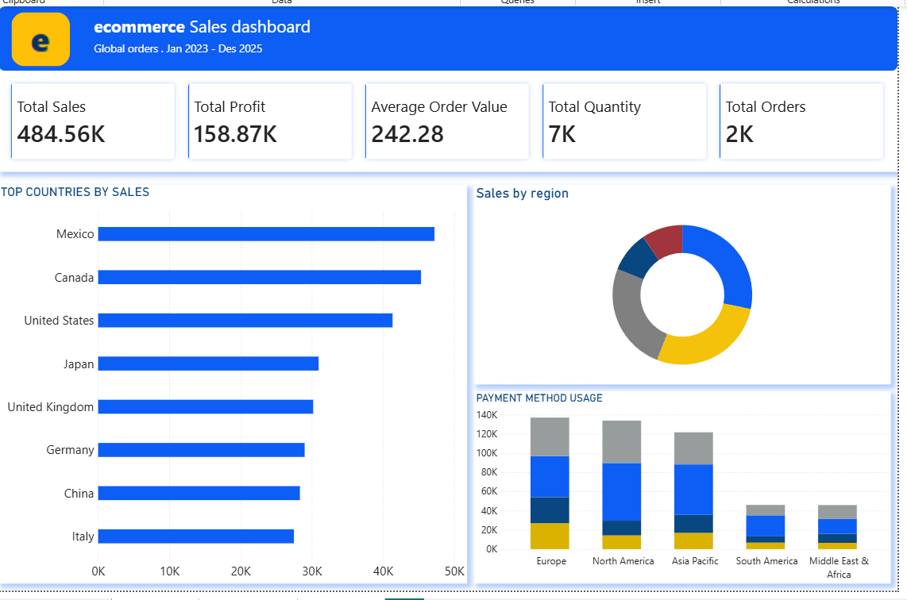
e
The Power BI Dashboard
Overview · Geography · Products — three linked pages, one theme
Overview
Geography
Products
09

Slide 10
Business Recommendations
Where the data points next
1
Grow Clothing & Accessories
2
Double Down on Furniture
Highest margin category (37.6%) but only 14.3% of sales — room to expand without eroding profit.
Already 52.9% of revenue — protect this base with better stock availability in Mexico, Canada, and the US.
3
Promote Digital Payments
4
Expand Corporate & Home Office
Credit Card and PayPal cover 69% of sales; shifting more Cash-on-Delivery orders online can speed fulfillment.
Together 45% of orders — tailored bulk pricing could lift both segments further.
10

