Slide 1


SMART INDIA HACKATHON 2026
Problem Statement ID – USICT002
Problem Statement Title- Low-Cost Lite Smart Hostel Allocation & Optimization System
Theme-
Smart Campus Management
&
Student
Security
PS Category- Software
Team ID-
Team Name - ZeroCommit

Slide 2








HOSTEL 360
THE IDEA
HOW IT ADDRESSES THE CHALLENGE
Hostel allocation is often a first-come-first-served, fragmented and manual process, requiring students to visit the institution for applications, verification, counselling, fee payment and registration.
This is especially challenging for students from distant locations, while genuine need, accessibility and room availability are difficult to consider together.
Hostel 360 brings the complete hostel journey online, enabling students to apply, complete verification, make payments and register from home through a centralized platform.
DIGITIZES THE HOSTEL PROCESS
OPTIMIZES ROOM ALLOCATION
Physical visits → Online portal
Students apply, upload documents and submit preferences directly from home.
First-come-first-served → Need-based matching
Allocation engine applies eligibility, accessibility, institutional rules and room availability to assign the best available single-bed room.
VERIFIES & ESTABLISHES PRIORITY
COMPLETES REGISTRATION DIGITALLY
Self-declared data → Verified need
Address/documents are verified → Routes API calculates distance → priority is generated based on distance and eligibility.
Multiple offices → One platform
Student views allocation → attends counselling if required → pays online → completes registration → receives digital allotment letter
UNIQUE FEATURES & INNOVATIONS
Verified Distance Priority
Hometown-to-campus distance based ranking
Rule-Driven Allocation, without using probabilistic AI
Smart Waitlist Mechanism
Digital Document submission
and verification
Zero-Cost System, Serverless, and No Need for DevOps
Live Admin Dashboard
Occupancy, vacancies & application insights
Smart Room Matching and
Optimized allocation
Online payment and DD verification after room confirmation

Slide 3

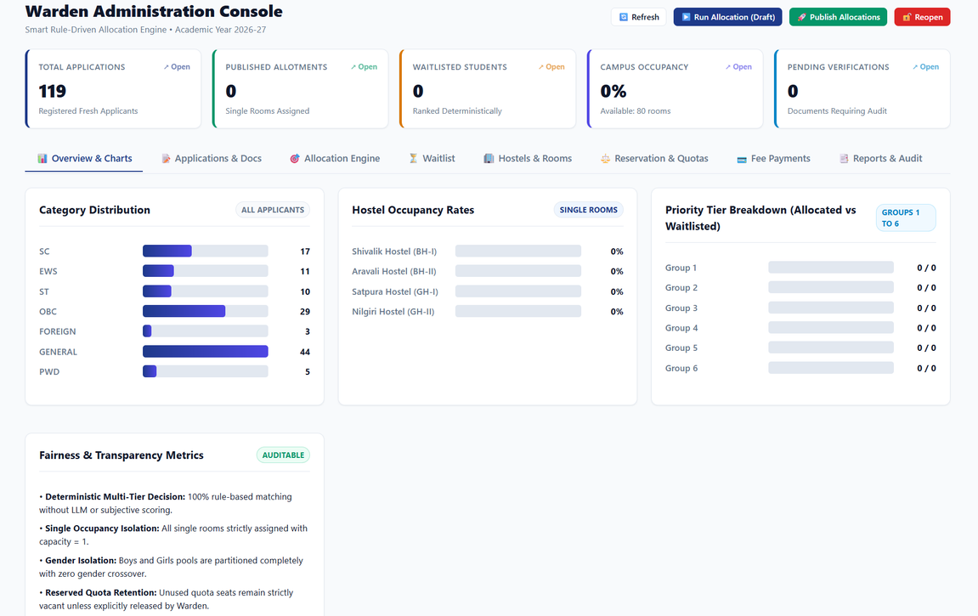
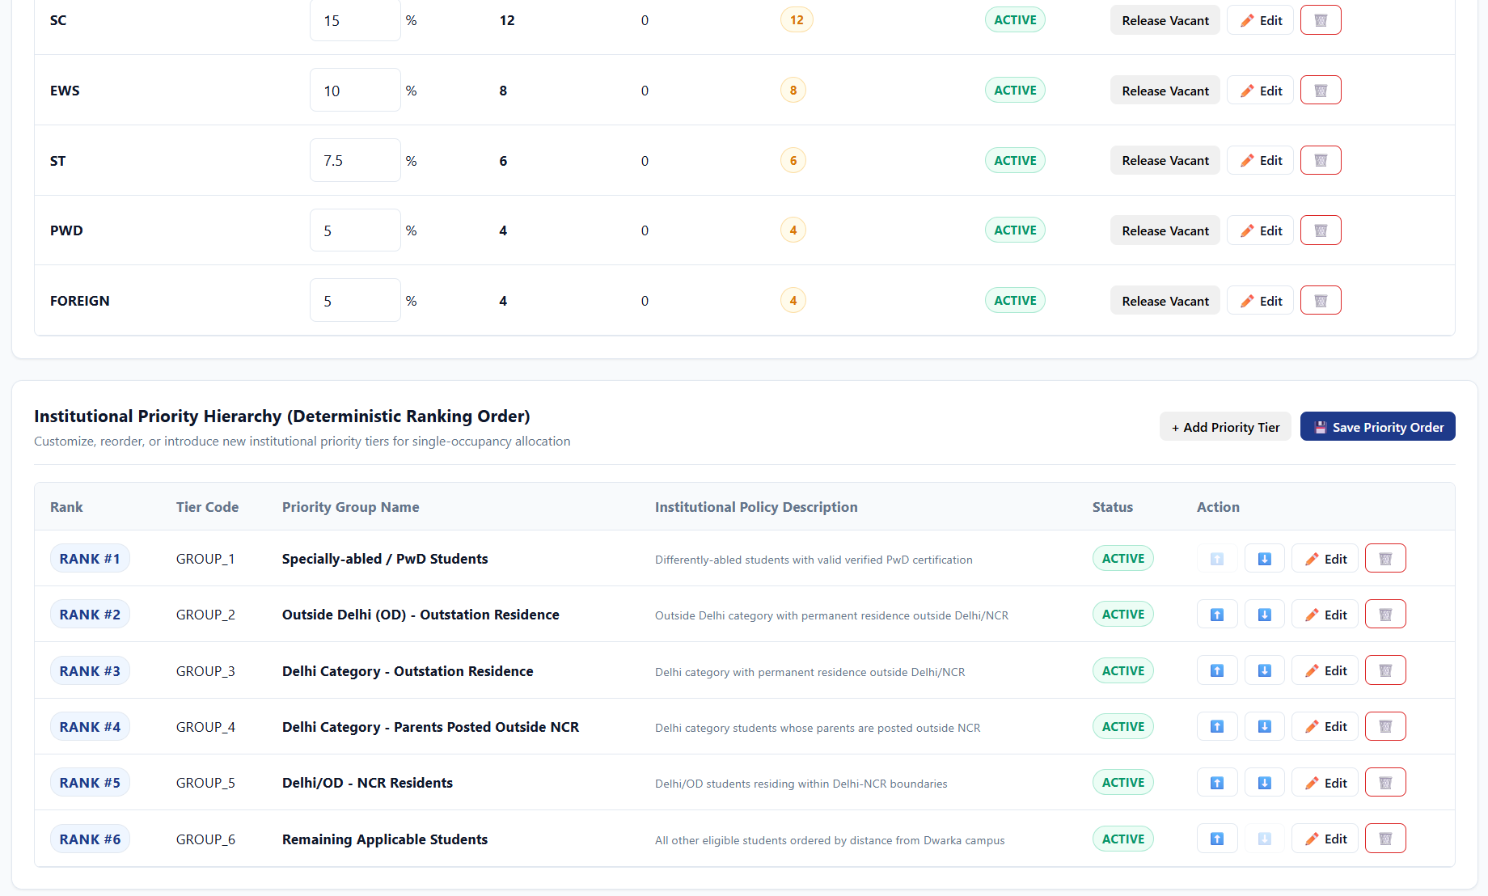
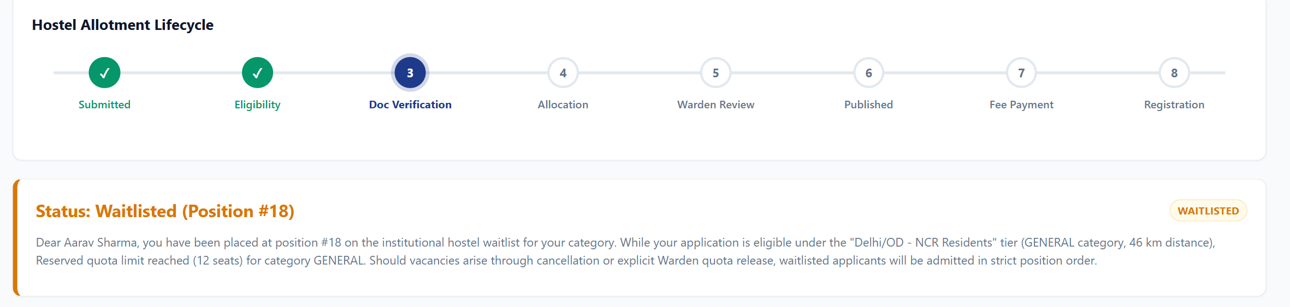

TECHNICAL APPROACH
TECH STACK
WORKFLOW
ALLOCATION ENGINE
Frontend
HTML • CSS • JavaScript
-> Student & Admin
Web Portal
STUDENT INPUT
Document Verification
Initial Hard Constraints
  Hostel application
  Hometown/address
  Preferences & accessibility requirements
  Valid Documents upload
Digital verification of
documents through Warden side
1. Single-room Occupancy
2. Gender Partition
Backend
Google Apps Script V8
-> Business Logic • Verification • Allocation Engine
6-tier Priority Hierarchy
Published
Database
Google SpreadSheets
1. PwD / Specially-abled students
2. Outside Delhi Residents
3. Delhi Outstation Residents
4. Exempted Residents (parents posted outside Delhi)
5. Local Delhi-NCR Residents
6. General and Late Applicants
Email is sent to the
student and the alloted
hostel is published
Document Management
Google Drive + Google Docs
-> Documents • Allotment Letters • Audit Reports
Category Quotas for reserved seats
General (40.5%), OBC (27%), SC (15%), ST (7.5%), EWS (10%), PwD (5%), Foreign (5%)
Admin validates
Distance Calculation
Google Routes API
-> Precise Real-World distance calculation from the Institute
Admin validates the
alloted hostel
Deployment
Apps Script Web App
-> Serverless • Low-Cost • Easy Deployment
Preference Engine
Draft Allocation
Preference 1 (if available) -> Preference 2 (if available) -> Official Waitlist (if both preferences are unavailable)
The draft is sent
to the Warden
Prototype link:
https://script.google.com/macros/s/AKfycbz2gqdNf-fevMecr7wx91fgggoFDJ3otrjxAo57F2X6i0Wqd7iMIPoB2tkB3VPTtgJtzw/exec

Slide 4

FEASIBILITY AND VIABILITY
CHALLENGES
FEASIBILITY
Data Reliability:
User Adoption:
Government or address documents require secure handling, controlled access and reliable verification.
Accessibility:
Allocation rules
differ across the institutions, requiring configurable policies and staff acceptance.
Incorrect addresses, duplicate applications and incomplete documents can affect fair allocation.
Technical:
Built using the Google Workspace ecosystem — Apps Script, Sheets, Drive and HTML/CSS/JS — enabling a low-cost, serverless and easily deployable solution.
Operational:
Digitizes the complete hostel workflow from application and verification to allocation, payment and registration, reducing manual workload.
SOLUTIONS
Smart Validation:
Automated checks for duplicates, missing information and address inconsistencies, with manual verification for flagged cases.
Secure Data Handling:
Role-based access, limited data collection, audit logs and controlled document access.
Configurable Allocation:
Administrators can define eligibility, priorities, accessibility rules, weights and deadlines without changing the core system.
Economic:
Uses existing Google infrastructure with minimal deployment and maintenance costs, making it suitable for resource-constrained institutions.

Slide 5


IMPACT AND BENEFITS
OUR IMPACT ON:
F
I
T
S
N
E
S
t
u
d
e
n
t
s
I
n
s
t
i
t
u
t
i
o
n
E
SOCIAL
B
Fair access based on Need and Distance Improved accessibility for PwD Students Transparent allocation and reduced bias
Reduced paperwork and faster management of applications, rooms, payments,
cancellations and waiting lists.
Better utilization of hostel capacity with centralized records, analytics and accountable decision- making.
Fairer, transparent and need-based hostel allocation with a digital admission experience.
ECONOMIC
H
o
n
Low-cost deployment using Google Workspace
Reduced administrative paperwork
Better utilization of available hostel capacity
o
s
t
e
r
a
t
i
l
A
d
m
i
n
i
s
t
DIGITAL
Fair & Need-Based
End-to-End Digital
Apply → Verify → Allocate
→ Pay → Register
▪︎Digital application, verification and registration
▪︎Digital documents, receipts and allotment letter generation
WHY CHOOSE Hostel 360?
Moves beyond first-come-first-served allocation.
Verified & Transparent
Low-Cost & Scalable
Built on Google Workspace for easy institutional deployment.
Address verification + explainable allocation decisions.
t
Reduced processes
physical
visits
and
administrative

Slide 6

RESEARCH AND REFERENCES
RESEARCH PAPERS
  Students’ Accommodation Allocation: A Multicriteria Decision Support System — AHP, Weighted Sum & PROMETHEE for student accommodation ranking.
  Stable Matching of Student-Groups to Dormitories — Fair and stable approaches to student–dormitory allocation.
  Multi-Level Genetic Algorithm for Hostel Space Allocation — Optimization approaches for real-world university hostel allocation.
TECHNICAL REFERENCES
  Google Apps Script Documentation — Web apps, automation and Google Workspace integration. Google Apps Script Services & APIs — Sheets, Drive, Gmail and external API integration.
  Google Apps Script Quotas & Limitations — Deployment and scalability considerations.
RESEARCH INSIGHTS USED
  Multi-criteria ranking → Priority-based student allocation
  Stable/fair matching → Transparent room assignment
  Optimization techniques → Efficient use of limited rooms
  Data protection principles → Secure document & address handling
6

