Slide 1


IllumiRefine AI
Hybrid Architecture: Self-Calibrated Illumination + Adaptive Frequency Fusion
for Extreme Low-Light Image Enhancement.
Kunal Pramanik
202518001@dau.ac.in
Chauhan Aman Satpal
Advance Image Processing
202518004@dau.ac.in
Guide: Dr. Srimanta Mandal
Associate Professor · Dhirubhai Ambani University · Gandhinagar, Gujarat

Slide 2
Agenda
Presentation Roadmap
01
02
03
Introduction & Problem Statement
Related Work
Phase 1 — Homomorphic Filtering
Why low-light enhancement is a critical challenge
HE, CLAHE, Retinex, RetinexNet — and their limits
Frequency-domain classical approach
04
05
06
Phase 2 — Self-Calibrated Illumination
Phase 3 — SCI-Guided Adaptive Fusion
System Architecture
CVPR 2022 deep learning backbone
Our novel hybrid contribution
Full-stack cloud deployment
07
08
09
Experimental Results
Performance Analysis
Conclusion & Future Work
Before/After comparisons
Speed, efficiency & scalability
Takeaways and next steps

Slide 3



Introduction & Problem Statement
Why Low-Light Enhancement Matters
THE CHALLENGE
Autonomous Driving
Detecting pedestrians & signs on unlit roads at night
Low photon capture → high signal-to-noise ratio (SNR)
Structural details, edges & color channels buried under sensor noise
Traditional global methods (HE, Gamma) fail on spatially non-uniform lighting
Retinex division amplifies noise in pitch-black regions
Mid-tone dullness: flat contrast in partially-lit zones
Security & Surveillance
Identifying faces & license plates in deep shadows
Medical Imaging
Endoscopes operate under strict illumination limits — algorithmic enhancement required

Slide 4
Related Work
Evolution of Low-Light Enhancement
Spatial Methods
Retinex / Frequency
Supervised DL
Unsupervised DL
Histogram Equalization (HE)
Retinex Theory (Land 1977)
LLNet
Zero-DCE
Flattens pixel distribution globally. Over-amplifies noise in dark regions.
Image = Illumination × Reflectance. Physical model of human color vision.
Stacked sparse denoising autoencoders. Requires paired dark/normal images.
Pixel-wise curve estimation. No paired reference images needed.
CLAHE
SSR / MSR / MSRCR
RetinexNet
SCI (CVPR 2022)
Adaptive tiles + clamped contrast gain. Better, but still fails under extreme non-uniform lighting.
Gaussian-based illumination estimation at single or multiple scales.
End-to-end Retinex decomposition CNN. 136+ GFLOPs. Paired data required.
Cascaded self-calibrating process. Only 0.0619 GFLOPs at inference. ✔ Our backbone.
Gamma Correction
Homomorphic Filtering
Power-law transform (Vout = A·Vᵧin). Blows out bright regions when γ < 1.
Frequency-domain separation via FFT + HPF. Introduces edge halos.

Slide 5

Phase 1: Homomorphic Filtering
Frequency-Domain Classical Approach
CORE PRINCIPLE
KEY EQUATIONS
Illumination varies slowly → Low frequencies in Fourier domain
Reflectance (edges, textures) → High frequencies
Log-transform converts multiplication to addition
High-Pass Filter: suppresses dark illumination, boosts detail
IFFT + exp() returns enhanced spatial-domain image
Limitation: Gaussian cutoff introduces edge halos at high-contrast boundaries
Image Formation
f(x,y) = i(x,y) · r(x,y)
Log Transform
z(x,y) = ln[i(x,y)] + ln[r(x,y)]
FFT
Z(u,v) = Fᵢ(u,v) + Fᵣ(u,v)
HPF Filter
H(u,v) = (γH − γL)[1 − e^(−c·D²/D₀²)] + γL
Apply Filter
S(u,v) = Z(u,v) · H(u,v)
Recover Image
g(x,y) = exp( IFFT { S(u,v) } )

Slide 6
Phase 2: Self-Calibrated Illumination (SCI)
CVPR 2022 · Unsupervised Deep Learning Backbone
Why switch from Homomorphic Filtering? Classical HPF uses fixed Gaussian cutoffs — it cannot adapt to the dynamic, non-linear spatial variation of real-world lighting. SCI replaces rigid math with learned convolutions trained without any paired ground-truth data.
ARCHITECTURE
LOSS FUNCTIONS & EFFICIENCY
Retinex model: y = z ⊙ x (observation = reflectance × illumination)
Network Hθ learns residual illumination — far easier than direct mapping
Cascaded training: uᵗ = Hθ(vᵗ), xᵗ⁺¹ = xᵗ + uᵗ
Self-calibration: vᵗ = y + Kθ(xᵗ) forces stages to converge
At inference: only 1 lightweight block (3 × Conv3×3 + BN + ReLU)
Final output: z = y / (x + ε), ε = 1e‒4 for numerical stability
Fidelity Loss
Lf = Σ ||xᵗ − (y + sᵗ⁻¹)||²
Pixel-level consistency between estimated illumination and input
Smoothing Loss
Ls — Spatially-variant L1 norm
Prevents the network from confusing sharp object edges with lighting changes
⚡ 0.0619 GFLOPs · < 1 MB model · vs RetinexNet 136+ GFLOPs

Slide 7

◆ OUR PRIMARY NOVEL CONTRIBUTION
Phase 3: SCI-Guided Adaptive Fusion
Hybrid Post-Processing Engine — Resolving Pure Retinex Failures
FAILURE 1: Mid-Tone Dullness
FAILURE 2: Noise Amplification
OUR SOLUTION
Raw Retinex division leaves partial-light zones flat & desaturated
y / x ≈ 0 in pitch-black regions explodes sensor grain into visible artifacts
Adaptive Fusion: bridge AI output with classical OpenCV — no added parameters
STEP 1 — Adaptive Exposure + Fractional Gamma
STEP 2 — Illumination-Guided Denoising Mask
z_raw = (y / (x + ε)) · Eg
z_γ = (z_raw)^γ
z_final = z_denoised·(1−x_norm) + z_γ·x_norm
NLM denoised image weighted by (1 − illumination): dark zones → smooth; bright zones → sharp original texture preserved.
Exposure gain Eg > 1 lifts brightness; fractional γ < 1 compresses dynamic range to boost shadows without blowing out highlights.
Result: Shadow regions rendered grain-free and smooth — while highlight zones maintain crisp, high-frequency edge fidelity.
No additional network parameters. No increase in inference time.

Slide 8



System Architecture
Full-Stack Cloud Deployment · illumi-refine-ai.vercel.app
FRONTEND
BACKEND API
CLOUD INFRA
React.js + Tailwind CSS + Axios
FastAPI (Python 3.11) + PyTorch
Hugging Face Spaces Docker
File Upload via Browser File API
Local object URL preview
Async API requests + loading states
Deployed on Vercel Edge Network
POST /enhance — multipart form
np.frombuffer → cv2.imdecode
Tensor: (H,W,C) → (N,C,H,W)
torch.no_grad() → 40% faster
Adaptive Fusion post-processing
CPU-optimized PyTorch wheel
FastAPI CORSMiddleware (CORS)
< 2.0 sec end-to-end latency
Globally accessible at vercel.app
Byte Decode → BGR→RGB → Normalize [0,1] → Tensor (N,C,H,W) → SCI Inference → Adaptive Fusion → PNG Stream

Slide 9
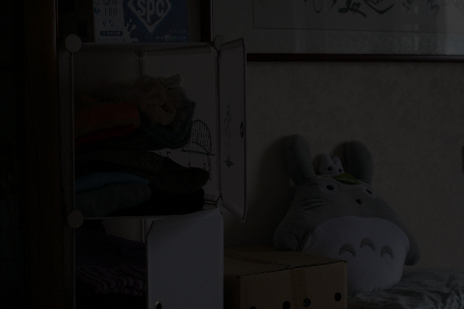
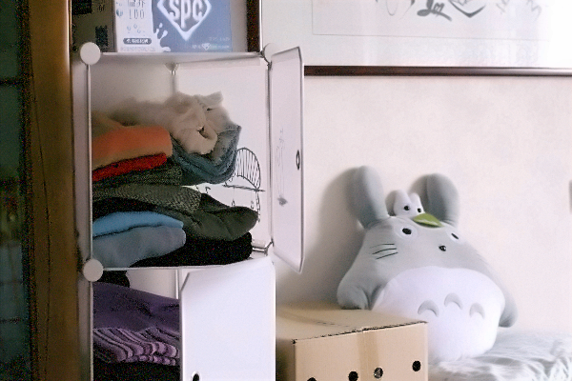
Experimental Results — Shadow Recovery
Test Scene: Extreme Low-Light · Shelving Unit
INPUT IMAGE
ADAPTIVE FUSION OUTPUT
[ Enhanced Output ]
[ Extreme Low-Light Input ]
Features INVISIBLE:
• White shelving unit structure
• Folded clothing textures
• Plush toy (Totoro)
Features RECOVERED:
• Distinct fabric textures
• Sharp shelf geometry
• Accurate Totoro color fidelity
✔ Zero artificial halos · ✔ Sensor grain fully suppressed by NLM(Non Local Masking) · ✔ No overexposure artifacts · ✔ Natural color constancy preserved

Slide 10
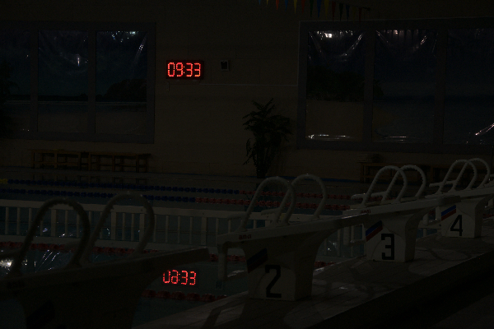
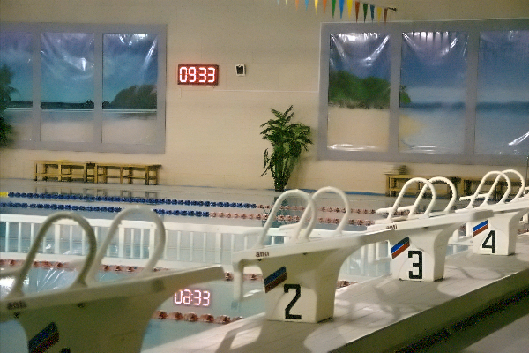
Experimental Results — HDR Exposure Control
Test Scene: High Dynamic Range · Swimming Pool with Digital Clock
INPUT IMAGE
ADAPTIVE FUSION OUTPUT
[ High Dynamic Range Low-Light ]
[ Localized Exposure Control ]
Red clock (09:33) glowing
Pool tiles & diving blocks
entirely pitch-black
Pool tiles & lane markers
clearly revealed
Red clock LEDs clamped — not blown out to 255,255,255
Key Insight: Traditional global Gamma Correction would overflow the clock to pure white. Our spatial illumination tensor identifies the clock as already-bright and selectively enhances only the dark foreground.

Slide 11
Performance Analysis
Computational Efficiency & Speed Benchmarks
0.0619
0.0003
< 2.0
~0
GFLOPs
(Giga Floating Point Operations)
MB
seconds
ms
Inference compute
Compiled model size
End-to-end on CPU cloud
On CUDA GPU (local)
MODEL COMPARISON
Model | GFLOPs | Model Size | Paired Data | Inference
RetinexNet | 136+ | ~50 MB | Required | Slow
KinD | ~34 | ~20 MB | Required | Moderate
Zero-DCE | ~0.084 | ~1 MB | Not Required | Fast
IllumiRefine AI (Ours) | 0.0619 | 0.0003 MB | Not Required | < 2 sec (CPU)

Slide 12
Conclusion & Future Work
Key Takeaways and Research Roadmap
CONCLUSION
FUTURE WORK
Rigorously explored the full enhancement spectrum: from classical Homomorphic Filtering → unsupervised SCI deep learning
Identified and resolved two critical SCI failure modes: mid-tone dullness & noise amplification
Proposed SCI-Guided Adaptive Fusion — a novel, zero-parameter hybrid layer
Proved that complex tensor math + neural inference can be operationalized in an accessible cloud app
Live system achieves < 2 sec per image on CPU infrastructure
Real-Time Video
Temporal consistency loss + LSTM/GRU for flicker-free video enhancement
Edge Deployment
INT8 quantization → ONNX/TFLite for smartphones & IoT cameras
Vision Pipeline
Direct integration with YOLOv8 / Mask R-CNN for dark-scene perception
Domain Fine-Tuning
Underwater robotics, astronomy & medical endoscopy datasets

Slide 13
Thank you
Questions & discussion
IllumiRefine AI — Live demo
https://illumi-refine-ai.vercel.app/
Kunal Pramanik · Chauhan Aman Satpal
Guide: Dr. Srimanta Mandal · Dhirubhai Ambani University

