Slide 1
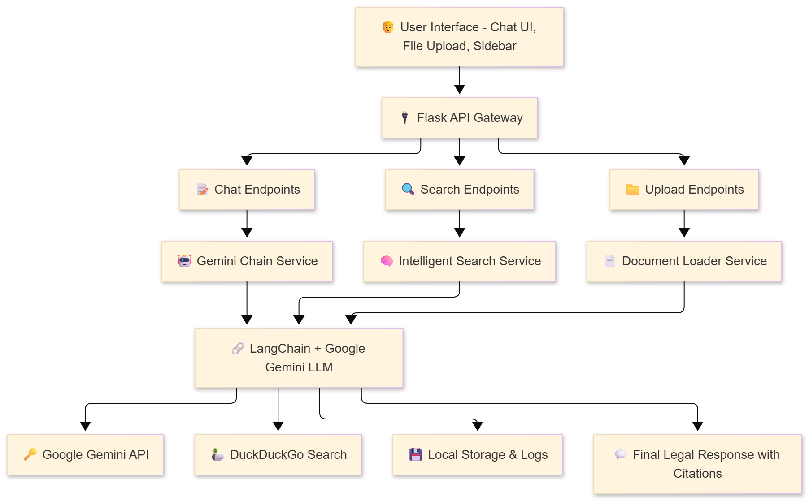
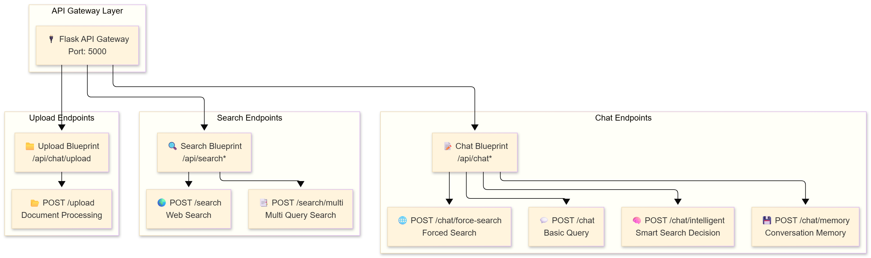
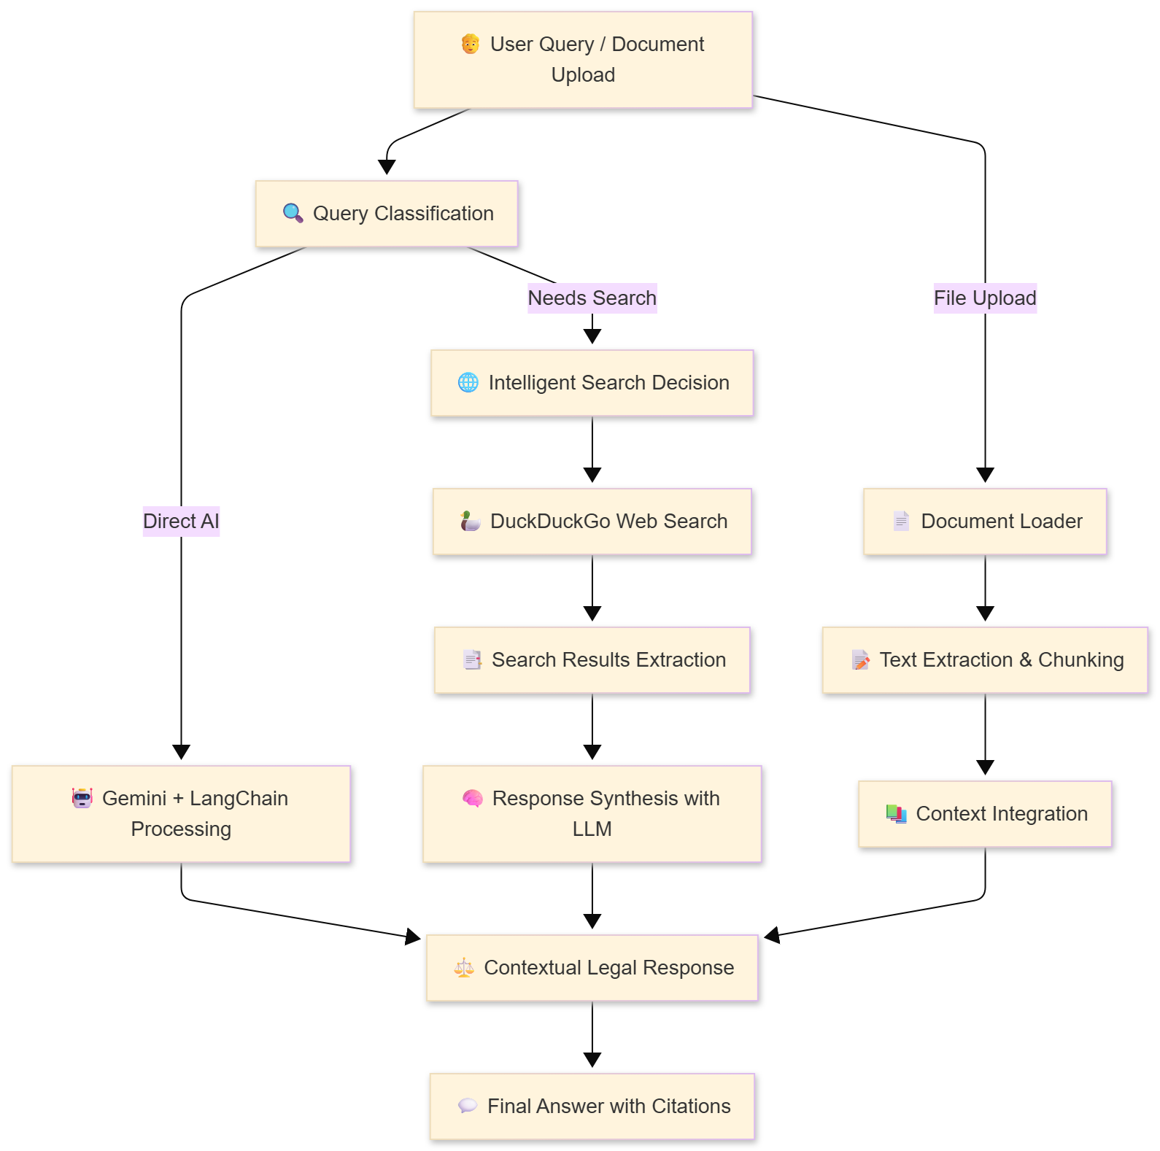
NyayaAI: AI-Powered Indian Legal Assistant
Rishav Singh – 1032233012
Kunal Tailor – 1032233258
Yash Pathrikar - 1032233341
Anuj Kudu – 1032233203
Advanced Legal Research Platform with Intelligent Search Integration
Guide : Pranali Dahiwal
ABSTRACT
SYSTEM ARCHITECTURE
RESULTS & PERFORMANCE
NyayaAI is an innovative AI-powered legal assistant designed specifically for the Indian legal system. The platform combines Google Gemini AI with intelligent web search capabilities to provide comprehensive legal research assistance.
Built on a modern Flask backend with responsive frontend, NyayaAI offers real-time legal information retrieval, document analysis, and contextual legal guidance.
The system democratizes access to legal information, making complex Indian legal knowledge accessible to law students, practicing lawyers, and the general public.
Response Time: 2.1s average API Success Rate: 97.3% Search Accuracy: 91.2% User Satisfaction: 4.3/5
CASE STUDIES
Law Student Research: 2-3 hours → 5 minutes with citations Legal Professional: Auto-triggered search for recent amendments
API ENDPOINTS
METHODS & TECHNOLOGIES
Backend: Flask 3.0 with Blueprint architecture AI: LangChain + Google Gemini 1.5/2.5 Flash Search: DuckDuckGo with LLM synthesis Validation: Pydantic models, CORS security Frontend: HTML5, Tailwind CSS, Vanilla JavaScript Document Processing: PyPDF2, python-docx
OBJECTIVES
• Develop an AI-powered legal assistant for Indian law • Create intuitive interface for legal research and queries • Integrate real-time web search for current legal developments • Provide contextual legal guidance with proper citations • Support legal professionals, students, and general public
LIMITATIONS
DATA FLOW PIPELINE
• Dependent on external APIs • Focused on Indian legal system • Requires internet connectivity • AI responses need human verification
FUTURE WORK
KEY FEATURES
• Database integration • Multi-language support • Mobile application • Legal database integration
✓ Intelligent Chat: Auto-decides when to search web ✓ Force Search: Always augment with web sources ✓ Document-Aware: PDF/DOCX/TXT processing ✓ Conversation Memory: Per-session history ✓ Robust Error Handling & Logging ✓ Responsive Web Interface
ETHICS & PRIVACY
Clear disclaimers for legal advice limitations. Privacy-respecting data handling.

